Slide 1
Introduction to Linux Systems Bash and Shell Scripts
Chia-Heng Tu
Dept. of Computer Science and Information Engineering
National Cheng Kung University
Fall 2024

Slide 2
Lab1: Personalize Primary Prompt
Change the original style of the primary prompt with the following requirements:
New color
Extend with your student id
Replace “$” with “#”
Example:

Slide 3
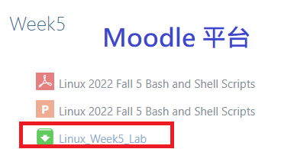

Lab2: Automated Uncompressing
The given directory “Linux_Week5_Lab” has the following contents:
Linux_Week5_Lab/
compressed_files/ (all .zip .rar .tar.gz and unknown files)
student_id (the list of student id for uncompressing files)

Slide 4
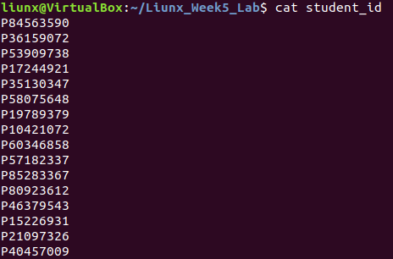
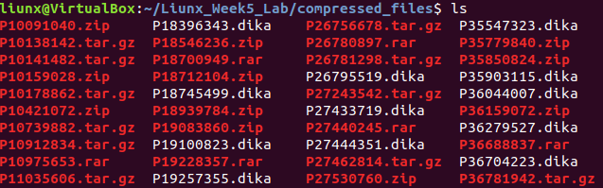
Lab2: Automated Uncompressing
Giving a bunch of compressing files named with student id, the files will be .zip, .tar.gz, .rar and unknown.
Using the student ID list to find out
who did not hand in files. (record into missing_list)
who hand in the incorrect file format. (record into wrong_list)

Slide 5
Lab2: Automated Uncompressing
The files will be .zip, .tar.gz, .rar and unknown, please classify them into four groups.
Uncompressing tool: $ sudo apt install tar unzip unrar
Finally, uncompress them all except unknown files.
After sorting

Slide 6
Lab2: Automated Uncompressing
The flow of overall steps and final directory tree.
Linux_Week5_Lab/
compressed_files/
Linux_Week5_Lab/
student_id
compressed_files/
Using id list to examine files
zip/
rar/
Uncompress
tar.gz/
Linux_Week5_Lab/
Classify files
unknown/
compressed_files/
student_id
student_id
missing_list
missing_list
wrong_list
wrong_list
Your shell script
should be root of directory.

Slide 7
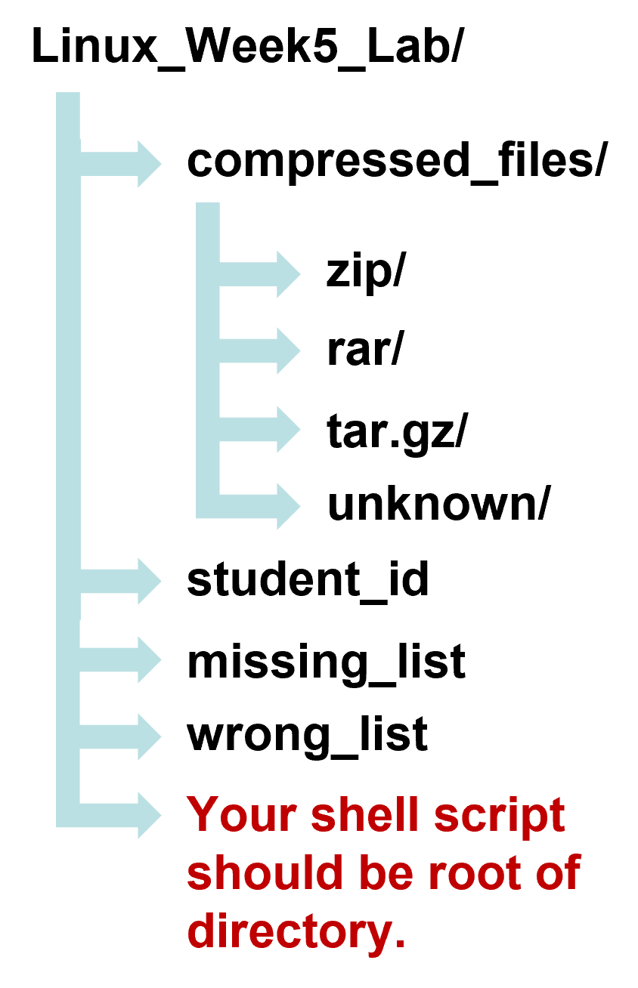
Video Demo
將兩部影片、Linux_Week5_Lab資料夾、心得文字檔全部壓縮成一壓縮檔繳交至moodle
Due Date (Upload in Moodle): 12:10 on 10/30 Wed.
You shall upload two videos and the compressed file of Linux_Week5_Lab.
Lab1 (20%)
Record the video to show how you edit the Primary Prompt.
Lab2 (80%)
Record the video to show how your shell script works and explain the detail of your code. (do not exceed 5 minutes)
Upload the compressed file of Linux_Week5_Lab.

Slide 8
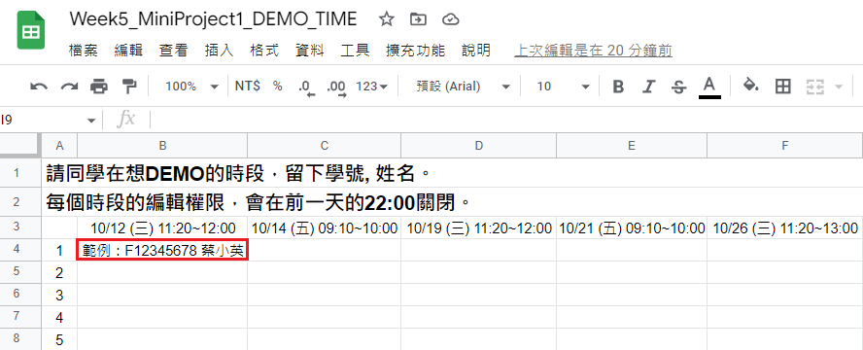

Class Demo
將Linux_Week5_Lab資料夾、心得文字檔一起壓縮成一壓縮檔繳交至moodle
Due Date (Upload in Moodle): 12:10 on 10/30 Wed.
Reserve your Demo time here.
Lab1 (20%)
Show TA how you edit the Primary Prompt.
Lab2 (80%)
Show TA how your shell script works and explain the detail of your code.
Upload the compressed file of Linux_Week5_Lab.

Slide 9
QUESTIONS

