Slide 1

Introduction to Linux Systems Linux File and Filesystem Command Line Tools
Chia-Heng Tu
Dept. of Computer Science and Information Engineering
National Cheng Kung University
Fall 2024

Slide 2

Lab: Server Maintainer
Please create
2 groups (grp1, grp2) and 3 users (usr1, usr2, usr3)
usr1 and usr2 are in grp1
usr3 is in grp2
Hint
# add users and groups
$ sudo addgroup ${group_name}
$ sudo adduser --ingroup ${group_name} ${user_name}
# delete users and groups
$ sudo delgroup ${group_name}
$ sudo deluser ${user_name}
# check
$ groups ${user_name}

Slide 3
Lab: Server Maintainer
參考老師上課講義p25-p33
Please do the lab in a clean directory, Linux_Lab5/
Please make a file (test1) in which the user is usr1 and
the group is grp1.
Please create a file (test2) that usr1 and usr2 can read and write, but usr3 can’t.
Let a directory (test_dir1) can’t be enter by usr2 and
usr3, but usr1 can.
(checkpoint) Set UID to a file (test3).
(optional)Copy all of them (test1-3 and test_dir1) into /tmp.
(optional) And delete all of them.

Slide 4
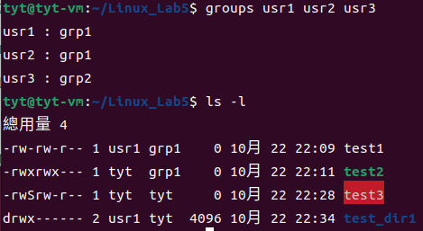
Demo
Show the screenshot with the following commands.
# checkpoint command
$ groups usr1 usr2 usr3
$ ls -l
僅供參考

Slide 5
THANKS

