Slide 1
Introduction to Linux Systems Networking
Chia-Heng Tu
Dept. of Computer Science and Information Engineering
National Cheng Kung University
Fall 2024

Slide 2
NIC Configuration
Configure static IP
by GUI
by netplan
Recover

Slide 3
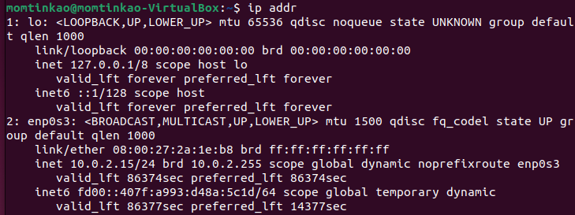
Print available network interface
$ ip addr
or
$ ip a
Notes:
https://www.tecmint.com/set-static-ip-address-in-ubuntu/

Slide 4
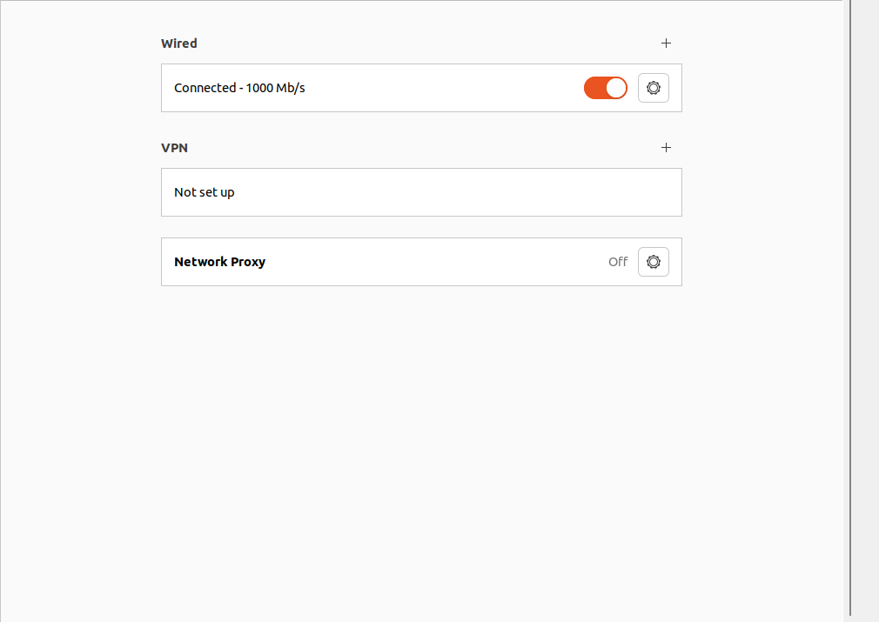
Configure static IP by GUI
Open settings
Network
Open setting
of wired

Slide 5
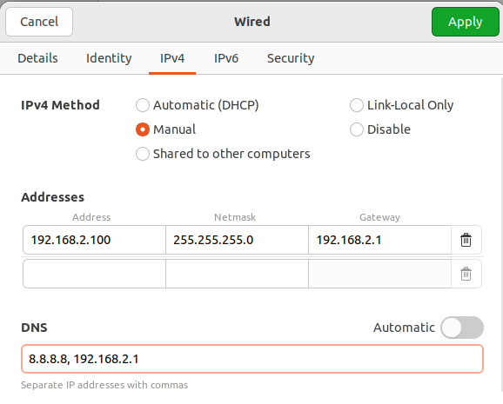
Configure static IP by GUI
IPv4
Configure highlighted sections
為了檢查方便，麻煩同學按照範例設定 IP

Slide 6
Configure static IP by GUI
Toggle connected wired twice time

Slide 7
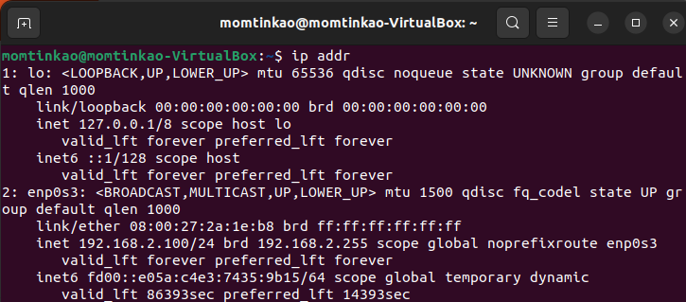
Configure static IP by GUI
Dump available network interface again

Slide 8
Configure static IP by netplan
backup original network config file (under /etc/netplan)
edit config file (.yaml)

Slide 9
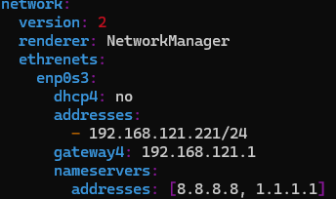
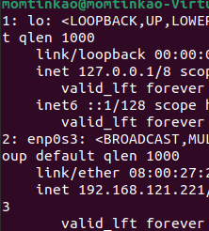
Example config file

Slide 10
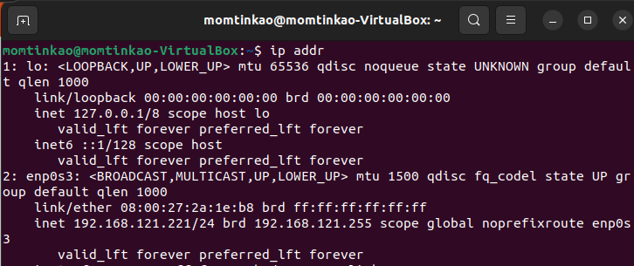
Validate and apply configuration
$ sudo netplan try
$ sudo netplan apply
$ip addr

Slide 11
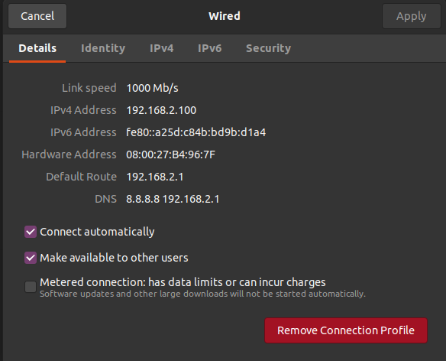
Recovery (GUI)

Slide 12
Recovery (netplan)
restore backup file (.yaml) to /etc/netplan
type “sudo netplan apply”

Slide 13
Demo
截圖檢查項目:
透過 ip addr 之類的工具印出修改 static IP 前後的 network interface 資訊
原始
netplan
繳交方式：截圖上傳至 moodle
GUI

Slide 14
QUESTIONS

