Slide 1
Linux Systems and Open Source Software ROS Based Autonomous Driving Systems
Chia-Heng Tu
Dept. of Computer Science and Information Engineering
National Cheng Kung University
Fall 2024

Slide 2
Lab(ROS & ROS2)
turtlesim(ROS2 click here)
rosbag(ROS2 click here)

Slide 3
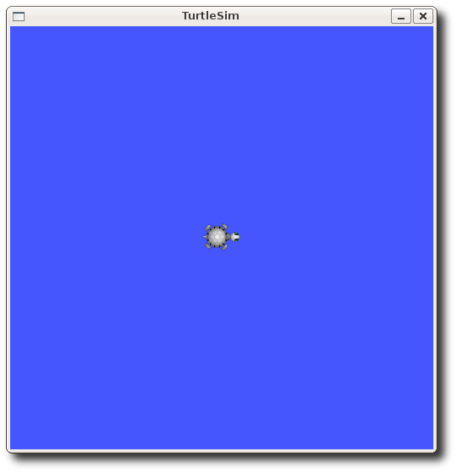
Getting Started with Turtlesim
First terminal:
請記得每個terminal都要
$ source /opt/ros/$(rosdistro)/setup.sh
$ sudo apt install ros-$(rosversion)-turtlesim
$ roscore(ROS2不需要做這一步)
Second terminal:
$ rosrun turtlesim turtlesim_node
(ROS2請用ros2 run)
Third terminal:
$ rosrun turtlesim turtle_teleop_key
(ROS2請用ros2 run)

Slide 4
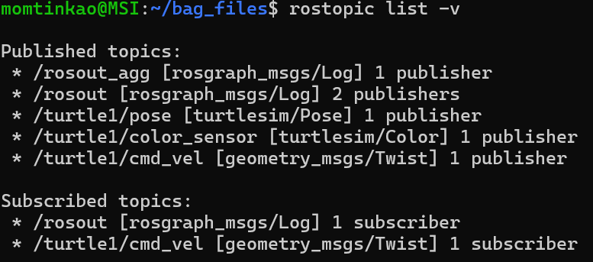
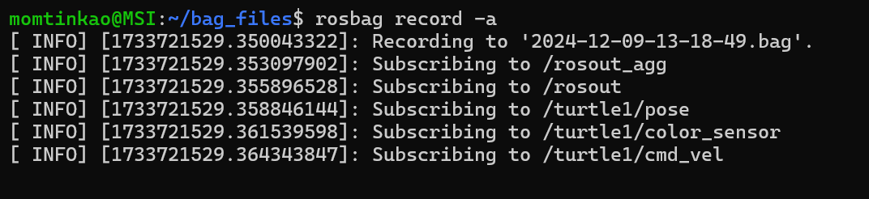
Record Rosbag
$ mkdir bag_files
$ cd bag_files
$ rostopic list –v(ROS2請用 $ ros2 topic list -v)
$ rosbag record –a(ROS2請用$ ros2 bag record -a)
Switch back to the terminal window with turtle_teleop and move the turtle around for 10 or so seconds.
Exit the rosbag record (ctrl + C)

Slide 5
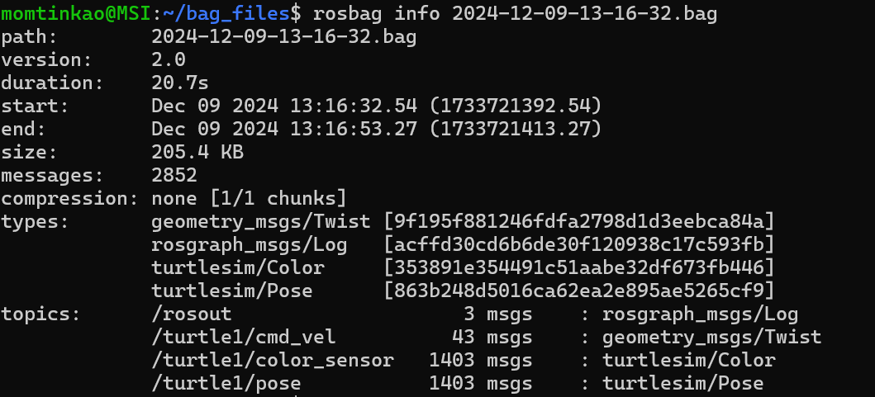
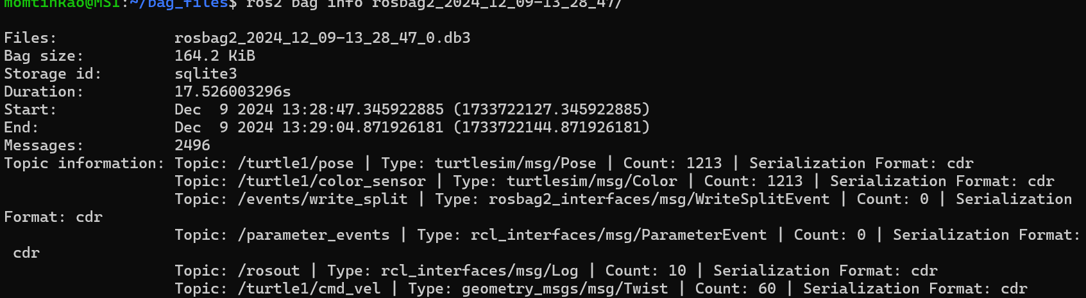
Examine Rosbag
$ rosbag info <your bagfile>(ROS2請用ros2 bag)
ROS:
ROS2:

Slide 6
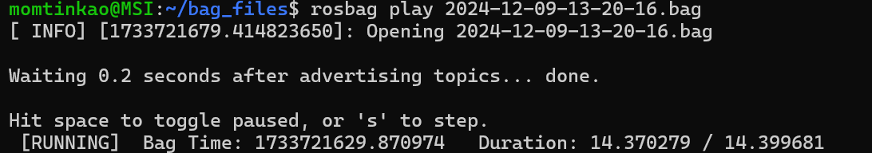
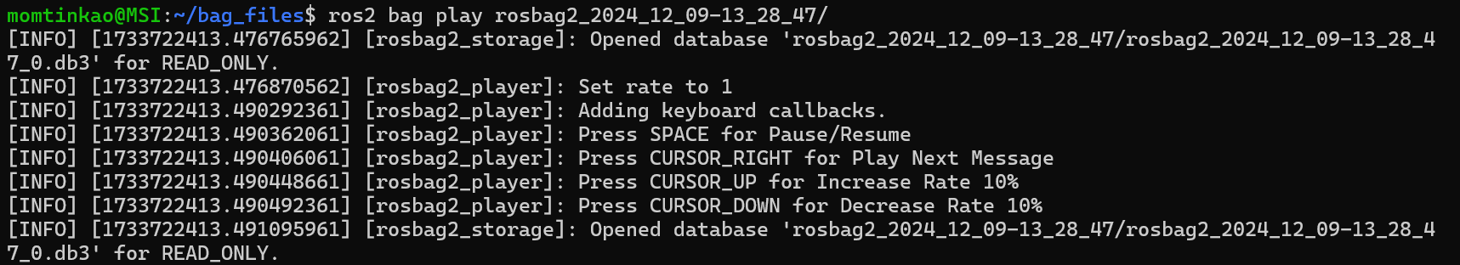
Play Rosbag
Exit the turtle_teleop.
Restart the turtlesim_node.
$ rosbag play <your bagfile>(ROS2請用ros2 bag)

Slide 7
Demo
Please upload 2 screenshots with rosbag info and rosbag play to moodle.

Slide 8
QUESTIONS

