Slide 1
ThreeJS Primer for Game Programmer
Tutorial files are available
here

Slide 2
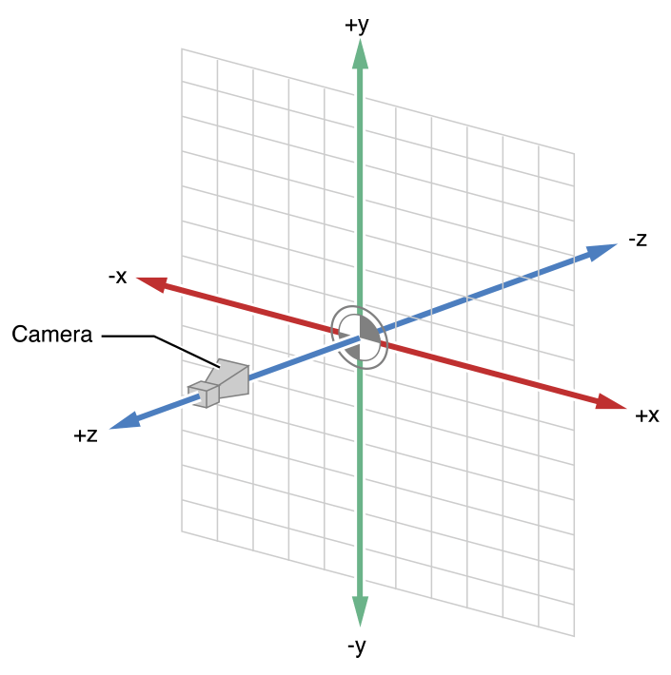
Basic Concepts
Coordinate System, Scene, Camera
The same as OpenGL, WebGL

Slide 3
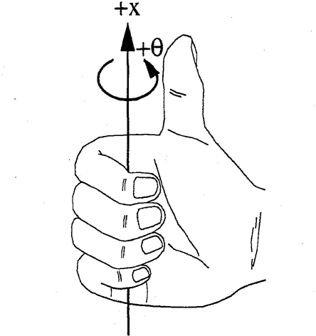
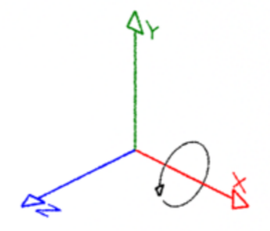
Object3D
+Y
(三角網格)
A base class for camera, mesh, …
(concept of local coordinate frame)
Specify its configuration by setting:
Object3D.position
Object3D.rotation (Euler angles ‘xyz’)

Slide 4
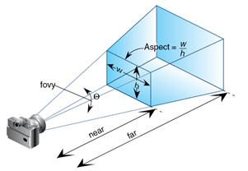

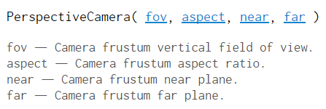

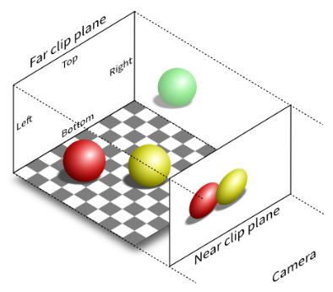
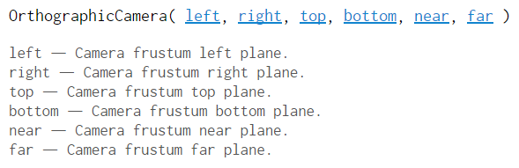
Camera
Camera.position
Camera.lookAt (Vector3)

Slide 5
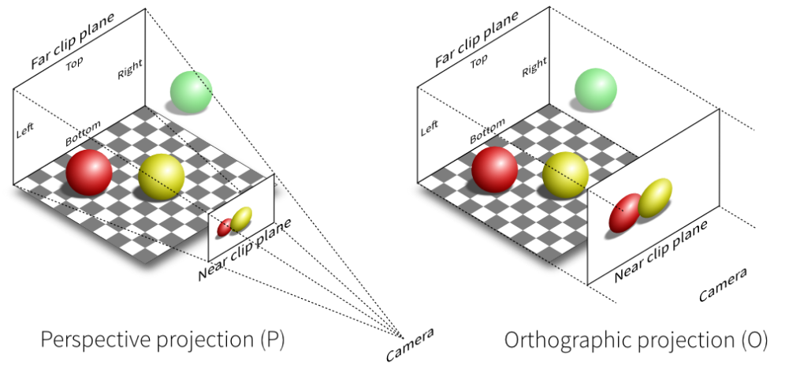


(Often used in 2D graphics)

Slide 6
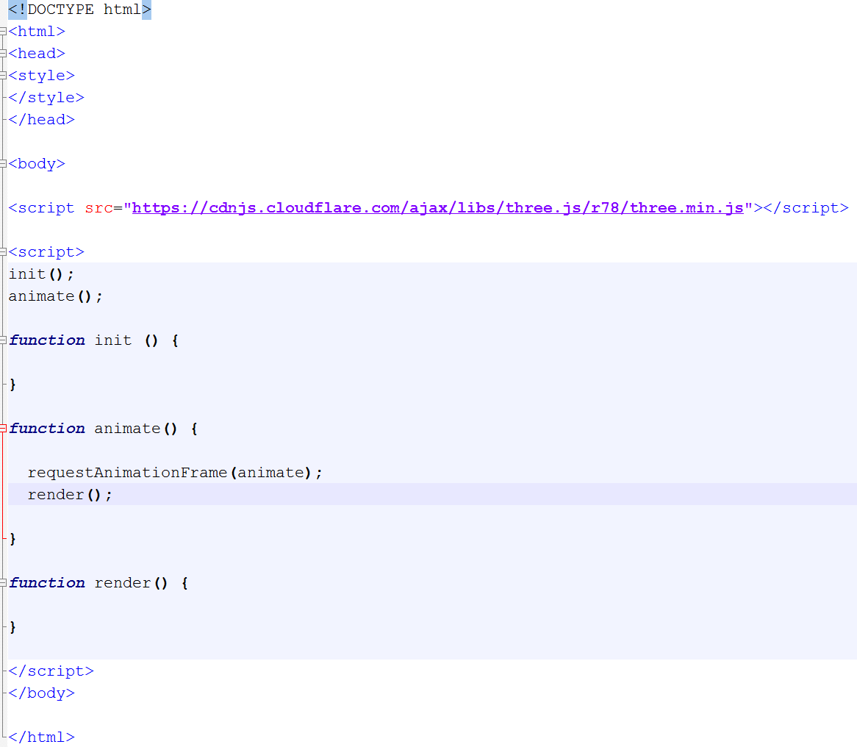
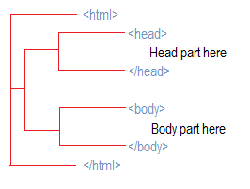
Basic Framework
Where to get three.js?
cdnjs.com
What is CDN (content delivery network)?
Distributed network of proxy servers for various internet content

Slide 7
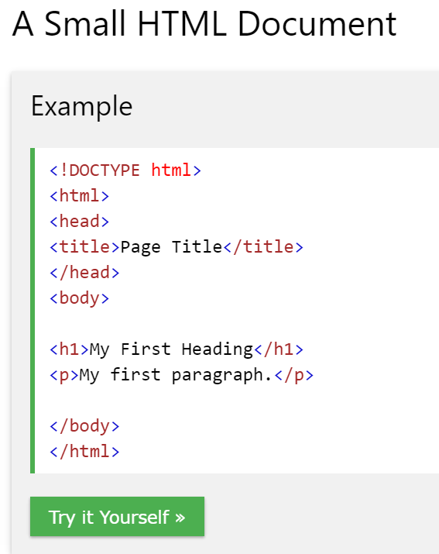
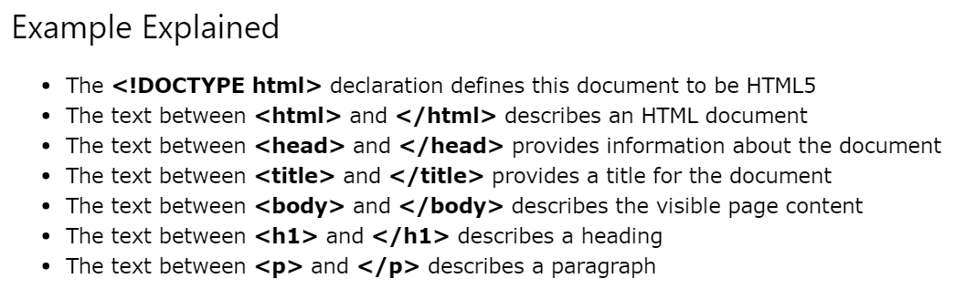
HTML File Structure (ref)

Slide 8
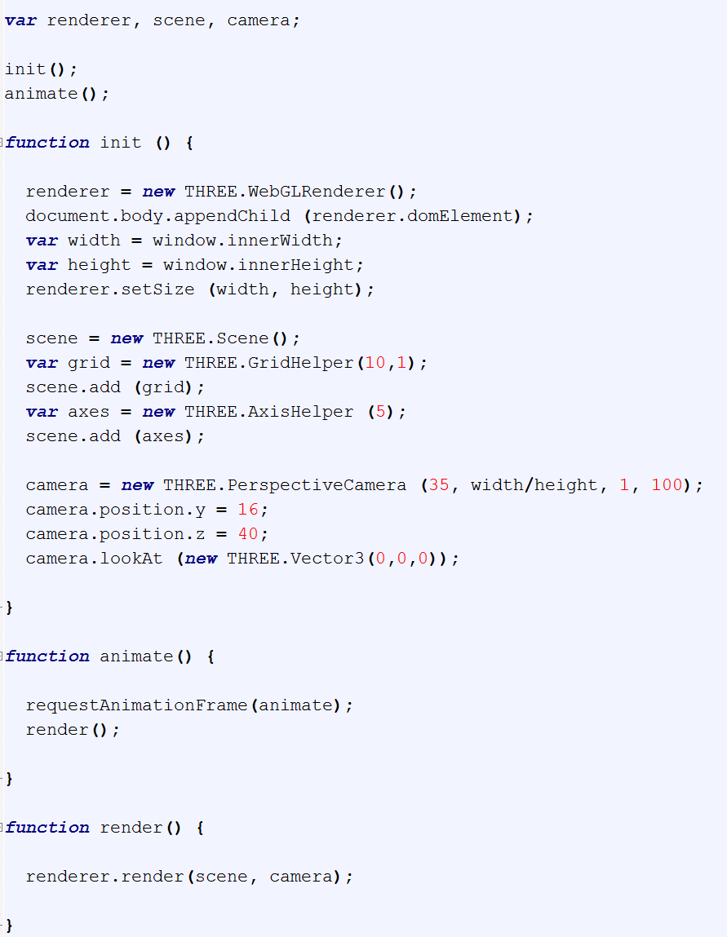
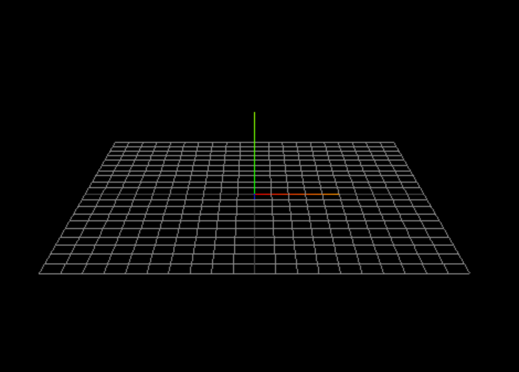
Tut1: Coordinate system

Slide 9
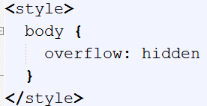
Overflow: hidden

Slide 10

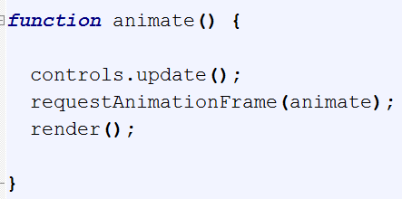
Tut2: OrbitControls

Slide 11
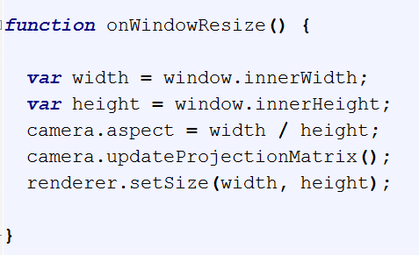
Tut2: Resize

Slide 12

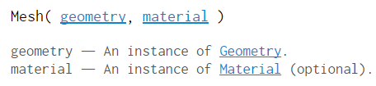
Object3D & Mesh
+Y
Object3D.position
Object3D.rotation
(Euler angles ‘xyz’)

Slide 13
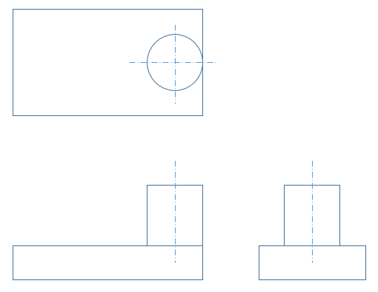
Configuring Objects
Primitive Positioning
x
z
y
x
Primitive Grouping
Custom Rotation

Slide 14
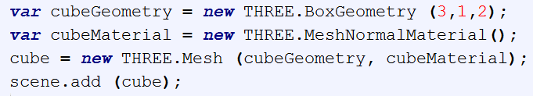
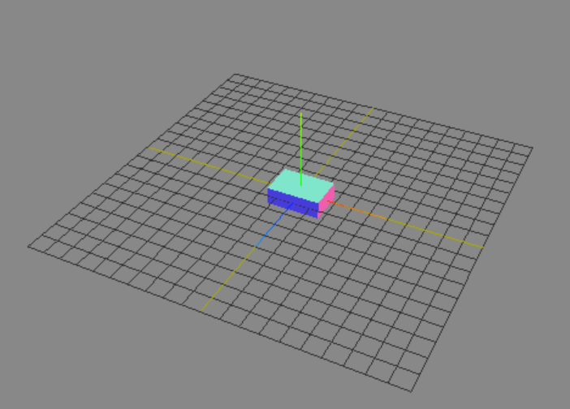
Tut3: BoxGeometry

Slide 15
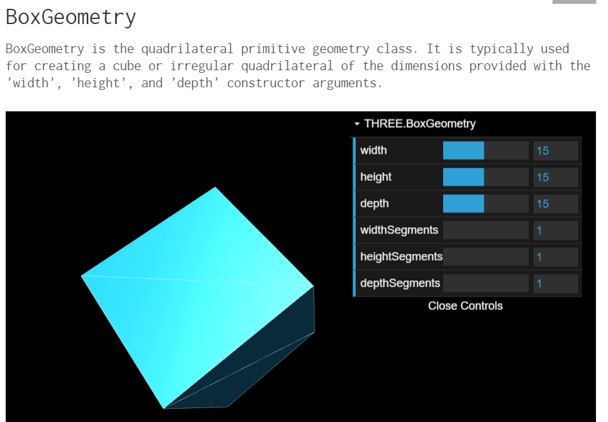
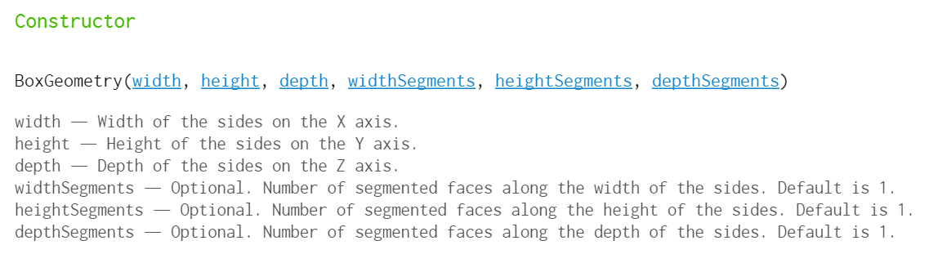
(three.js documentation)

Slide 16
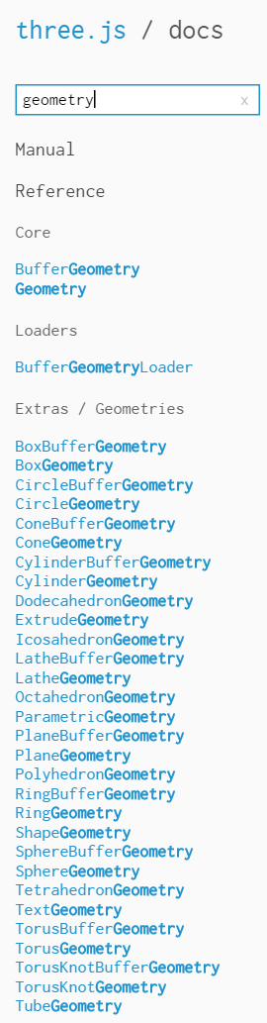
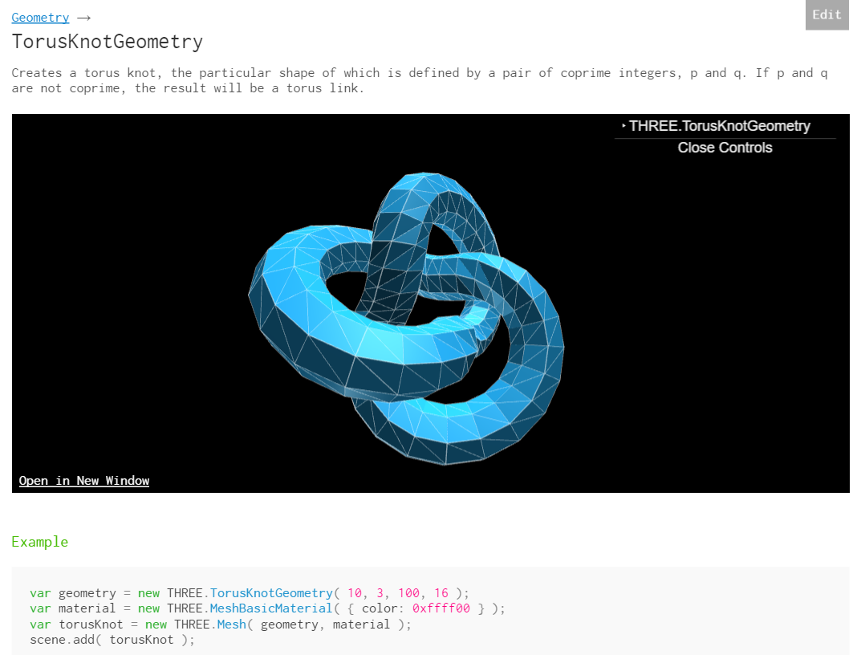

Slide 17
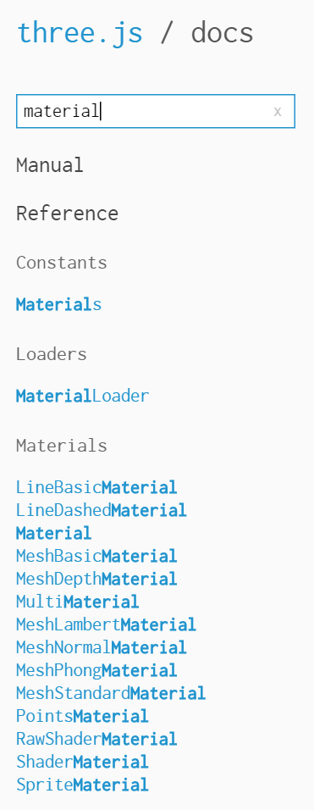
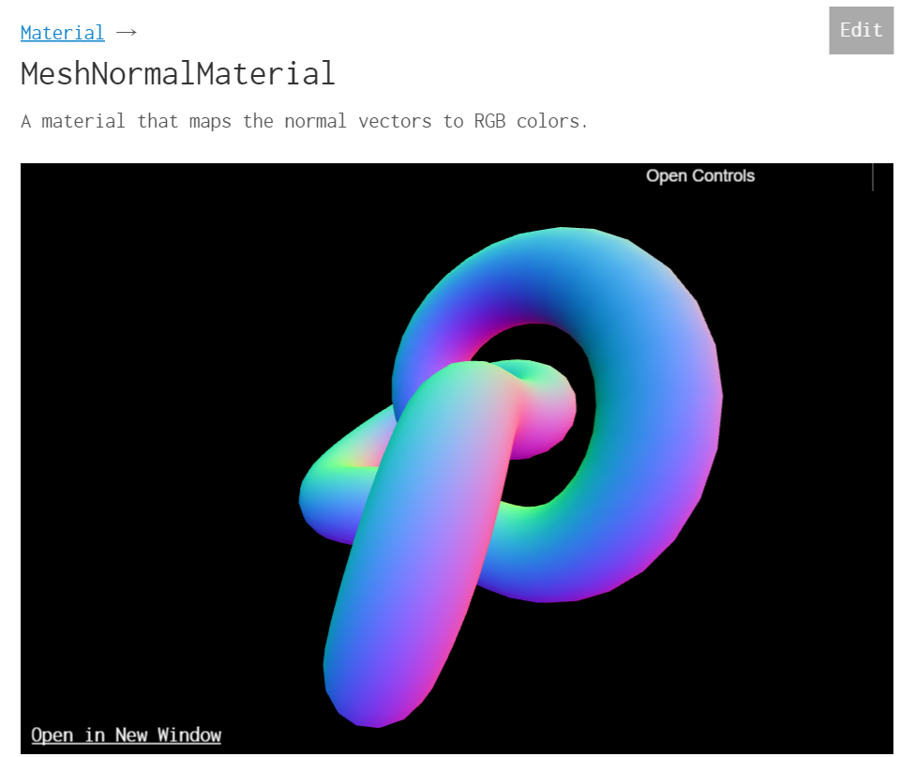

Slide 18
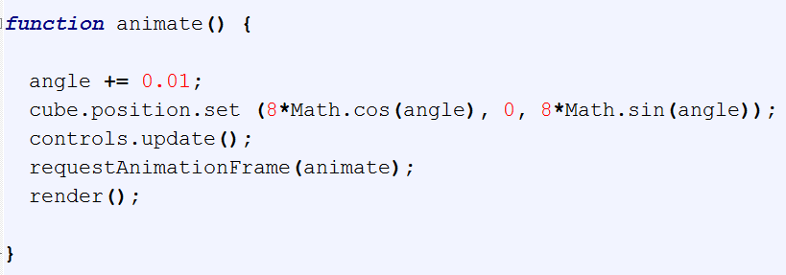
Tut4: animation

Slide 19
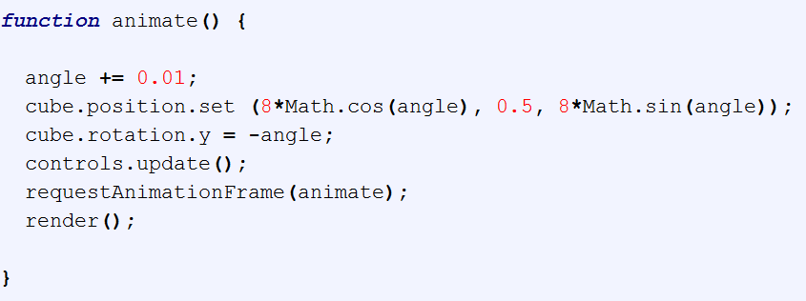
Tut5: animation

Slide 20


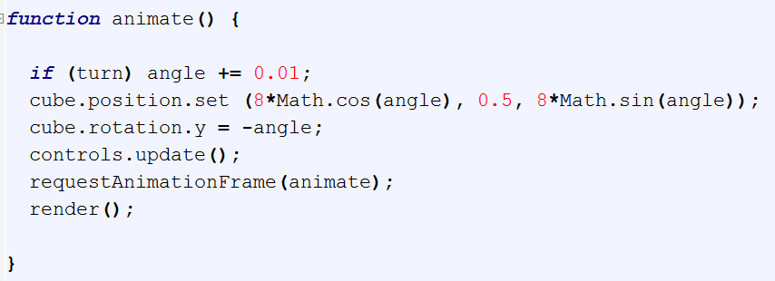
Tut6: controls

Slide 21
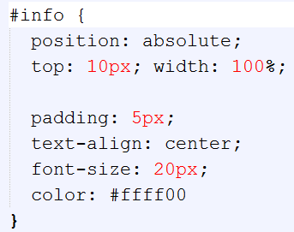
<DIV> & Style

Slide 22
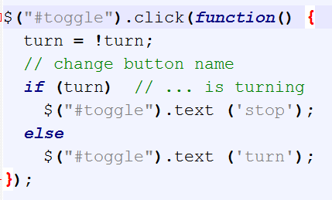
Tut61: jQuery Button
<div id = ‘show’></div>
for on-screen display …

Slide 23

Tut62: Keyboard Control

Slide 24
Exercises

