Slide 1
Node.js, shelljs, Three.js
讓JavaScript程式(three.js)
透過 shelljs的介面
來執行 C/C++ 所編譯出來的程式 (EXE)

Slide 2
Node.js & NPM
Node.js: a program and an environment
an open-source, cross-platform JavaScript runtime environment for developing a diverse variety of tools and applications
has an event-driven architecture capable of asynchronous I/O
NPM (node.js package manager):
makes it easier for programmers to publish and share source code of Node.js libraries and is designed to simplify installation, updating and uninstallation of libraries

Slide 3
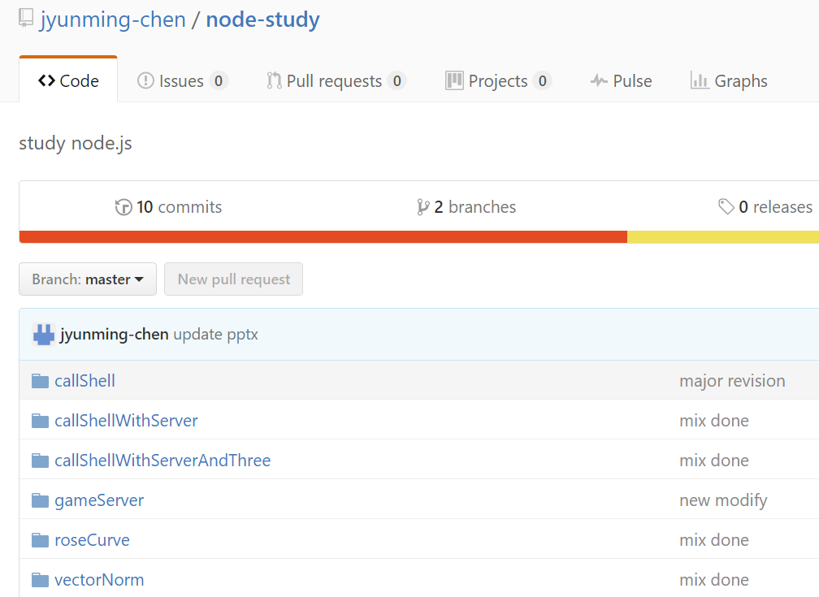
Content
Github repository
Explained in these examples
callShell
callShellWithServer
callShellWithServerAndThree
roseCurve
vectorNorm
gameServer

Slide 4
callShell from node.js
後端的node.js
透過 shelljs
直接呼叫 main.exe

Slide 5
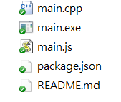
In the Directory …
Initially …

Slide 6
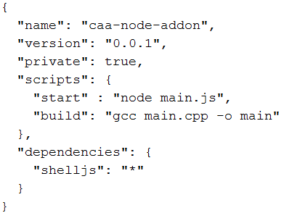
package.JSON
(reference)
Shelljs of any (“*”) version

Slide 7
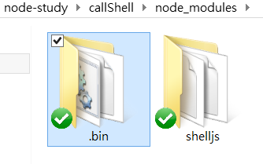
You need to install first:
Then …
after ‘npm install’ got created

Slide 8
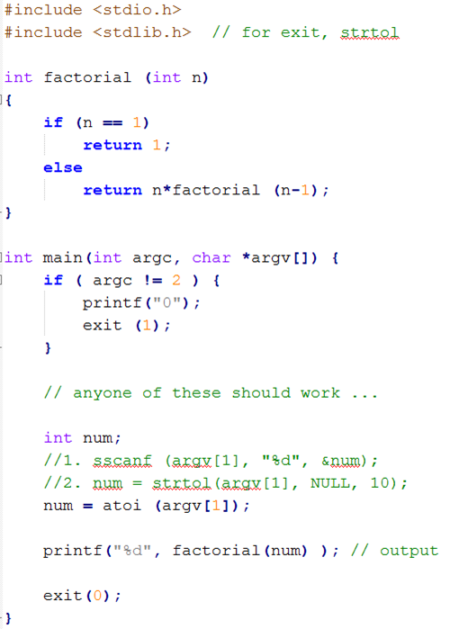
main.cpp
> main.exe 5
120

Slide 9
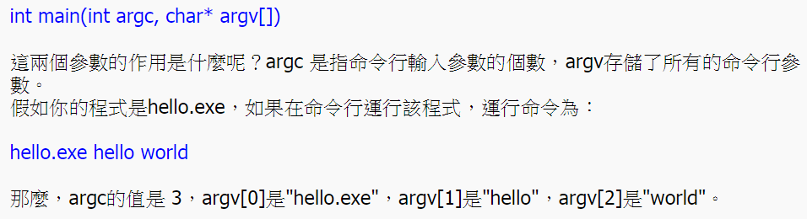
有關 argc & argv (reference)

Slide 10
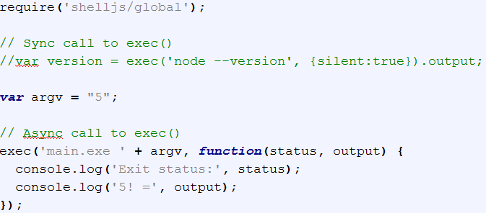
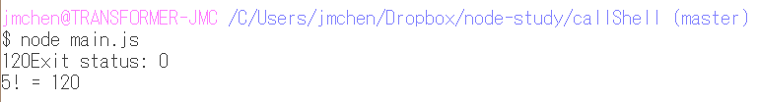
main.js
Running …
Alternatively, this can be started with:
$ npm run start
(as specified in scripts of package.JSON)

Slide 11
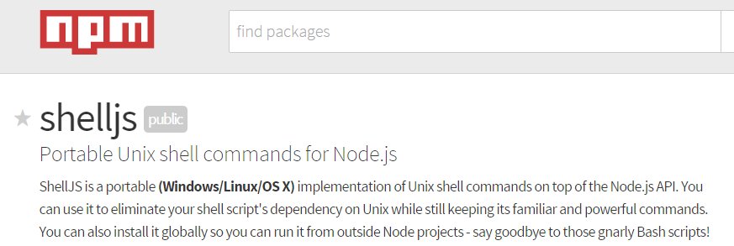

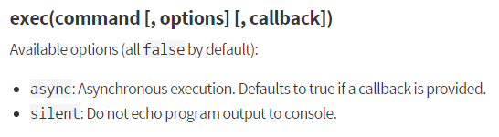
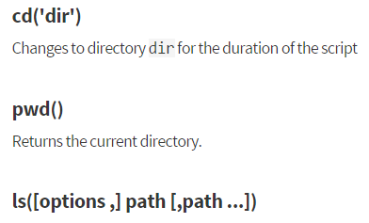

reference
and many others …

Slide 12

Require: global vs. local
Global (global namespace)
Local (local namespace)

Slide 13
callShellWithServer
後端以node.js建構一個server
讓前端的browser 經由http
以url字串與其連接
所得response 傳回browser

Slide 14
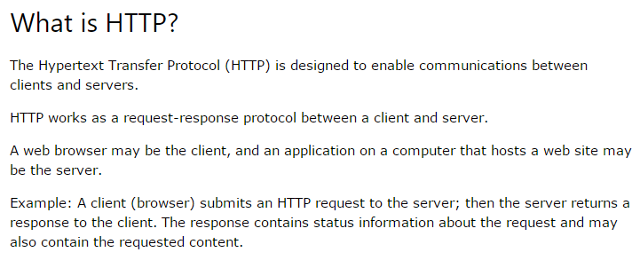
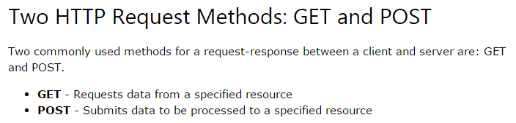
HTTP: GET & POST (reference)
client
response
request
port
server
request-response protocol

Slide 15
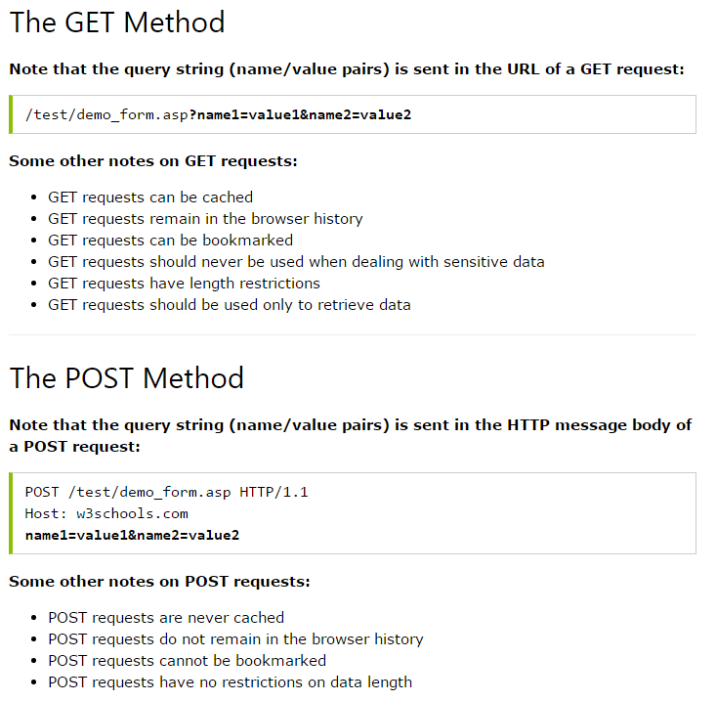

Slide 16
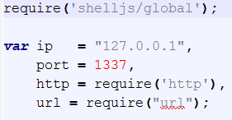
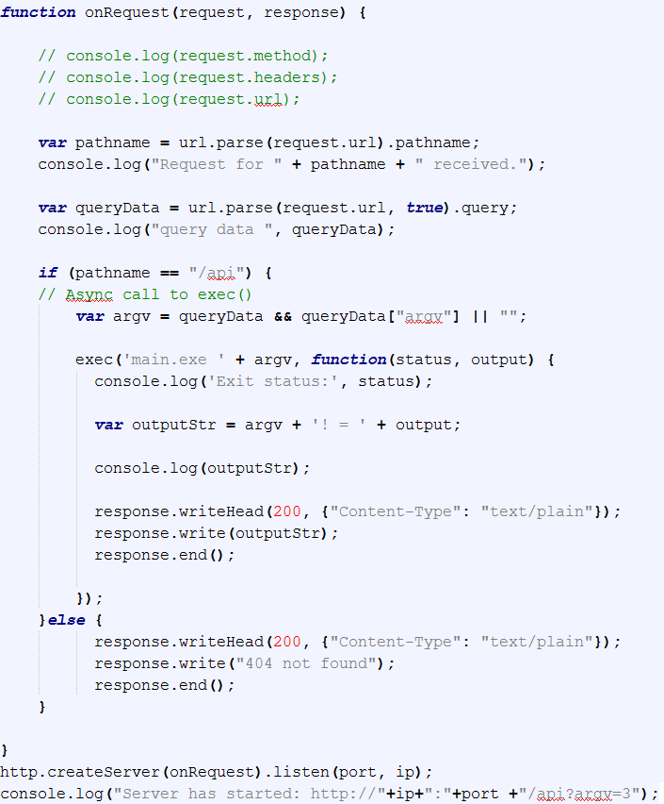
main.js
localhost
“GET”
Same
package.JSON,
main.exe
/api?argv=6
“/api”
{ argv: 6 }

Slide 17


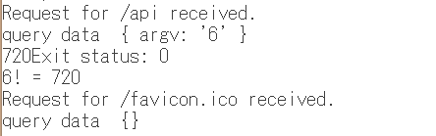


Running …
1. Start server first …
2. Client issued a request via url string …
3. Server sends a response …
Two GET’s
4. Client gets a reply …

Slide 18
callShellWithServerAndThree
前端的browser 連接到 three.js 網頁
經由網頁中的HTTP GET
連接 後端的server (node.js)
並將response 傳回 browser, 以graphics呈現

Slide 19
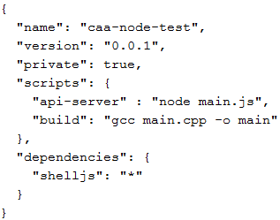
package.json (same as before)
client
127.0.0.1
Cube.html
80
http
1337
api-server

Slide 20
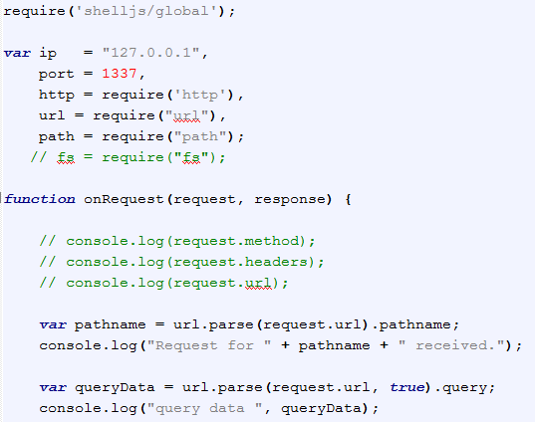
main.js
Router handler: next page

Slide 21
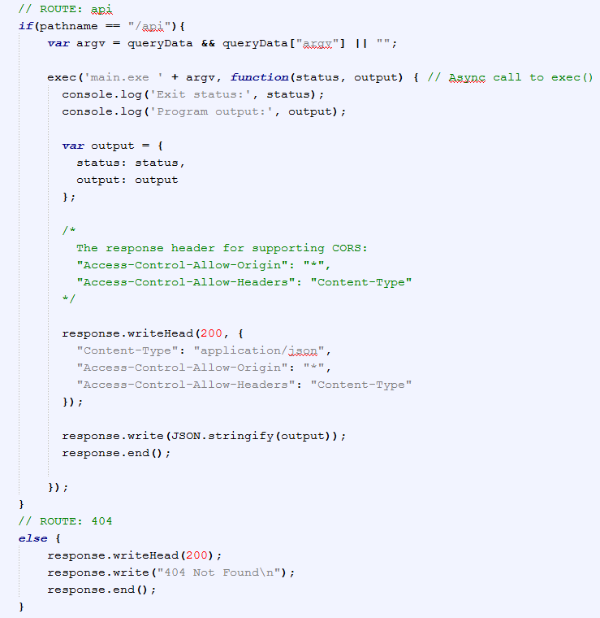


Slide 22
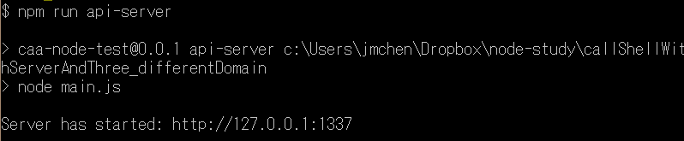
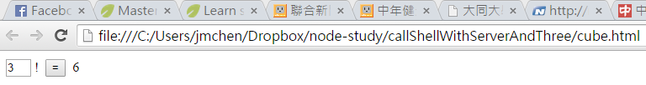
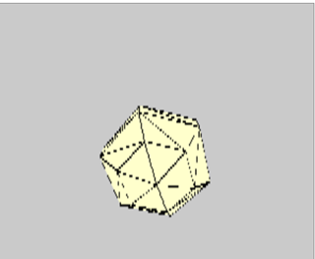
Running …
1. Start API server …
2. Open HTML page …

Slide 23
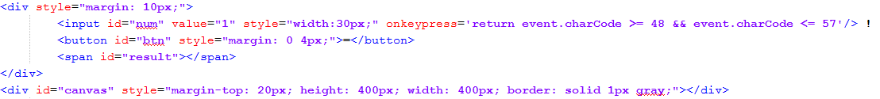
cube.html

Slide 24
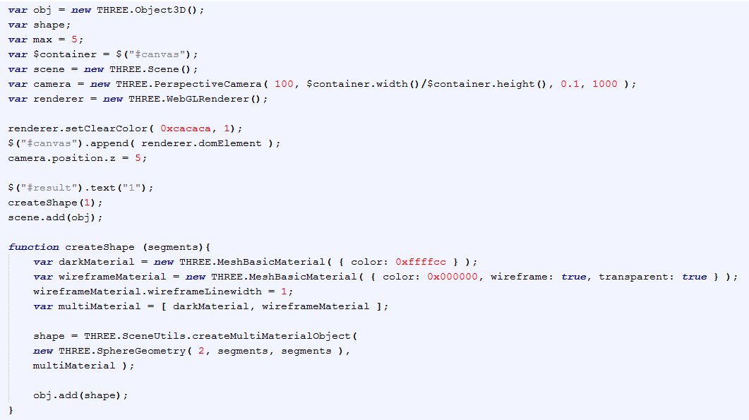
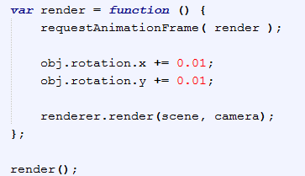

Slide 25
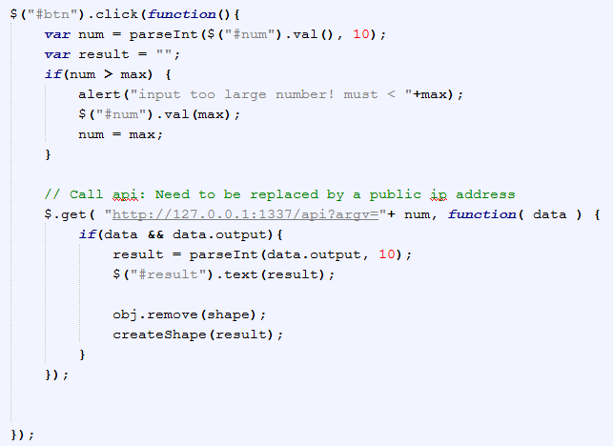
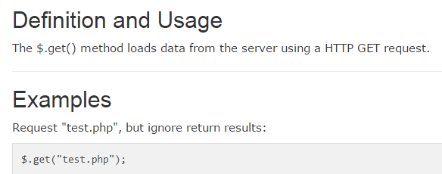
reference
reference

Slide 26
Rose Curve
前端的three.js 網頁
不斷地經由HTTP GET
連接 後端的server (node.js)計算軌跡
並將結果傳回，完成動畫

Slide 27
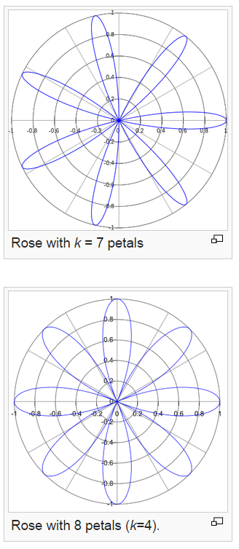
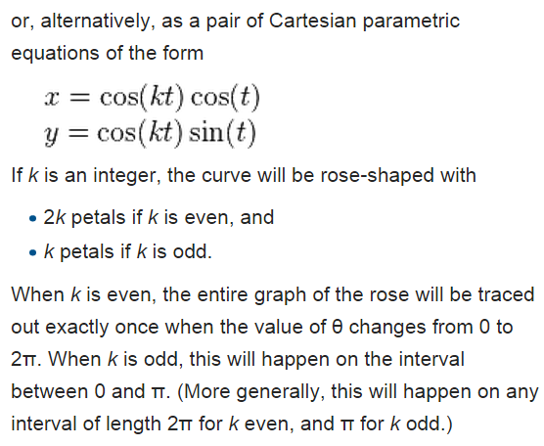
rose or rhodonea curve

Slide 28
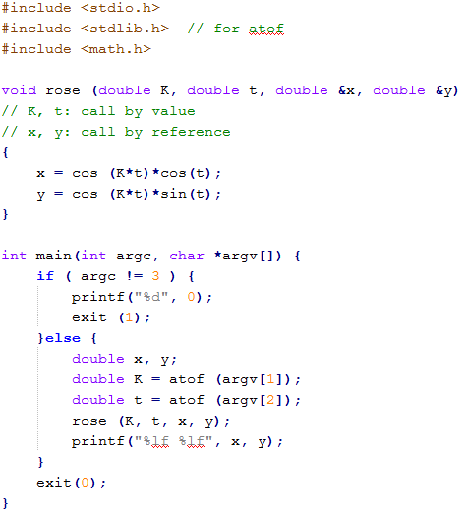
main.cpp

Slide 29
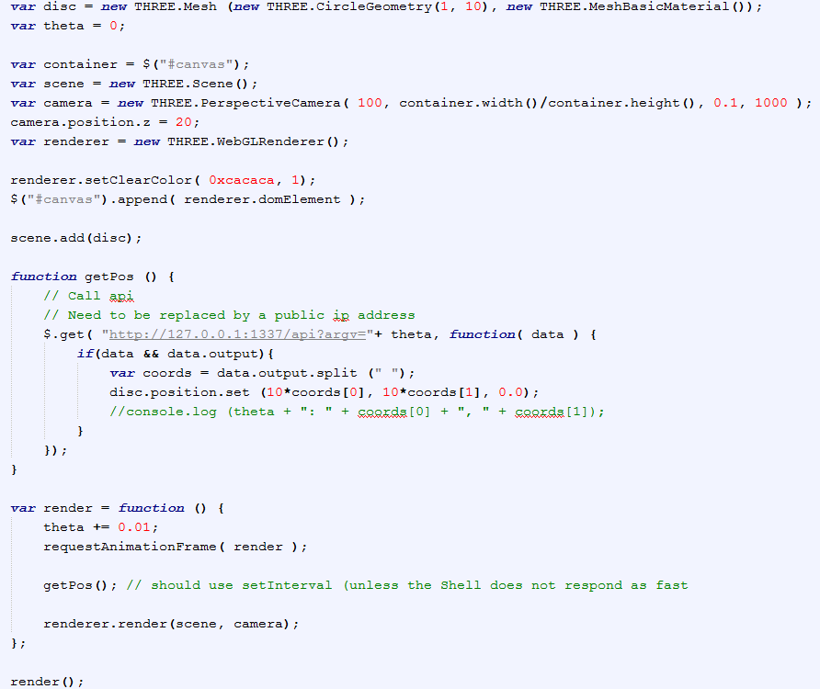
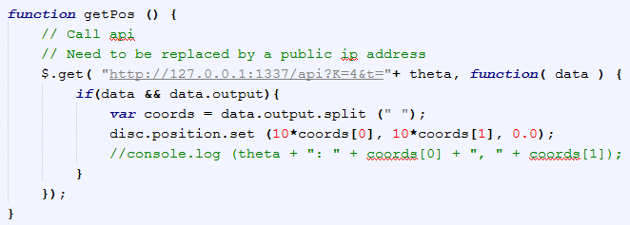
rose.html

Slide 30
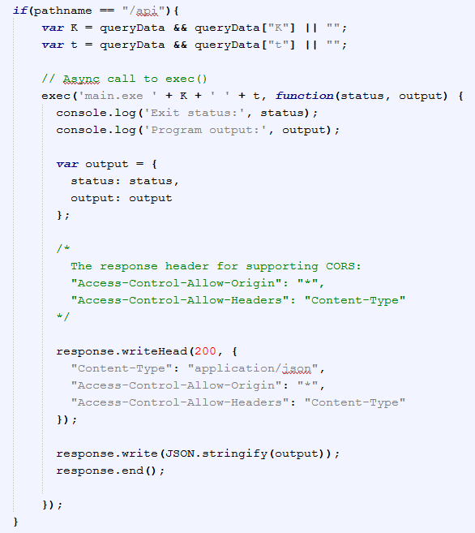
main.js

Slide 31
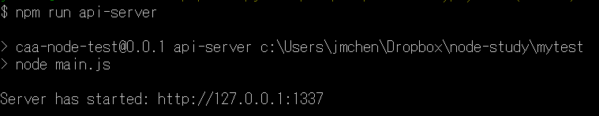
Running…

Slide 32
Vector Norm
說明較複雜的資料 (JSON, array)如何編入URL String

Slide 33
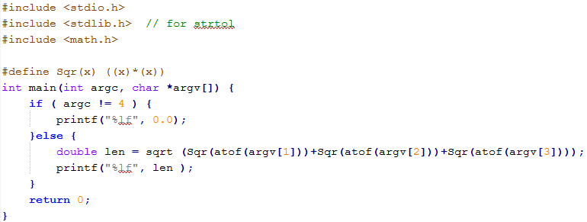
main.cpp

Slide 34
Desired Interface
Input a 3-vector
v[0]:
v[1]:
v[2]:
Norm =

Slide 35
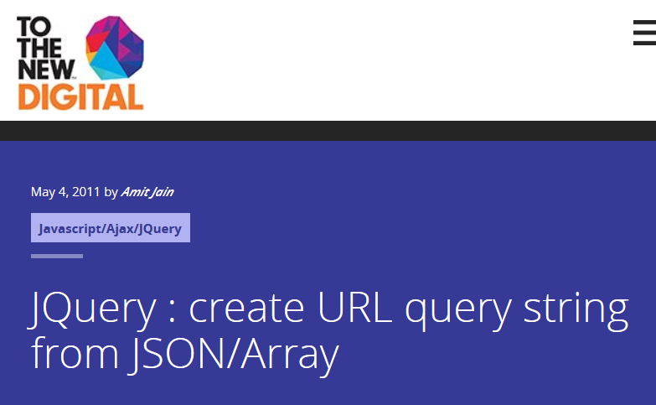
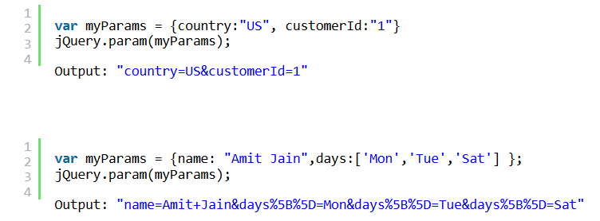
(ref1)
(ref2)

Slide 36


Two cases: JSON & Array
query data { num: '13', 'denom[time]': '1', 'denom[val]': 's' }
query data { 'v[]': [ '1.1', '2.2', '-3.2' ] }

Slide 37
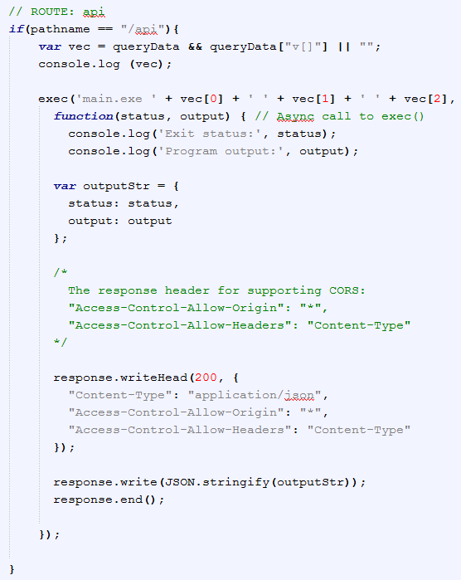
main.js

Slide 38
Statistics Server of Game Action Prediction
簡單的serve設計(不用shelljs)
用以統計遊戲資料

Slide 39
Prototype
Server
Win:
/100
Submit
localStorage

Slide 40
localStorage in Node.js
localStorage (of HTML 5) is client-side API. Not available in servers. (ref)
npm has localStorage extension (reference)

Slide 41
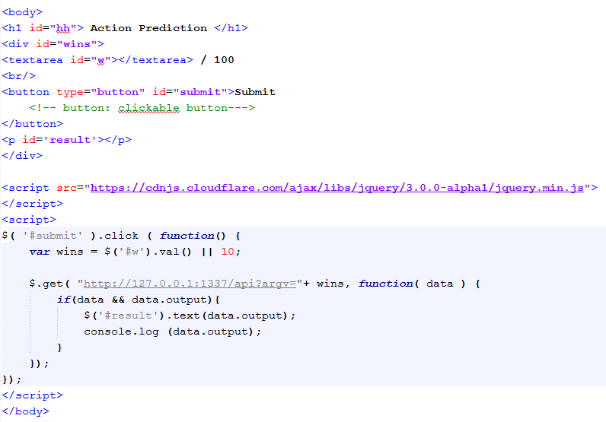
game.html

Slide 42
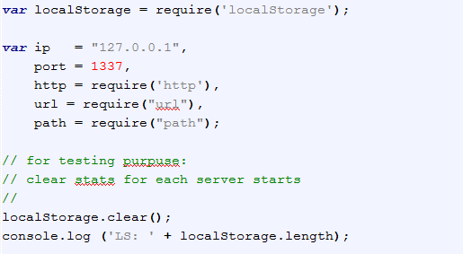
main.js

Slide 43
