Slide 1

Visual Studio Code
https://code.visualstudio.com/

Slide 2






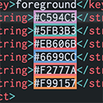



Vetur
Prettier - Code formatter
vscode-icons
Babel JavaScript
gitignore
Color Highlight
Live Server
Copy filename
AutoFileName
Bracket Pair Colorizer

