Slide 1

Vuex & API
Vue 基礎入門篇

Slide 2
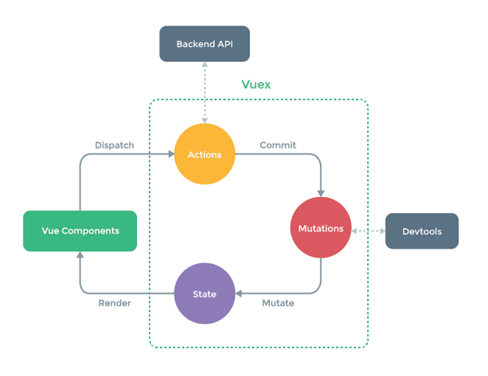

Slide 3
課程用API
https://vue-lessons-api.herokuapp.com/photo/list (圖片列表)

Slide 4
api/photoRequest.js
import axios from "axios";
const photoRequest = axios.create({
baseURL: "https://vue-lessons-api.herokuapp.com/",
});
export const getPhotoRequest = () => photoRequest.get("/photo/list");
api/index.js
import { getPhotoRequest } from "./photoRequest.js";
export const apiGetPhotoRequest = getPhotoRequest;

Slide 5
handInit({ commit }) {
const res = apiGetPhotoList();
return res.then((response) => {
commit("init", response.data);
return response.data;
});
},
async handInit({ commit }) {
try {
const res = await apiGetPhotoList();
commit("setPhoto", res.data);
return res.data;
} catch (error) {
console.error(error);
}
},

