Slide 1

Platform for semantic extraction of the web
Jakub Podlaha

Slide 2
Problem definition
Design a tool for extracting data from web
Data in semi-structured form (HTML)
Target structure in a form suitable for Semantic Web
Focus on dynamic, simple solution
Use Cases…

Slide 3
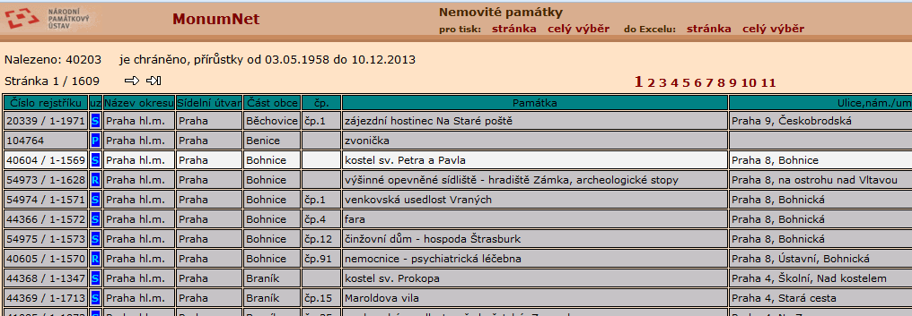
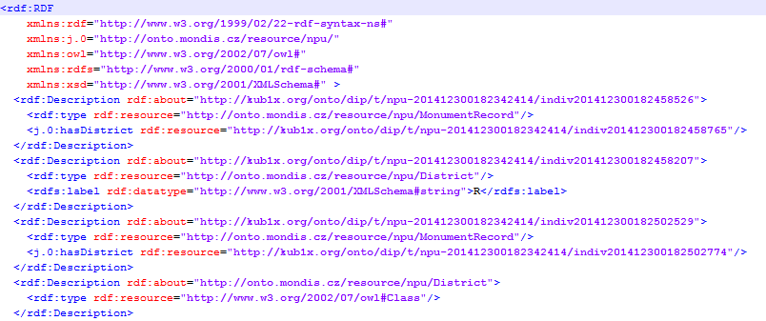
Problem definition

Slide 4
Problem definition

Slide 5
Existing solutions
Rapid prototyping to explore suitable platforms and libraries
Semantic
Strigil, crOWLer, jOWL, rdfquery
Non-semantic
InfoCram 6000, Aardvark, Selenium IDE and Builder, WebDriver

Slide 6
Program design
Components
SOWL – frontend, the tool for scenario creation
crOWLer – backend, the semantic crawler
Scraping scenario
Syntax and semantics of scraping scenario commands
Mapping of ontological resources on DOM nodes
Elemental data handling
JavaScript support

Slide 7
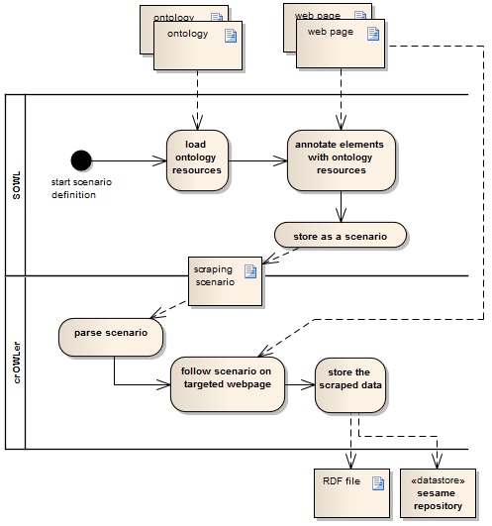
Program workflow

Slide 8
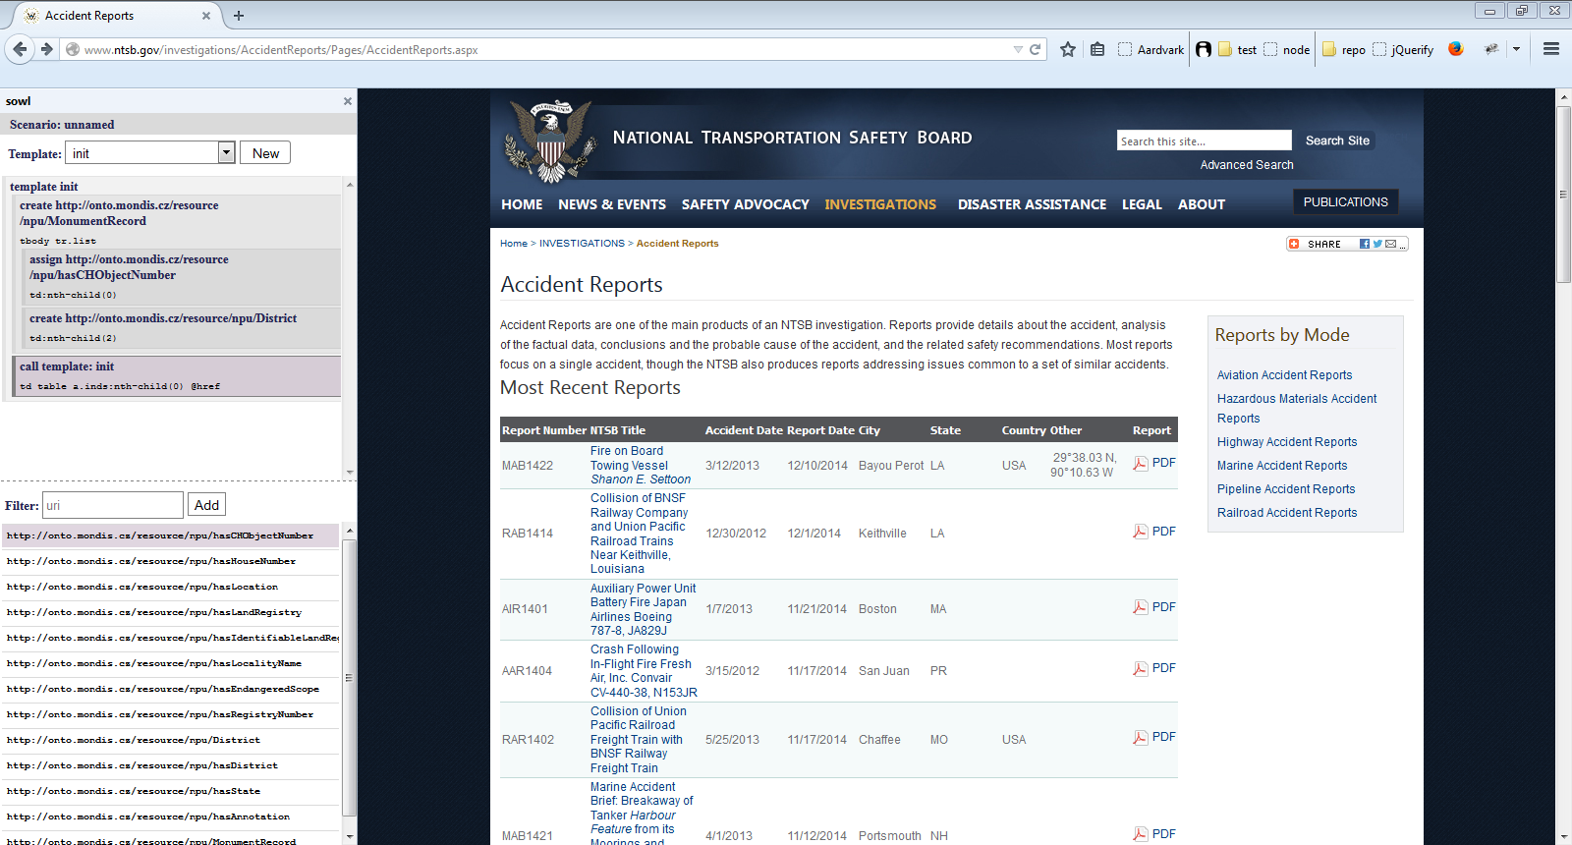
Implementation

Slide 9
Outcomes and future work
Improvement of current approach in semantic crawling
Definition of scraping scenario
Architecture and implementation of platform stack
Usability and accessibility for end users
Full implementation of proposed design
Usability improvements according to users feedback
Better handling of ontological resources

Slide 10


