Slide 1
2024 Chicago Taxi Data Analysis presentation of findings
Kimberly Hubacek Student ID: 001249836

Slide 2

Introduction
Kimberly Hubacek
- Student at Western Governors University
- Aspiring Data Analyst
- Has been working with Python for a year, SQL for 2 years, and Excel for over 10 years.
- Likes going on hikes

Slide 3
Problem and Hypothesis
Problem:
Chicago cab companies are losing drivers to Uber and Lyft. They seek to use a multiple linear regression model to discover what variables are associated with customer tipping so they can give drivers bonuses when they give rides to customers who typically do not tip.
Null Hypothesis: Customers tipping their taxi drivers in the city of Chicago is not statistically correlated with trip miles, trip duration, tolls, taxi fare, or payment method.
Alternative Hypothesis: Customers tipping their taxi drivers in the city of Chicago is statistically correlated with trip miles, trip duration, tolls, taxi fare, or payment method.

Slide 4

Summary of analysis

Slide 5
Data cleaning

Slide 6
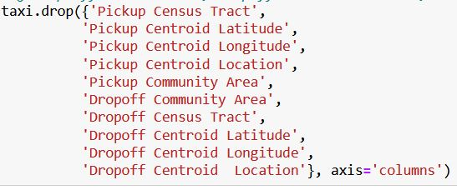
Dropping columns
Dropping Columns
List of dropped columns:
Columns containing location data and time stamp data were removed from the dataset.
Not relevant to the variables in the research question
Large amounts of intentional blank values

Slide 7
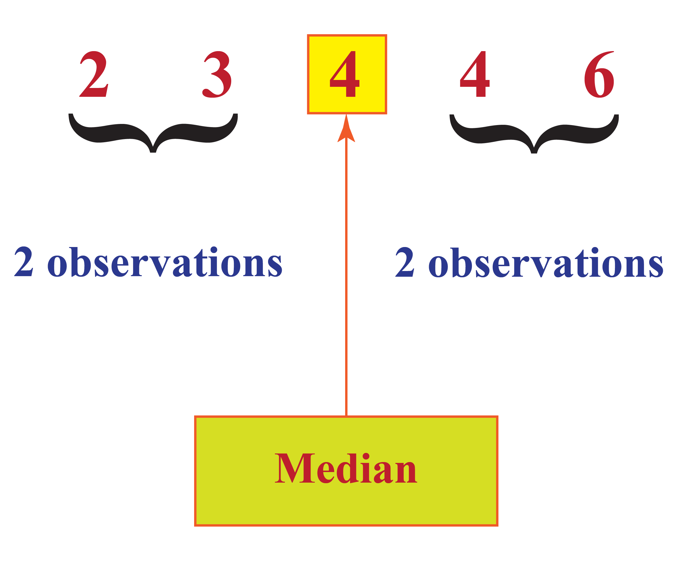
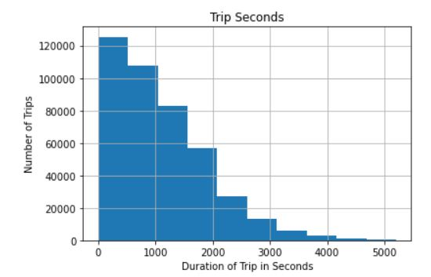
Null Values
Null values were replaced with the median value of each column since the distribution of each column containing nulls skewed left.
Bar graph of Trip Seconds to visualize data distribution. Distribution skews left
Example of median

Slide 8
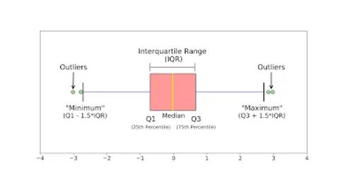
Addressing Outliers
Outliers were addressed by deleting rows with extreme outliers or by flooring or capping the data in columns with outliers. Flooring and capping data deletes rows with data values outside the range of 25% - 75% of the data values for that column. These values were calculated using interquartile ranges.

Slide 9
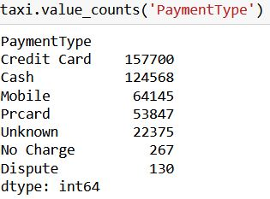
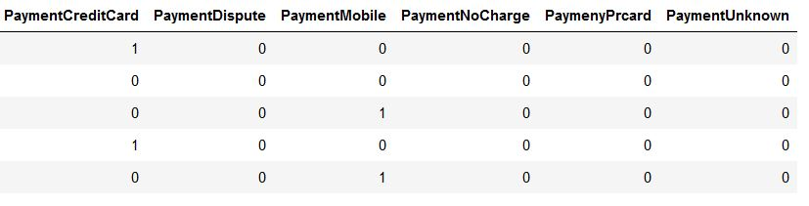
Re-expressing categorical values
The PaymentType column was converted to numerical values using one hot encoding. One hot encoding converts each category in a column into 0’s and 1’s. A 1 communicates that row contains that category while a zero indicates that row does not contain that category
Before
After

Slide 10
Visualizations

Slide 11
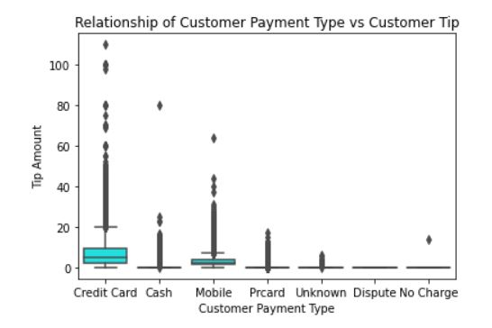
Visualizations revealed customers were more likely to tip (and tip higher amounts) if they paid with a credit card vs other payment methods.

Slide 12
Multiple Linear Regression

Slide 13
Multiple Linear Regression assesses if numerous explanatory variables are statistically correlated with a single target variable.
As an example, if performing multiple linear regression to see how long it takes to drive from point A to point B, time taken would be the target variable, and weather, traffic, road conditions, and time of day would be the explanatory variables. The multiple linear regression model would “score” the explanatory variables based on how much they impacted the time taken to travel from point A to point B.
For this analysis, tips is the target variable and trip miles, trip duration, tolls, taxi fare, or payment method are the explanatory variables. The multiple linear regression model determined if the explanatory variables are statistically correlated with tips and “scored” them based on how much they effected customer tipping.

Slide 14
Assumptions of multiple linear regression
The Chicago taxi data must meet the following assumptions to create a useable model:
There must be a linear relationship between the target variable and the explanatory variables. If no relationship exists, the model can’t confirm or “score” the relationship.
The explanatory variables must not be similar to each other (multicollinearity). If two or more explanatory variables are similar to each other, this confounds the multiple regression model's attempt to find a relationship between them and Tips. If a construction zone is in a high traffic area, it would be difficult to determine if delays were caused by traffic or construction.
All observations must be independent from each other. Each row in a data set represents an observation. If observations are related to each other, it causes similar issues to multicollinearity, where different variables are "talking" to each other throughout the process of trying to find a relationship
The residuals have no discernable pattern when graphed or plotted and be evenly spaced from each other.

Slide 15
Model Evaluation
Multiple Linear Regression “Scores” the model itself and each of the explanatory variables with the following:
Adjusted R-squared: This “scores” the entire model based on how much of the variance in Tips is explained by the explanatory variables. For example, a Adjusted R-Squared of 0.944 would mean that 94% of the variance in Tips is explained by the explanatory variables. A higher Adjusted Score indicates a better model.
P-Values: P-values score the explanatory variables by how much they statistically effect Tips individually. P-value scores range from 0.00 to 1.0. A lower P-value indicates stronger statistical significance while a higher P-Value rating indicates little or no statistical significance. I chose to retain variables with P- Values of 0.05 or less.
Residual Standard Error: This is not in the model report and was calculated separately. The residual standard error measures the standard error of the model’s residual points. The lower the score the better the model.

Slide 16
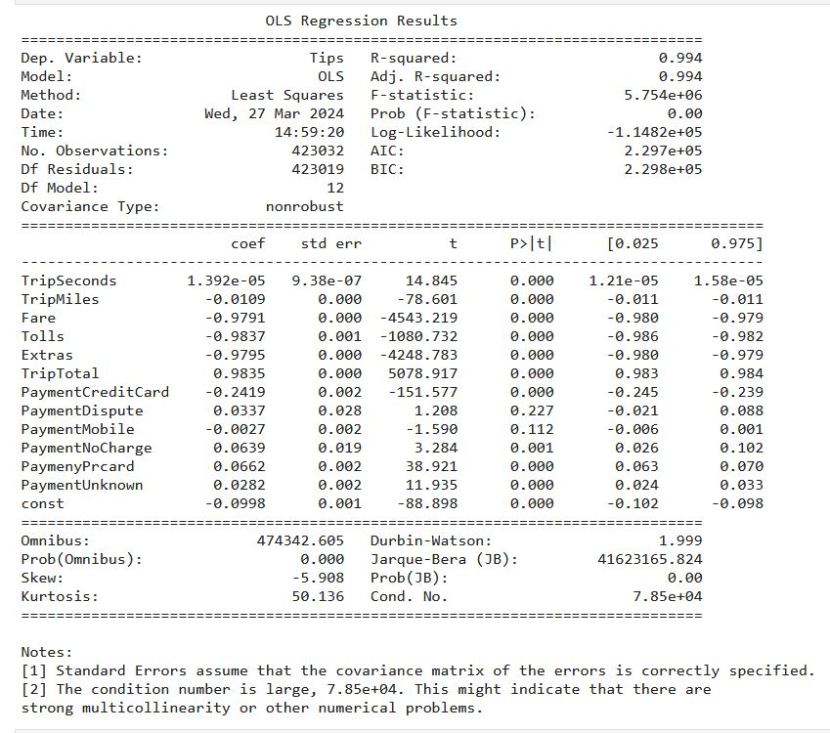






Initial Model
Initial Model
Calculated Residual Standard Error of Initial Model:
0.317
P-Values
Warning that variables are similar to each other

Slide 17
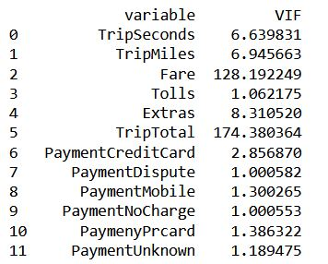
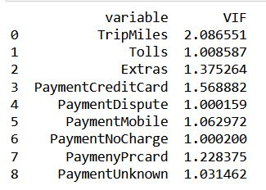
Removing Variables that Are similar to each other
Variance Inflation Factor (VIF) was used to remove explanatory variables that were too similar to each other. VIF measures how similar the explanatory variables are to each other. The variance inflation factor has a scale from one to ten, with one indicating little to no correlation and ten indicating that the variables are identical. All variables with a VIF above 5.0 were removed, one at a time.
Explanatory Variables Removed with VIF:
TripTotal
Fare
Trip Seconds
Before
After

Slide 18
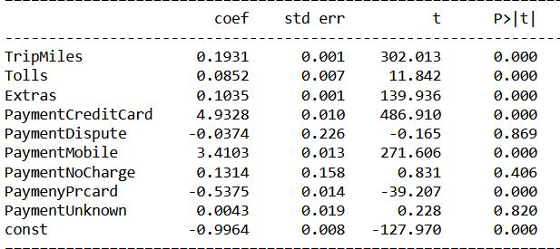
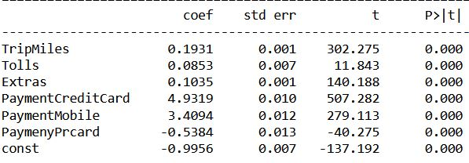






Removing Variables that Were Not Statistically Significant
Variables with P-Value Scores above 0.05 were removed from the model, one at a time. P-value scores above 0.05 demonstrate the variable was not statistically significant to Tips. After removing explanatory variables with high P-values, all remaining variables had P-values of 0, indicating statistical significance to Tips.
Explanatory Variables Removed due to high P-values:
PaymentDispute
PaymentUnknown
PaymentNoCharge
Before
After

Slide 19
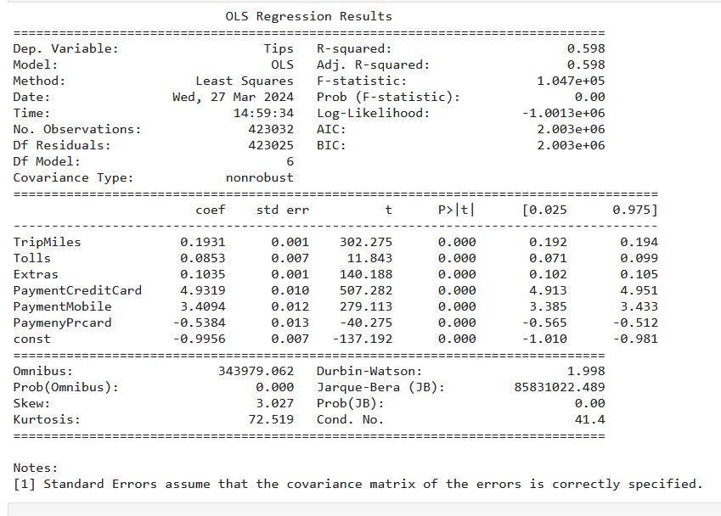



Final Model
Final Model Explanatory Variables:
TripMiles
Tolls
Extras
PaymentCreditCard
PaymentMobile
PaymentPrcard
Calculated Residual Standard Error: 2.580

Slide 20
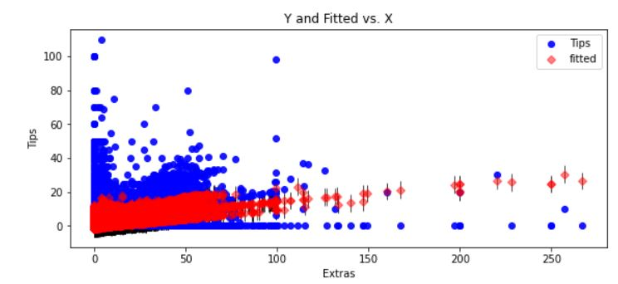
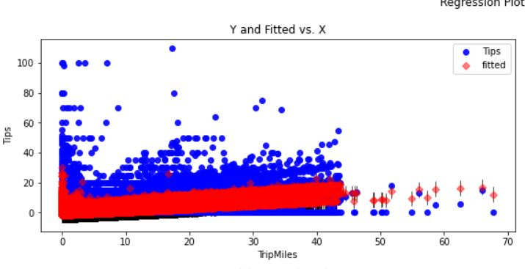
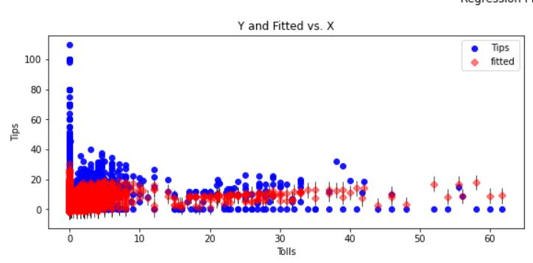
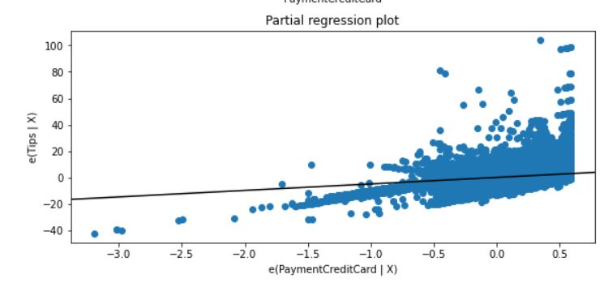







Residual Plots

Slide 21
Outline Of Findings
Neither model or their results are useable
Initial Model
Final Model
Final model was less accurate than initial model. Adjusted R-Squared was 0598 and residual standard error was higher at 2.580
Residual plots showed data points clustering together to form a funnel shape, breaking the assumption of multiple linear regression that the residuals are evenly spaced and do not form a pattern
Initial Model scored better with an adjusted R-Squared of 0.994 and lower residual standard error of 0.317
Initial model was unusable due to having explanatory variables that were too similar to each other and variables that were not statistically significant to Tips
Exploratory data analysis revealed customers who paid by credit card were more likely to tip (and tip higher amounts) than those who used other payment methods.

Slide 22
Limitations of analysis
Multiple Linear Regression Limitations
Chicago Taxi Data Limitations
Multiple Linear regression is sensitive to outliers and variables that are too similar to each other
Multiple Linear Regression is sensitive to data with wide ranges of values and does not handle them well.
The Chicago taxi dataset included legitimate outliers that would compromise the integrity of the data if removed
Many explanatory variables, such as Extras, had wide ranges of value.
Many rows had values that were intestinally left blank.

Slide 23
Summary Of Proposed Actions
Chicago taxi companies can give their taxi drivers a $0.50 bonus every time they accept non-credit card payment to make up for any lack of tips.
If further analysis is desired to see if Tips and the explanatory variables are statistically correlated, I suggest redoing the analysis and transforming the data with a log transformation during data preparation. This would coerce the data into a normal bell curve distribution. Since multiple linear regression models handle normally distributed data well, the resulting model may be more accurate.

Slide 24
Expected Benefits of Study
Offering a $0.50 bonus for drivers who accept non-credit card form of payment could increase a driver’s salary up to $200 a month, assuming they give rides to 20 customers day and the driver works five days a week. This could total to a $2,400 pay increase per year.
The bonus would increase driver retention and incentivize drivers to increase their daily rides, increasing revenue for Chicago cab companies.

Slide 25
Sources
Magaga, A. M. (2021a, November 12). Identifying, cleaning and replacing outliers: Titanic dataset. Medium. https://medium.com/analytics-vidhya/identifying-cleaning-and-replacing-outliers-titanic-dataset-20182a062893
Median - formula, meaning, example: How to find median?. Cuemath. (n.d.-b). https://www.cuemath.com/data/median/
Taxi Photo:
File:new york taxi.JPG - Wikimedia Commons. (n.d.). https://commons.wikimedia.org/wiki/File:New_York_Taxi.JPG

