Slide 1
WEBINAR (SHORT VERSION)
HOW TO USE BPMN* FOR MODELLING BUSINESS PROCESSES
Dr Alexander Samarin
www.samarin.biz
* Business Process Modeling Notation

Slide 2
Agenda
BPM reference model
BPMN basic elements
Modelling methodology
  BPMN diagramming style
  BPMN practical patterns
  BPMN-based modelling procedure
Evolution of BPMN
BPMN advanced use
How to use BPMN for modelling business processes
2009-summer

Slide 3
Context for BPMN
Ideally, one formal description of business processes
  model in design
  input for project planning and execution
  executable program for coordination of work
  documentation for all staff members
Explicit expression of coordination
Express relationships between BPM artefacts
Understandable by all staff members
A tool for communication
A tool for joint work of the business and the IT
How to use BPMN for modelling business processes
2009-summer

Slide 4
BPMN standard
An original development by Business Process Management Initiative to align modelling notations since 2000
The primary goal – understanding by business stakeholders
OMG standard since 2005
Current version 1.2 since Jan 2009
Version 2 is under development (to be discussed at the end of this webinar)
How to use BPMN for modelling business processes
2009-summer

Slide 5
It is important to follow a critical approach to BPMN
This is based on the experience that the direct use of some standards does not guarantee interoperability
Development “by committee” leads to exotic features
Bottom-up approach leads to yet another attempt to solve all problems with the current tool
BPM industry is vendor-driven and not customer-driven
BPMN has no solid execution semantic model – each tool executes BPM diagrams differently
How to use BPMN for modelling business processes
2009-summer

Slide 6
Agenda
BPM reference model
BPMN basic elements
Modelling methodology
  BPMN diagramming style
  BPMN practical patterns
  BPMN-based modelling procedure
Evolution of BPMN
BPMN advanced use
How to use BPMN for modelling business processes
2009-summer

Slide 7




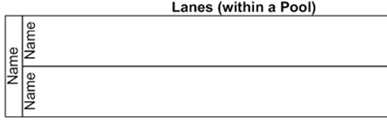
BPMN basic set shapes
3 kinds of flow objects
  Activity
  Gateway
  Event
3 ways of connecting
  Sequence flow
  Message flow
  Association
Two types of container
  Pools
  Lanes (swimlanes)
How to use BPMN for modelling business processes
2009-summer

Slide 8

Three types of coordination logic (1)
Template-based
  static connection of “flow objects” or sequence relationship (predecessor and successor)
  similar to a river (upstream and downstream)
  process template is an abstract description of a process
How to use BPMN for modelling business processes
2009-summer

Slide 9
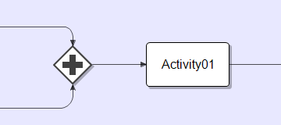
Three types of coordination logic (2)
Token-based
  token marks elements which active at a particular time
  dynamic connection of “flow objects” or synchronisation (wait for) / chronologic relationship
  similar to a “flock” of ducks (split and join)
  several tokens may co-exist
How to use BPMN for modelling business processes
2009-summer

Slide 10
Three types of coordination logic (3)
Instance-based
  process instance is an enactment of a process template
  each instance may have different behaviour of tokens
  a process instance is completed when all tokens have been consumed
  a process instance may start several instances of another process (although the latter is mentioned only once in the former)
How to use BPMN for modelling business processes
2009-summer

Slide 11

Event types
Start event produces a token
End (or finish) event consumes a token
Intermediate token means that something happened within a business process engine
How to use BPMN for modelling business processes
2009-summer

Slide 12
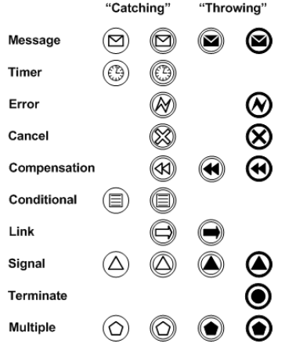

Event details
Too many events details
Recommendations to use:
  Mainly “message”
  Sometimes “empty”,
  “error” and “timer”
Start message
Throw message
Catch message
End message
How to use BPMN for modelling business processes
2009-summer

Slide 13

Simplest useful process
It has at least one activity!
How to use BPMN for modelling business processes
2009-summer

Slide 14
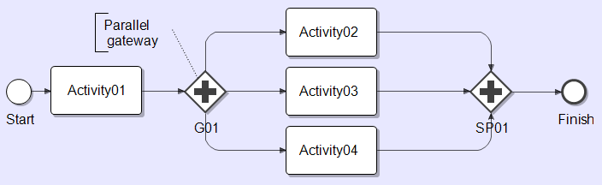
Parallel gateway
Activity02, Activity03 and Activity04 will be executed in parallel; the process will only be continued when each of them is completed
Logic of tokens is used
How to use BPMN for modelling business processes
2009-summer

Slide 15
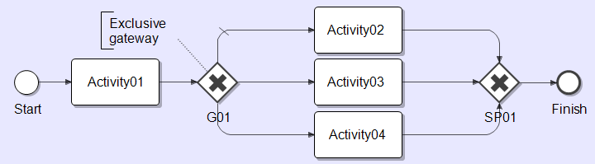
Exclusive gateway
A single activity Activity02 or Activity03 or Activity04 will be executed. The choice is based on the logic defined within the gateway G01
Logic of tokens is used
How to use BPMN for modelling business processes
2009-summer

Slide 16
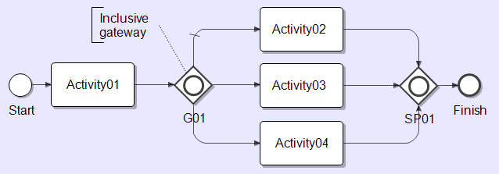
Inclusive gateway
Several activities can be executed in parallel
It covers functionality of parallel and exclusive gateways
Logic of tokens is used
How to use BPMN for modelling business processes
2009-summer

Slide 17
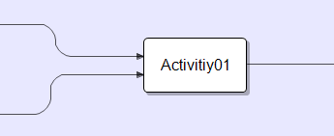
Logic of templates vs. logic of tokens
Many tokens can pass the same activity
How to use BPMN for modelling business processes
2009-summer

Slide 18
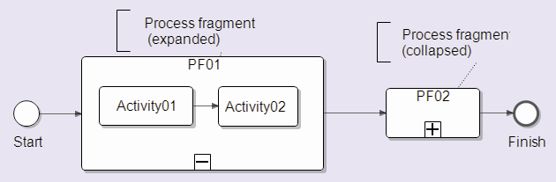
Process fragments
Process fragment is a compound activity
Also called “sub-process”
How to use BPMN for modelling business processes
2009-summer

Slide 19
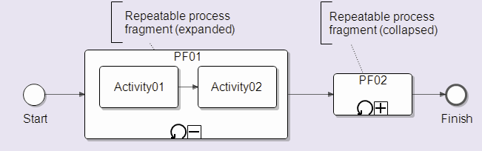
Repeatable process fragments (1)
Repeating conditions may be different in different systems
How to use BPMN for modelling business processes
2009-summer

Slide 20
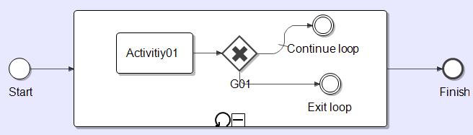
Repeatable process fragments (2)
Be explicit within fragments; the exclusive gateway G01 which is used to specify two branches – one to continue the loop and one to exit it
How to use BPMN for modelling business processes
2009-summer

Slide 21
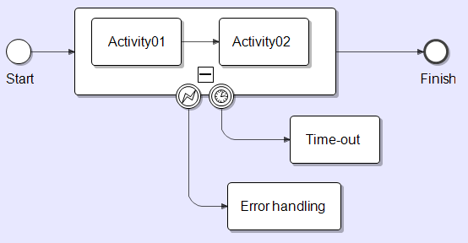
Process fragment as logical grouping
Catching errors and time-outs
How to use BPMN for modelling business processes
2009-summer

Slide 22

Pool
A pool is a container for activities carried out by a particular participant in a process
Typically, a participant is
  a role for a human activity
  a service (or a process) for an automated activity
How to use BPMN for modelling business processes
2009-summer

Slide 23

Connectors
Flow connector represents the sequence of activities within the same pool
Message connection represents
the communication between
activities in separate pools
How to use BPMN for modelling business processes
2009-summer

Slide 24
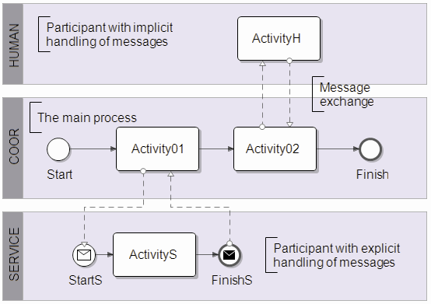
Handling of messages (1)
How to use BPMN for modelling business processes
2009-summer

Slide 25
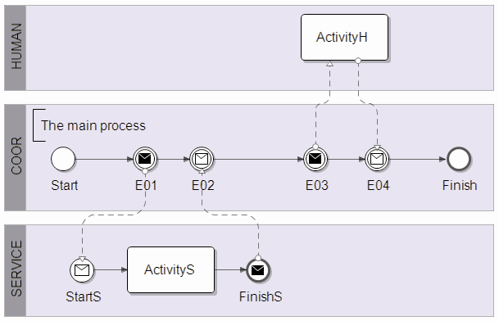
Handling of messages (2)
How to use BPMN for modelling business processes
2009-summer

Slide 26
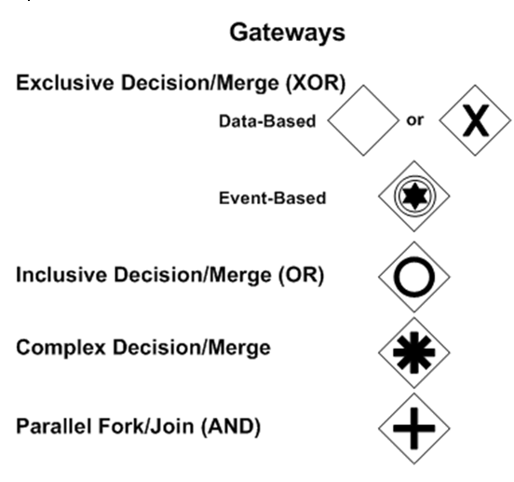
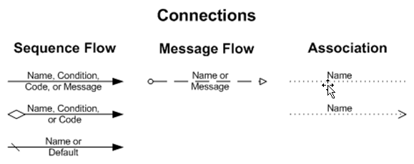

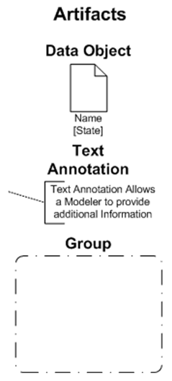
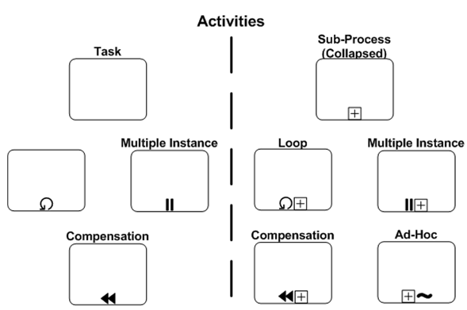
The full set of elements
How to use BPMN for modelling business processes
2009-summer

Slide 27
Agenda
BPM reference model
BPMN basic elements
Modelling methodology
  BPMN diagramming style
  BPMN practical patterns
  BPMN-based modelling procedure
Evolution of BPMN
BPMN advanced use
How to use BPMN for modelling business processes
2009-summer

Slide 28
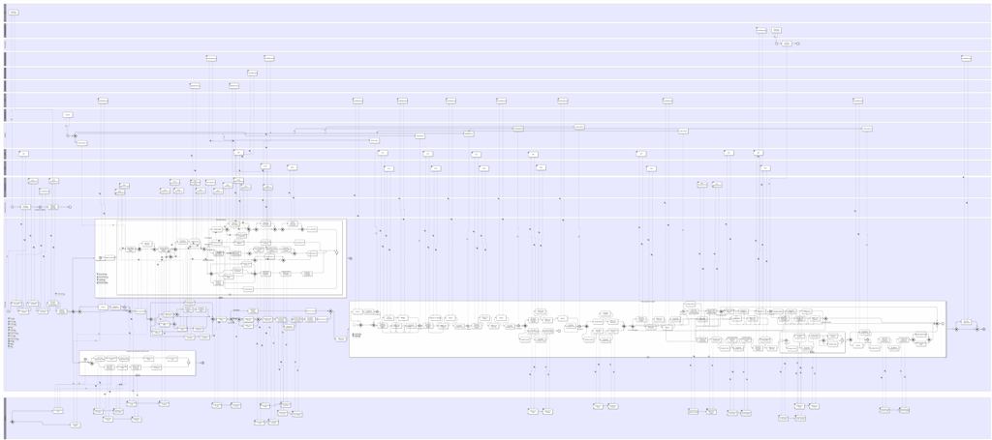
Example of unstructured BPMN
How to use BPMN for modelling business processes
2009-summer

Slide 29
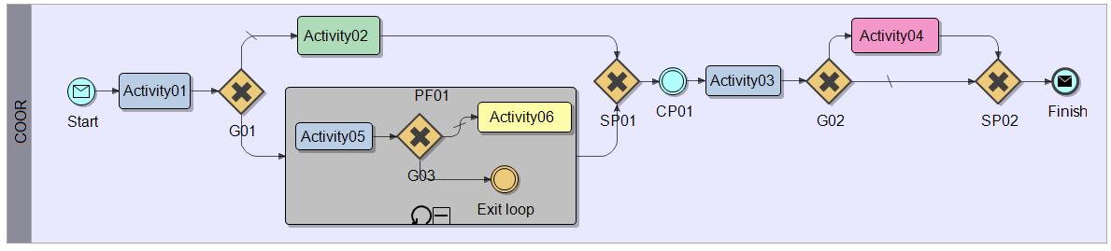
Diagramming style in BPMN (1)
Horizontal vs. vertical timeline
Timeline
How to use BPMN for modelling business processes
2009-summer

Slide 30
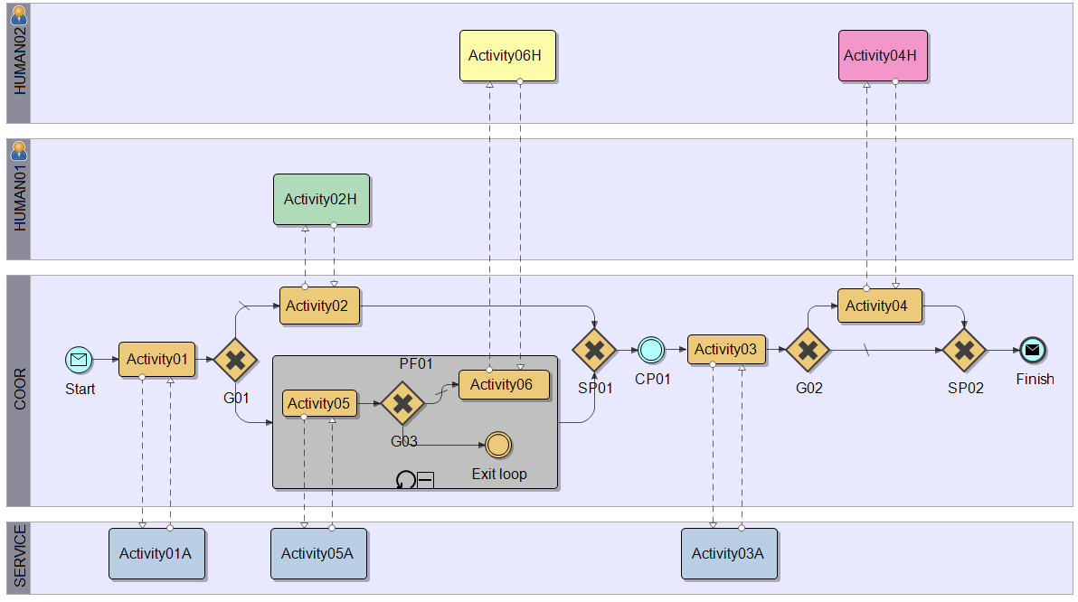
Diagramming style in BPMN (2)
Participants
How to use BPMN for modelling business processes
2009-summer

Slide 31
Agenda
BPM reference model
BPMN basic elements
Modelling methodology
  BPMN diagramming style
  BPMN practical patterns
  BPMN-based modelling procedure
Evolution of BPMN
BPMN advanced use
How to use BPMN for modelling business processes
2009-summer

Slide 32
Workflow patterns
Recent research work led by several universities has led to the identification of about 40 workflows patterns; used for comparison of different workflow engines
Visit http://www.workflowpatterns.com/
Most of them are complex
How to use BPMN for modelling business processes
2009-summer

Slide 33
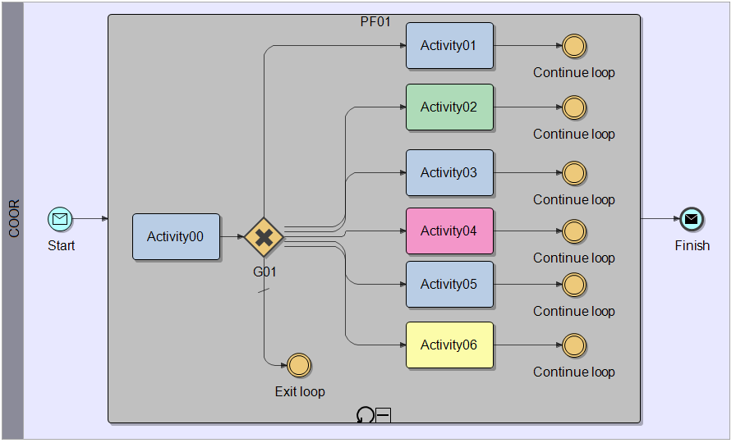
Anti-pattern PRF
Process Realisation Faked
How to use BPMN for modelling business processes
2009-summer

Slide 34
Pattern PP
Process Package
With a process instance we “carry” a package with
  Business objects (by value and by reference)
  Business documents (by value and by reference)
  Key Performance Indicators (KPIs)
  Audit trails
  Comments
  Local variables
  etc.
How to use BPMN for modelling business processes
2009-summer

Slide 35
Agenda
BPM reference model
BPMN basic elements
Modelling methodology
  BPMN diagramming style
  BPMN practical patterns
  BPMN-based modelling procedure
Evolution of BPMN
BPMN advanced use
How to use BPMN for modelling business processes
2009-summer

Slide 36
Principles of the modelling procedure
it treats human and automated activities equally
it is primarily for capturing the flow of control, and not for optimisation
it is a tool for both the business and the IT (maybe with coaching by a process architect/engineer)
it provides validation by simulation
it provides validation by quick prototyping – real services can be invoked
it is a visual programming approach
How to use BPMN for modelling business processes
2009-summer

Slide 37
The modelling procedure
Its purpose is
  to analyse a building block (what it is supposed to do)
  to synthesise its implementation (how it does this) as the explicit coordination of other building blocks (processes or activities)
It is iterative – we can apply it until we have left only indivisible building blocks (i.e. activities)
Artefacts are constructed recursively, like Russian dolls
How to use BPMN for modelling business processes
2009-summer

Slide 38
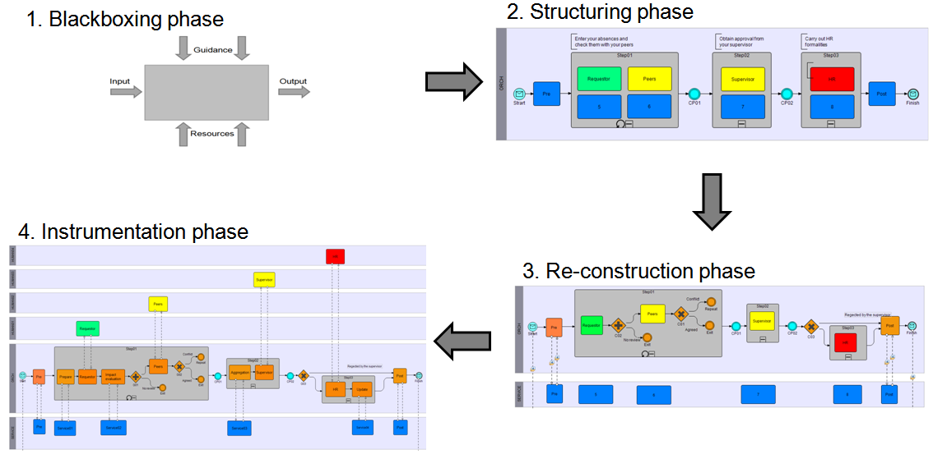
Four phases
How to use BPMN for modelling business processes
2009-summer

Slide 39
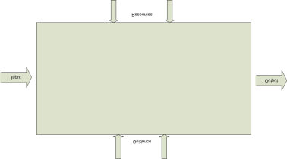
Blackboxing phase
The purpose
  to analyse a building block as a whole
  to discover its functional characteristics and some related artefacts
The method
  the business story behind this building block should be carefully analysed to determine some of its artefacts
Recommendations
  at this point, don’t go into excessive detail for each artefact; this should be done later
How to use BPMN for modelling business processes
2009-summer

Slide 40
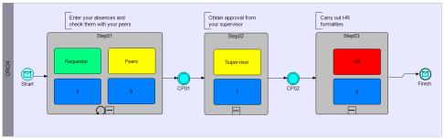
Structuring phase (1)
The purpose
  to analyse a building block from within to determine its internal structure and its major artefacts
The method
  determine the main functional (or logical) steps
  add check-points between steps
  classify artefacts for these steps
Recommendations
  don’t have more than 7 steps
  avoid loop-back over check-points
How to use BPMN for modelling business processes
2009-summer

Slide 41
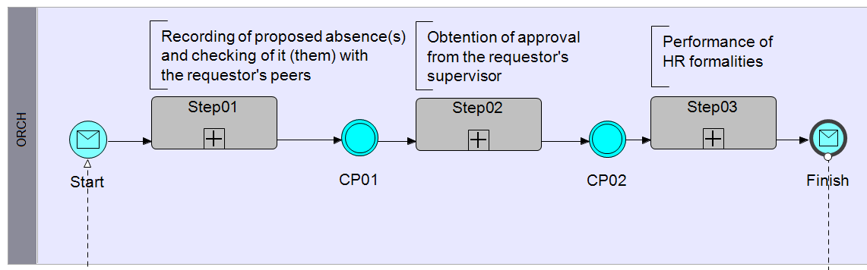
Structuring phase (2)
Steps and check points
How to use BPMN for modelling business processes
2009-summer

Slide 42
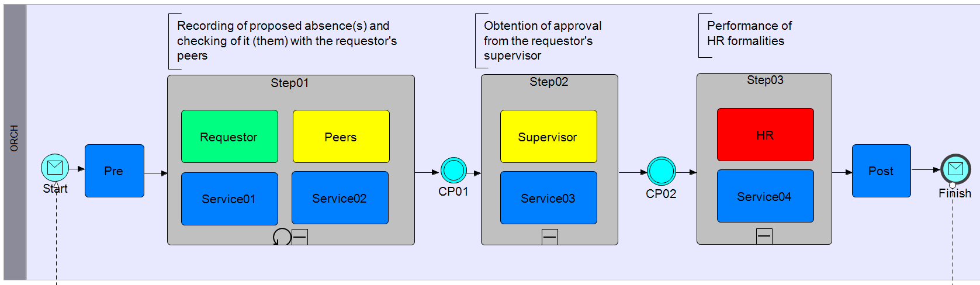
Structuring phase (3)
Steps, check points and artefacts
How to use BPMN for modelling business processes
2009-summer

Slide 43
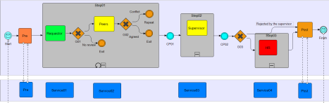
Re-construction phase (1)
The purpose
  to synthesize an initial version of the formal coordination: some kind of process skeleton
The method
  add intra-step logic
  start formalising the business objects involved
  collect test scenarios
Recommendations
  consider implementation of human activities as interactive forms
How to use BPMN for modelling business processes
2009-summer

Slide 44

Re-construction phase (2)
The diagram
How to use BPMN for modelling business processes
2009-summer

Slide 45
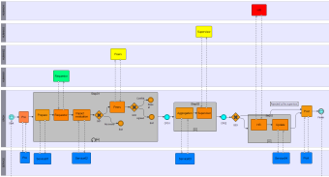
Instrumentation phase (1)
The purpose
  to enrich the process skeleton by adding more automated activities
The method
  add pools
  apply different practical patterns
  use a business rule engine if available
  collect test scenarios
Recommendations
  work iteratively (step-by-step)
How to use BPMN for modelling business processes
2009-summer

Slide 46
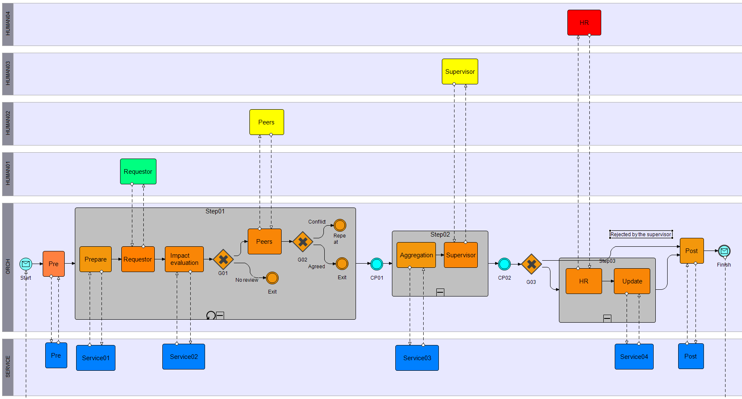
Instrumentation phase (2)
The diagram
How to use BPMN for modelling business processes
2009-summer

Slide 47
Agenda
BPM reference model
BPMN basic elements
Modelling methodology
  BPMN diagramming style
  BPMN practical patterns
  BPMN-based modelling procedure
Evolution of BPMN
BPMN advanced use
How to use BPMN for modelling business processes
2009-summer

Slide 48
BPMN 2.0 (in development)
Seamless exchange between different modelling tools
Conformance levels
Execution semantic promised
Merging orchestration and choreography
Driven by vendors
How to use BPMN for modelling business processes
2009-summer

Slide 49
Dreaming about a customer-centric BPM
Agreed BPM reference model
Conformance for standard execution semantic
BPMN-like model with different levels of detail
A modelling procedure which guides people
A coherent set of standards similar to W3C for HTML:
  xHTML for structure and content
  CSS for presentation
  DOM-based API for dynamic modifications
  some other specialized standards
All vendors benchmark their products against an agreed test (similar to acid3.acidtests.org)
How to use BPMN for modelling business processes
2009-summer

Slide 50
Agenda
BPM reference model
BPMN basic elements
Modelling methodology
  BPMN diagramming style
  BPMN practical patterns
  BPMN-based modelling procedure
Evolution of BPMN
BPMN advanced use
How to use BPMN for modelling business processes
2009-summer

Slide 51
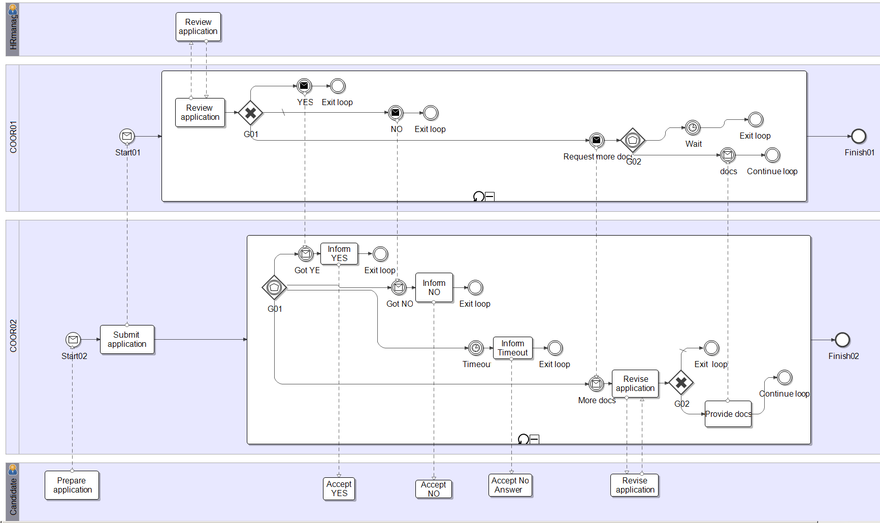
Example: Apply for a position
How to use BPMN for modelling business processes
2009-summer

Slide 52
Thank you
Contact information:
Alexander Samarin
samarin@bluemail.ch
www.improving-BPM-systems.com
How to use BPMN for modelling business processes
2009-summer

