Slide 1


SSPM’s College of Engineering. Kankavali. Sindhudurg
Department Of Electrical Engineering.
Hydroponic monitoring and contol system for sustainable food production
Presented by
BE Electrical 2024-25 Course-MP-2B
Tanuja ganpat rane (44)
Sampada makarand parab (39)
Pratik vilas chavan (7)
Karina sunil kubal (22)
Under the Guidance of
Prof. v .v .sawant

Slide 2
Abstract
This project presents the design and development of an IoT-based hydroponic monitoring and control system aimed at promoting sustainable food production. Hydroponics, a soilless farming technique, offers efficient use of water and nutrients, making it ideal for urban and resource-limited environments. By integrating IoT technologies, key environmental parameters such as pH, electrical conductivity (EC), temperature, humidity, and water level are continuously monitored using sensors. A microcontroller (e.g., Arduino or ESP32) processes the sensor data and triggers automated control actions—such as nutrient dosing, pH adjustment, and lighting control—based on predefined thresholds or fuzzy logic algorithms. The system also features remote monitoring through a web or mobile dashboard, enabling real-time data access and control. The proposed solution reduces manual intervention, optimizes resource usage, and enhances crop yield and quality, thereby contributing to environmentally sustainable and technologically advanced agriculture

Slide 3
Introduction
With the global population steadily increasing and arable land becoming scarce, there is a pressing need for innovative and sustainable agricultural methods. Hydroponics, a soilless cultivation technique that allows plants to grow in nutrient-rich water solutions, has gained significant attention due to its efficient use of water and space, as well as the ability to produce higher yields compared to traditional farming.
However, managing hydroponic systems manually can be labor-intensive and prone to human error, especially in maintaining optimal environmental conditions such as pH, nutrient concentration, temperature, and humidity. Variations in these parameters can significantly impact plant growth, quality, and yield.
The integration of the Internet of Things (IoT) into hydroponic systems provides a promising solution by enabling real-time monitoring and automated control of critical factors. IoT technology uses sensors and actuators connected to microcontrollers and cloud platforms to collect, analyze, and respond to environmental data remotely. This automation reduces manual intervention, ensures consistent growing conditions, optimizes resource utilization, and can improve crop productivity.
This project aims to design and implement an IoT-based hydroponic monitoring and control system that continuously tracks essential parameters and automates necessary adjustments. The system will support sustainable food production by enhancing efficiency, reducing resource wastage, and providing a scalable solution suitable for urban farming and areas with limited agricultural resources

Slide 4
Literature Review
Hydroponics, a soilless method of growing plants, has emerged as a sustainable alternative to traditional agriculture, especially in urban and resource-constrained environments. The integration of the Internet of Things (IoT) into hydroponic systems has significantly enhanced their efficiency, enabling real-time monitoring and automation of critical parameters such as pH, electrical conductivity (EC), temperature, humidity, and water level.
According to [Rahman et al. (2022)](https://arxiv.org/abs/2208.00364), IoT-based hydroponic systems provide better control over plant growth environments through the use of sensors and microcontrollers like Arduino and ESP32. These systems can automatically adjust nutrient levels and environmental conditions, improving yield and reducing resource usage. Similarly, \[Setiawan et al. (2021)] developed a fuzzy logic-based control system for hydroponics that maintained optimal pH and nutrient levels, demonstrating the advantage of intelligent control over manual adjustments.
Studies by \[Susanto et al. (2023)] highlighted the importance of using cloud-based dashboards and mobile apps to enable remote control and monitoring, thereby reducing labor and increasing system scalability. Furthermore, \[Ahmed et al. (2020)] emphasized the role of low-cost, energy-efficient components in making IoT solutions more accessible for small-scale and urban farmers.

Slide 5
However, challenges remain, such as sensor calibration, system maintenance, and high initial costs. Future research is focused on integrating machine learning for predictive control, improving sensor reliability, and enhancing sustainability through renewable energy sources.
In summary, IoT-enhanced hydroponic systems offer a promising solution for sustainable food production, particularly in areas with limited arable land or water resources. Continued innovation in automation, AI integration, and cost reduction will further expand their potential.

Slide 6
Problem statement
Manual monitoring and control of hydroponic systems are labor-intensive and prone to errors, leading to inefficient resource use and inconsistent crop yields. There is a need for an automated IoT-based solution that enables real-time monitoring and control of key parameters to improve productivity and sustainability in hydroponic farming

Slide 7
1. System Design and Architecture
The system employs a **centralized IoT architecture** utilizing an **ESP32 microcontroller** as the core processing unit. This microcontroller interfaces with various sensors and actuators to monitor and control the hydroponic environment. Data from the sensors are transmitted to a cloud platform, enabling remote monitoring and control via a mobile application.
2. Hardware Components
Microcontroller: ESP32, chosen for its Wi-Fi and Bluetooth capabilities, facilitating seamless communication.
Sensors:
pH Sensor: Monitors the acidity of the nutrient solution.
TDS (Total Dissolved Solids) Sensor: Measures the concentration of dissolved nutrients.
Temperature and Humidity Sensor: Tracks environmental conditions.
Water Level Sensor: Detects the water level in the reservoir.
Actuators:
Peristaltic Pumps: Control the addition of pH adjusters and nutrients.
Water Pump: Circulates water within the system.
LED Grow Light: Provide necessary light for plant growth.

Slide 8
3. Software Development
Embedded Programming: The ESP32 is programmed using the Arduino IDE, utilizing libraries compatible with the sensors and actuators.
Cloud Integration: Data from the sensors are sent to a cloud platform using MQTT protocol, ensuring real-time data access.
Mobile Application: A custom mobile application is developed to display sensor data and allow users to control actuators remotely.
4. System Operation
Data Collection: Sensors continuously monitor environmental parameters and send data to the ESP32.
Data Processing: The ESP32 processes the sensor data and compares it with predefined thresholds.
Control Actions: Based on the processed data, the ESP32 activates or deactivates actuators to maintain optimal growing conditions.
User Interaction: Users can view real-time data and control the system remotely through the mobile application.
5. Testing and Calibration
Sensor Calibration: Each sensor is calibrated to ensure accurate readings.
System Testing: The entire system is tested under various conditions to ensure reliable operation.
Performance Evaluation: The system's performance is evaluated based on its ability to maintain optimal growing conditions and its responsiveness to user inputs.

Slide 9
[ 1. **System Design and Architecture**
The system employs a **centralized IoT architecture** utilizing an **ESP32 microcontroller** as the core processing unit. This microcontroller interfaces with various sensors and actuators to monitor and control the hydroponic environment. Data from the sensors are transmitted to a cloud platform, enabling remote monitoring and control via a mobile application.
### 2. **Hardware Components**
* **Microcontroller**: ESP32, chosen for its Wi-Fi and Bluetooth capabilities, facilitating seamless communication.
* **Sensors**:
* **pH Sensor**: Monitors the acidity of the nutrient solution.
* **TDS (Total Dissolved Solids) Sensor**: Measures the concentration of dissolved nutrients.
* **Temperature and Humidity Sensor**: Tracks environmental conditions.
* **Water Level Sensor**: Detects the water level in the reservoir.
* **Actuators**:
* **Peristaltic Pumps**: Control the addition of pH adjusters and nutrients.
* **Water Pump**: Circulates water within the system.
* **LED Grow Lights**: Provide necessary light for plant growth.
### 3. **Software Development**
* **Embedded Programming**: The ESP32 is programmed using the Arduino IDE, utilizing libraries compatible with the sensors and actuators.
* **Cloud Integration**: Data from the sensors are sent to a cloud platform using MQTT protocol, ensuring real-time data access.
* **Mobile Application**: A custom mobile application is developed to display sensor data and allow users to control actuators remotely.
### 4. **System Operation**
* **Data Collection**: Sensors continuously monitor environmental parameters and send data to the ESP32.
* **Data Processing**: The ESP32 processes the sensor data and compares it with predefined thresholds.
* **Control Actions**: Based on the processed data, the ESP32 activates or deactivates actuators to maintain optimal growing conditions.
* **User Interaction**: Users can view real-time data and control the system remotely through the mobile application.
### 5. **Testing and Calibration**
* **Sensor Calibration**: Each sensor is calibrated to ensure accurate readings.
* **System Testing**: The entire system is tested under various conditions to ensure reliable operation.
* **Performance Evaluation**: The system's performance is evaluated based on its ability to maintain optimal growing conditions and its responsiveness to user inputs.
---
This methodology outlines the systematic approach taken to develop an IoT-based hydroponic system capable of monitoring and controlling environmental parameters to promote sustainable and efficient vegetable growth.
If you require further details or assistance with specific aspects of the project, feel free to ask!

Slide 10
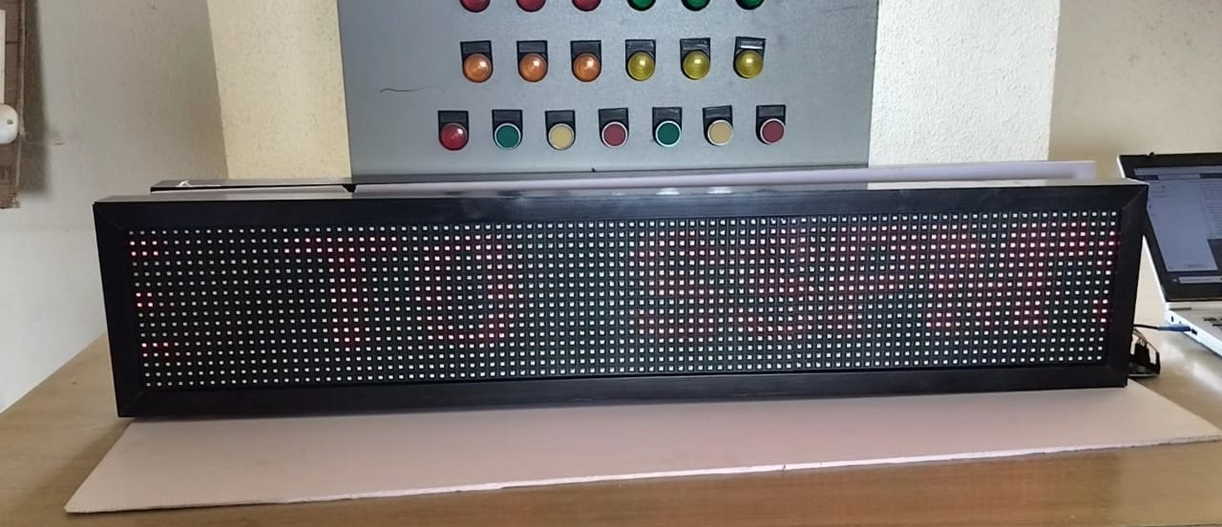
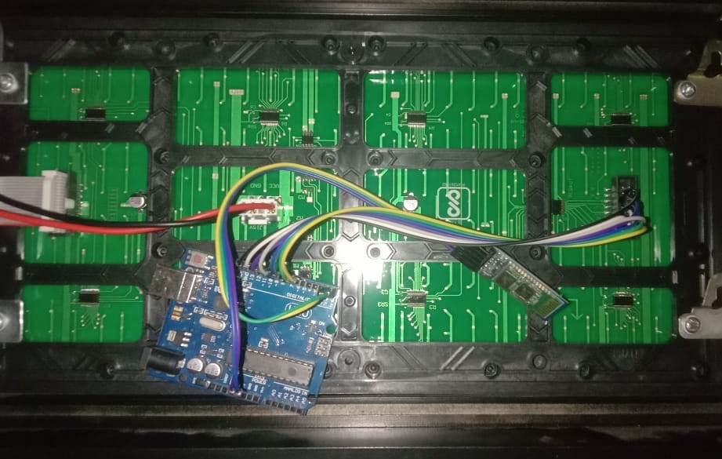
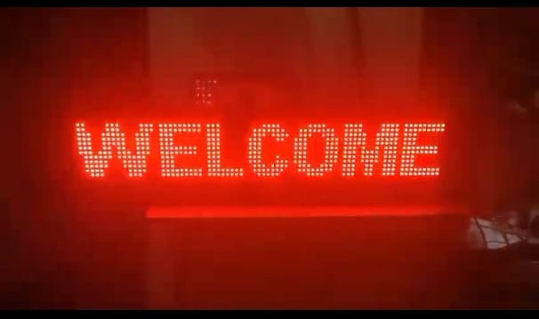
Hardware Implementation

Slide 11
### 4. **System Operation**
* **Data Collection**: Sensors continuously monitor environmental parameters and send data to the ESP32.
* **Data Processing**: The ESP32 processes the sensor data and compares it with predefined thresholds.
* **Control Actions**: Based on the processed data, the ESP32 activates or deactivates actuators to maintain optimal growing conditions.
* **User Interaction**: Users can view real-time data and control the system remotely through the mobile application.
### 5. **Testing and Calibration**
* **Sensor Calibration**: Each sensor is calibrated to ensure accurate readings.
* **System Testing**: The entire system is tested under various conditions to ensure reliable operation.
* **Performance Evaluation**: The system's performance is evaluated based on its ability to maintain optimal growing conditions and its responsiveness to user inputs.
---
This methodology outlines the systematic approach taken to develop an IoT-based hydroponic system capable of monitoring and controlling environmental parameters to promote sustainable and efficient vegetable growth.
If you requir

Slide 12
Results and Discussion
* **Peristaltic Pumps**: Control the addition of pH adjusters and nutrients.
* **Water Pump**: Circulates water within the system.
* **LED Grow Lights**: Provide necessary light for plant growth.
### 3. **Software Development**
* **Embedded Programming**: The ESP32 is programmed using the Arduino IDE, utilizing libraries compatible with the sensors and actuators.
* **Cloud Integration**: Data from the sensors are sent to a cloud platform using MQTT protocol, ensuring real-time data access.
* **Mobile Application**: A custom mobile application is developed to display sensor data and allow users to control actuators remotely.
### 4. **System Operation**
* **Data Collection**: Sensors continuously monitor environmental parameters and send data to the ESP32.
* **Data Processing**: The ESP32 processes the sensor data and compares it with predefined thresholds.
* **Control Actions**: Based on the processed data, the ESP32 activates or deactivates actuators to maintain optimal growing conditions.
* **User Interaction**: Users can view real-time data and control the system remotely through the mobile application.
### 5. **Testing and Calibration**
* **Sensor Calibration**: Each sensor is calibrated to ensure accurate readings.
* **System Testing**: The entire system is tested under various conditions to ensure reliable operation.
* **Performance Evaluation**: The system's performance is evaluated based on its ability to maintain optimal growing conditions and its responsiveness to user inputs.
---

Slide 13
Application of the system
Public information displays
Advertising and promotional displays
Transportation hubs (airports, bus stations)
Public events and exhibitions
Rural or remote areas with limited power access
Traffic management and information displays

Slide 14
Summary and Future trends
Summary of project
The Solar-Powered P10 Scrolling Display using GSM Technology project aims to design and develop an energy-efficient display system that receives and displays messages via GSM technology. The system utilizes a solar panel to reduce energy consumption and a P10 scrolling display to clearly show messages. Integrated with a GSM module, the system enables remote message sending and receiving, increasing convenience and scalability. With its user-friendly interface and energy-efficient design, this system is ideal for public information display, advertising, emergency notification, and remote monitoring applications.
Future trends:-
public places like bus stops, parks, shopping malls,railway platforms, banks, public offices, hotels,training institutes, nightclubs and shops.

