Slide 1
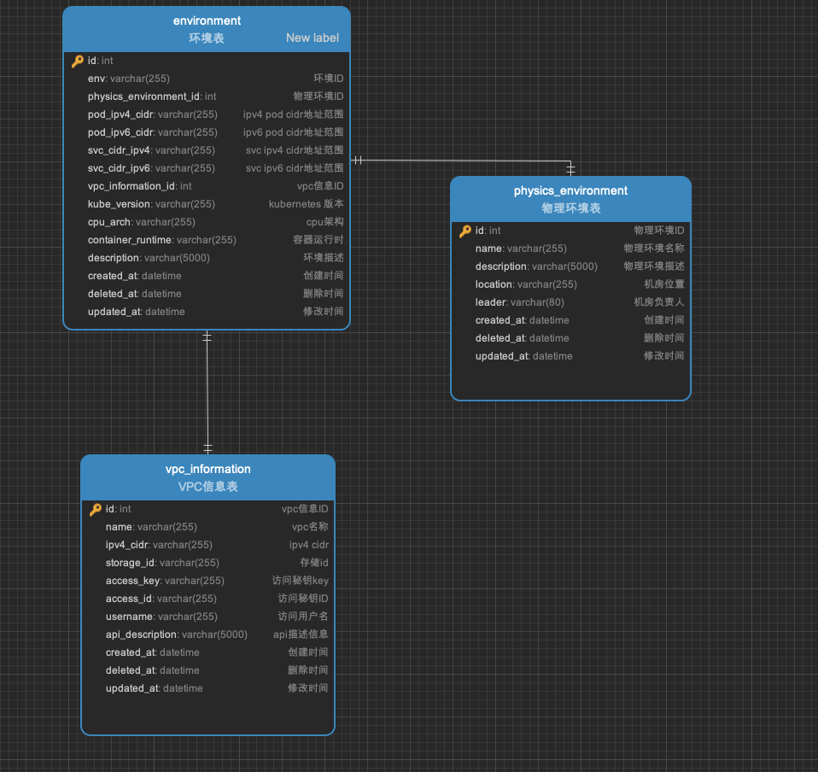
1fasdv
sadfasdfsadf

Slide 2
111
2213

