Slide 1
Jammy Key for Configurational Sampling How to use JKCS
Jakub Kubecka
Version 1.06
2018

Slide 2
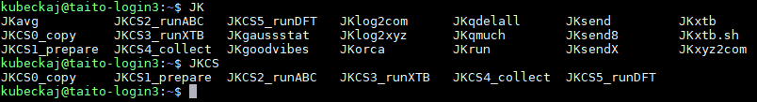
SETUP environment
If you are on taito, put this to the end of your ~/.bashrc file (by using VIM,nano,emacs etc.)
alias updateJKCS=’yes|cp –r /wrk/kubeckaj/DONOTREMOVE/Apps/JKCS /wrk/$USER/DONOTREMOVE/'
export PATH=/wrk/kubeckaj/DONOTREMOVE/Utilities:$PATH #using other JK scripts
alias molden= 'module add molden;unalias molden; molden’ #no need to load molden everytime
alias qs='qstat -u $USER’ #shortcut to see your jobs in queue
Run
source ~/.bashrc updateJKCS #should work if you followed previous steps cd /wrk/$USER/DONOTREMOVE/ sh run.sh #if no error, everything is ok source ~/.bashrc
You should be able to see something like this:
[ TAB ]
[ TAB ]

Slide 3
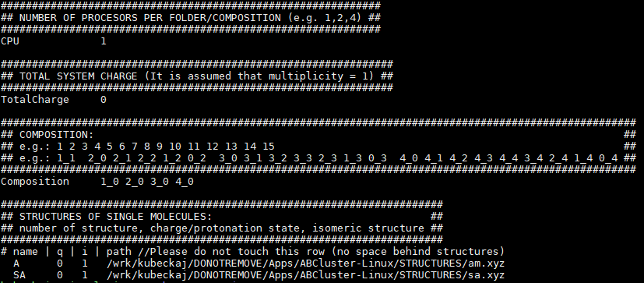

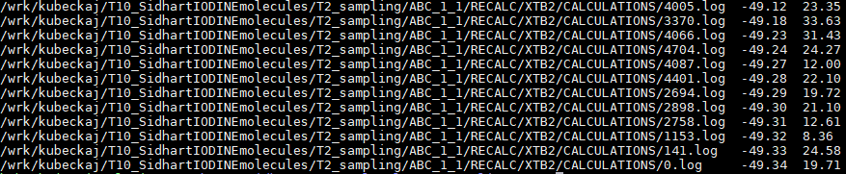
The easiest way (use a new folder for each sampling)
JKCS0_copy
(modify input.txt)
JKCS1_prepare
(see filesABC.dat)
JKCS2_runABC
JKCS3_runXTB
JKCS4_collect
(see results.dat)
(molden movie.xyz)
JKCS5_runDFT etc.
setup
you do not have to touch unless you your system has more then ~5 molecules

Slide 4
JKCS0_copy
copies input.txt and commands.txt (see JKCS6_commands) to your directory
By default NH3 and H2SO4 but you can add different: JKCS0_copy A W SA //or GD,DMA, TMA etc. (you might also like: JKCS0_copy -all)
Then, you have to setup file input.txt for system
- name = correspond to molecule, q = charge, i = number of isomer
structure paths:
1) /homeappl/home/kubeckaj/wrk/DONOTREMOVE/Apps/ABCluster-Linux/testfiles/rigidmolecularcluster/charmm36/*.xyz
(Ar, Na⁺, Cl⁻, SO₄²⁻, H⁺, TIP4P, gd, guaninidium⁺, urea, NH₃, NH₄⁺, CO₂, C₂H₅OH …)
2) /homeappl/home/kubeckaj/wrk/DONOTREMOVE/Apps/ABCluster-Linux/STRUCTURES/*.xyz
(g – guanidine, gp – guanidium⁺, sa – sulphuric acid, sam – bisulphate⁻, samm – sulphate²⁻,am – ammonia, amp – ammonium⁺, aq – water, tma – TMA … )
3) Your molecule does not exist? Optimize your structure in Gaussian, then run NBO population analysis on HF level, then run
JKlog2xyz –abc file.log …… and still it is not enough, you have to discuss it with Jacob

Slide 5
JKCS1_prepare
Prepare all folders for ABC calculations
You can also run: JKCS1_prepare -init 5000 -gen 100 -sc 4 -lm 5000
You can check the file filesABC.dat
You do not have to change anything unless your system start grows over ~5 molecules or your system is “weird” (contains Iodine, multiplicity is not one etc.)
You can simply ask Jacob for advice

Slide 6
JKCS2_runABC
It will run all ABC algorithms by using ABCluster
You can check calc.out in each folder to see how is the calculation going on

Slide 7
JKCS3_runXTB
It runs GNF2-xTB on top of ABC structures
It will not start until the ABC is not finished
For now, the best way how to check if all calculations are finished is to see queue
qstat -u $USER or qs
or run in the directory SYS_*:
JKcheck

Slide 8
JKCS4_collect [folder]
You can run it even before all the previous calculations are finished
(you will get just warning that all the calculations are not finished yet)
It will produce following files:
collectionFOLDER.txt containing all structures, their energies and Rg
resultsFOLDER.dat unique structures
movieFOLDER.xyz structures from resultsFOLDER.dat
See structure by: molden movieFOLDER.xyz
Check resultsFOLDER.dat:
full path Rg El.energy

Slide 9
JKCS7_filter
Connected to script DataFilter.py mainly written by VITTUSAATANA
Filter out some reasonable amount of files for next step
Run:
JKCS7_filter resultsXTB.dat -rg 15 -s 50
For more details about attributes see
JKCS7_filter -help
THERE EXIST THREE DIFFERENT THINGS: uniqueness, filtering, uniform sampling/selecting

Slide 10
JKCS5_runDFT
Optimize you system:
JKCS5_runDFT -f DFTopt -r XTB -m "# wb97xd 6-31++g** opt=verytight int=ultrafine gfinput IOP(6/7=1)"
Run frequency calculations
JKCS5_runDFT -f DFTfreq -r DFTopt -method “# wb97xd 6-31++g** freq gfinput”
You can even run DLPNO calculations
JKCS5_runDFT -p DLPNO -r DFT_HIGH_freq -f DLPNO -diff 3
ORCA calculations coming soon

Slide 11
JKCS6_commands DO NOT USE UNLESS JACOB ALLOWS IT TO YOU
Run all commands in file commands.txt
Use just in case that you already know how all JKCS works
Run:
sbatch JKsend JKCS6_commands -m name@email.com -mtJK
------------- generally all can done just like this ---------------
JKCS0_copy SA GD W
Change input.txt and commands.txt
JKCS1_prepare
sbatch JKsend JKCS6_commands

Slide 12
JKxxx scripts
RUN JKxxx –help to understand more each script
XTB
JKxtb sends xtb job to queue // JKxtb -opt “-char 1” structure.xyz
Gaussian
JKgaussstat print results (columns) from Gauss .log // JKgaussstat -p -el -gibbs -r2 *.log
JKlog2xyz converts last str. from Gauss .log to .xyz // JKlog2xyz test.log
JKlog2com converts last str. from Gauss .log to .com // JKlog2com -m “# PM7 opt” test.log
JKxyz2com converts str. To Gauss. Input // JKxyz2com -m “# PM7 opt” test.xyz
Queueing
JKrun sends Gaussian jobs to queue // JKrun -max 150 *.com
JKsend sends small inputs to queue // sbatch JKsend “sleep 600; JKrun”

