Slide 1
Best practices for communication between microservices in k8s environment
Lior Nabat, CTO
E-mail:lior.nabat@kubemq.io
Twitter:@lior_nabat

Slide 2
Before we start … Please make sure
Kubernetes is up and running in your laptop
kubectl config current-context
git clone https://github.com/kubemq-io/kubemq-workshop.git

Slide 3


Container based infrastructure and Kubernetes are quickly becoming the new standard for deploying and managing software. A native messaging broker for this environment is missing.
KubeMQ is a Kubernetes Message Queue Broker
Enterprise-grade message broker and message queue, scalable, high available and secured

Slide 4
Use cases
Supporting most common use cases of the messaging in Kubernetes
Multi-stage pipeline
Task / Job Distributed Queue
Streaming data workflows
Pub/Sub in real time
Application decoupling - microservices

Slide 5
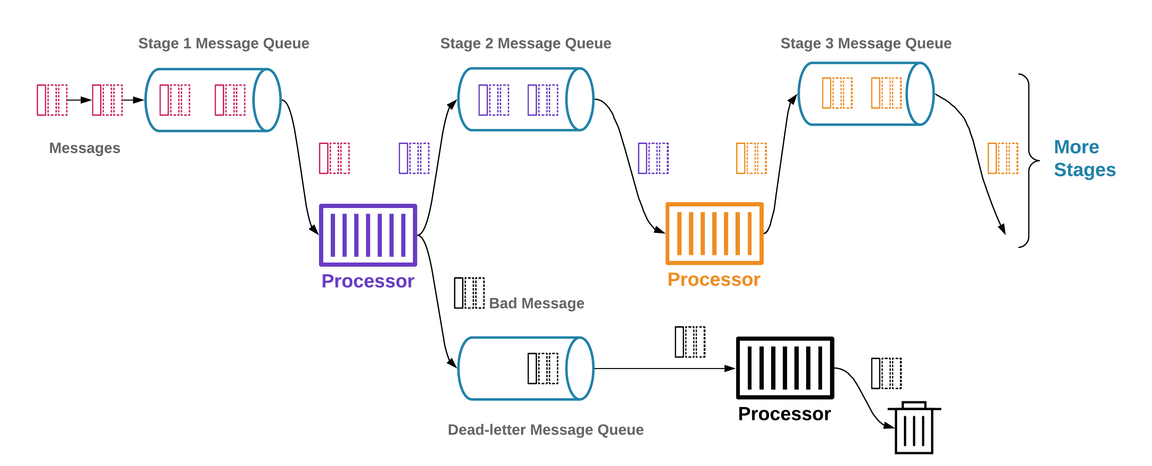
Multistage Data Processing Pipeline

Slide 6
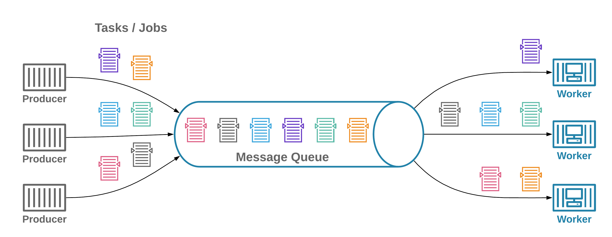
Task / Job Distributed Queue

Slide 7
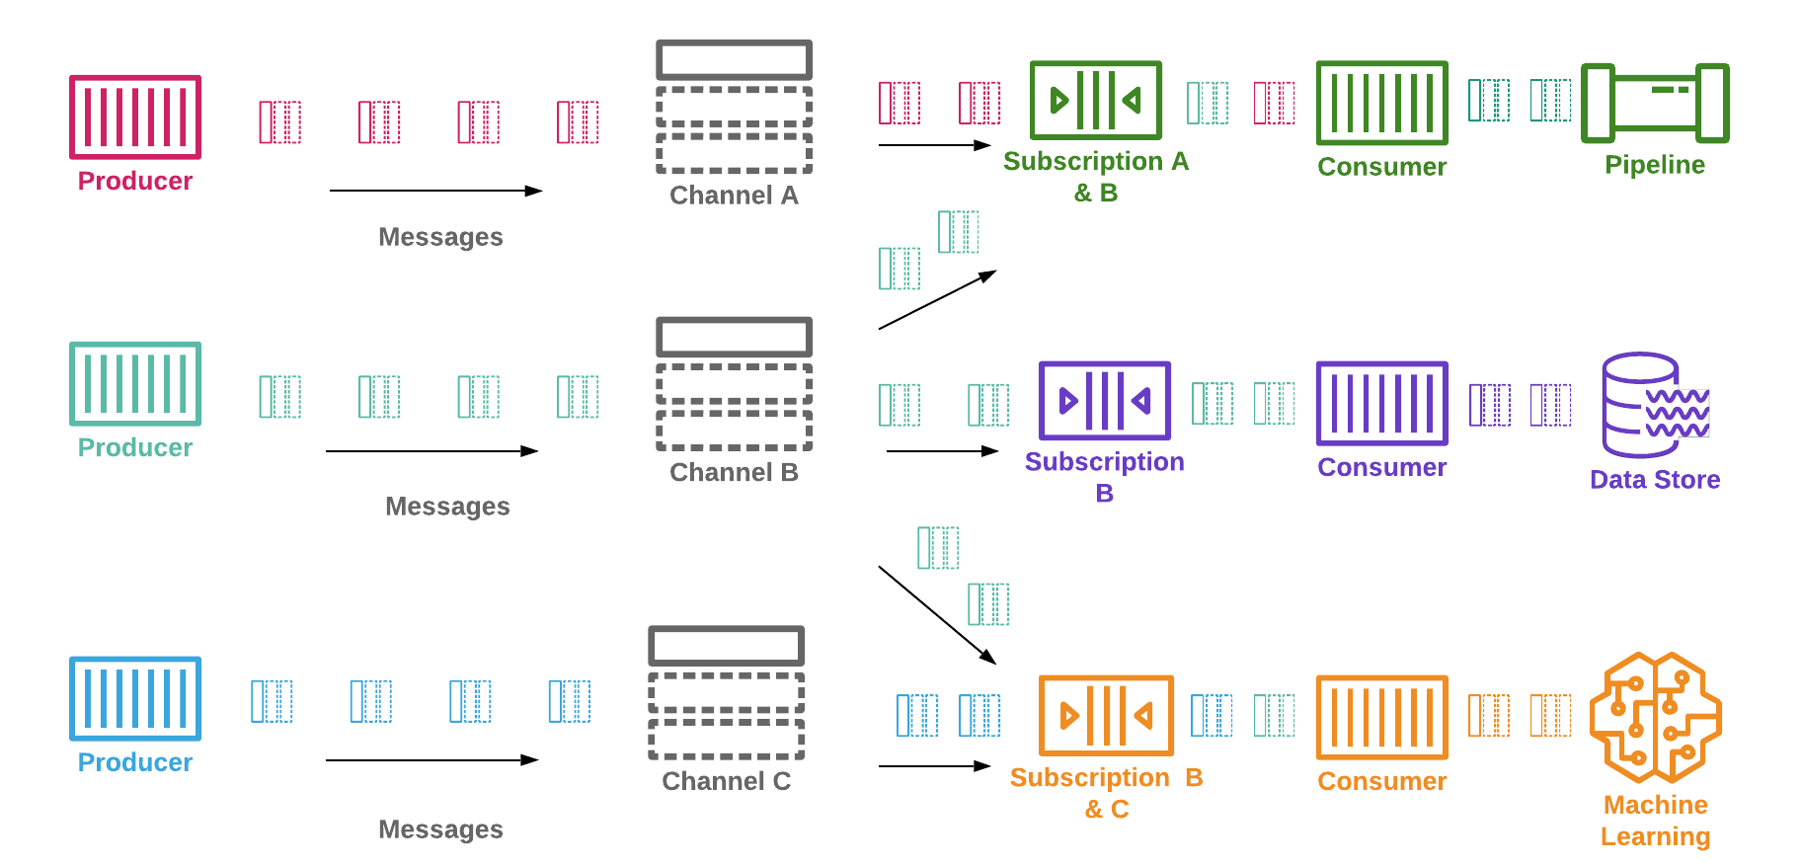
Stream Messages Processing

Slide 8
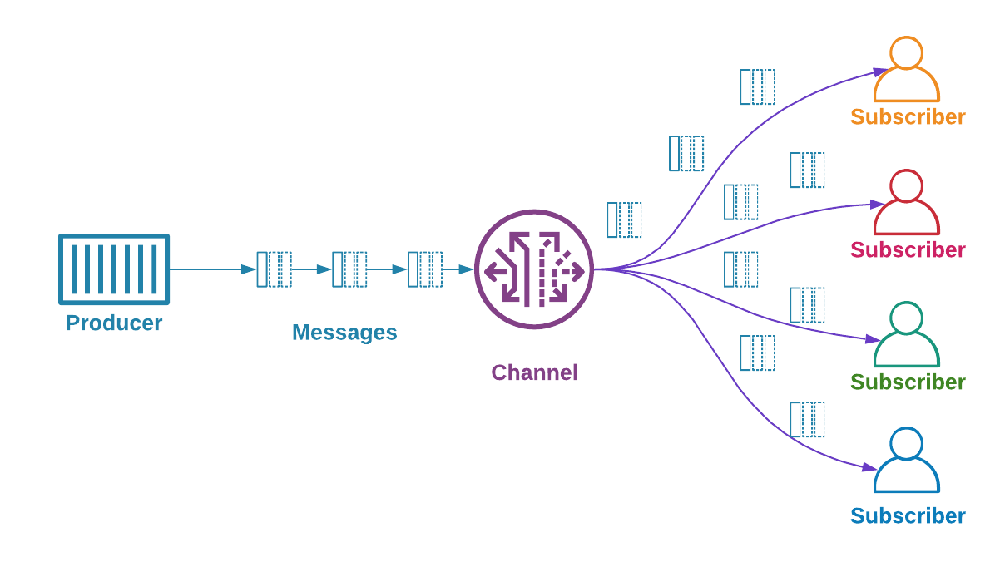
Pub/Sub Realtime Messaging

Slide 9
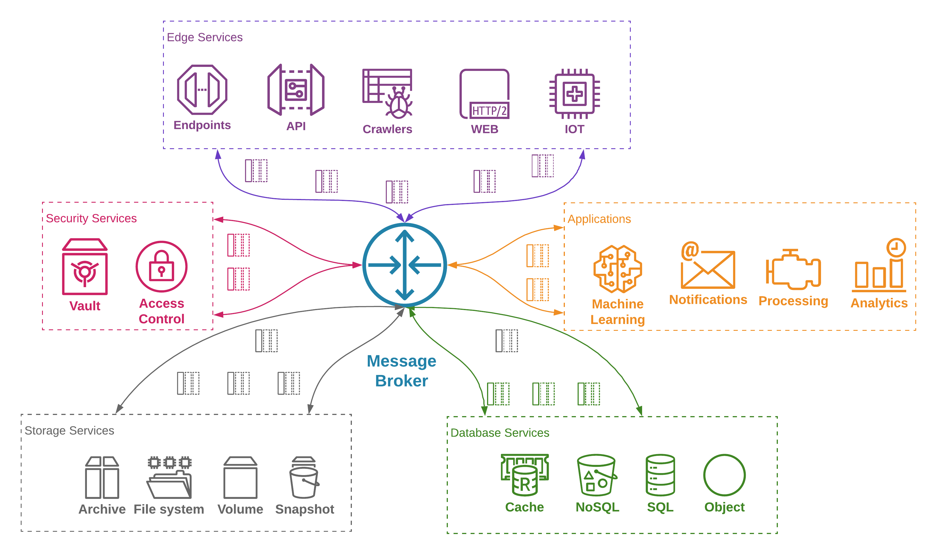
Application decoupling / Microservices

Slide 10
Let’s stream Prices !!

Slide 11
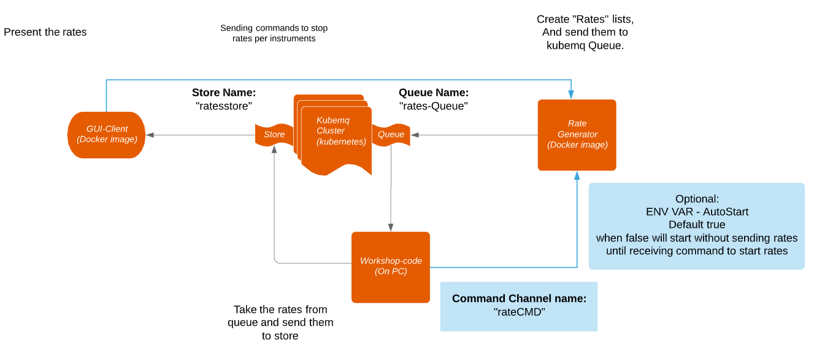
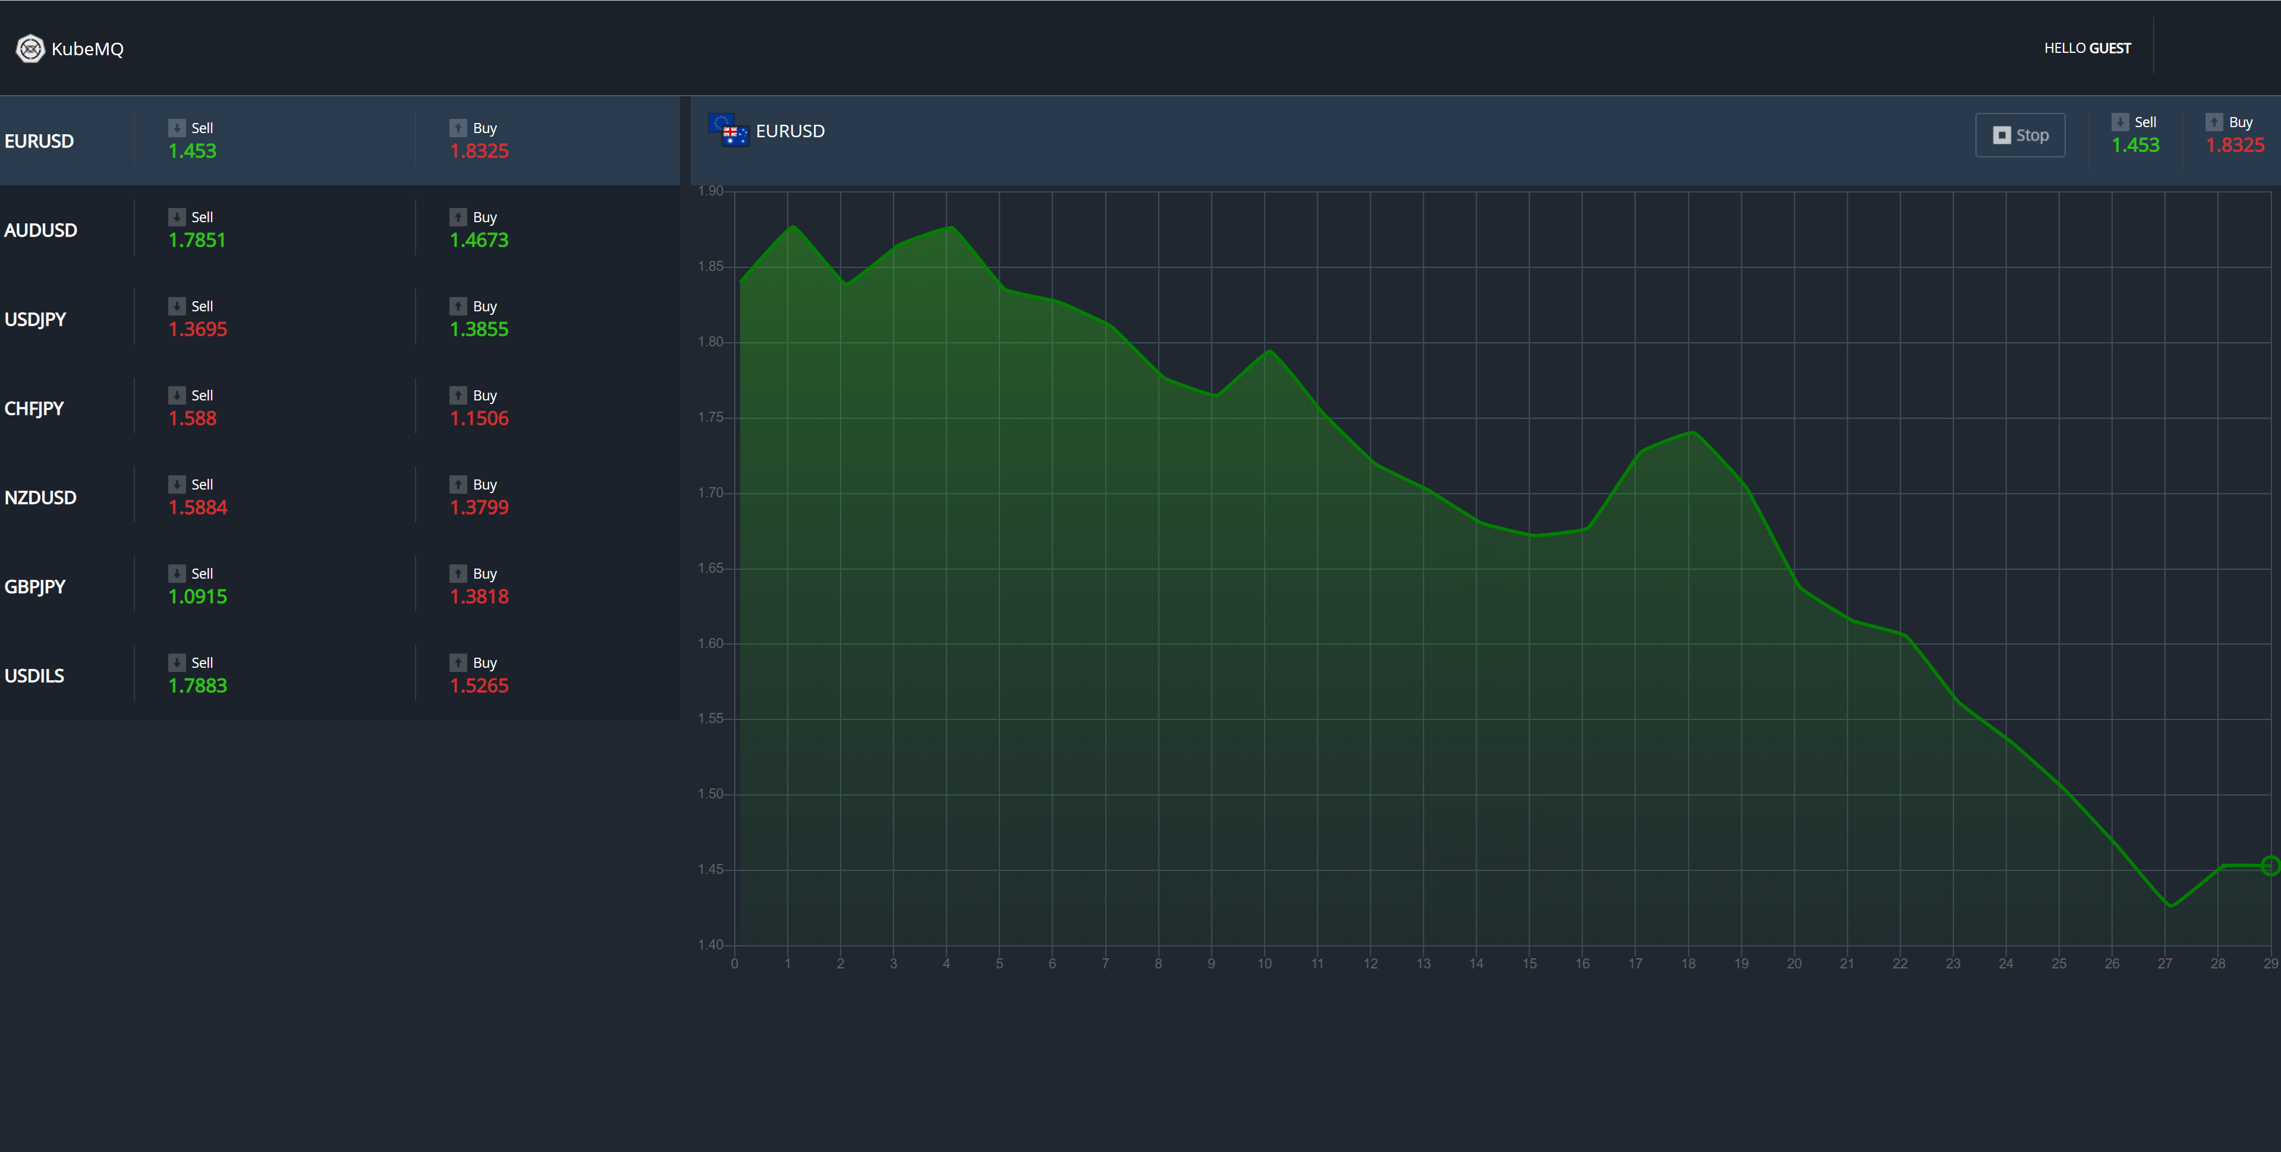
You Build This !

Slide 12
The Setup
Kubernetes Cluster
KubeMQ – Message Queue Broker
Rate Source Container
Web Client Container
Your app running on your laptop
Notes:
1. All run on a docker-compose
2. Describe all components,
3. Open kibana
4. Open Slack
5. Put Monitors

Slide 13
Step 1 - Deploy setup yaml file to kubemq namespace
kubectl apply -f ./deploy/kubemq.yaml
Notes:
1. All run on a docker-compose
2. Describe all components,
3. Open kibana
4. Open Slack
5. Put Monitors

Slide 14
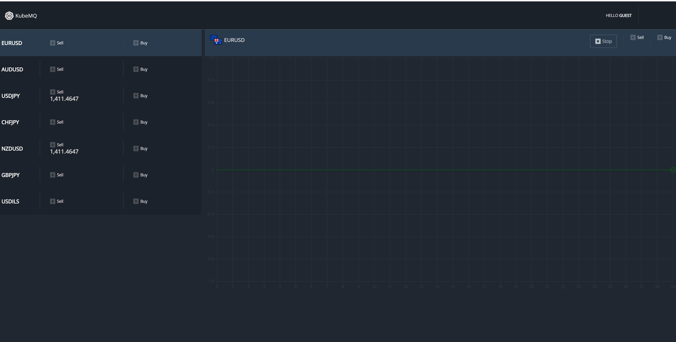
Step 2 - Verify proper installation
λ kubemqctl cluster get Getting KubeMQ Cluster List... Current Kubernetes cluster context connection: kind-kind NAME DESIRED RUNNING READY IMAGE AGE SERVICES kubemq/kubemq-cluster 3 3 3 kubemq/kubemq:v2.0.0 51m31s ClusterIP 10.96.241.62:5228, ClusterIP 10.96.125.94:8080, ClusterIP 10.96.203.116:50000, ClusterIP 10.96.84.253:9090
Browse to:
Localhost:31000
Notes:
1. All run on a docker-compose
2. Describe all components,
3. Open kibana
4. Open Slack
5. Put Monitors

Slide 15
Step 3 - Proxy KubeMQ Ports
λ kubemqctl cluster proxy Current Kubernetes cluster context connection: docker-for-desktop ? Select KubeMQ cluster to Proxy kubemq/kubemq-cluster Current Kubernetes cluster context connection: docker-for-desktop Connecting To Kuberenets Cluster... Ok. Start proxy for kubemq/kubemq-cluster-2. press CTRL C to close. Kubemq/Kubemq-Cluster-2:8080 -> 127.0.0.1:8080 Kubemq/Kubemq-Cluster-2:9090 -> 127.0.0.1:9090 Kubemq/Kubemq-Cluster-2:50000 -> 127.0.0.1:50000
Notes:
1. All run on a docker-compose
2. Describe all components,
3. Open kibana
4. Open Slack
5. Put Monitors

Slide 16
Let’s Build…

Slide 17

General Feature List

Slide 18
Kubernetes Native
Deployed as Statefulset cluster within seconds
Small Docker container - ~30M
Scales instantly
With or without Persisted Volume
All nodes are active and serve traffic
Raft protocol cluster management
Expose Health and readiness
Observability Support
Prometheus
Jeager
Zipkin
AWS X-Ray
Datadog
Google Stack Driver
HoneyComb

Slide 19
Zero Configuration
No need to configure
Topics
Exchanges
Partitions
Queues
Send message and forget
Subscribe to channel and get messages

Slide 20
Authentication and Authorization
Interfaces
gRPC
REST
TLS authentication support
REST CORS setting support
ACL – Access Control List support
Configuration of buffers and payload size for all interfaces

Slide 21




VISIT US AT: www.kubemq.io
CONTACT US AT: info@kubemq.io
Thank you
KubeMQ is an enterprise grade message broker for Kubernetes

