Slide 1
Pop The Letters[Game]
Made by-
Kuber Dhure 19203A0056
Vinay savla 19203A0016

Slide 2
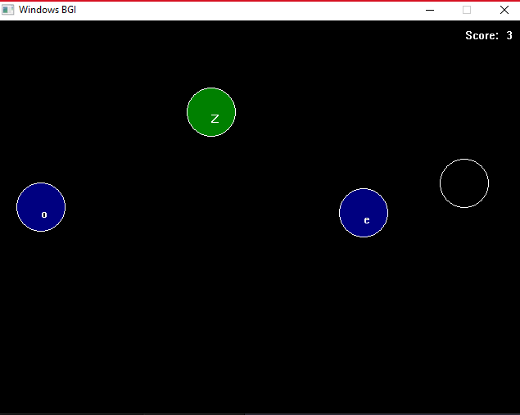
Introduction
This game is developed to improve the typing skill.
In this game a random number of bubbles are generated with unique letters.
Then the user has to press the displayed key on the keyboard and if the key is matched then user will get points.

Slide 3
Methods
Initgraph
circle
getmaxx
Itoa
Outtextxy
Setfillstyle
Kbhit
floodfill
Cleardevice
closegraph

Slide 4

Software used
Vs code
Colorado university cs1300 C compiler
BGI graphics library (included in above compiler)

Slide 5
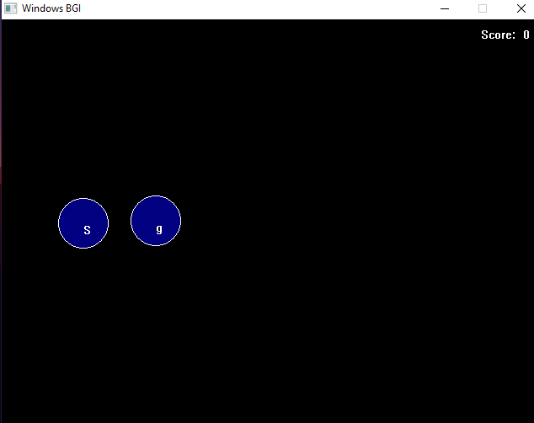
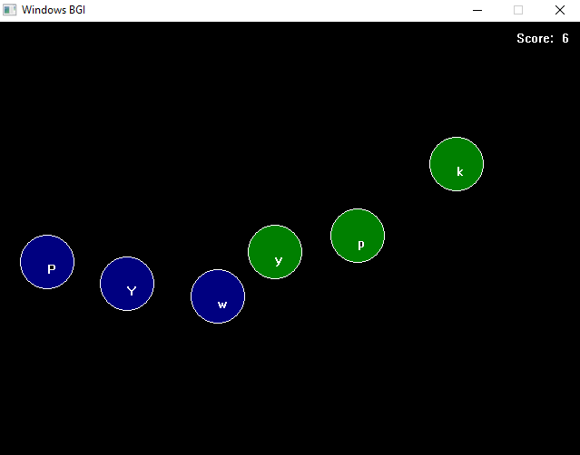
Output

Slide 6

Conclusion
This game helps to improve the typing skill of the user.
It helps to improve hand-eye co-ordination and accuracy while typing.
Also it is a fun game🎮

Slide 7
THANK YOU

