Slide 1
openSUSE Kubic
The Container Platform by openSUSE
https://kubic.opensuse.org
Sarah Julia Kriesch
sarah.kriesch@opensuse.org

Slide 2
Agenda
About me
The openSUSE project
openSUSE Kubic
Features
Transactional Updates
openSUSE Leap and Kubic
Podman
How to contribute

Slide 3
About me
Student in Computer Science (B.Sc.), TH Nürnberg
Student Representative in Senate/ University Council
Student Representative in AG Study Plan, AG Laboratories
Founder AG Open Source (Educator + Trainer), TH Nürnberg
Global Translation Coordinator, QA, Wiki, Advocate (openSUSE) at openSUSE
Chairman at One Week Experience e.V. (One Week Student)

Slide 4












Slide 5
openSUSE Kubic project
Container as a Service Platform
MicroOS, based on openSUSE Tumbleweed
Provides all to run a Kubernetes cluster

Slide 6
Features
Transactional Updates
Fully automated updates possible
Latest packages with openSUSE Tumbleweed
Based on Podman
Easy to use for people with other container knowledge (e.g Docker)

Slide 7
Transactional Updates
Is Atomic:
  Fully applied or not at all
  Update does not influence the running system
Can be rolled back:
  A failed or incompatible update can be discarded and the previous system can be restored

Slide 8
Requirements
BtrFS root filesystem with snapper (snapshots)/
rollback enabled
zypper
btrfsprogs

Slide 9
Snapshots vs. Transactional Updates
current root
ro
ro
ro
ro
ro
ro
ro
ro
current root

Slide 10
Transactional Update
Clone of current root to ro
Change rw
zypper up
Change to ro
“Rollforward” with btrfs subvol set-default
After reboot change / update executed
Quickly rollback

Slide 11
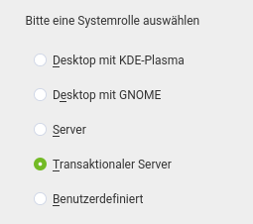
Executing Transactional Updates
Update/Upgrade: transactional-update [up|dup|patch]
Installation/ Remove / Update 1 package:
transactional-update pkg [install|remove|update] pkg
Rollback:
transactional-update rollback

Slide 12
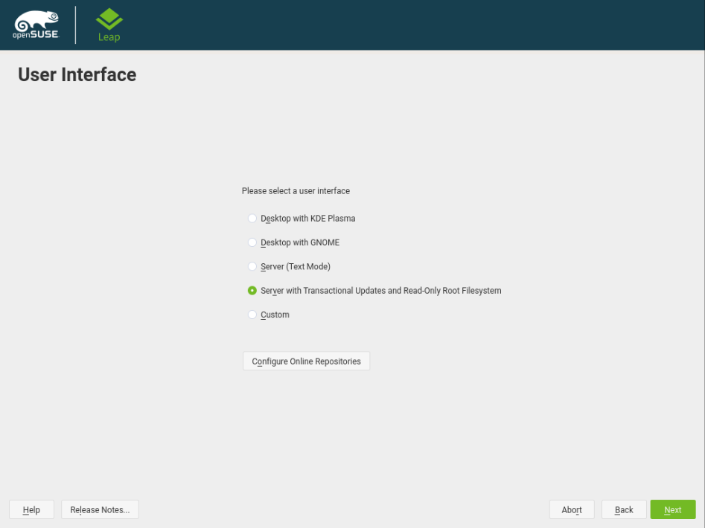
How does Leap profit from Kubic?
Transactional Updates available in Tumbleweed and Leap

Slide 13
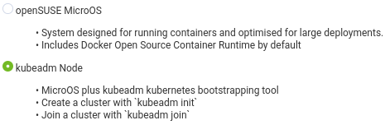
kubeadm
toolkit produced by Kubernetes
Creation of kubeadm nodes for a cluster
Initialization of the network and joining a node:
kubeadm init –pod-network-cidr=10.244.0.0/16
kubeadm join

Slide 14
kubicctl
Adding Worker Nodes:
  kubicctl node add node1,node2,…
Verifying the cluster:
  kubectl get nodes

Slide 15

Verification of the cluster

Slide 16
Kubic Node Roles
Kubic Admin Node:
  kubicd
  (daemon which communicates via gRPC with clients and setup of Kubernetes network)
  salt-master (for node management via Dashboard)
  Kubernetes Master Node
Kubic Loadbalancer Node:
  MicroOS without container runtime
  haproxy installed
Additional Kubic Node:
  Additional Master for HA
  Worker Node

Slide 17
Podman
Container runtime for running OCI containers
Same commands as docker
Daemonless and rootless containers possible
Container Manager as docker-compose
Sharing of one network namespace
Compatible with multiple image formats including the OCI and Docker image formats

Slide 18
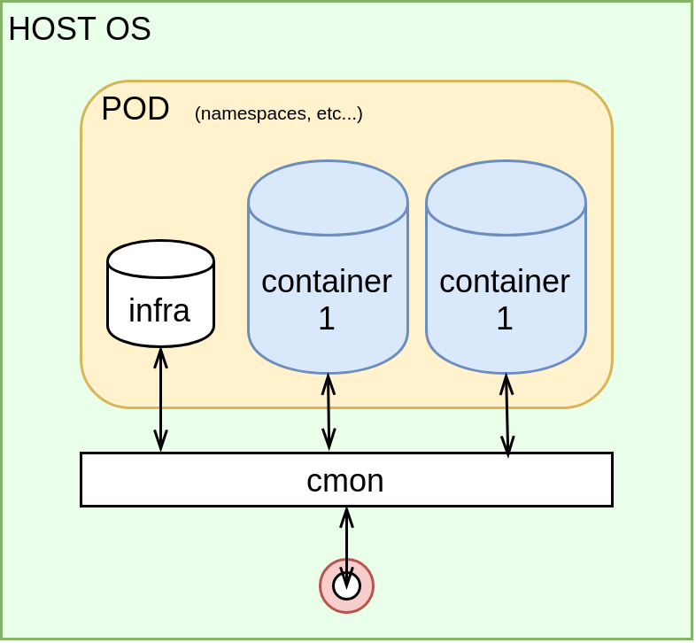
Pods
1 Kubernetes pod in 1 Linux namespace and the same cgroup
Flexible combinations of services possible (webserver, github pull, database, ...)

Slide 19
Daemonless
Docker daemon is (mostly) executed by root
Podman is working without central daemon
Additional process conmon is monitoring and gives correct start parameters for the container runtime

Slide 20
Rootless
Start of a container without root privileges
Mapping of the UID in the namespace
Using root in a container possible (isolating root)
User in the container has default access on host system
Docker offers that since version 19.03

Slide 21
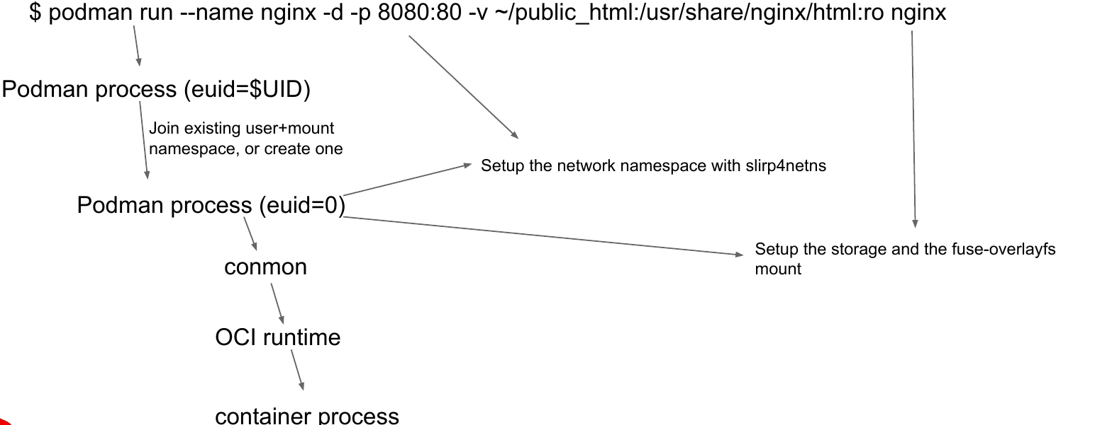
Example of a rootless podman process

Slide 22
Podman commands – as docker
podman run
podman exec
podman info
podman logs
podman ps
podman cp
podman rm
podman poll
podman push
podman build
podman image
podman images
podman commit
podman history
podman stop
podman start
podman volume

Slide 23
Podman (only) commands
podman generate kube
podman container cleanup
podman container exists
podman container restore
podman image exists
podman pod create
podman pod kill
podman pod ps
podman pod pause
podman pod restart

Slide 24
“Do you wonna become a Contributor?”

Slide 25
Packaging
Creation of packages with the Open Build Service
Submit to openSUSE Factory
  > openSUSE Tumbleweed
https://build.opensuse.org/project/show/devel:kubic

Slide 26
Development of openSUSE Kubic
Github contributions:
  https://github.com/kubic-project

Slide 27
Quality Assurance
Test it!
Try it!
Perform it!
Report bugs!
Bugzilla: https://bugzilla.opensuse.org/buglist.cgi?component=Kubic&product=openSUSE%20Tumbleweed

Slide 28
References
openSUSE Kubic:
https://kubic.opensuse.org
https://www.projectatomic.io
Podman:https://jaxenter.de/docker/podman-container-daemonless-rootless-89349
Podman Usage: https://github.com/containers/libpod/blob/master/transfer.md

Slide 29
References
openSUSE Kubic:
https://kubic.opensuse.org
Podman:https://jaxenter.de/docker/podman-container-daemonless-rootless-89349
Podman Usage: https://github.com/containers/libpod/blob/master/transfer.md

Slide 30
Questions?

Slide 31
openSUSE Summit 2020
Dublin
May 27 – 28, 2020 https://events.opensuse.org

Slide 32
Join our conference,
contribute & have a lot of fun!
events.opensuse.org

Slide 34
License
This slide deck is licensed under the Creative Commons Attribution-ShareAlike 4.0 International license. It can be shared and adapted for any purpose (even commercially) as long as Attribution is given and any derivative work is distributed under the same license.
Details can be found at https://creativecommons.org/licenses/by-sa/4.0/
Credits
Template
Richard Brown
rbrown@opensuse.org
Design & Inspiration
openSUSE Design Team
http://opensuse.github.io/branding-guidelines/

