Slide 1
Software engineering applied in Internet of Things
Course introduction
Project setup

Slide 2
Who we are?
Adam Kamizelich
Wrocław University of Technology graduate
Senior Software Engineer
at Viessmann since 2014
Adam Zięty
Wrocław University of Technology graduate
Senior Software Engineer
at Viessmann since 2012

Slide 3
Agenda
Viessmann R&D Center Introduction
Our Goal
Git Essentials
Setting up the solution

Slide 4
Viessmann R&D Center Introduction

Slide 5
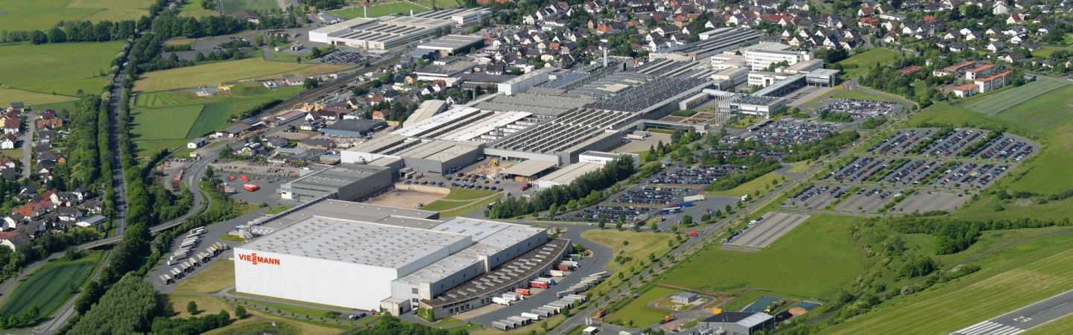
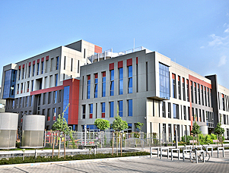

Viessmann R&D Center
Headquarters in Allendorf, Germany
R&D Center established in 2012
Nearly 80 people working in 3 departments
Business&Mobile Solutions
Embedded Solutions
Quality Assurance
Full stack development: from embedded electronics, through distributed, cloud based platforms to mobile and web client applications
http://www.viessmann.pl
http://www.technologpark.pl/pl/delta

Slide 6
















Business&Mobile Solutions
Telemetry
Analysis
Remote Control

Slide 7
Our Goal

Slide 8
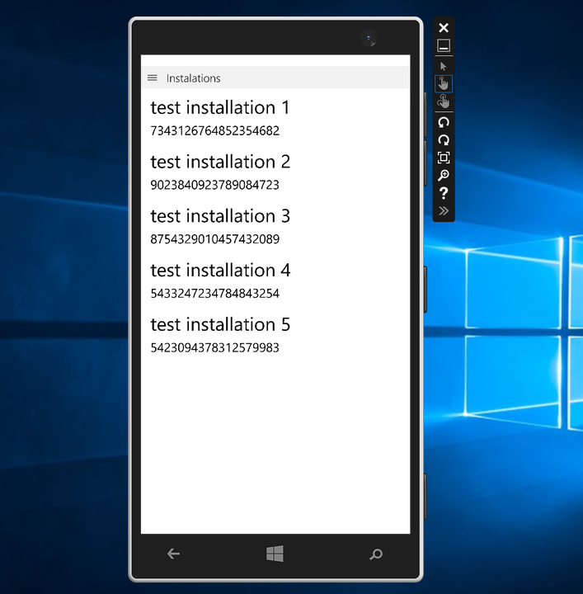
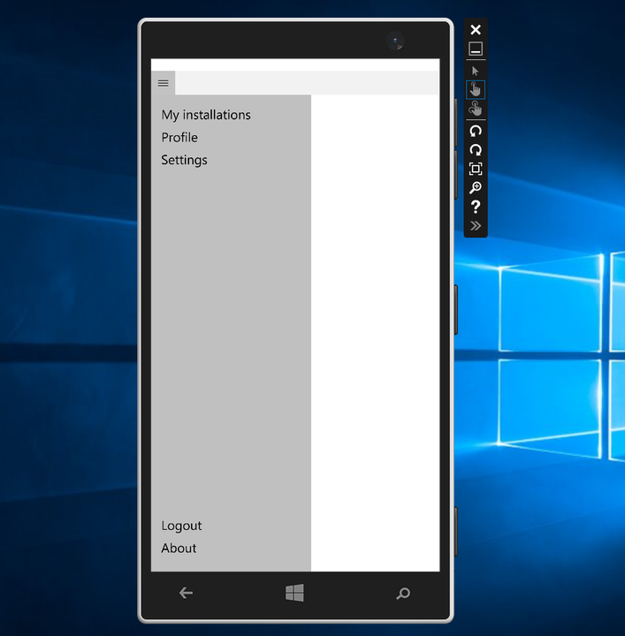
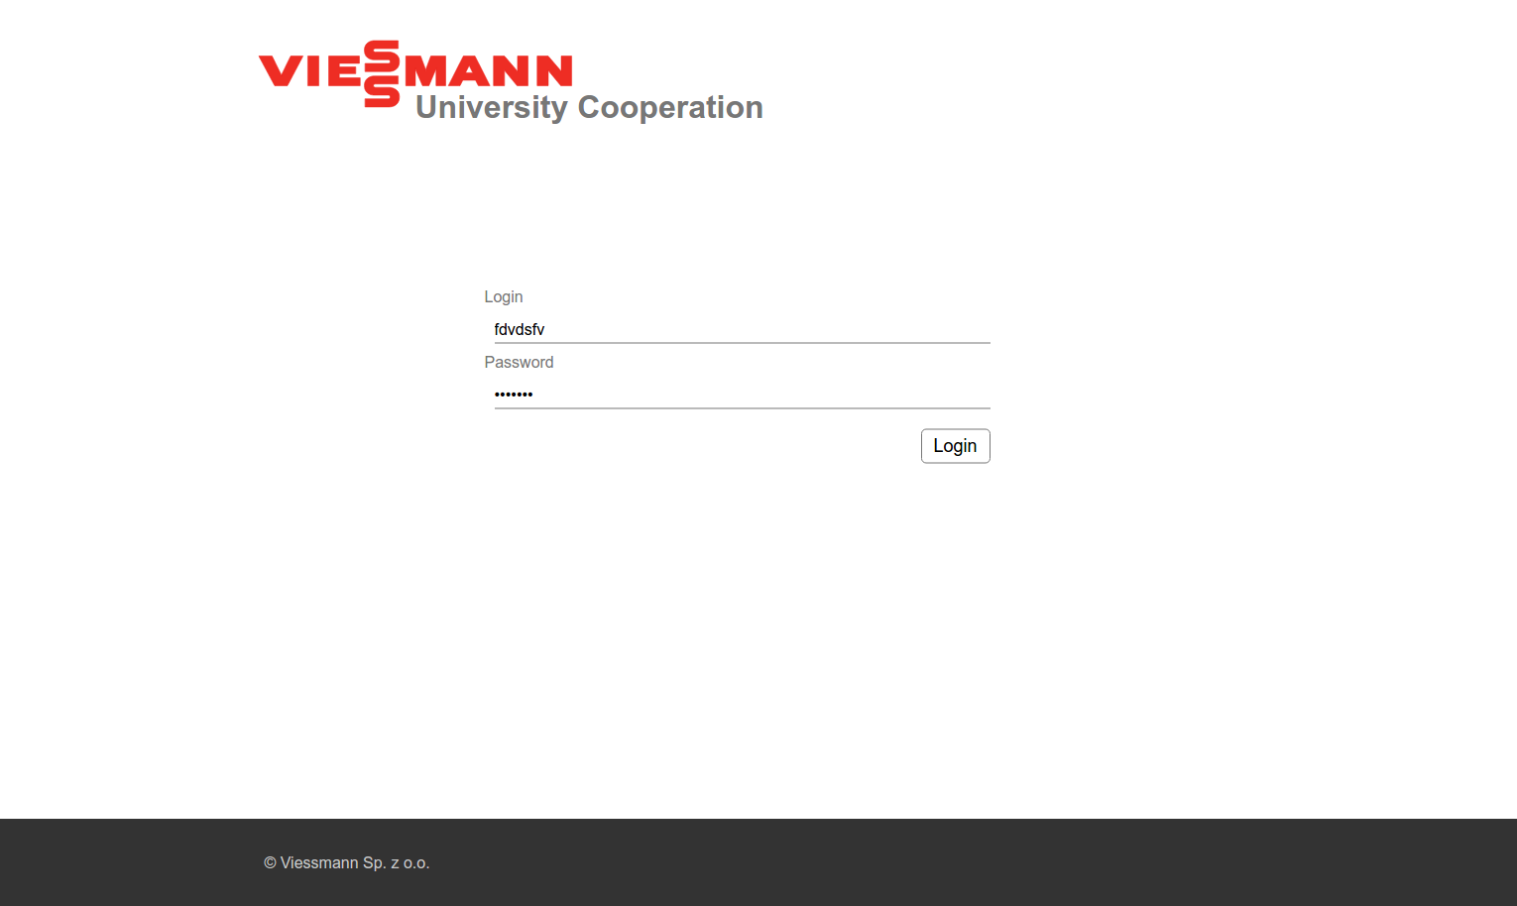
Requirements
Easily scalable system to remotely control users device
Ability to connect to devices with desktop and web application
Enable system access only to authenticated users

Slide 9
System Architecture
Xamarin App
Web App
REST
Users Service
Gateways Service
Gateway

Slide 10
Git Essentials

Slide 11
In few words
Created by Linus Torvalds for Linux kernel source code
Fast beast
Much faster than other VCS
Optimized to handle huge code repos
Undoable
Almost everything can be undone
Powerful
Lot of helpers
Lot of ways to do the same thing (e.g. fix something)
Can handle big repos

Slide 12
Distributed not centralized
Distributed Version Control System (DVCS)
Local clone of project
Full history of changes locally
More crash resistant due to local copy
Faster because of local copy
Bad for binary files

Slide 13
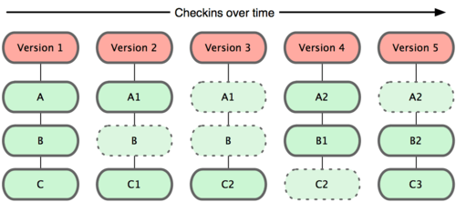
Working directory - snapshots
The way how GIT stores changes
Snapshots
Only changes

Slide 14
Basic console commands
git push origin branch_name
Committed
git commit -m "[KEY-xxx] Message”
Staged (indexed)
git reset <path>
git add .
git add . -A
Modified
git add .
Untracked

Slide 15
Checkout & pointers
Branch-1
Branch-2
git checkout develop
HEAD
develop
Branch-3

Slide 16
Stashing
stash
[0]
[1]
Branch-1
Branch-2
git stash pop
git stash
HEAD
develop
Branch-3

Slide 17
Standard merge
HEAD
NG-100
NG-100
B
Moving NG-100 branch fast-forward
git checkout –b NG-100
git merge NG-100
git merge develop
git checkout develop
develop
A
C

Slide 18
Merge & Rebase
HEAD
NG-100
git checkout –b NG-100
git rebase develop
develop

Slide 19
Simple daily GIT flow
Simple flow (develop)
git pull origin develop
git checkout -b NG-100
..... changes .....
git add . git add . –A git gui
git commit -m "[NG-100][Fix] This is a fix"
git checkout develop
git pull origin develop
git checkout NG-100
git rebase develop git merge develop
git checkout develop
git merge NG-100
git push origin develop

Slide 20
Setting up the solution

Slide 21
Key Features
Setting up the solution and folders structure
Project configurations and configuration file transformations
Static code analysis

Slide 22
Dziękujemy.

