Slide 1
Development and best practices approach
SOLID introduction
Unit testing

Slide 2
Who we are?
Piotr Martyński
Opole University of Technology graduate
Senior Software Engineer
at Viessmann since 2015
Adam Zięty
Wrocław University of Technology graduate
Senior Software Engineer
at Viessmann since 2012

Slide 3
Agenda
Best practice in software development
Unit testing and Test Driven Development

Slide 4
Best Practices in Software Development

Slide 5
SOLID principles
S
Single Responsibility Principle
O
Open-Closed Principle
L
Liskov Substitution Principle
I
Interface Segregation Principle
D
Dependency Inversion Principle

Slide 6
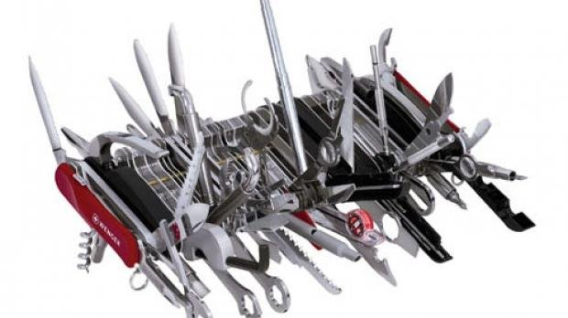
Single Responsibility Principle
www.intertech.com
There should never be more than one reason for a class to change.

Slide 7

Open-Closed Principle
www.vikingcodeschool.com
Software entities should be open for extension, but closed for modification

Slide 8

Liskov Substitution Principle
www.f7dobry.pl
Objects in a program should be replaceable with instances of their subtypes without altering the correctness of the program

Slide 9
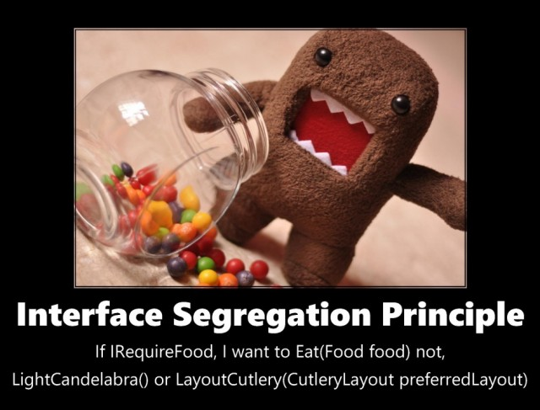
Interface Segregation Principle
www.zeroturnaround.com
Many client-specific interfaces are better than one general-purpose interface

Slide 10
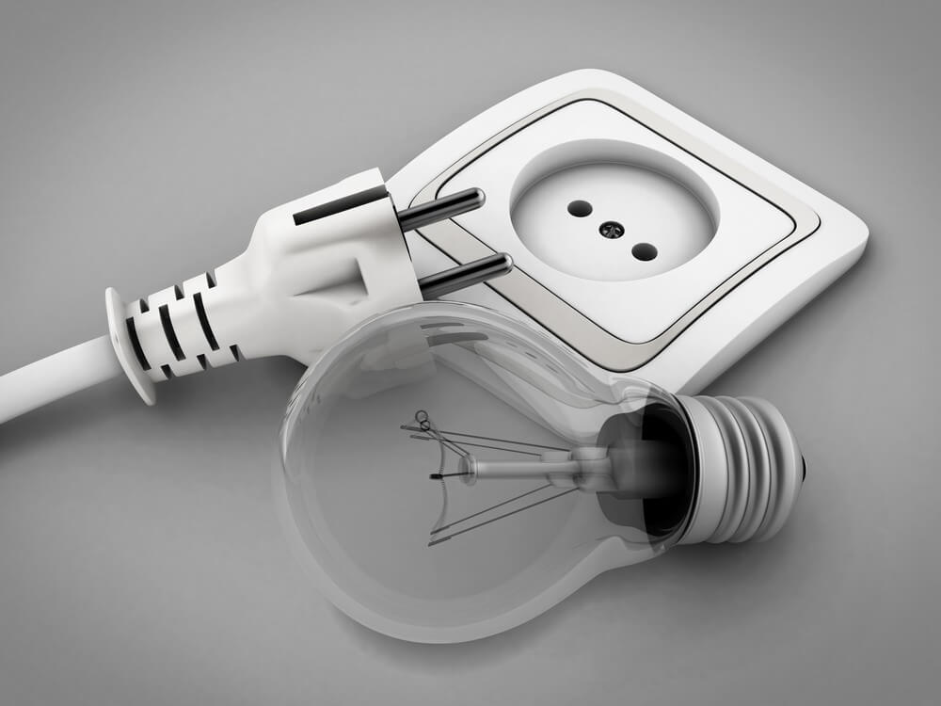
Dependency Inversion Principle
www.automatetheplanet.com
High-level modules should not depend upon low-level modules; they should depend on abstractions.

Slide 11
Best practices applied
DRY
Do not repeat yourself
YAGNI
You ain’t gonna need it
Keep it simple stupid (and short || and straight)
KISS

Slide 12
Unit testing and Test Driven Development

Slide 13
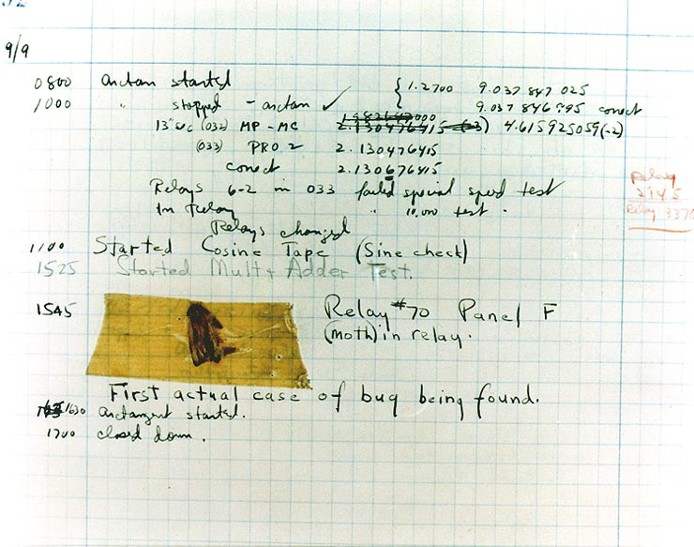
Why should I test my software anyway?
https://commons.wikimedia.org

Slide 14
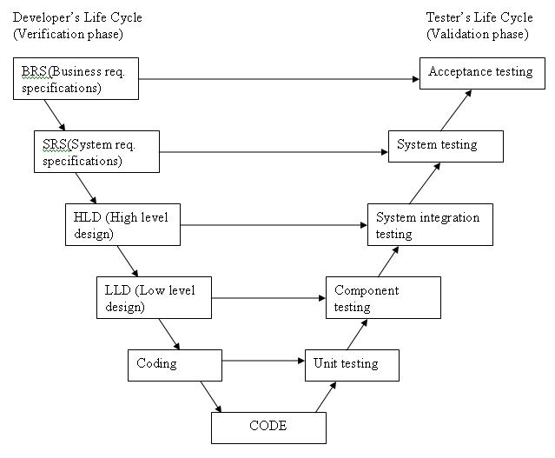
Software tests classification
http://istqbexamcertification.com/

Slide 15
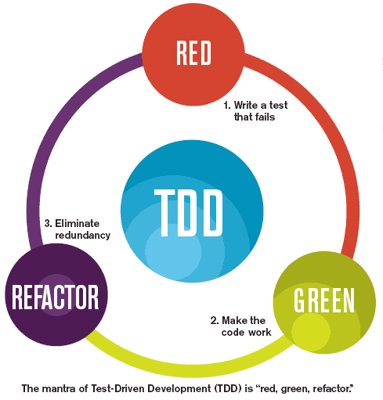
Test Driven Development
http://luizricardo.org/

Slide 16
TDD side effects
Pros:
easier functional requirement verification
runnable specification
prevents from defects in earlier stages
forces using good practices
Cons:
hard to begin
lower efficiency in the beggining
can be tricky for unexperienced developers

Slide 17
Perfect test characteristics
should run fast
should run in isolation
should use realistic data
should test only one requirement
should have readable and meaning name

Slide 18
Frequent errors in test design
test doesn’t check anything
test checks more than one requirement
test is not refactored
test uses shared state with other tests
unit test uses real dependency instead of mock
unit tests mixed with component/integration tests
test case name doesn’t express what is it checking

Slide 19
How to write well designed tests
use Arrange-Act-Assert pattern (Given-When-Then in BDD nomenclature)
make your test maintainable using creational design patterns like:
Factory,
Builder,
Object Mother
remember about good practices when writing your application code, big ball of mud wont be testable at all
use solid, especially Dependency Inversion Principle and Single Responsibility Principle

Slide 20



Test automation tools in .NET Framework

Slide 21
Showcase specification
UserService
GetUser
Should fetch user object by Id from data service
Should throw ObjectNotFoundException when user doesn’t exist
GetAllUsers
Should fetch all users fetched from data service
Should return empty user collection, when no user exists
CreateUser
Should return created user object on success
Should throw validation exception when email or name is empty
Should throw ObjectDuplicationException when user with same email exists
UserDataService
InsertUser
GetUserById
GetAllUsers

Slide 22
Dziękujemy.

