Slide 1
Entity framework

Slide 2
Entity Framework
With ADO.NET you still need to be aware of database schema, manage connections etc.
Object Relational Mapping
Work at a higher level of abstraction as a set of domain objects
Maintain applications with less code than in traditional applications
Multiple data sources
Shipped as nuget package (version 6).

Slide 3
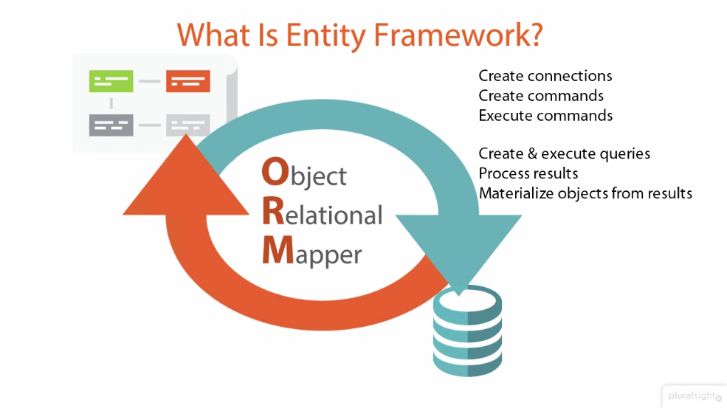

Slide 4
Entity Framework – Features
Change tracking
Lazy loading
Identity Map resolution (caching)
Asynchronous query and save
Connection resiliency
Database command logging
And many more..

Slide 5
Entity Framework – Schema creation approach
Two ways of creating models:
- code (full control of your code)
- emdx (designer, xml files – generates code/in memory model at runtime)

Slide 6
Entity Framework – Schema creation approach
Database first
Model first
Code first
How to decide

Slide 7
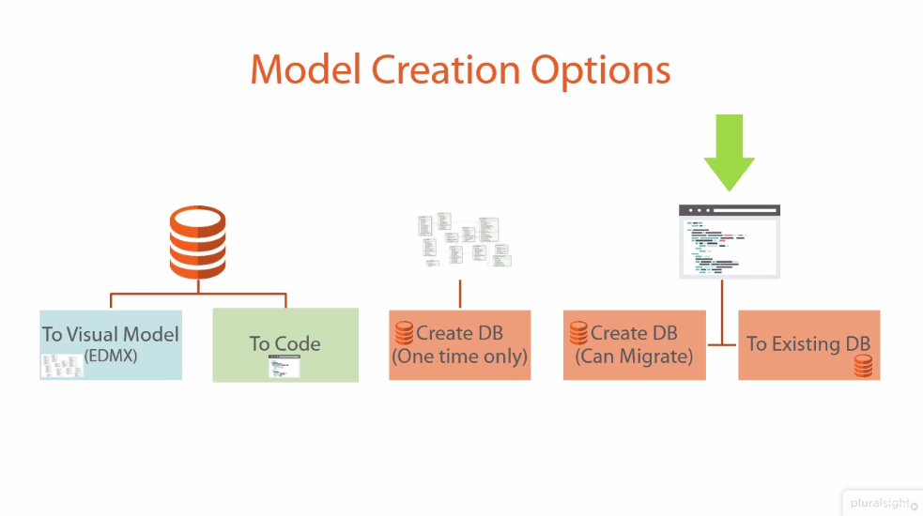

Slide 8
Entity Framework – Migrations
Automated
Enable-migrations command run in PMC
Creates Configuration class
Sets AutomaticMigrationsEnabled to true
Set MigrateDatabaseToLatestVersion DB Initializer
In case of data schema change, set AutomaticMigrationDataLossAllowed to true
Code-based
You have more control
Manually create migration using Add-Migration command
Apply changes to the DB with Update-database command

Slide 9
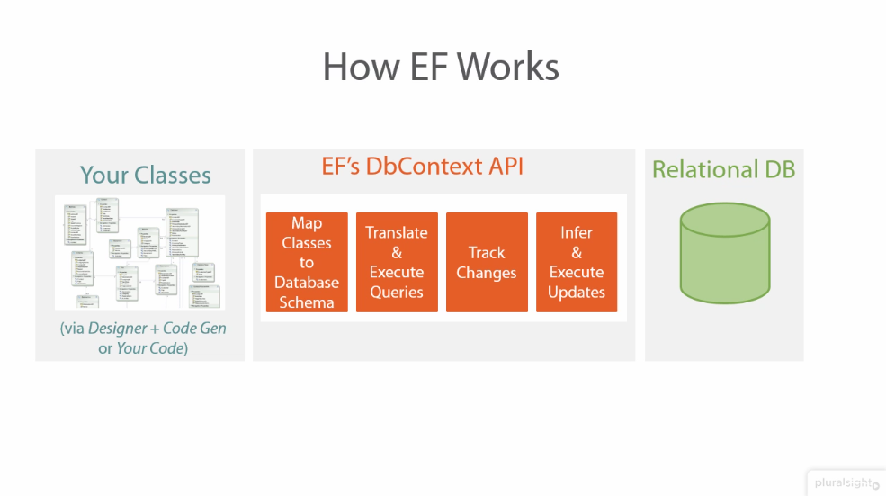
DbContext
TODO

Slide 10

DbSet
DbContext
implementation of UoW pattern
abstraction of single Database
implementation of Repository pattern
abstraction of single Table
Notes:
Tworzę ConsoleApp
Klasa Gateway z dwoma Propercjami Id i Serial
Ściągam EF z Nuget-a (pokazuję że dodały się referencje i wpisy do App.config)
Dodaję połączenie do App.config: <add name="MainDbContext" connectionString="Data Source=.\sqlexpress;Initial Catalog=UniversityIot;Integrated Security=True" providerName="System.Data.SqlClient" />
Tworzę DbContext i DbSet
Robię „Enable-Migrations”:
- dodany folder Migrations i plik Configurations
Robię „Add-Migration Initial”:
plik migracji
język definiowania migracji (dodaję index po Serial i robie Serial NotNullable)
„Update-Database –Verbose”
- output z konsoli
- tabela dbo.Gateways
- tabela _Migrations
9. Dodaję dwa Gateway-e do bazy
10. Piszę w Main przykład jak pobrać je z bazy
11. Dodaję klasę Datapoint i kolekcję do Gateway
- robię Add-Migration i pokazuję, że stworzyła się relacja 1 do wielu
- robię Update-Database –Verbose – pokazuję tabelę Datapoint

Slide 11
Entity Framework – Mapping configuration
Using conventions
Default rules
Can be overriden
DataAnnotation
By using attributes
(Key, ForeignKey, Reguired, MaxLength, NotMapped ...)
Fluent API
More expressive than others
They can be used at the same time.

Slide 12
Entity Framework – Conventions
Default Convention For | Description
Table Name | Creates DB table with entity class name suffixed by 's'
Primary key Name | Creates primary key column for the property named Id or <Entity Class Name> + "Id" (case insensitive)
Foreign key property Name | By default EF will look for foreign key property with the same name as principal entity primary key name. If foreign key property does not exists then EF will create FK column in Db table with <Dependent Navigation Property Name> + "_" + <Principal Entity Primary Key Property Name> e.g. EF will create Standard_StandardId foreign key column into Students table if Student entity does not contain foreignkey property for Standard where Standard contains StandardId
Null column | Creates null column for all reference type and nullable primitive properties.
Not Null Column | Creates NotNull columns for PrimaryKey and non-nullable value type properties.
DB Columns order | Creates columns same as order of properties in an entity class. However, primary key columns would be moved first.
Properties mapping to DB | By default all properties will map to database. Use [NotMapped] attribute to exclude property or class from DB mapping.
Cascade delete | Enabled By default for all types of relationships.
Notes:
Tworzę klasę Datapoint2, i mapuję ją na tabelę SpecialDatapoints (Table)
Dodaję propercję MainKey i oznaczam ją jako (Key)
Robię HexAdress mapuję na Adress (Column) i oznaczam jako Required
Dodaję propercję Description jako NotMapped
Dodaję IDbSet<Datapoint2> do Context
Dodaję OnModelCreating i modelBuilder.Entity<Datapoint2>().Property(x => x.HexAdress).MaxLength(20);
Dodaję migrację i pokazuję efekt

Slide 13
Loading data
IDbSet is IQueryable
LINQ to Entities (translated to SQL)
Method Find() – will not call db when entity is already in context
Stored procedures / SQL (not a good idea...)

Slide 14
Adding
Every Add generates one Insert and one Select statement (to get Id)

Slide 15
Updating
EntityFramework recognizes changes, and updates only relevant fields

Slide 16
Deleting

Slide 17
Entity Framework – Loading related entities
Eager loading
Lazy loading
Property must be virtual
Configuration.LazyLoadingEnabled and ProxyCreationEnabled property must be true
Explicit loading
Context.Entry(obj).Reference(p => p.prop).Load()
Context.Entry(obj).Collection => p.prop).Load()
Can apply filters on related entity by using Query method.

Slide 18
Entity Framework – Async support
Free up current thread (gets back to thread pool)
Make use of IO completion ports for external work (e.g. while database processing)
Benefits
Used for many concurrent calls to db improves overall time
Might improve scalability in certain scenarios
Drawbacks
Might hit the performance when executing single query.

Slide 19
Materiały
https://msdn.microsoft.com/pl-pl/library/ms254937(v=vs.110).aspx
https://app.pluralsight.com/library/courses/entity-framework-6-getting-started/table-of-contents

