Slide 1
Invent Analytics
Promotion Bump Assignment

Slide 2
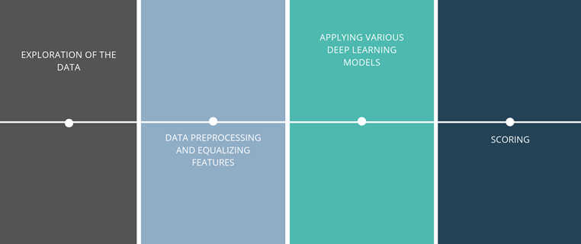
Process timeline

Slide 3
Exploration of the data
An overall analyze of the data
The general structure of the data: Train Set, Test Set, Promotion Dates (fixed)**, Product Groups.
Checking for discrepancies
The data is checked whether is contained a discrepancy or not.
The objective of the project
The case is the prediction of a sales or return count of a product from a store, regression.

Slide 4
Data Preprocessing
Adding more Features
In order to increase the overall efficiency of the project, following features are added:
Day, month, and weekday are added for seasonality purposes.
Product groups are added.
Promotion dates are added as binary variable, explaining the bump during promotions.
Item and store types are added as suggested in the case. (Slow, Medium, or Fast.)
Data Transformations
The Linear and SGD regression models doesn’t accept features as categorical, so I transformed each variable to multiple binary columns.
Not necessary for the CatBoost model.
Checking the relations within stores and items
Using excel, I’ve conducted an analysis explaining the sales during promotions.

Slide 5
IFPromo | 1
StoreType | ProductType | Sum of SalesQuantity | AvgDaily | Change
Fast | Fast | 31,141 | 865 | 0%
Fast | Medium | 20,797 | 578 | 24%
Fast | Slow | 29,495 | 819 | 18%
Medium | Fast | 49,150 | 1,365 | 10%
Medium | Medium | 34,640 | 962 | 21%
Medium | Slow | 53,581 | 1,488 | 17%
Slow | Fast | 53,923 | 1,498 | 12%
Slow | Medium | 35,170 | 977 | 21%
Slow | Slow | 62,830 | 1,745 | 15%
Grand Total |  | 370,727 | 10,298 | 15%

Slide 6
Models applied
GB Decision Tree CatBoost : Best performing model, however not informative as the others.
Linear Regression : Moderate performance, Informative
Stochastic gradient Descent Regression

Slide 7
Scoring
Quality of predictions
Models quality of predictions are evaluated. Decision tree gave better results, however computing power is large.
Metrics
RMSE used during training but MAE should be used during validation.
RMSE
MAE

Slide 8
Future Improvements
Different models for different types of products or stores or different model for each store or product
It will increase predictability during promotion days.
Adding national holidays to the data.
So, that we could explain the bumps or diminishes along with the data.
More information about the stores and items
Stock data or availability data of the products will help.
More data could help tracking down the seasonality
Then, using the seasonality we could create multivariate SARIMA models, which is a lot more powerful than Regression models, more efficient than CatBoost models.

Slide 9
Thank you for your attention
Fatih Kubilay Yavuz

