Slide 1
Clever Machines Learn How to Be Curious
Kubilay Agi
UID: 304784519

Slide 2
Curiosity and Reward Systems
Intrinsic Motivation
Internal desire to learn
Ex: learning how to play a new video game
Extrinsic Motivation
Point system
Ex: Salary

Slide 3
Point Systems in Machine Learning
Reward good behavior
“Punish” bad behavior
Repeat

Slide 4
Issues with this Point System
Doesn’t allow for any grey-area for the machine
Everything must be hard coded as a reward or punishment
Not portable
Machine will get lost
Counterproductive for the purpose of machine learning
Requires too much repetition
Ex: Autonomous cars don’t get second chances

Slide 5
Intrinsic Curiosity
Machine explores its environment - greedy
Psychological study says infants prefer toys that are the most surprising

Slide 6
Applications

Slide 7
Intrinsic Curiosity in Machine Learning
Pulkit Agrawal and Deepak Pathak based their machine learning system on this intrinsic curiosity and surprise driven learning
In context of Super Mario Bros:
Develops mathematical representation of game
Predicts what game should look like in a few frames
Intrinsic reward signal based on how wrong the model was
“The higher the error rate — that is, the more surprised it is — the higher the value of its intrinsic reward function.”
Drawn toward unexplored states

Slide 8
Intrinsic Curiosity Models
Nothing is predictable in the real world
Ex: leaves blowing across the ground – image constantly changing
Can’t be modeled as easily as pixels in a game
Solution: Be curious, but not too curious.
Still searching for right balance

Slide 9
Improvements
Abstraction:
The technology translates from individual pixels to general features
Best of both worlds approach:
Combine extrinsic and intrinsic motivation styles to better guide the machine

Slide 10
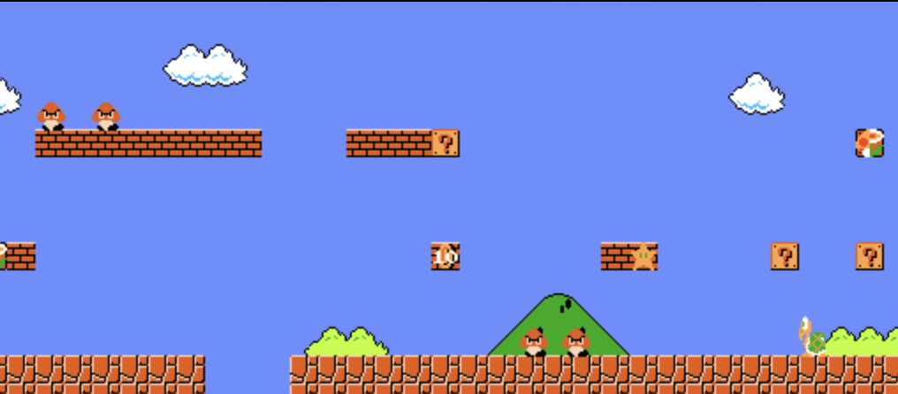
AI’s Arch-Nemesis

Slide 11
Race Conditions
Difficult to emulate human curiosity in machines
Why? Psychological study does not have a formal definition for curiosity, or even a reason why we are curious in the first place.
Offers possibilities of collaboration

Slide 12
A Simple Conclusion
Better, but not perfect (yet)
There is a time and place for everything
A long way still to go

Slide 13
Bibliography
Pavlus, John. Clever Machines Learn How to Be Curious. 19 Sept 2017. Quanta Magazine. https://www.quantamagazine.org/clever-machines-learn-how-to-be-curious-20170919/
Barto, Andrew. Intrinsically Motivated Learning of Hierarchical Collections of Skills. http://www.lira.dist.unige.it/teaching/SINA_08-09/SINA_PREV/library/ICDL2004/pdfs/24.pdf
Baldassarre, Gianluca. Intrinsically Motivated Learning Systems: An Overview. https://link.springer.com/chapter/10.1007/978-3-642-32375-1_1#Sec3

