Slide 1

The Most Suitable Place to Open a Cafe in Istanbul

Slide 2
INTRODUCTION
Opening a cafe in Istanbul might be difficult but deciding to do so is even more difficult. You must have great strategies and come up with great ideas to successfully open your cafe.
While doing so you can count endless challenges, and this project aimes to solve some of these challenges you may encounter.

Slide 3
BUSINESS PROBLEM
There are so many cafes in Istanbul, therefore if you open your cafe in a place full of cafes, you might not be successful.
Likewise, if you open your cafe in a place that has no attraction, you still might fail.
The aim of this project is to show you the best places to open your cafe.

Slide 4
TARGET AUDIANCE
The project aims to reach people who are;
- considering about opening a cafe in Istanbul.
- aiming to find the best place to open a cafe.
- curious about the most popular venues in Istanbul’s boroughs.

Slide 5
DESIRED OUTCOME
The best outcome of this project would be to see;
- The most popular venues in every borough, which are cafes mostly
- The places full of cafes, in order to avoid those places
- The places that have enough attraction, not completely empty
- The best place to open your cafe

Slide 6

DATA ACQUISITION
The sources that are used in this project are:
- atlasbig.com
- geopy client
- Foursquare API

Slide 7
DATA PREPARATION
Boroughs and their information like are acquired from atlasbig.com
Geographic coordination information of the boroughs are acquired from geopy client
Most popular venue categories are acquired from Foursquare API
Maps are created by using Folium library

Slide 8
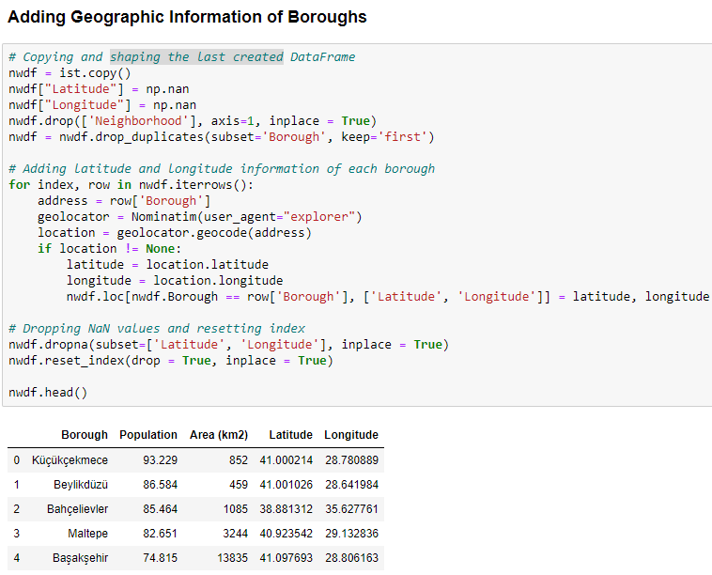
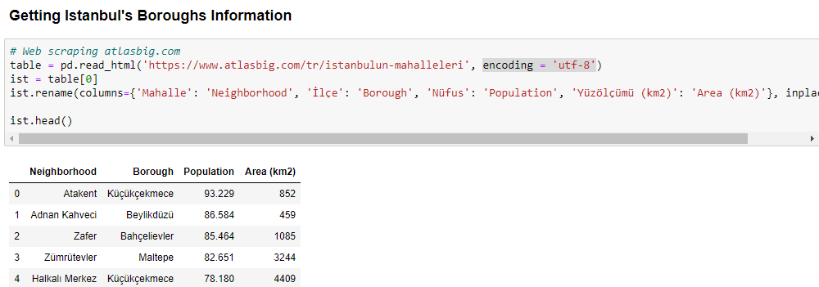
METHODOLOGY
After scaping borough information into a DataFrame from the source web site, each one’s latitude and longitude information and were added to the DataFrame. This far, all processes were made by Python libraries.

Slide 9
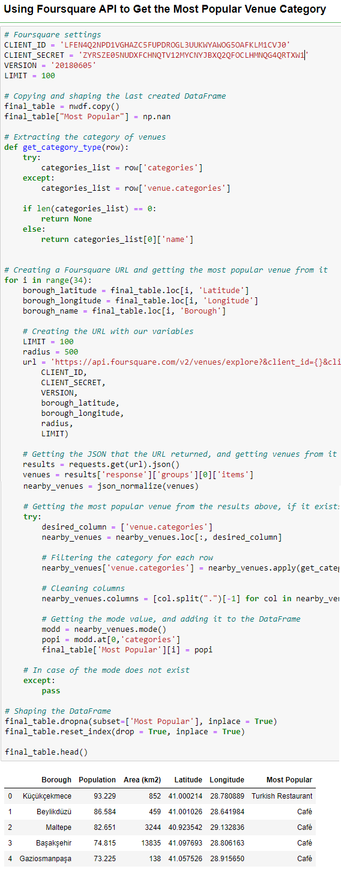
METHODOLOGY
By using a Foursquare app with the help of app’s client ID and client secret, the most popular venue type of each borough were added to the DataFrame.

Slide 10
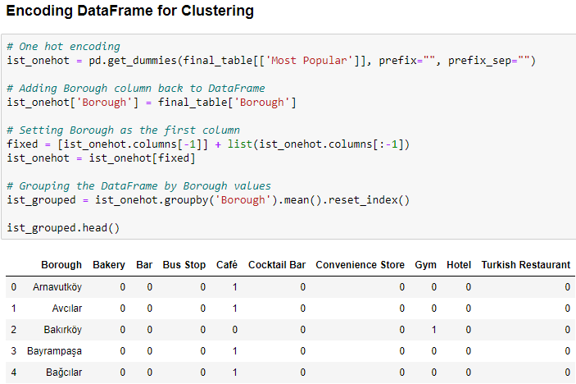
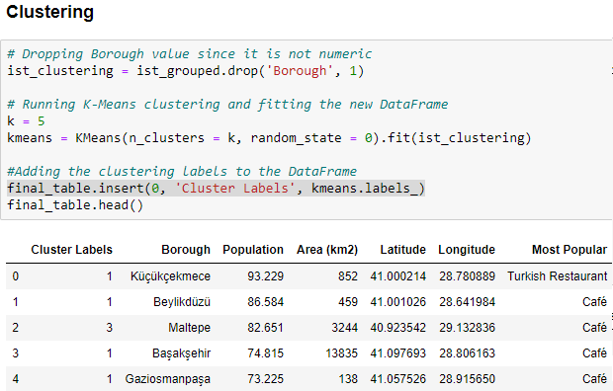
METHODOLOGY
Since the standard k-means algorithm cannot be directly applicable to categorical data, an encoding process was done to the DataFrame and all values were turned into numeric values. Then the DataFrame was fit into a k-means clustering model and results of each borough were added to the DataFrame.

Slide 11
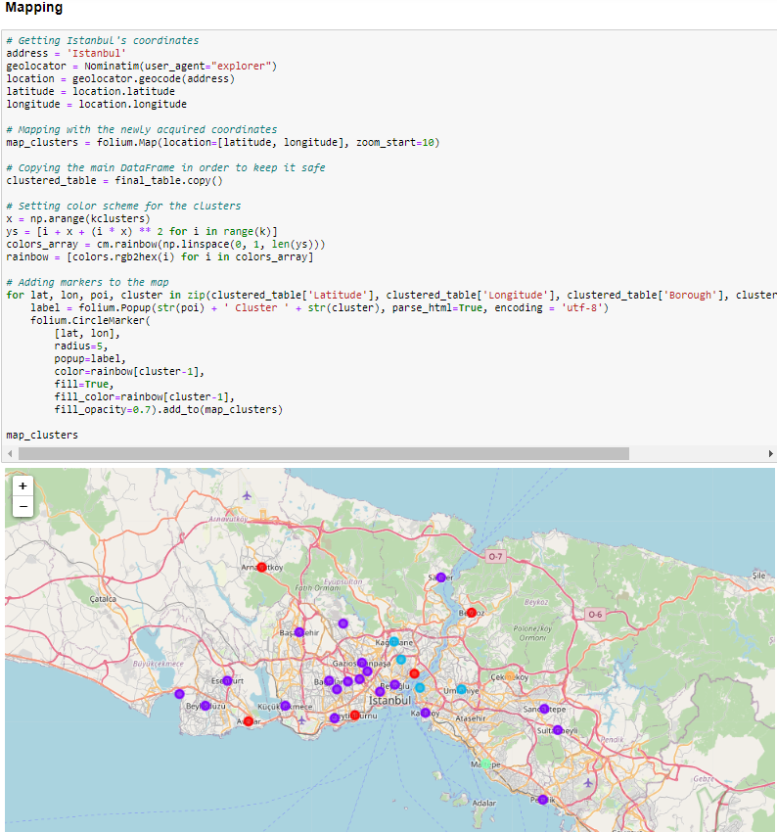
METHODOLOGY
Finally, a map that is based on the cluster and location information was created and shown.

Slide 12
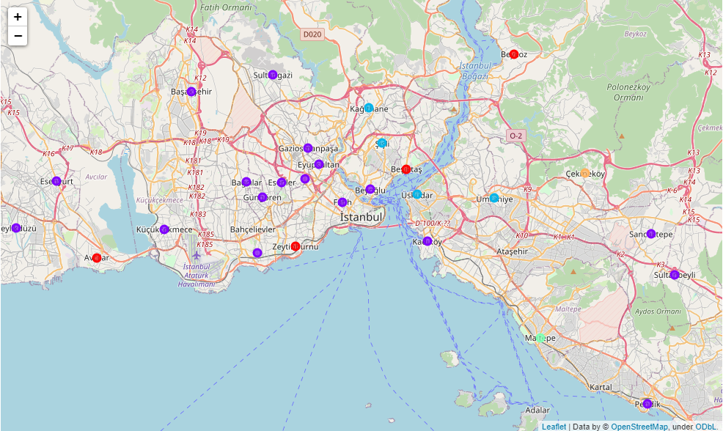
RESULT
Venues of boroughs can be seen in the final map. All of them were located and clustered previously. Venues and boroughs close to each other can be observed easily.

Slide 13
DISCUSSION
We can conclude that opening a cafe in a borough which is not too close or too away from others could be the best option.
According to the map and the algorithm, new cafes in the light blue cluster could be successful.

Slide 14
CONCLUSION
In this project; the venues in Istanbul, their geographic information and venues in them was analyzed by using several tools. K-Means clustering model was used to cluster venues in boroughs and these clusters was used to build a map. As a future directions, information like population and areas of the boroughs, number of venues and neighborhoods could be used to get a better result.

