Slide 1
Artificial Intelligence & Deep Learning E2022 Exam Presentation
Jakub Schovanec
10.1.2023
Examiners: Henning Christiansen, Masoumeh Vahedi

Slide 2
Agenda
Description
Data Set
Modelling

Slide 3
Description
Binary classification of x-ray images
Normal lungs or lungs infected with pneumonia
CNN built with Tensorflow

Slide 4
Data Set
X-ray images
1 583 images of normal lungs
4 273 images of lungs infected with pneumonia
Imbalanced dataset
Under sampling to balance the binary classification
Pseudo-random deletion

Slide 5
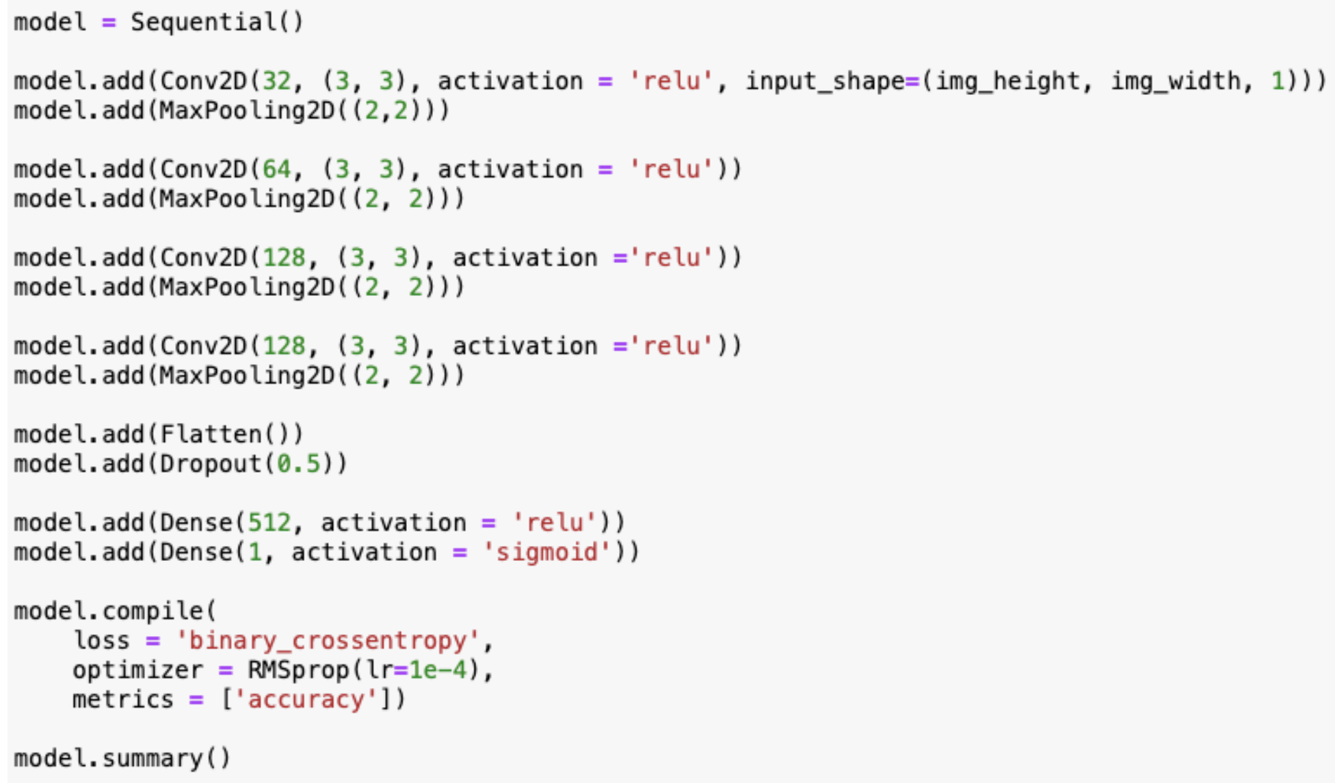
Pre-processing & Modelling
Resized images
Convert to grayscale and rescale pixel values to range 0-1

Slide 6
Test results

