Slide 1
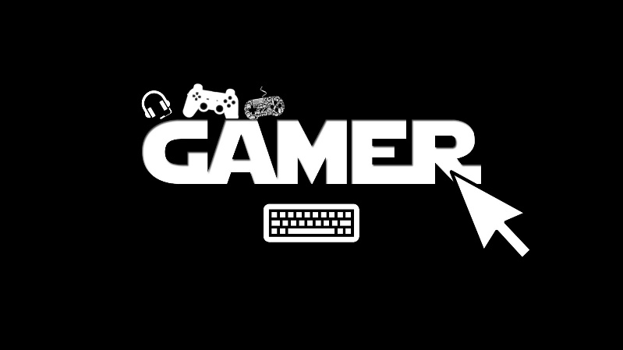

game management system

Slide 2
ABSTRACT
Game Management System is a database based project. The project maintains a database of various games. The details maintained in the database can be in regard with the hard disk specification, speed of processor etc., required to play a specific game. Since gaming is a booming industry and all the young population loves playing, having such a database is a great help for the purpose and also it gives great amount of options.

Slide 3
OBJECTIVE
The objective of this mini-project is to build an application using android studio. The application is further programmed based on xml. This helps maintain the gaming database of different games effectively.

Slide 4

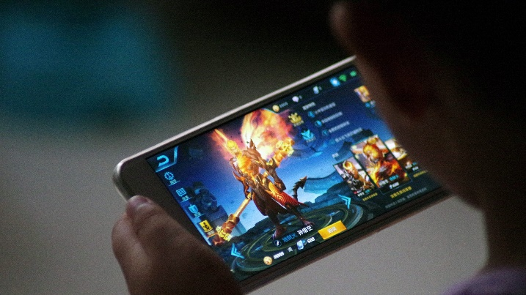

COMPONENTS USED
Smart phones
Android studio
Backend programming
Personal computer

Slide 5
WORKING
The project mainly is to create a database for different games. In this project we first create an app using android studio and java.
There are two main modules of the app mainly-the Admin and the User. The admin can log into the app and maintain the app as and when required. The user can be any gamer.
The user needs to have a login to make use of the application.

Slide 6
CONTINUED
The app gives gaming options to the user. The user can select any game from the list. The app gives suggestions if the user system supports the game selected.
Only the admin can feed in the details regarding the requirements of the game to be played in the database.

Slide 7
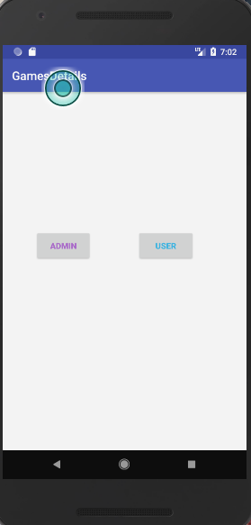
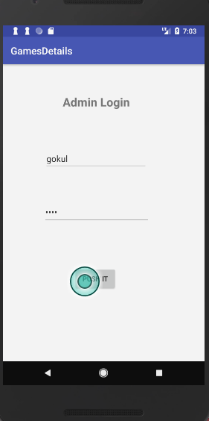
PROJECT SCREENSHOTS

Slide 8
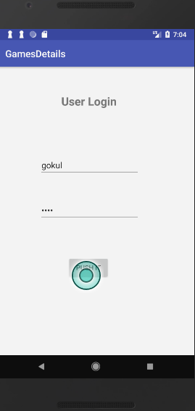
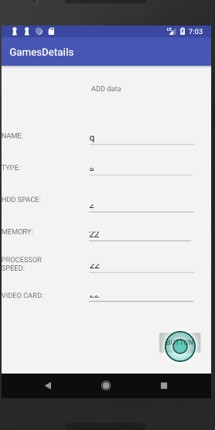
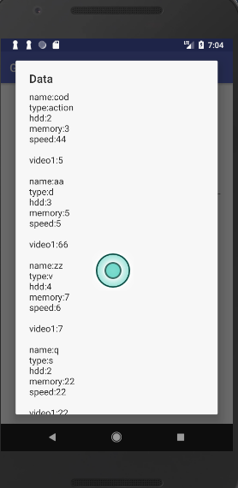

Slide 9

THANK YOU!

