Slide 1


Geo Guess World – Full Stack Web GIS
Presented for GMT 458 – Web GIS
Student: Hatice Kübra Haydar
Technology Focus: Full Stack Web GIS

Slide 2

Project Overview: Geo Guess World
This project introduces a full-stack Web GIS application designed for an interactive map-based guessing game called "Geo Guess World." The application allows users to log in, explore geographic locations, and test their spatial reasoning skills.
Interactive Gameplay
Integrated System
Client-Server Architecture
Users engage in a map-based game where they identify locations, combining entertainment with geographical learning.
The system seamlessly combines spatial data handling, robust user authentication, and detailed performance analytics to deliver a smooth user experience.
The application's architecture follows a classic client-server model, ensuring scalability and efficient data management for both frontend and backend operations.

Slide 3





System Architecture: Technology Stack
The Geo Guess World application is built upon a robust and modern technology stack, ensuring both functionality and scalability. Each component is carefully selected to provide optimal performance and a seamless development experience.
Backend: Node.js with Express
Frontend: HTML, CSS, JS with Leaflet
Powers the server-side logic, API endpoints, and handles data processing.
The interactive user interface, leveraging Leaflet for dynamic map visualization and user interaction.
Database: PostgreSQL + PostGIS
Deployment: AWS EC2
A powerful relational database with spatial extensions for efficient geospatial data storage and querying.
Backend hosted on an Amazon EC2 instance, with the static frontend assets served by Express.
Authentication: JWT and bcrypt
Ensures secure user sessions and password hashing for enhanced security.

Slide 4
Implemented Assignment Requirements
The Geo Guess World project meticulously addresses key requirements for a comprehensive Web GIS application, demonstrating proficiency in various aspects of full-stack development.
1
JWT-Based Authentication
Secure user access management implemented with JSON Web Tokens, providing stateless and reliable authentication.
2
Role-Based Access Control (RBAC)
Distinction between Admin, Player, and Viewer roles, controlling access to different functionalities and data.
3
CRUD Operations on Spatial Data
Ability to Create, Read, Update, and Delete spatial point data, crucial for managing game locations.
4
Non-Spatial Resource Management
Handling of non-spatial data, specifically user scores, allowing for game progression and leaderboards.
5
Performance Monitoring (Spatial Indexes)
Implementation and analysis of spatial indexes to optimize query performance on geographical data.
6
Load and Performance Testing
Rigorous testing to ensure the application can handle expected user loads and maintain responsiveness.

Slide 5
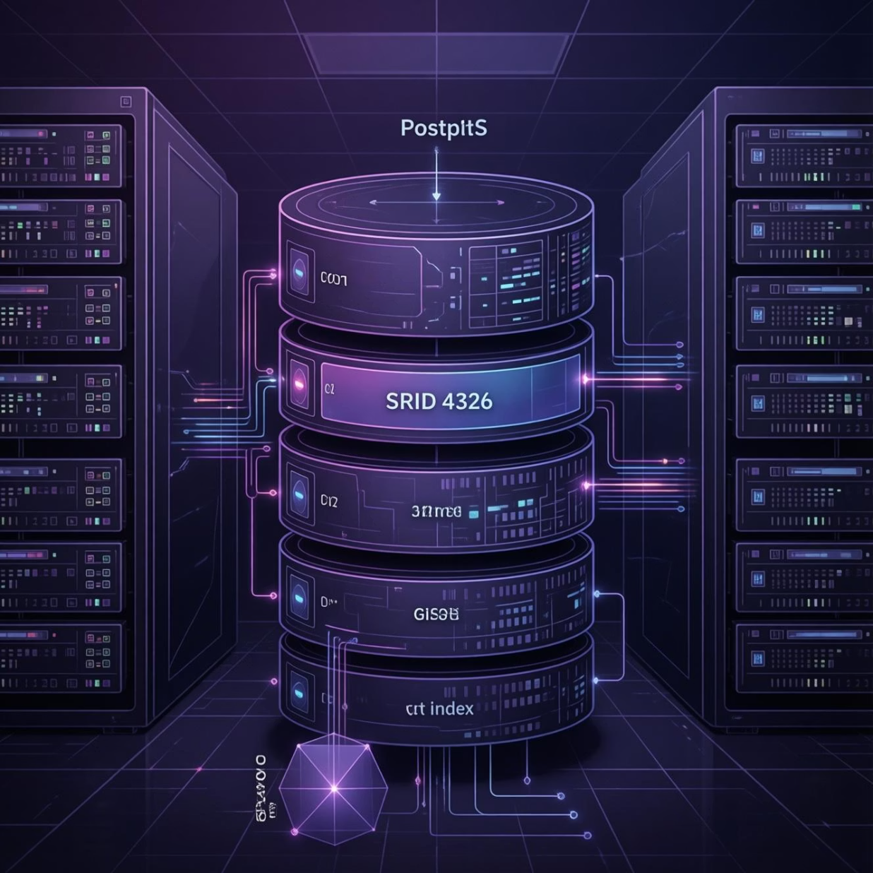
Spatial Data & Performance Optimization
Effective management and optimization of spatial data are critical for a responsive Web GIS application. Geo Guess World leverages PostGIS capabilities to ensure high performance for geographical queries.
Spatial Data Storage: Geographical locations are stored as Point geometry with SRID 4326 (WGS84), a widely recognized standard for latitude and longitude coordinates. This ensures compatibility and accuracy for global mapping.
GiST Spatial Index: A Generalized Search Tree (GiST) index has been applied to the spatial column in the PostgreSQL database. This index is specifically designed to accelerate spatial queries, enabling faster retrieval of nearby locations or areas within a given extent.
Query Performance Testing: The efficiency of spatial queries was evaluated using PostgreSQL's EXPLAIN ANALYZE command. This tool provides detailed execution plans and runtime statistics, allowing for precise identification of performance bottlenecks.
Results: Performance tests conclusively demonstrated that queries utilizing the GiST spatial index performed significantly faster compared to sequential scans, particularly for large datasets. This optimization is key to providing a smooth and responsive gameplay experience.

Slide 6
Live Deployment on AWS EC2
The Geo Guess World application is fully deployed and accessible online, providing a real-world demonstration of its capabilities. Hosting on AWS EC2 ensures scalability and reliability.
Cloud Hosting
Integrated System
Live Access
The backend server, powered by Node.js and Express, is hosted on an Amazon Elastic Compute Cloud (EC2) instance, ensuring high availability and scalability for the application.
Both the backend API and the static frontend assets are seamlessly integrated and served from the same EC2 instance, streamlining deployment and communication.
Users can register, log in, and play the Geo Guess World game directly through their web browsers.
Access the Live Demo Here

Slide 7





Conclusion: A Comprehensive Web GIS Project
The Geo Guess World project successfully demonstrates the integration of various essential components for a modern Web GIS application.
Requirements Met
All specified course requirements have been comprehensively addressed and implemented within the application.
Full Stack Development
Showcases end-to-end development skills from database management and backend logic to interactive frontend design.
Key Integrations
Successfully combines spatial data handling, robust security features, and critical performance optimizations.
Future Potential
Lays a solid foundation for further enhancements, such as additional game modes, more complex spatial analysis, and advanced user profiles.
Thank you for your attention.

