Slide 1
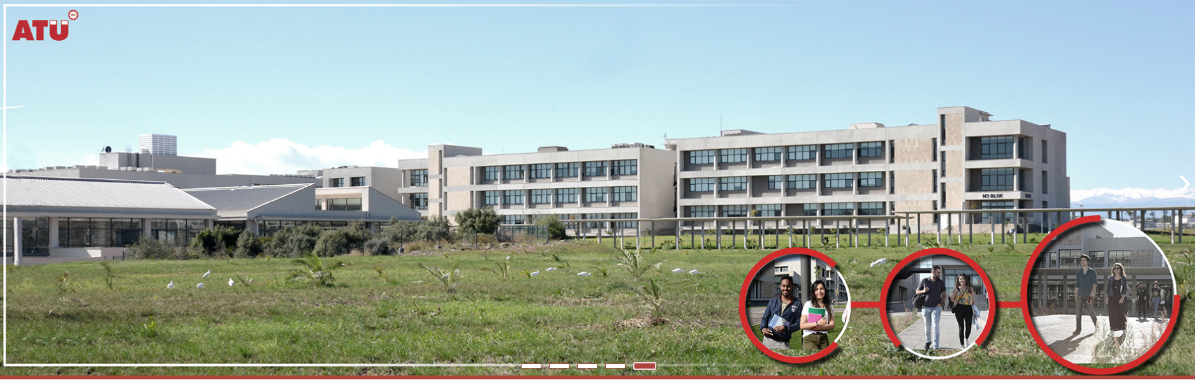

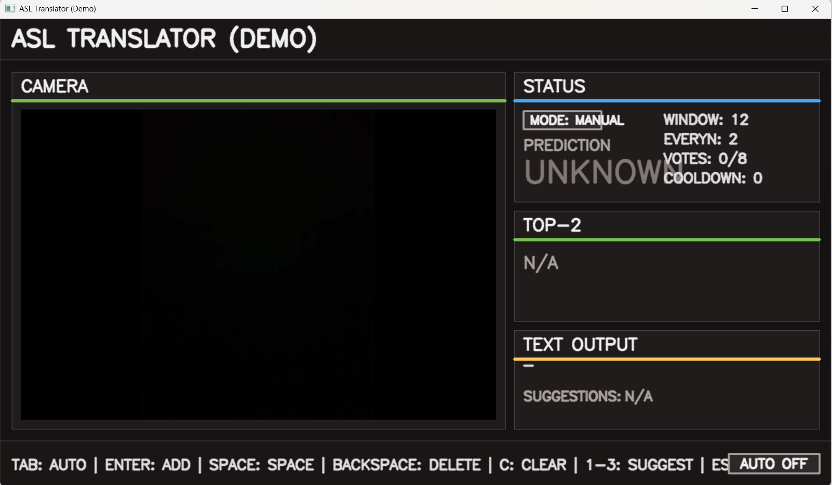
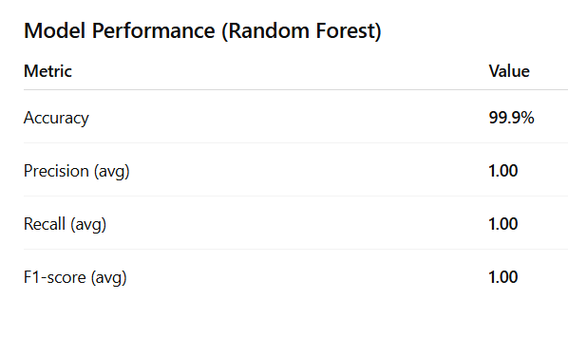
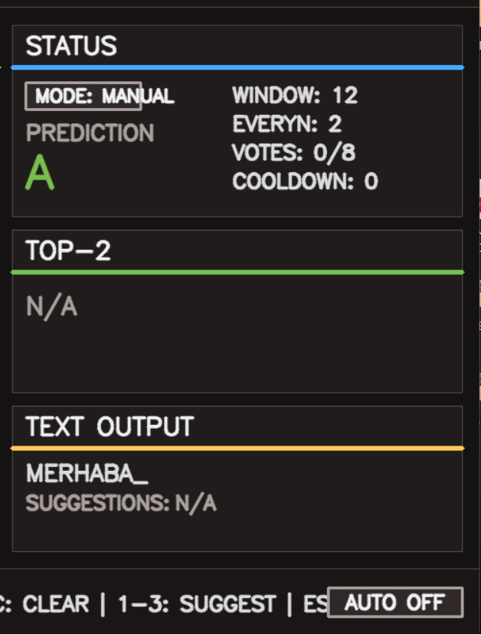
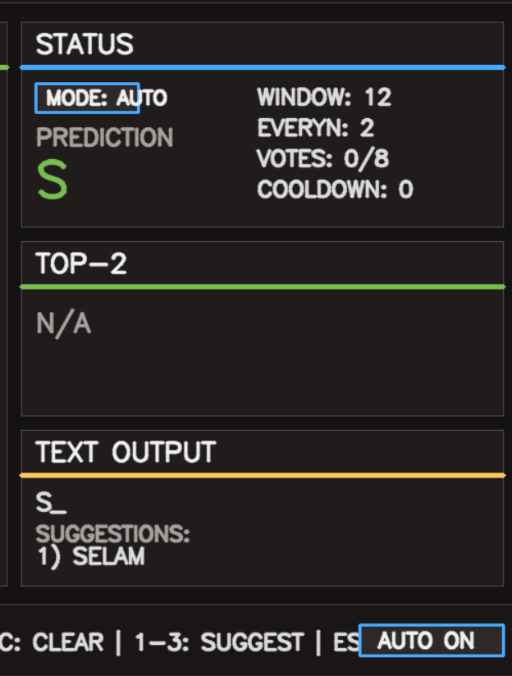
Real-Time ASL Recognition Using Hand Landmarks
Kübrasultan KÖSE
Department of Computer Engineering
Adana, Turkey
200101009@ogr.atu.edu.tr
Introduction
Dataset and Model Evaluation
Sign language recognition systems play a vital role in improving communication between hearing-impaired individuals and the rest of society. Computer vision and machine learning have made it possible to develop real-time hand gesture recognition systems using standard cameras without the need for additional hardware.
In this project, a real-time American Sign Language (ASL) letter recognition system was developed using hand gesture points and machine learning techniques. Hand gesture points obtained with MediaPipe were normalized and trained with a Random Forest classifier, enabling the system to convert static ASL letters into text in real time.
The dataset was created using a custom ASL data collection tool and consists of hand landmark samples collected from multiple users. Most classes contain approximately 1,000 samples., resulting in a balanced dataset with over 24,000 samples in total.
Experimental results show that the trained model achieves high classification accuracy for most ASL letters. Misclassifications are mainly observed between visually similar hand shapes, which is a common challenge in sign language recognition systems.
Several classical machine learning models were evaluated for American Sign Language (ASL) hand gesture recognition. Among the tested models, the Random Forest classifier achieved the highest overall performance in terms of accuracy and F1-score.
To improve prediction stability in real-time usage, temporal smoothing techniques such as majority voting and confidence-based filtering were applied. These mechanisms significantly reduced prediction noise while preserving responsiveness.
Figure 1. ASL Translator Demo
System Architecture and Methodology
The system consists of four main stages: data collection, feature extraction, model training, and real-time prediction. Hand landmark data is collected using a custom data collection application based on MediaPipe. Each hand is represented by 21 landmarks, resulting in 63 features (x, y, z).
The collected features are normalized by centering the wrist landmark and scaling according to the distance between the wrist and the middle finger MCP joint. A Random Forest classifier is trained on the normalized dataset and used for prediction.
A Random Forest classifier is trained using the normalized dataset and integrated into a real-time prediction pipeline. Temporal smoothing and majority voting are applied to improve prediction stability during live usage.
Figure 5. Offline Evaluation - Model Performance
Although the model achieves very high offline accuracy, real-time prediction performance is affected by hand pose transitions and visual similarity between certain ASL signs.
Future Works
✔ Adapting the system for different sign languages (e.g., TSL)
✔ Extending the system to recognize dynamic ASL signs (e.g., J and Z).
✔ Adding language models for smarter word and sentence completion.
✔ Improving the model to detect and interpret signs involving both hands simultaneously
✔ Expanding the dataset with more participants to improve generalization.
Conclusion
In this project, a real-time ASL letter recognition system based on hand landmark detection and machine learning was successfully developed. The results show that reliable ASL recognition can be achieved using lightweight models and standard camera hardware.The proposed system provides a strong foundation for future sign language translation applications and demonstrates the effectiveness of combining computer vision with machine learning for assistive technologies.
References
✔ Breiman, L. (2001). Random forests. Machine Learning, 45(1), 5–32.
https://www.stat.berkeley.edu/~breiman/randomforest2001.pdf
✔ Lugaresi, C., Tang, J., Nash, H., et al. (2019). MediaPipe: A framework for building perception pipelines.
https://arxiv.org/pdf/1906.08172
✔ iStock. (2018). American Sign Language hand gestures.
Retrieved from https://www.istockphoto.com/tr/fotoğraf/amerikan-i%C5%9Faret-dili-gm960235324-262223334
Figure 2. Manual Mode
Figure 3. Auto Mode
Figure 4. Toolbar

