Slide 1
세션 로딩 중

Slide 2


Slide 3
OT / BA 개요 / GitHub

Slide 4
1. Business Analytics

Slide 5
Business Analytics

Slide 6
<?_?>

Slide 7
+
Analytics
Business

Slide 8
Data Analytics for Business

Slide 9
<O_O>

Slide 10
<?_?>

Slide 11
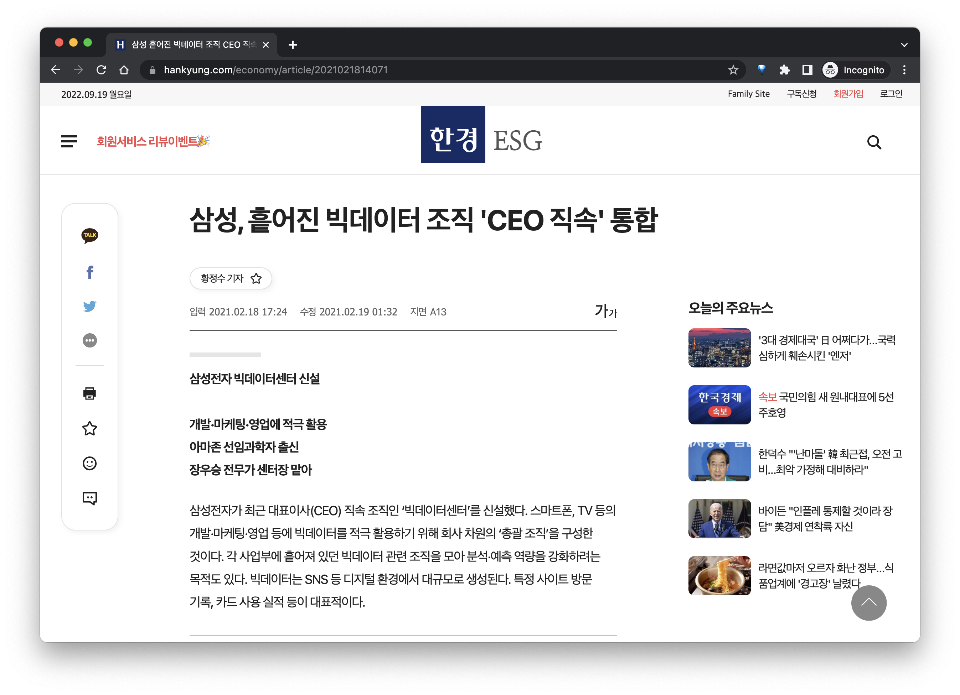
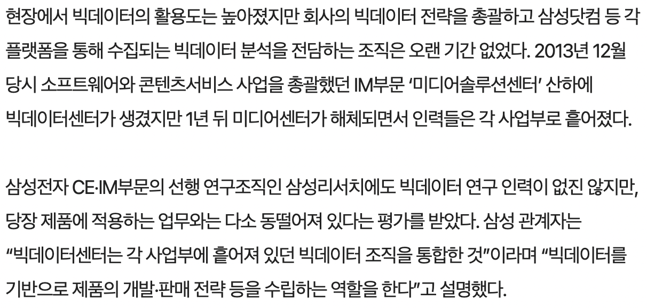
Industry

Slide 13
The first mover

Slide 14
First Mover Advantage

Slide 15


Slide 16
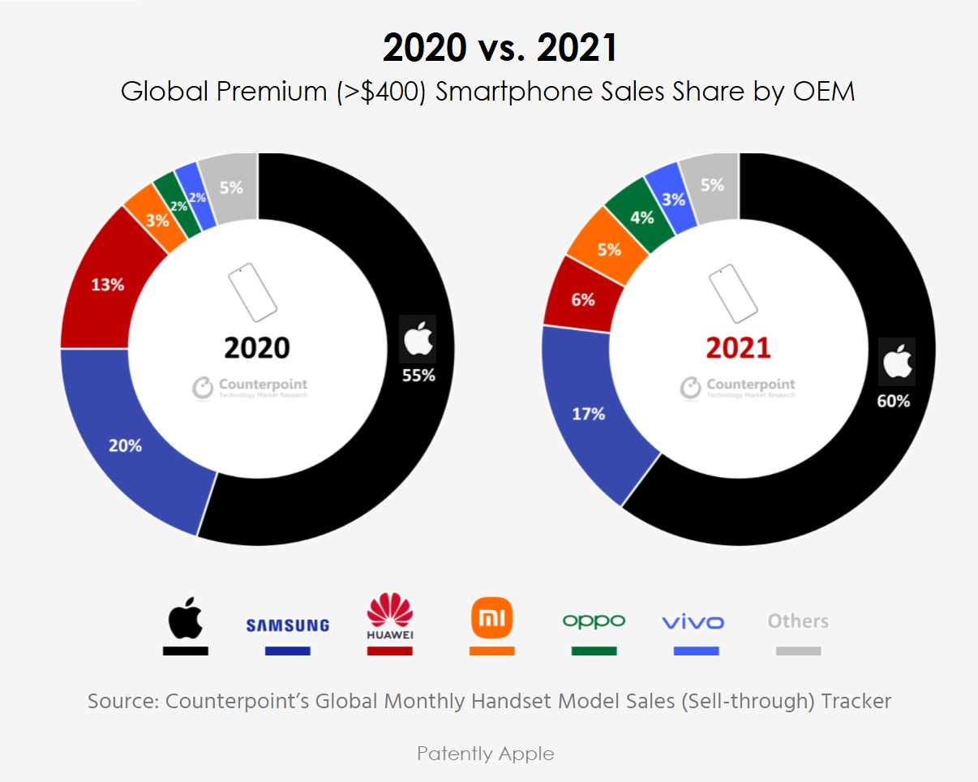

Slide 17
+
Analytics
Business

Slide 18
BA의 3단계
3. Prescriptive Analytics
2. Predictive Analytics
1. Descriptive Analytics

Slide 19
BA의 3단계
To summarize features
from historical data
What happened?
1. Descriptive Analytics

Slide 20
BA의 3단계
To exploit patterns
using models
What will happen next?
2. Predictive Analytics

Slide 21
BA의 3단계
To specify
actions and effects
What should we do?
3. Prescriptive Analytics
Predictive Analytic
Descriptive Analytic

Slide 22
Prescriptive Analytics for Business

Slide 23
Actions
Effects

Slide 24
Finance

Slide 25
International Strategy
Investments
Corporate Finance
ESG Management

Slide 26
2. OT

Slide 27
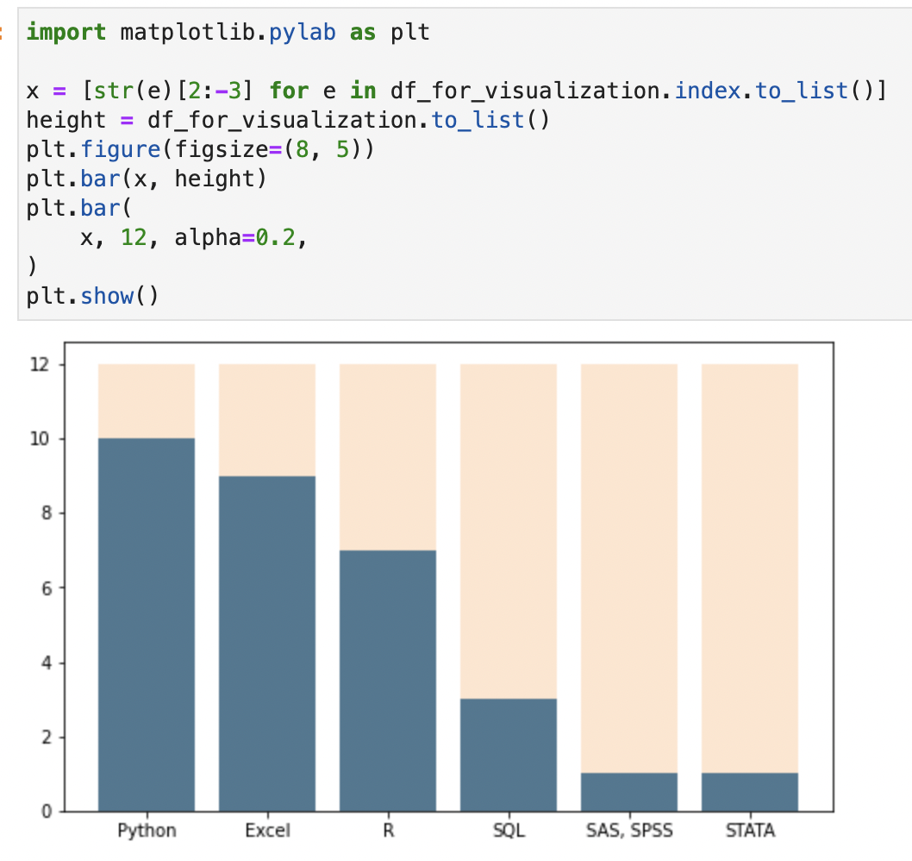
1
Curriculum

Slide 28
1
First Semester
정기 세션
중간고사
정기 세션
정기 세션
기말고사
휴회
휴회

Slide 29
학회 안내사항
출석 관련
기타 요건
정규세션 결석은 2번까지

Slide 30
세션 끝!

