Slide 1
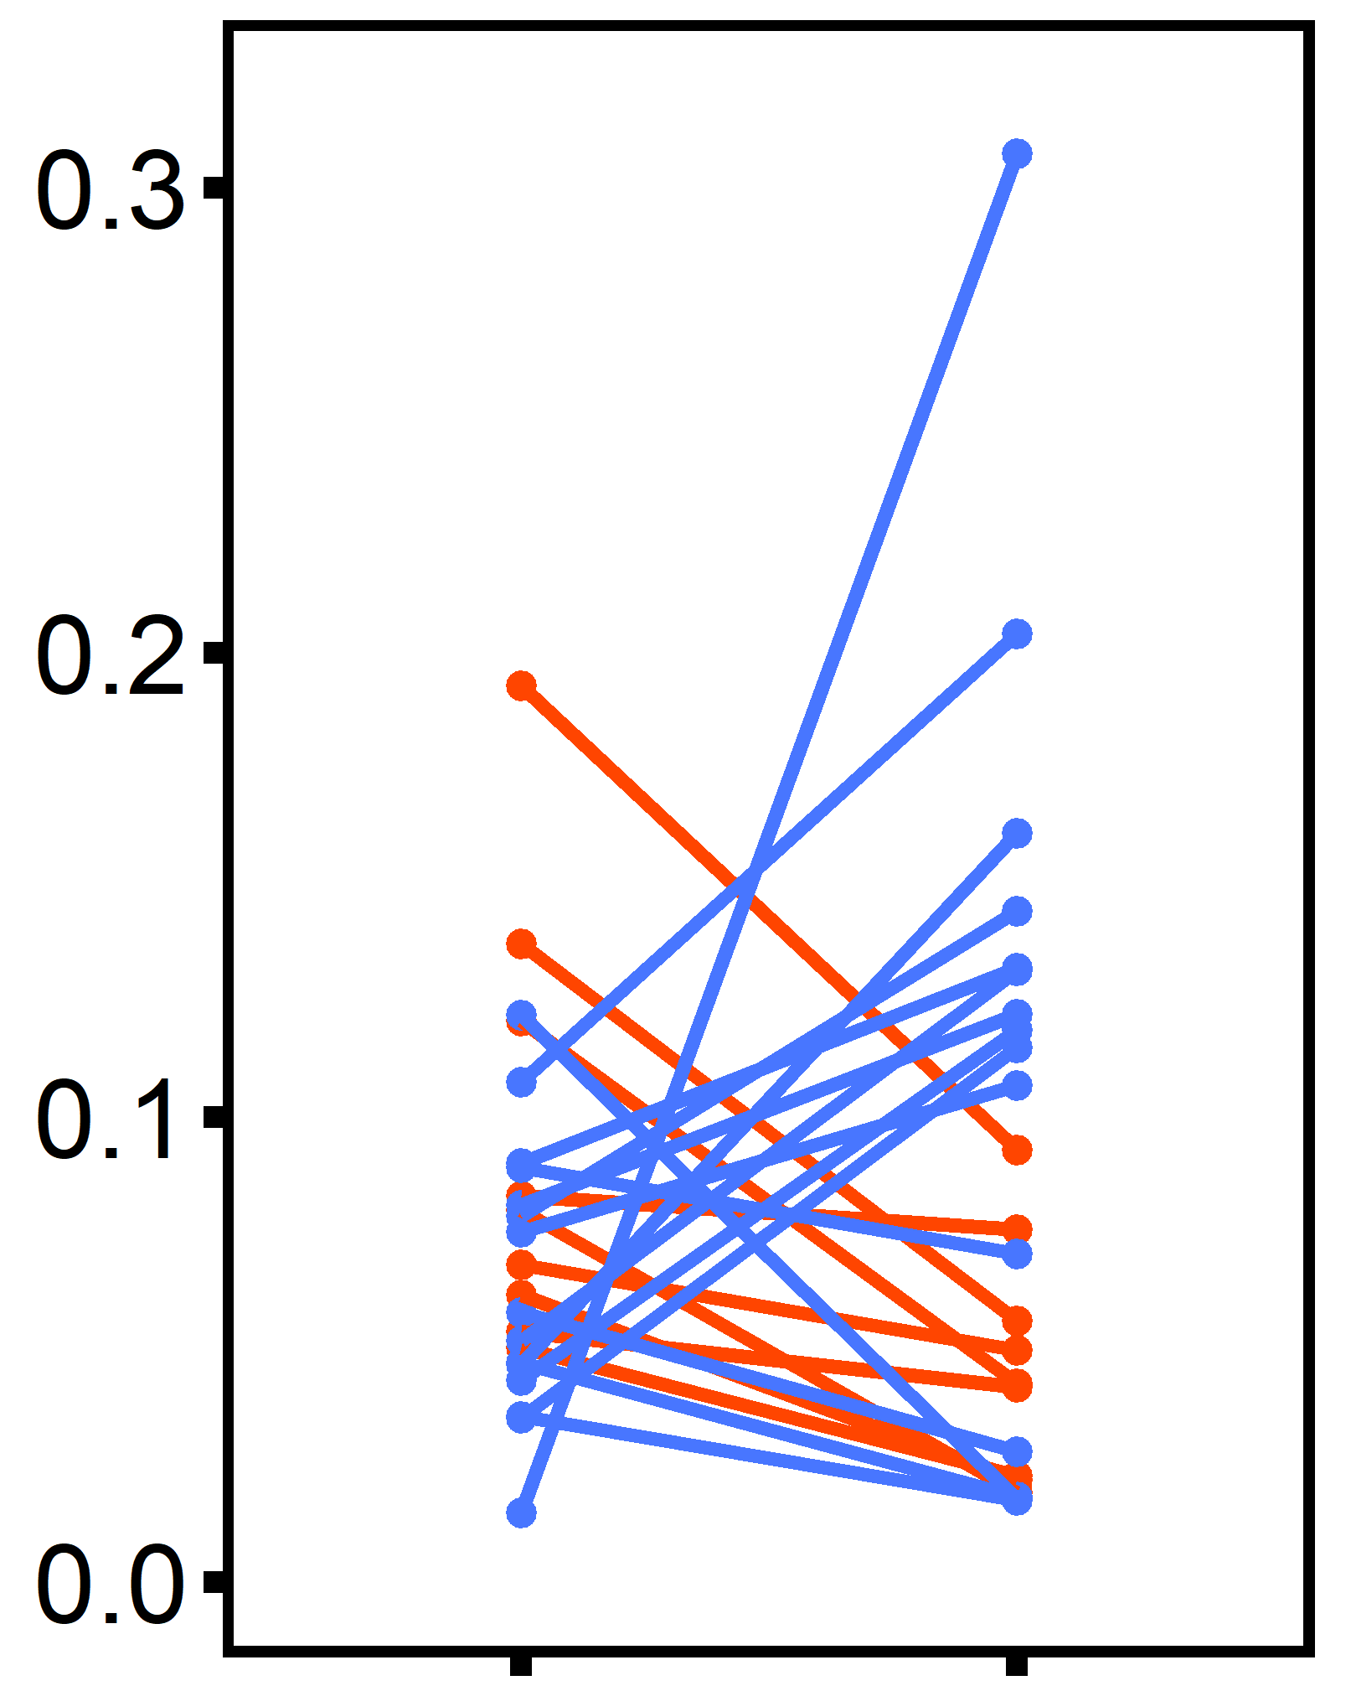
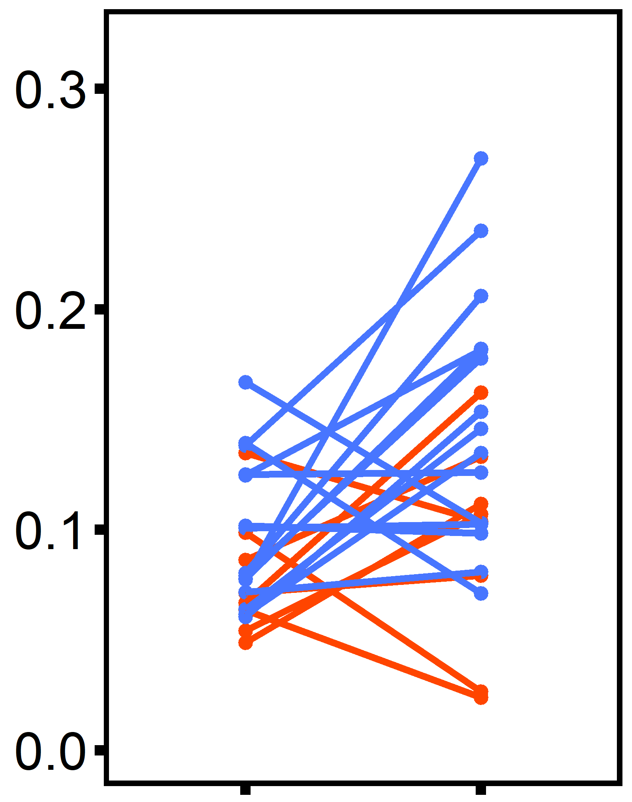
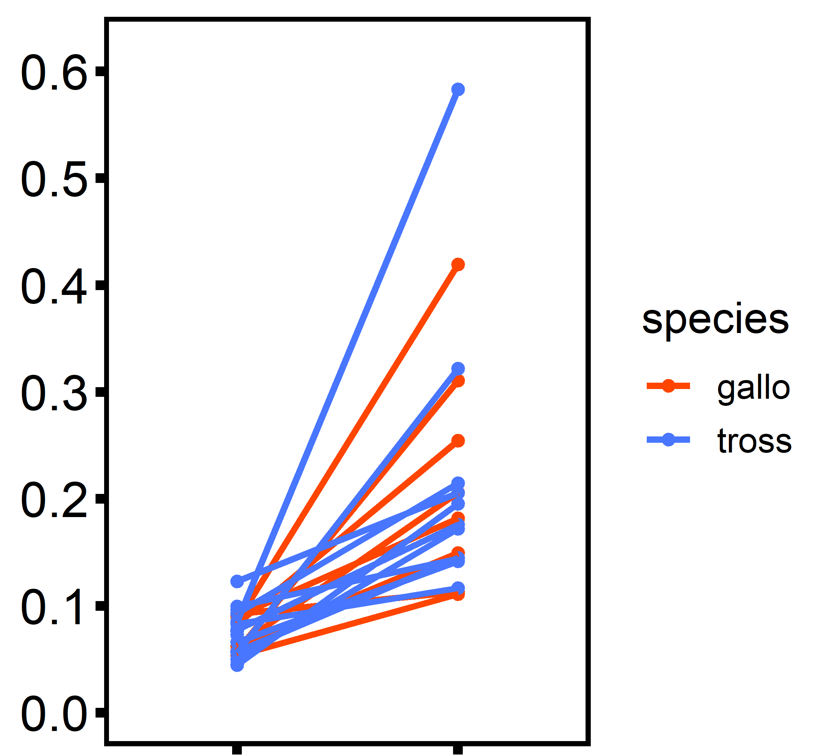
Ocean Acidification
Ocean Warming
Hypoxia
(A)
trt:species: p = 0.023
(B)
species: p = 0.01
(C)
trt: p < 0.001
Standard Metabolic Rate
(mg O₂ h⁻¹ cm⁻¹)
pH 8
pH 7
12°C
20°C
10 mg L⁻¹
4 mg L⁻¹

