Slide 1
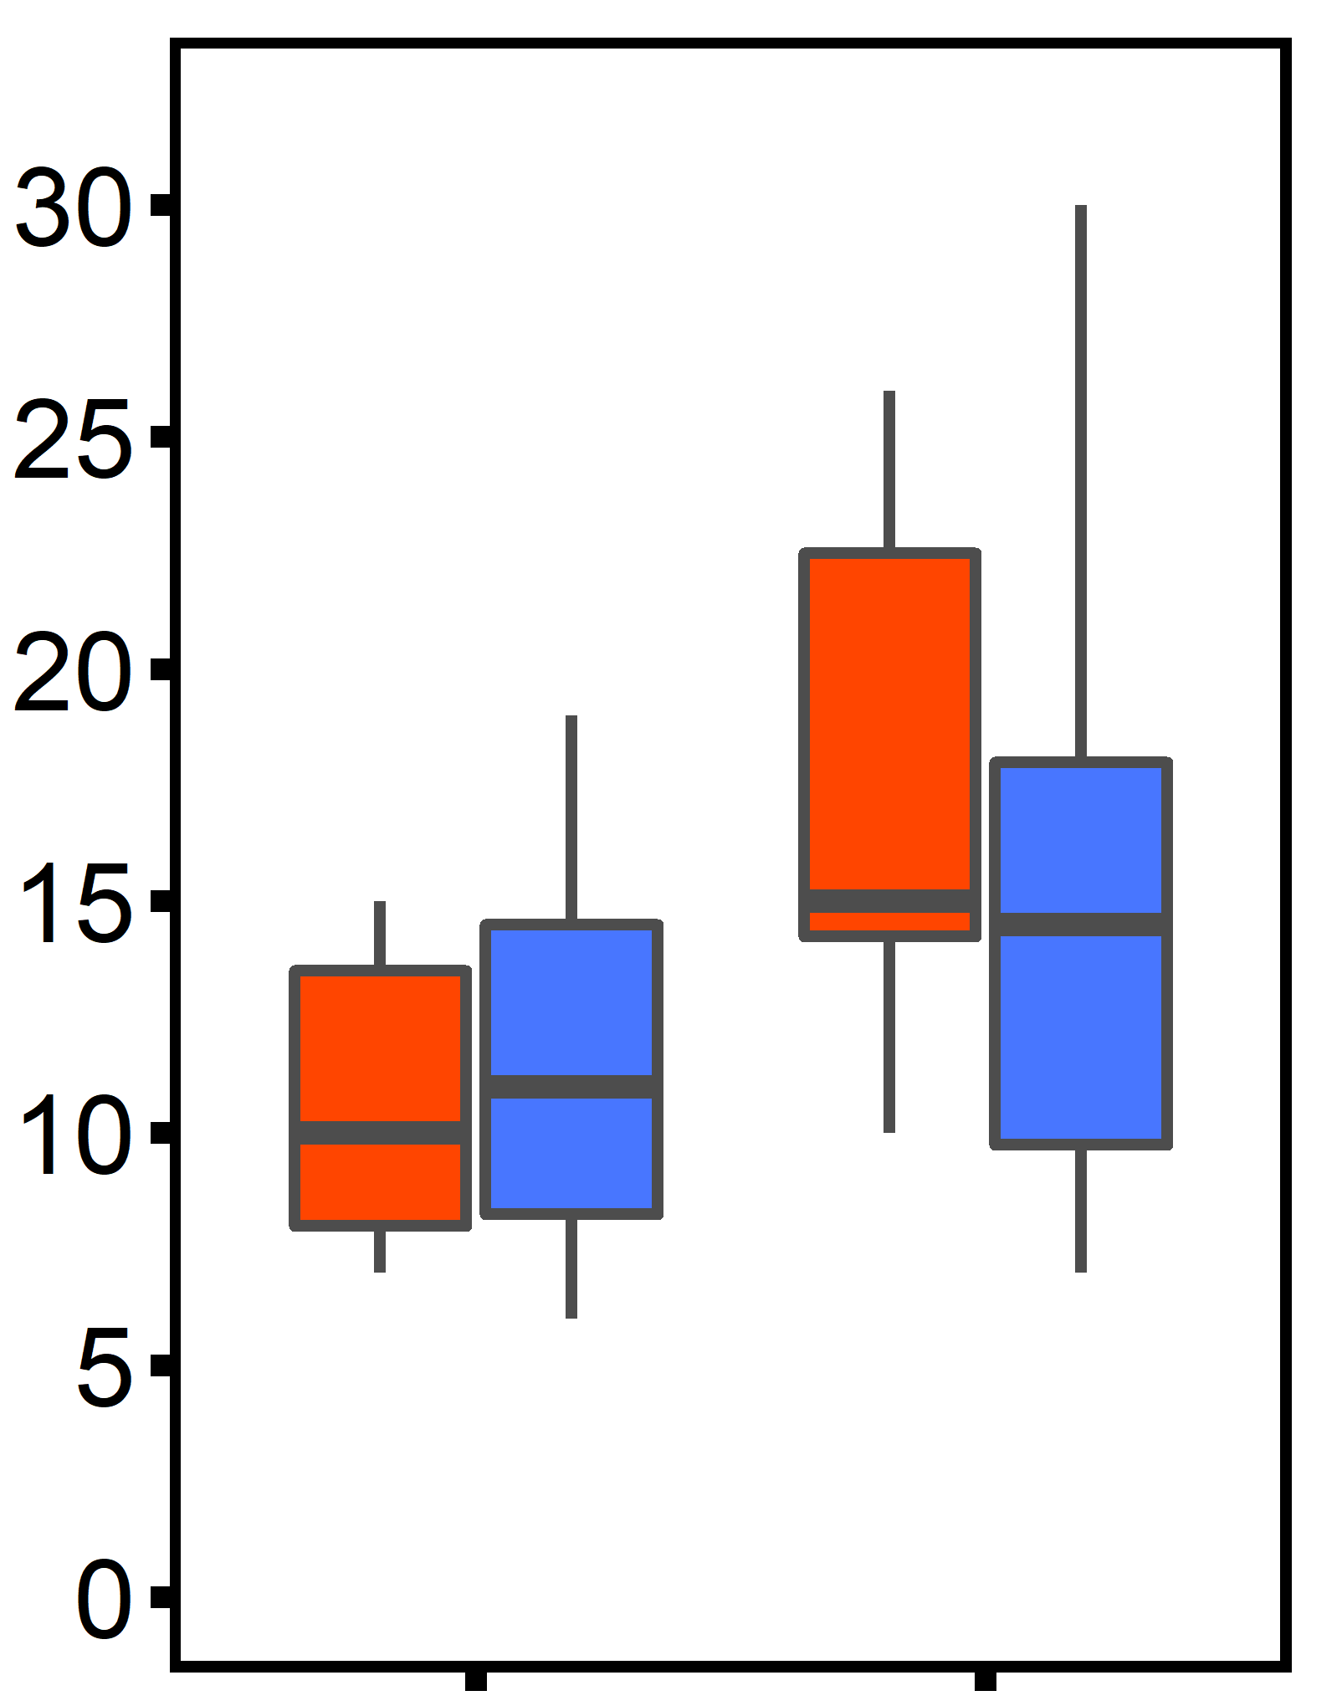
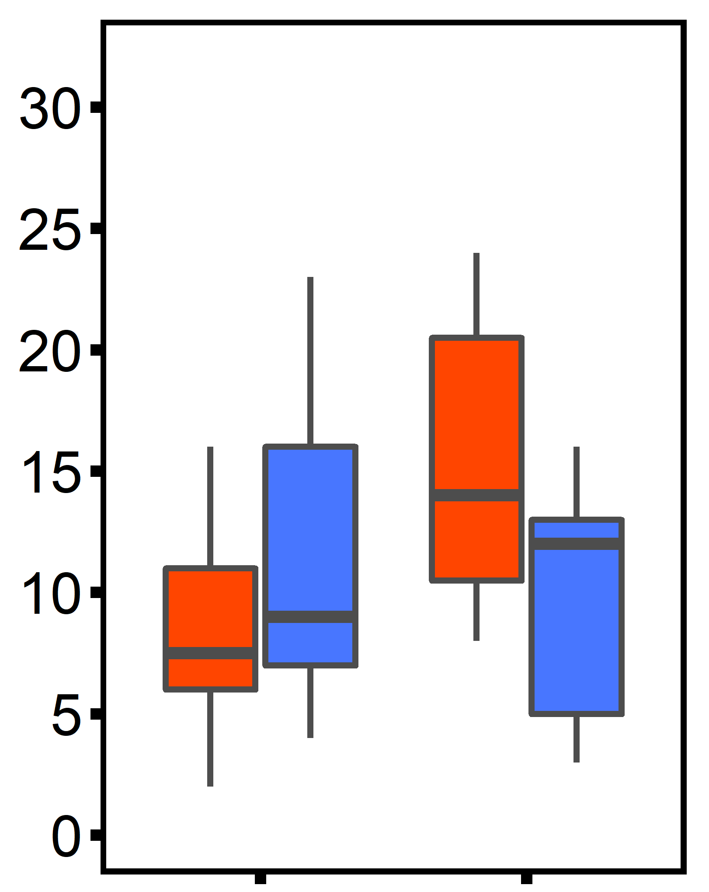
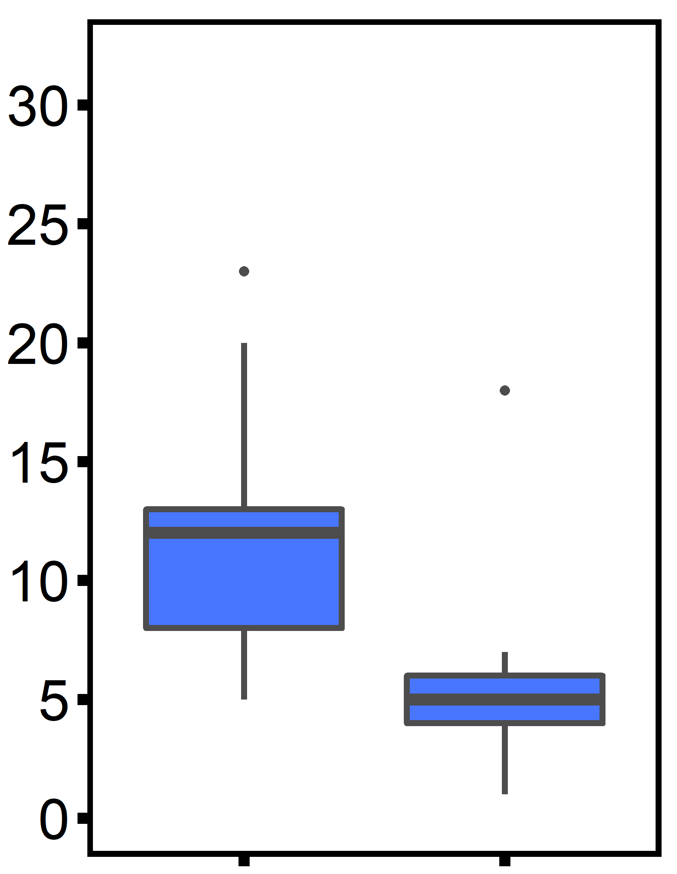
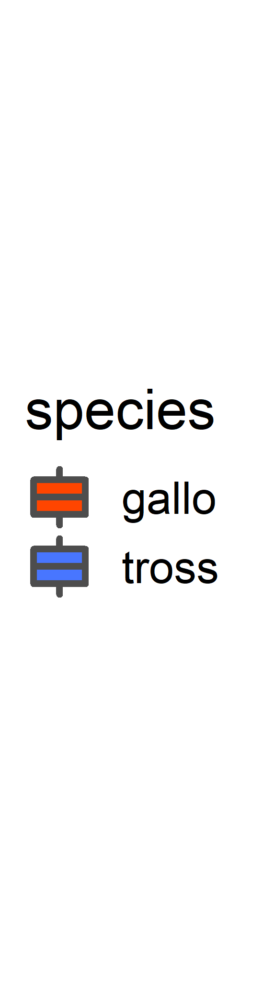
Ocean Acidification
Ocean Warming
Hypoxia
(A)
trt: p = 0.019
(B)
trt:species: p = 0.012
(C)
trt: p = 0.031
Thread number
pH 8
pH 7
12°C
20°C
10 mg L⁻¹
4 mg L⁻¹

