Slide 1
FINAL YEAR PROJECT DEFENSE
Efficient Energy Management of EV Charging Stations Using Renewable Microgrid Systems
How smart software — not more solar panels — gets more electric cars fully charged using clean energy
Abdulrahman, Ibrahim Adeiza
Matric No.: 21/52HP048
Department of Telecommunications Science, University of Ilorin
Supervisor: Dr. Akande H.B.

Slide 2
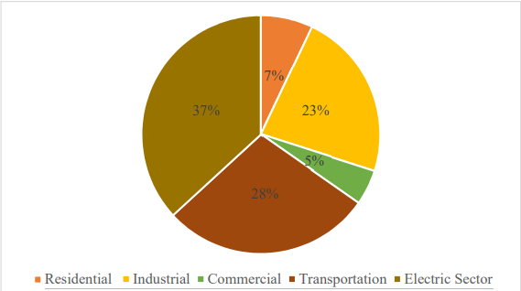
01 — INTRODUCTION
Why This Study Matters
More people are switching to electric cars every year — and every one of them needs somewhere to plug in.
Charging many cars at once pulls a huge amount of power from the electricity grid, the same way turning on dozens of kettles at once would.
Clean power — sunlight and wind — can charge cars without burning fuel. The catch: the sun and wind don't always show up exactly when cars need them.
This project asks a simple question: can smarter software make clean energy stretch further, without buying more solar panels or batteries?
Graph — Where our energy currently comes from (US, 2019)
Power plants and transport together burn most of our energy today — exactly the two areas this project tries to make cleaner and smarter.
2 / 15

Slide 3
01 — INTRODUCTION
The Problem, in Plain Terms
Think of it as bad timing between two daily routines:
6:00 AM
8:00–10:00 AM
1:00 PM
The sun is barely up. Solar panels make almost no power yet.
Most staff and students arrive and plug in their cars — the busiest charging window of the day.
The sun is at its strongest — but by now many morning cars have already left, undercharged.
The old way — "first come, first served" — just charges cars in the order they plug in. It has no idea the sun is about to get stronger, so it can't plan ahead.
3 / 15

Slide 4
02 — LITERATURE REVIEW
What Other Researchers Found
1
Uncontrolled charging hurts the grid
2
Smarter timing helps
Razeghi et al. (2014) and Mullan et al. (2011) found that letting cars charge whenever they like overloads transformers and wastes their lifespan faster.
Zhang et al. (2014) showed shifting charging to quieter hours reduces strain — but their method assumed we already know exactly what's coming, which isn't realistic.
3
Clean-energy microgrids work well
4
AI can help predict power
Sayed et al. (2019) and Tanrioven (2005) proved solar + wind + battery systems can power EV charging almost entirely on clean energy.
Amir et al. (2023) showed that machine learning can forecast upcoming solar and wind power well enough to guide smarter decisions in real time.
4 / 15

Slide 5
02 — LITERATURE REVIEW
What Was Still Missing
Too simple, or too complicated
1
Existing systems were either basic fixed rules (no real intelligence) or needed heavy computing power few campuses can afford.
Built for the wrong context
2
Most studies focus on wealthy, grid-connected cities — not university campuses in places like Nigeria with tighter budgets and less data.
Prediction and scheduling, kept apart
3
No one had combined "predicting the weather 30 minutes ahead" with "deciding which car to charge next" into one lightweight, practical system.
This study fills that gap with a practical system that predicts, then schedules — built for a real campus.
5 / 15

Slide 6
03 — PROBLEM STATEMENT
A Timing Problem, Not a Shortage of Power
Charging stations that rely on "first come, first served" don't know when the sun will be strongest, how full a battery already is, or when a car needs to leave. So they hand out power blindly — some cars leave half-charged, even though there was enough clean energy for everyone, just not at the right moment.
08:00–10:00
When most cars arrive to charge — the busiest, sunniest-starved window
13:00
Without a system that plans ahead, campus EV users lose confidence in charging stations — and the station ends up leaning on the regular (non-clean) power grid more than it should.
When solar power peaks — often after early cars have already left
"First Come"
The old rule: charge whoever plugged in first, no matter what
6 / 15

Slide 7
04 — AIM & OBJECTIVES
What We Set Out to Do
Our Goal: Build a smart charging system for a campus EV station, powered by solar, wind, and battery storage, that gets more cars fully charged using clean energy — without buying any extra equipment.
01
02
03
04
05
Build the microgrid
Teach it to predict
Test 3 strategies
Measure the results
Share practical advice
Simulate a realistic setup: solar panels, a wind turbine, and a battery, running a full 15-hour day.
Train a computer model to guess solar and wind power 30 minutes before it happens.
Compare the old "first come" method, a smarter priority method, and our new predictive method.
Check how many cars got fully charged, and how much clean vs. grid power was used.
Turn the findings into simple recommendations universities can actually use.
7 / 15

Slide 8
05 — METHODOLOGY
The System We Built (in Simulation)
Everything below was tested in a computer simulation of a real campus day — no physical hardware was needed to get these results.
SOLAR
WIND
BATT
GRID
EV
Solar Panels
Wind Turbine
Battery Storage
Grid Backup
25 Charging Cars
250 kW of panels — like the roof of a small building — producing power that rises and falls with the sun.
An 80 kW turbine adding a steadier trickle of power, day and night.
A 400 kWh battery that banks surplus power and releases it when it's needed most.
A limited connection to the regular power grid, used only as a last resort.
A realistic day of 25 electric cars arriving, parking, and leaving at different times.
8 / 15

Slide 9
05 — METHODOLOGY
Three Ways to Decide "Who Charges Next"
BASELINE
IMPROVED
OUR METHOD
First Come, First Served
Priority Scheduling
Smart Predictive Scheduling
Charges cars strictly in the order they plug in — like a queue at a shop counter. Ignores battery level, deadline, or sunshine.
Charges the neediest cars first — low battery, leaving soon. Better, but still has no idea whether the sun is about to get stronger.
Combines urgency with a 30-minute weather forecast. It saves battery power for cars that truly need it, and spends generously when sunshine is abundant.
9 / 15

Slide 10
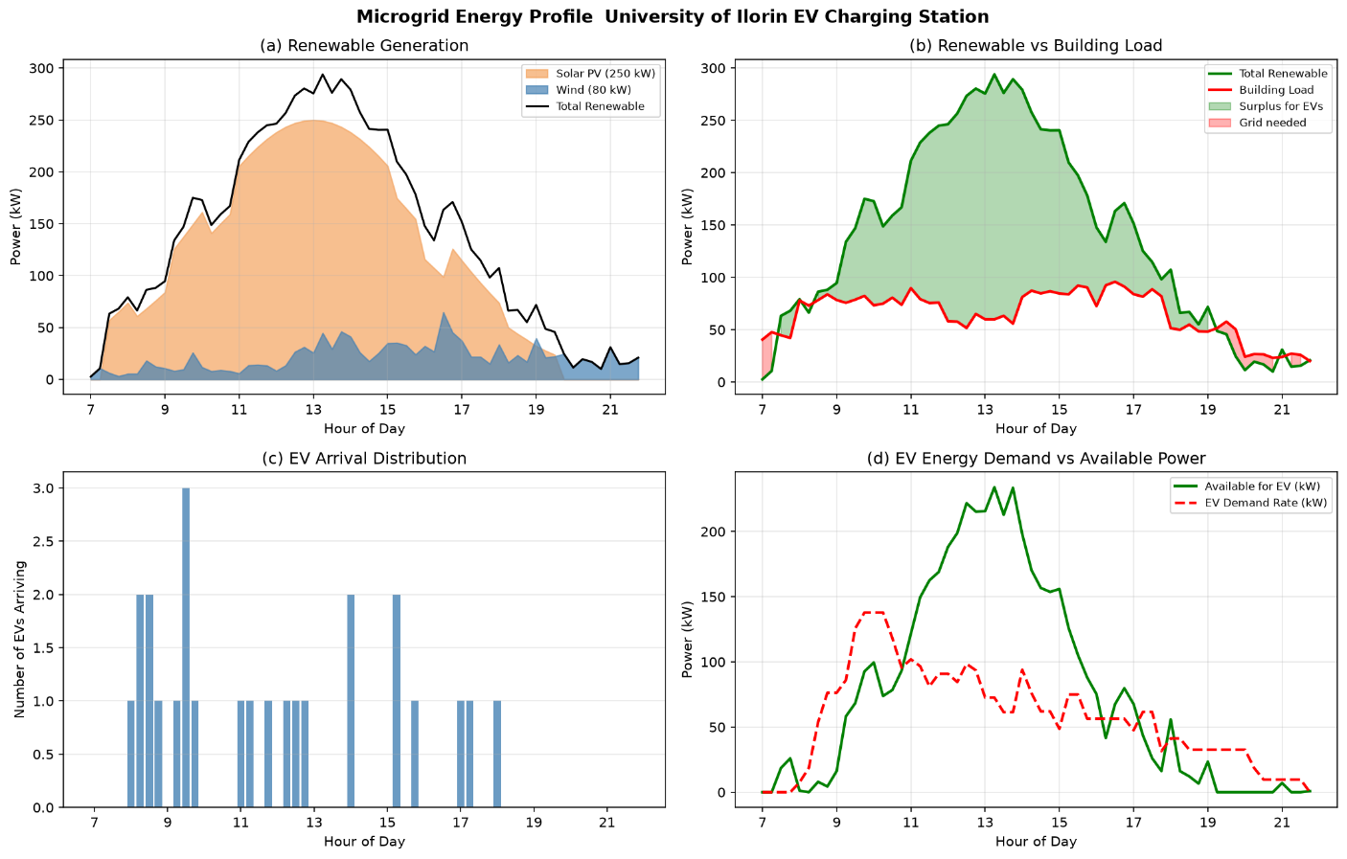
06 — RESULTS
How Much Sun and Wind Did We Actually Have?
In plain terms:
Solar power builds up slowly, peaks around 1 PM, and fades by evening — just as expected.
In the early morning, there simply isn't enough sun yet — a real "energy gap."
But over the whole day, we generated 30% more clean energy than all 25 cars needed combined.
So the real challenge isn't a shortage — it's matching supply to demand at the right time.
Graph — Solar & wind output vs. building demand and car arrivals across the day
10 / 15

Slide 11
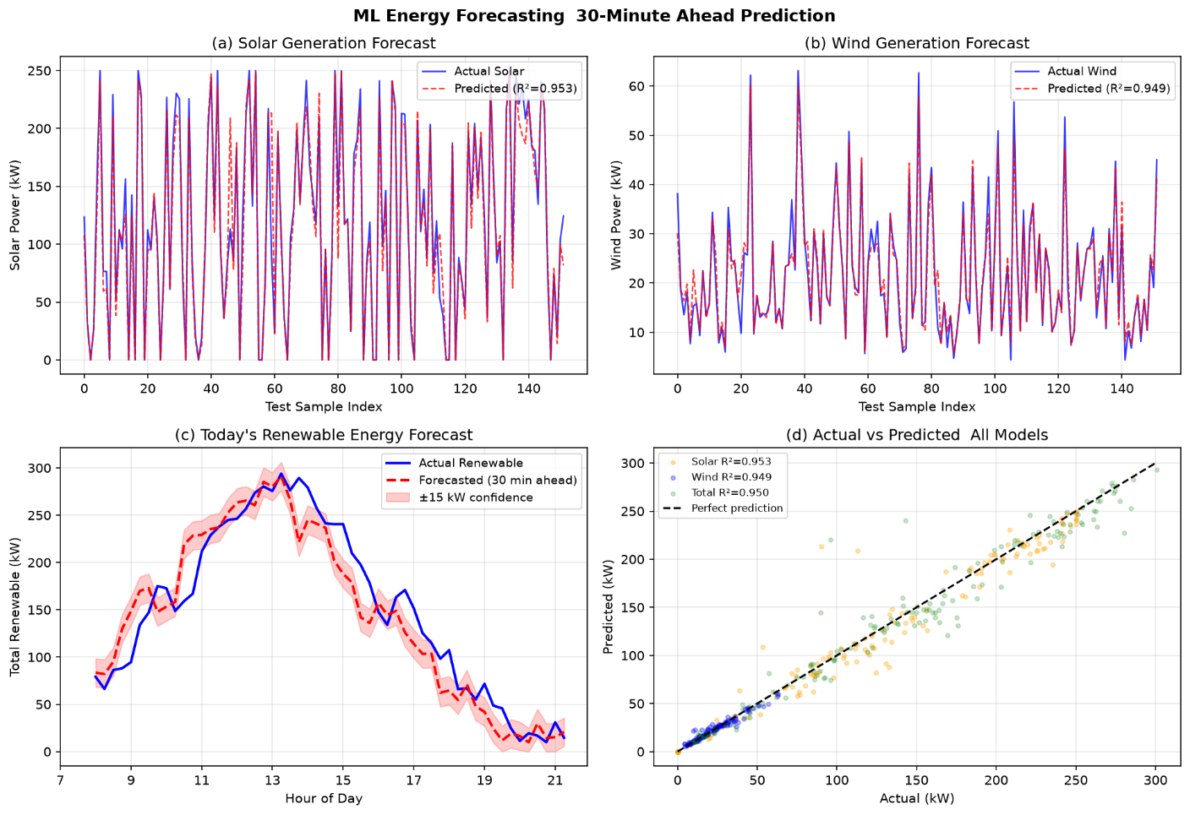
06 — RESULTS
Could We Predict the Weather 30 Minutes Ahead?
In plain terms:
We trained a computer model on two weeks of weather-like data to "guess" the next 30 minutes of solar and wind power.
Its predictions matched reality about 95% of the time — accurate enough to plan around.
This forecast is what lets our smart scheduler "see" a sunny afternoon coming and hold back battery power for it.
Graph — Predicted vs. actual solar and wind power, 30 minutes ahead
11 / 15

Slide 12
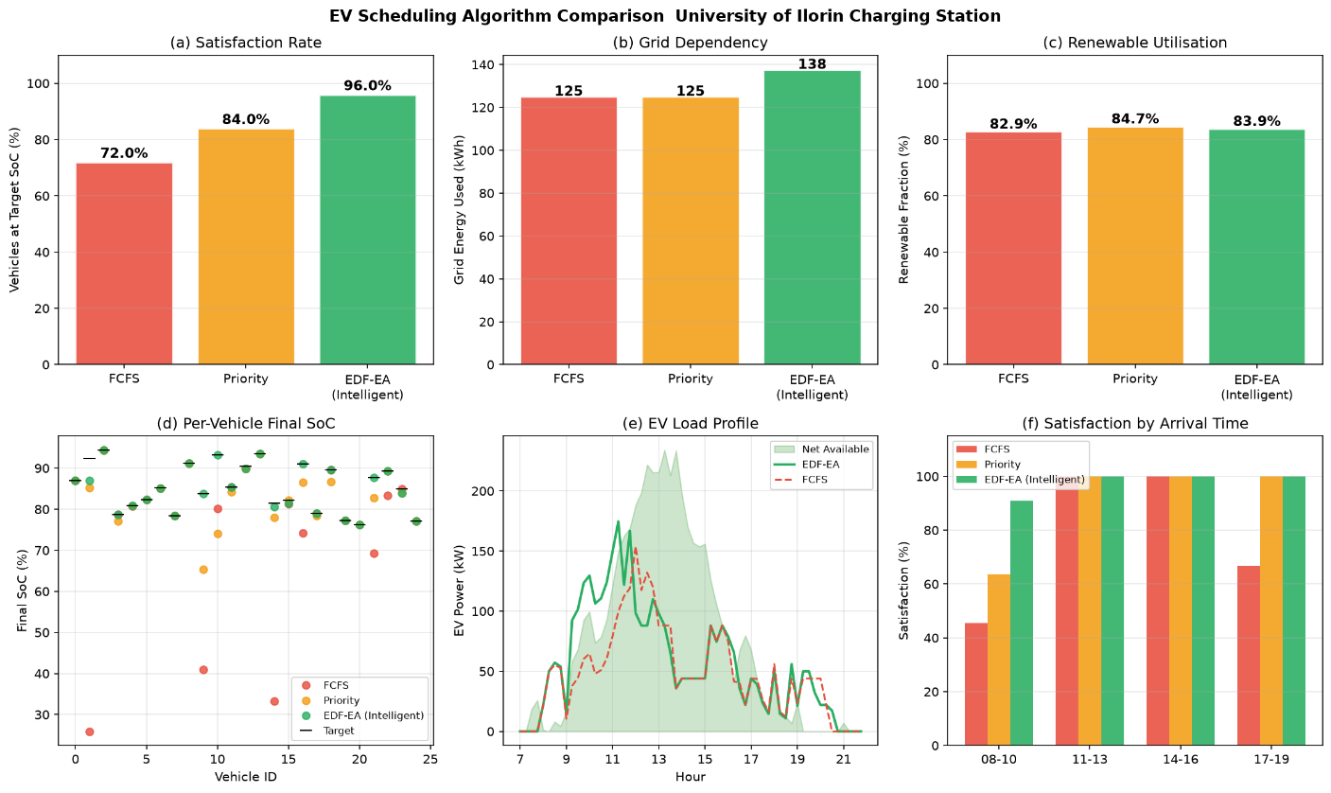
06 — RESULTS
Which Strategy Charged the Most Cars Fully?
Metric
Old Way
Our Way
Cars fully charged
18 / 25
24 / 25
Satisfaction rate
72.0%
96.0%
Clean energy delivered
730.0 kWh
852.9 kWh
Share powered by clean energy
82.9%
83.9%
In plain terms: Our smart method charged 6 more cars fully, using almost the same amount of grid backup power as the old method.
Graph — Head-to-head comparison of all three charging strategies
12 / 15

Slide 13
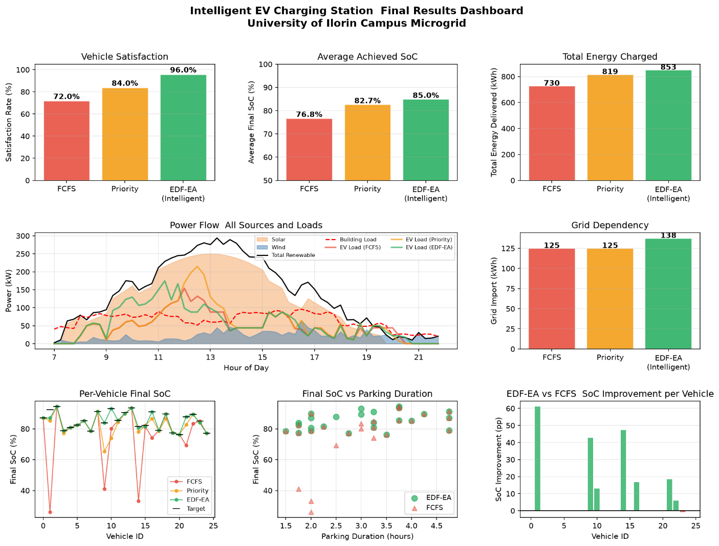
06 — RESULTS
The Big Picture: Everything at a Glance
Key takeaways:
Timing, not total power, was the real bottleneck all along.
Predicting the weather 30 minutes ahead was accurate enough to guide real decisions.
Smart scheduling lifted satisfaction from 72% to 96% — with the same solar panels, same battery, same wind turbine.
A tiny bit of extra grid backup (about the energy of one kettle running for a few hours) unlocked a much bigger clean-energy benefit.
Graph — Master summary dashboard: satisfaction, energy, power flow, and per-car results
13 / 15

Slide 14
07 — CONCLUSION & RECOMMENDATIONS
Software, Not Hardware, Is the Real Upgrade
In Conclusion
Our Recommendations
You don't need more solar panels or a bigger battery to charge more cars — you need smarter software that knows when the sun is coming.
Predicting the weather 30 minutes ahead is simple enough to run on a laptop, no supercomputer needed.
Saving a bit of battery power for the morning rush, instead of using it all overnight, made the biggest difference.
A small increase in grid backup use was a fair trade for far more happy, fully-charged drivers.
Universities installing EV chargers should invest in smart scheduling software first — it's cheaper than buying more panels or batteries.
Test this system on a real charging station, starting with a small pilot at University of Ilorin.
Make weather prediction a standard feature of every campus charging system.
Fine-tune the system's settings using real, ongoing usage data once it's deployed.
14 / 15

Slide 15
08 — REFERENCES
Selected References
Amir, M., et al. (2023). Intelligent energy management scheme-based coordinated control for reducing peak load in grid-connected PV-powered EV charging stations. IET Generation, Transmission & Distribution, 18(6), 1205–1222.
Sayed, K., Abo-Khalil, A. G., & Alghamdi, A. S. (2019). Optimum resilient operation and control DC microgrid based EV charging station powered by renewable energy sources. Energies, 12(22), 4240.
Hannan, M. A., Azidin, F. A., & Mohamed, A. (2014). Hybrid electric vehicles and their challenges: A review. Renewable and Sustainable Energy Reviews, 29, 135–150.
Tuchnitz, F., Ebell, N., Schlund, J., & Pruckner, M. (2021). Development and evaluation of a smart charging strategy for an EV fleet based on reinforcement learning. Applied Energy, 285, 116382.
Kumar, P., et al. (2025). A comprehensive review of vehicle-to-grid integration in electric vehicles. Energy Conversion and Management: X, 25, 100864.
Zhang, L., Jabbari, F., Brown, T., & Samuelsen, S. (2014). Coordinating plug-in electric vehicle charging with electric grid: Valley filling and target load following. IEEE J. Selected Topics in Signal Processing, 8(6), 1073–1083.
Razeghi, G., Zhang, L., Brown, T., & Samuelsen, S. (2014). Impacts of plug-in hybrid electric vehicles on a residential transformer. Journal of Power Sources, 252, 277–285.
Dorokhova, M., Martinson, Y., Ballif, C., & Wyrsch, N. (2021). Deep reinforcement learning control of EV charging in the presence of PV generation. Applied Energy, 301, 117504.
Full reference list (24 sources) available in the accompanying project report, Chapter References.
15 / 15

