Slide 1
Hashing
1. What is hashing?
2. How operates it?
3. Hash functions
4. Hash collision – pigeonhole Principle

Slide 2
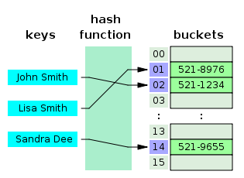
Hashing & Hash functions

Slide 3
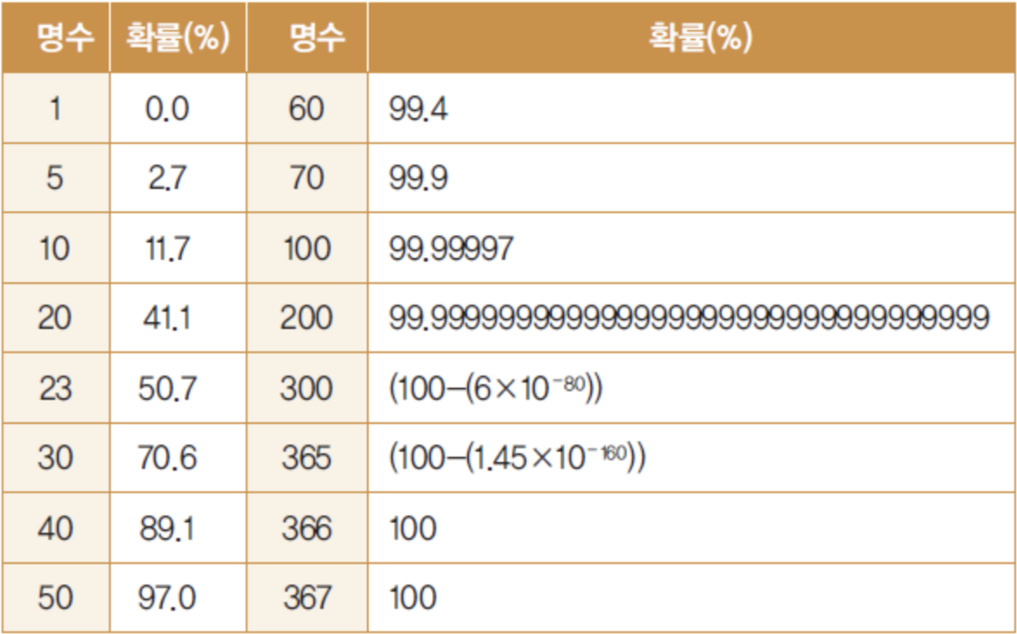
Pigeonhole principle

Slide 4
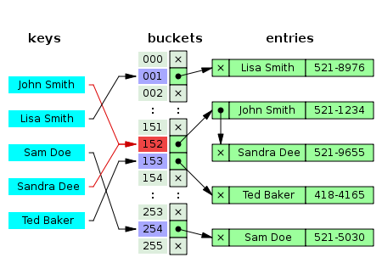
Hash collision - 1

Slide 5
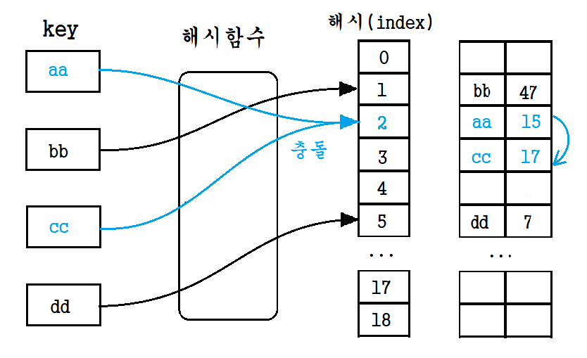
Hash collision - 2

Slide 6
Other Methods
1. Greedy Algorithm
2. Dynamic Programming

Slide 7
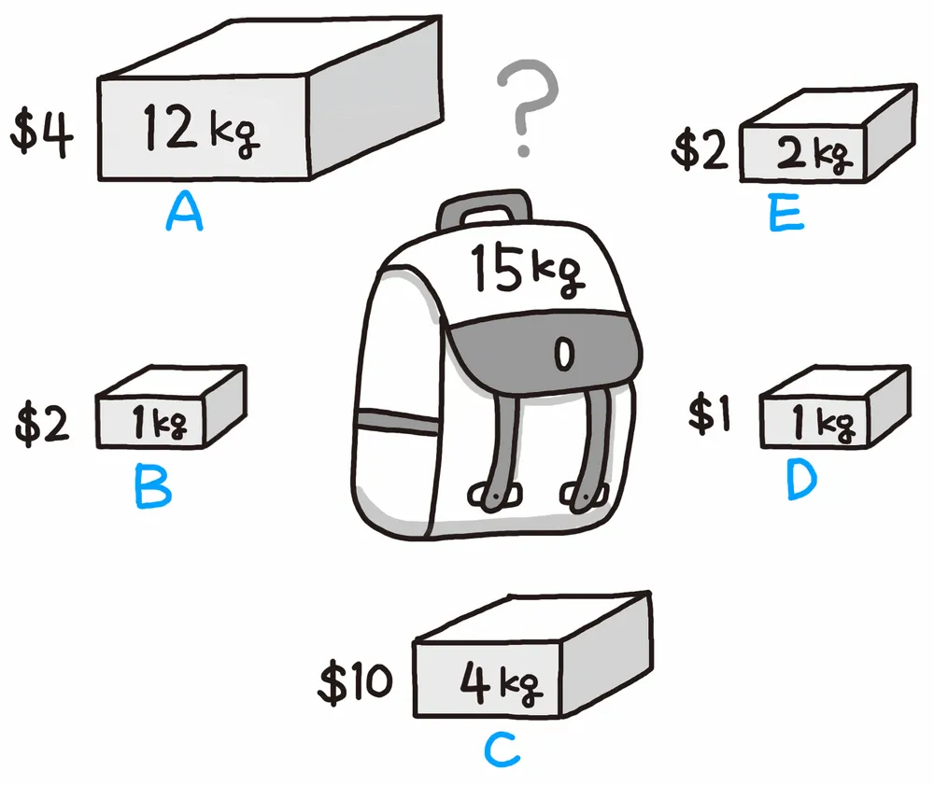
Greedy Algorithm

Slide 8
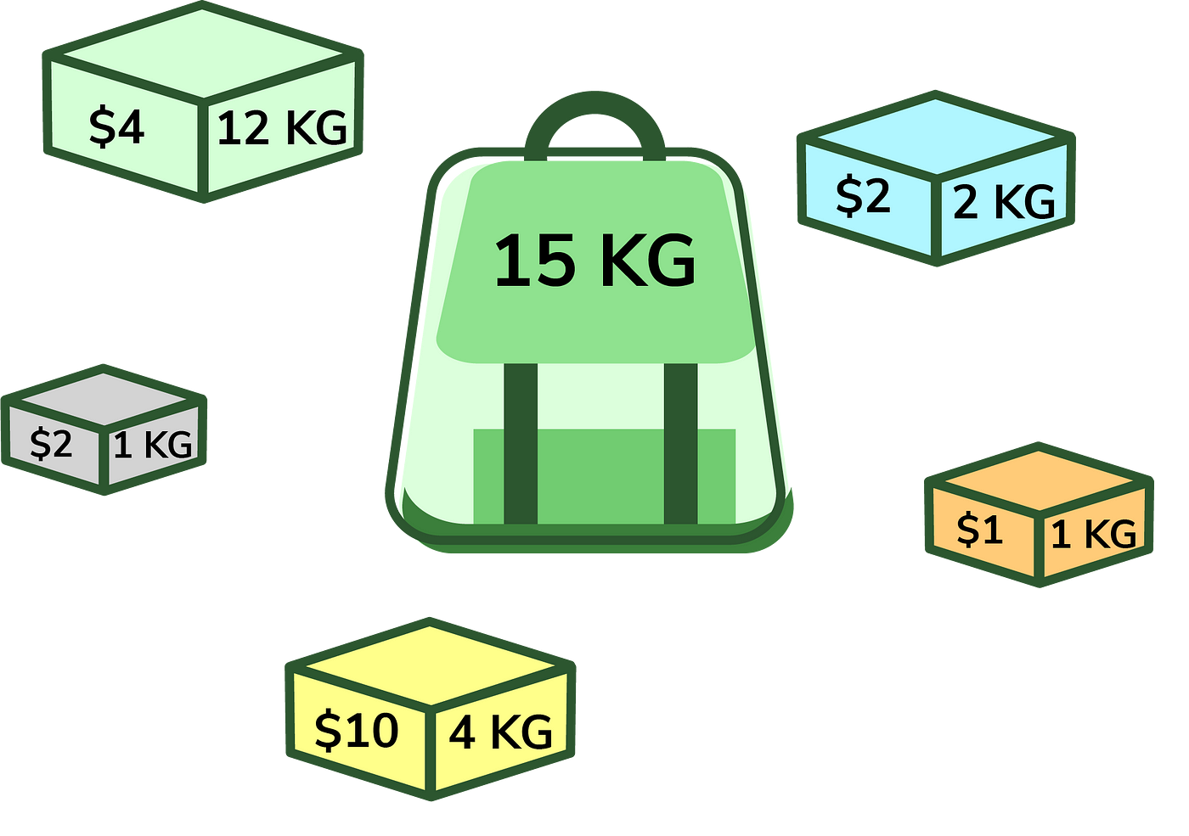
Dynamic Programming

Slide 9
Graph
1. Types of Graphs
2. Graph traversal – BFS/DFS
3. Shortest Path – Dijkstra, Bellman-Ford, Floyd-Warshall
4. Minimun Spanning Trees(MST): Kruskal, Prim, Solin

Slide 10
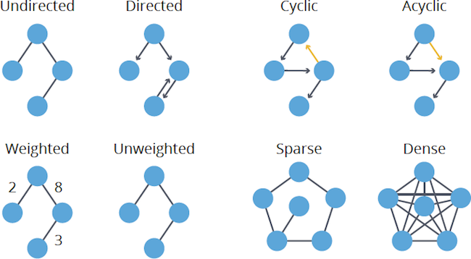
Types of Graph

Slide 11
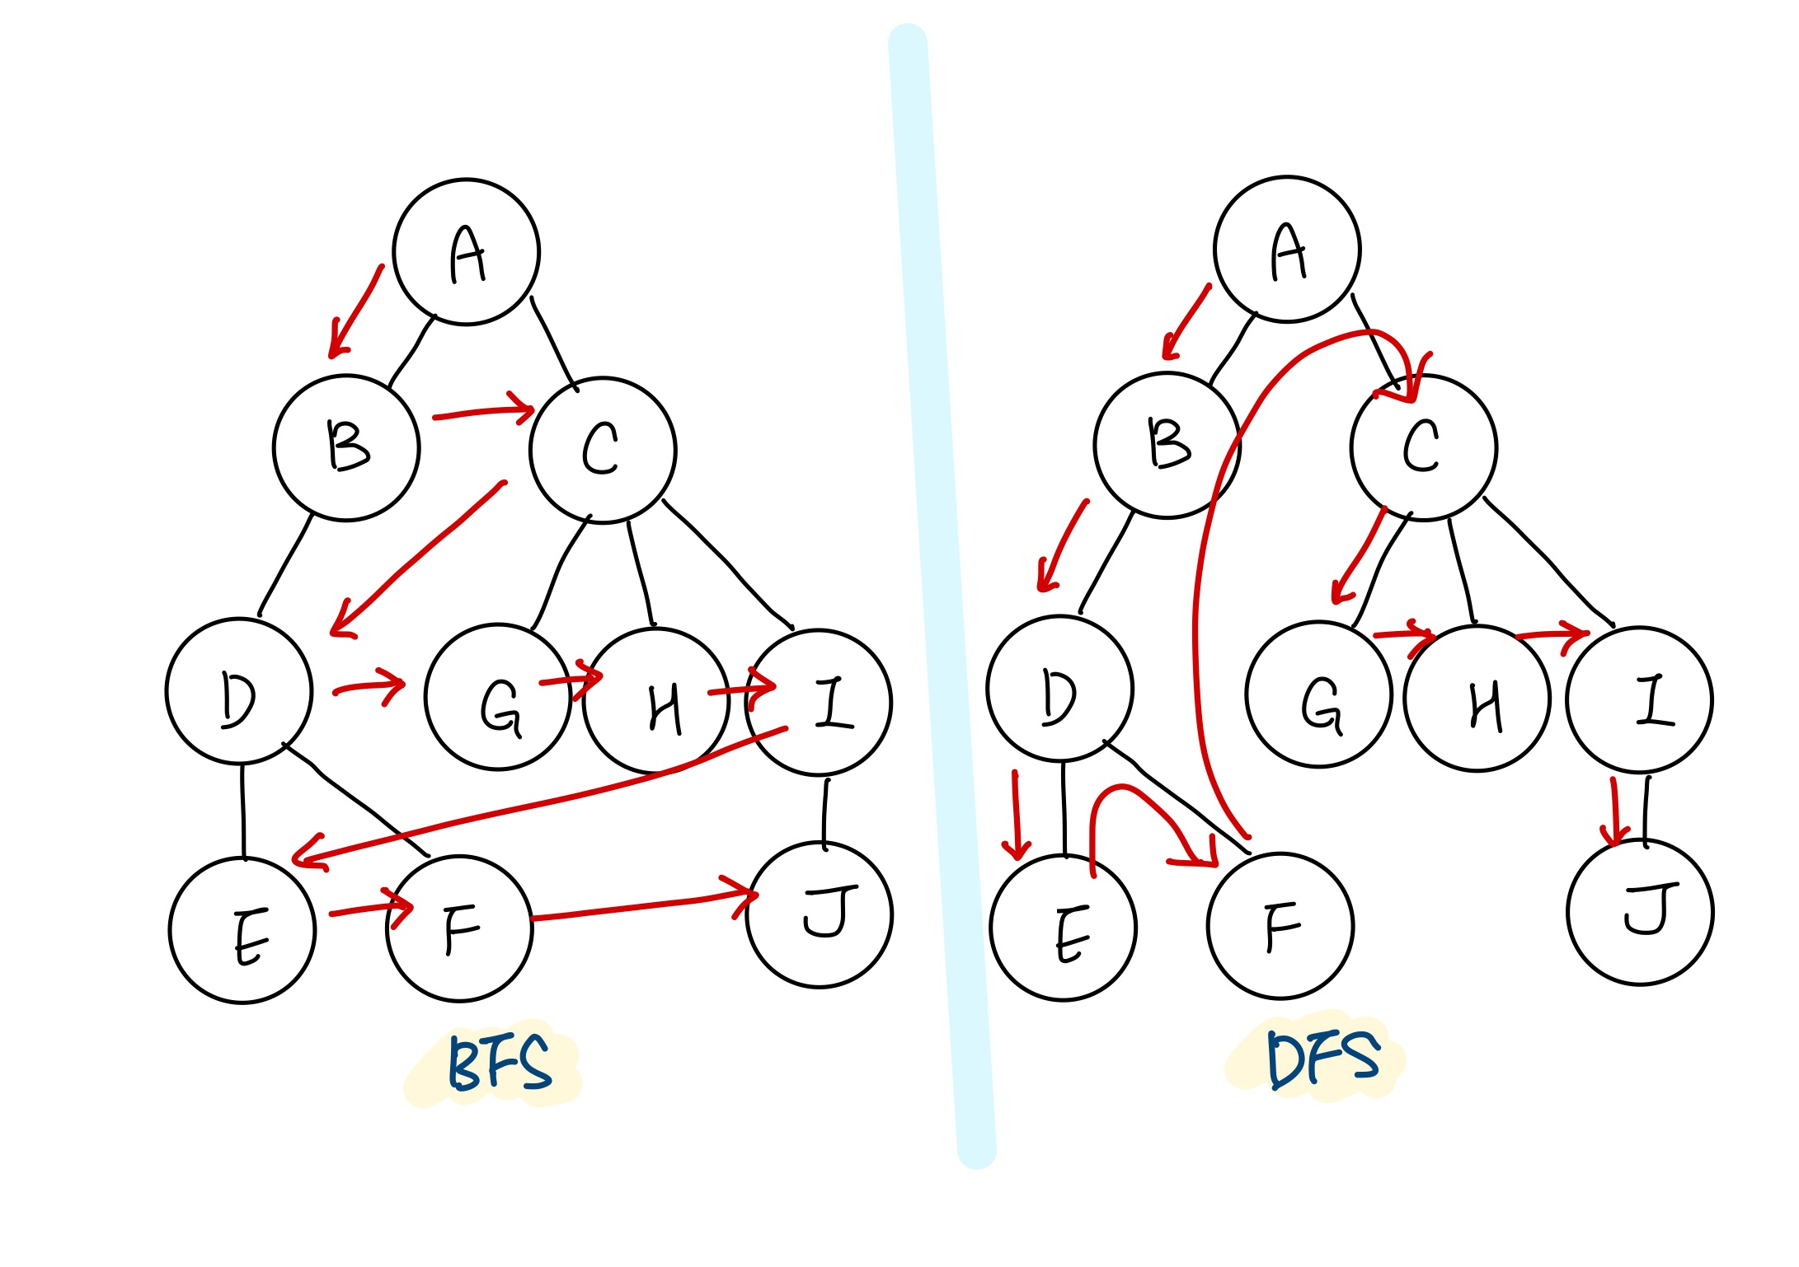
Graph traversal

Slide 12
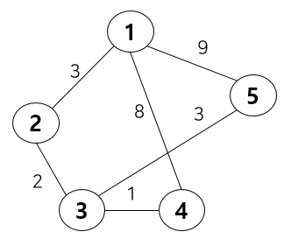
Shortest path - Dijkstra

Slide 13
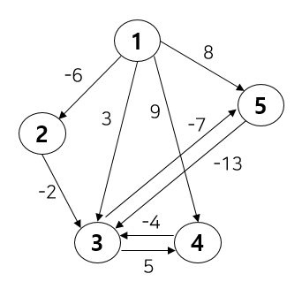
Shortest path – Bellman-Fort

Slide 14
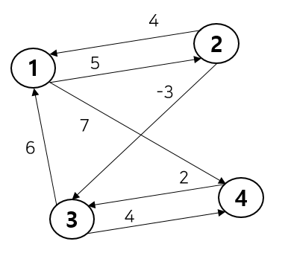
Shortest path – Floyd-Warshall

Slide 15
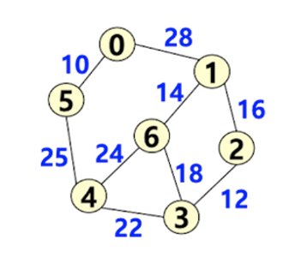
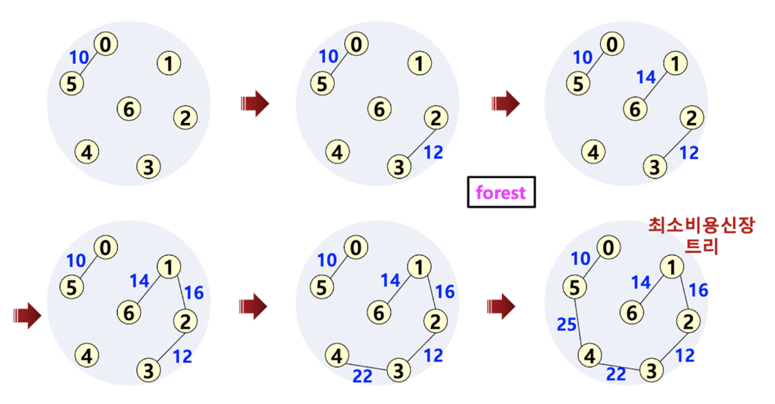
Minimum Spanning Tree - Kruskal

Slide 16
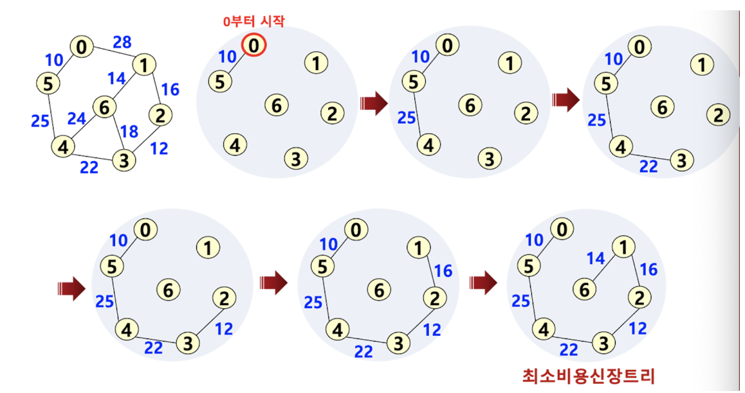
MST - Prim

Slide 17
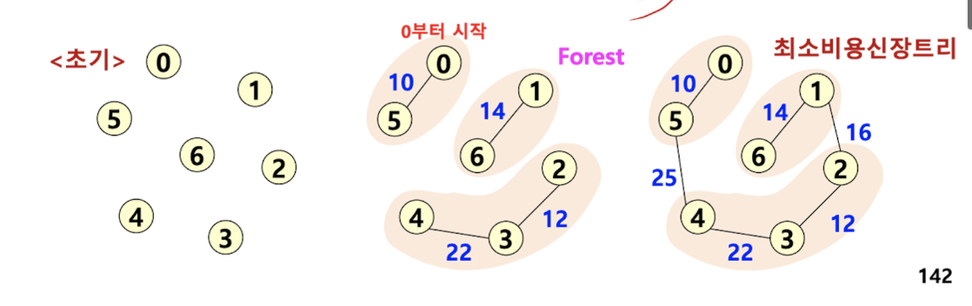
MST – Solin

