Slide 1
NEUTRAL MODEL

Slide 2
MODEL PARAMETERS
count of species
outside pool replacement rate (5%)
speciation rate - species level (10%)
speciation rate - individual level (40%)
death rate (10%)
inside pool replacement rate (count based or inverted) (0 and 1)
generations count (1000)
run count (10)

Slide 3
count
inverse

Slide 4
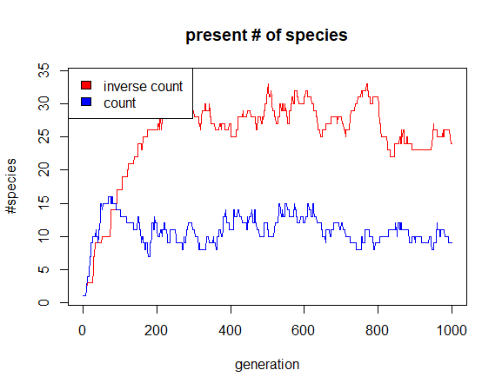

Slide 5
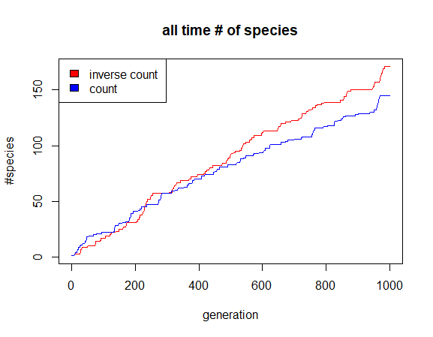

Slide 6
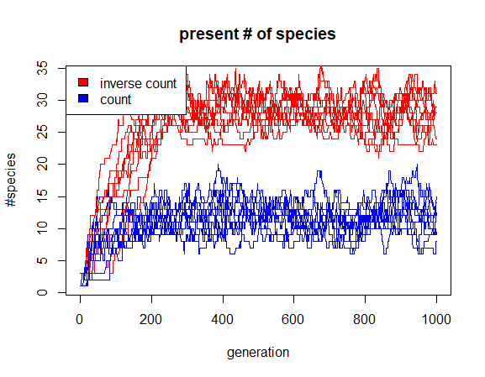

Slide 7
