Slide 1
.NET FRAMEWORK

Slide 2
INTRODUCTION TO .NET
.NET is a framework to develop software applications. It is designed and developed by Microsoft and the first beta version released in 2000.
It is used to develop applications for web, Windows, phone. Moreover, it provides a broad range of functionalities and support.
This framework contains a large number of class libraries known as Framework Class Library (FCL). The software programs written in .NET are executed in the execution environment, which is called CLR (Common Language Runtime). These are the core and essential parts of the .NET framework.
The .Net Framework supports more than 60 programming languages such as C#, F#, VB.NET, J#, VC++, JScript.NET, APL, COBOL, Perl, Oberon, ML, Pascal, Eiffel, Smalltalk, Python, Cobra, ADA, etc.

Slide 3
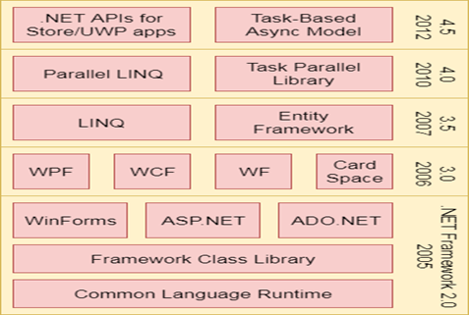
FOUR MAIN COMPONENTS
Common Language Runtime (CLR)
Framework Class Library (FCL),
Core Languages (WinForms, ASP.NET, and ADO.NET), and
Other Modules (WCF, WPF, WF, Card Space, LINQ, Entity Framework, Parallel LINQ, Task Parallel Library, etc.)

Slide 4
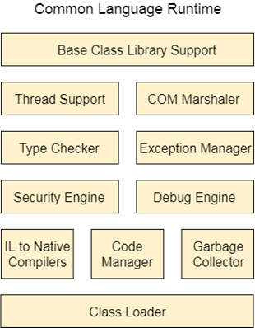
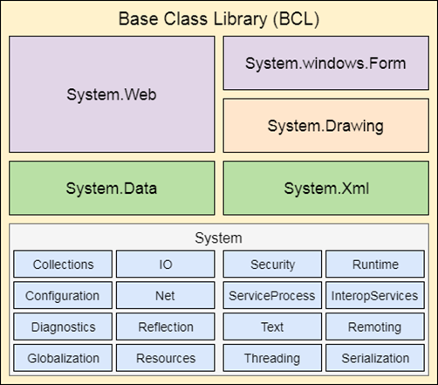
CLR (Common Language Runtime) and FCL (Framework Class Library)
It is a standard library that is a collection of thousands of classes and used to build an application. The BCL (Base Class Library) is the core of the FCL and provides basic functionalities.
It is a program execution engine that loads and executes the program. It converts the program into native code. It acts as an interface between the framework and operating system

Slide 5
WinForms
Windows Forms is a smart client technology for the .NET Framework, a set of managed libraries that simplify common application tasks such as reading and writing to the file system.
ASP.NET
ASP.NET is a web framework designed and developed by Microsoft. It is used to develop websites, web applications, and web services.
ADO.NET
ADO.NET is a module of .Net Framework, which is used to establish a connection between application and data sources.
WPF (Windows Presentation Foundation)
Windows Presentation Foundation (WPF) is a graphical subsystem by Microsoft for rendering user interfaces in Windows-based applications.
WCF (Windows Communication Foundation)
It is a framework for building service-oriented applications. Using WCF, you can send data as asynchronous messages from one service endpoint to another.
WF (Workflow Foundation)
Windows Workflow Foundation (WF) is a Microsoft technology that provides an API, an in-process workflow engine, and a rehostable designer to implement long-running processes as workflows within .NET applications.
LINQ (Language Integrated Query)
It is a query language, introduced in .NET 3.5 framework. It is used to make the query for data sources with C# or Visual Basics programming languages.
Entity Framework
It is an ORM based open source framework which is used to work with a database using .NET objects. It eliminates a lot of developers effort to handle the database. It is Microsoft's recommended technology to deal with the database.
Parallel LINQ
Parallel LINQ or PLINQ is a parallel implementation of LINQ to objects. It combines the simplicity and readability of LINQ and provides the power of parallel programming.

Slide 6
.NET Common Language Runtime (CLR)
.NET CLR is a run-time environment that manages and executes the code written in any .NET programming language
.NET CLR Functions
It converts the program into native code.
Handles Exceptions
Provides type-safety
Memory management
Provides security
Improved performance
Language independent
Platform independent
Garbage collection
Provides language features such as inheritance, interfaces, and overloading for object-oriented programmings.

Slide 7
.NET CLR Versions
The CLR updates itself time to time to provide better performance.
.NET CLR Structure
Base Class Library Support
It is a class library that provides support of classes to the .NET application.
Thread Support
It manages the parallel execution of the multi-threaded application.
COM Marshaler
It provides communication between the COM objects and the application.
Type Checker
It checks types used in the application and verifies that they match to the standards provided by the CLR.
Code Manager
It manages code at execution run-time.
Garbage Collector
It releases the unused memory and allocates it to a new application.
Exception Handler
It handles the exception at runtime to avoid application failure.
ClassLoader
It is used to load all classes at run time.

Slide 8
.NET FRAMEWORK CLASS LIBRARY
It contains thousands of classes that supports the following functions.
Base and user-defined data types
Support for exceptions handling
input/output and stream operations
Communications with the underlying system
Access to data
Ability to create Windows-based GUI applications
Ability to create web-client and server applications
Support for creating web services

Slide 10
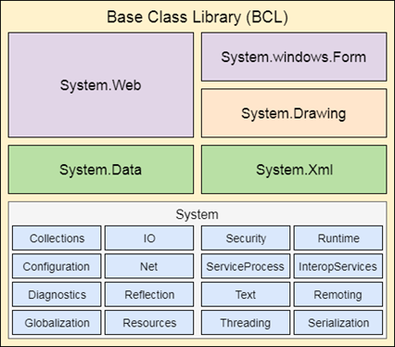
.NET Framework Base Class Library
.NET Base Class Library is the sub part of the Framework that provides library support to Common Language Runtime to work properly. It includes the System namespace and core types of the .NET framework.

Slide 11

THANK YOU

