Slide 1
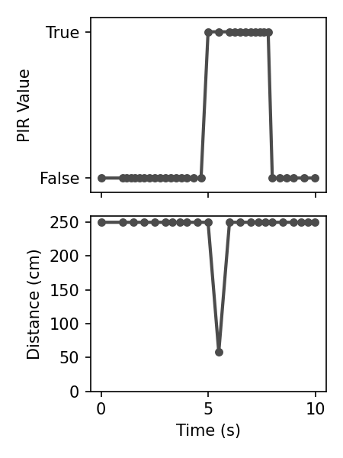
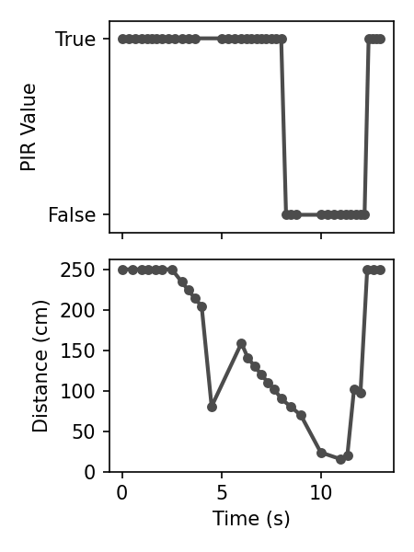
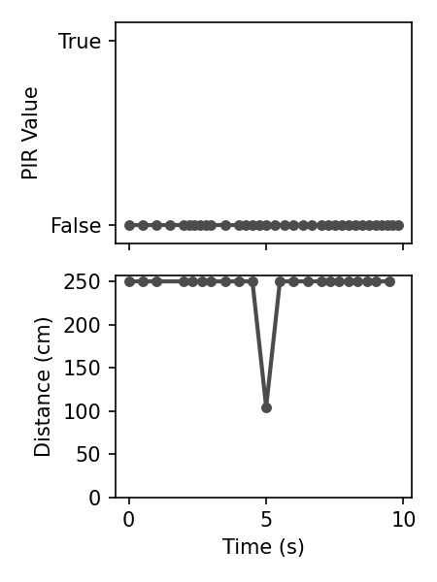
Pedestrian crossing
Approaching time
Erratic value
(a) Without wall
(b) Approaching to wall
(c) PIR reduces False Positive

