Slide 1
Dev-Talk March 2018
Bucher + Suter
Luca Berger Sandro Gerber
10.05.2018

Slide 2
Entity Framework Core

Slide 3
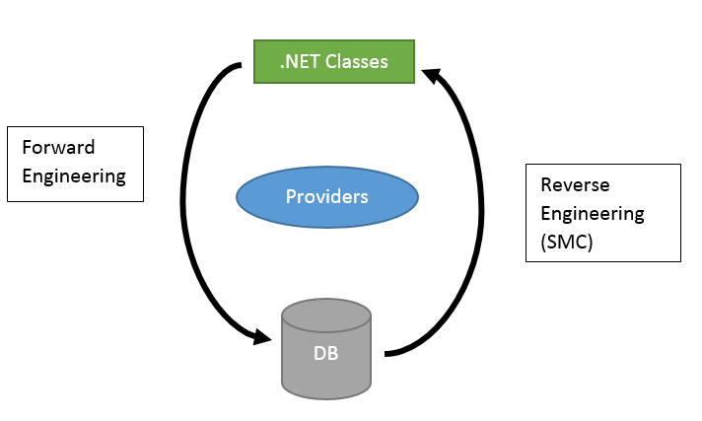
Overview

Slide 4
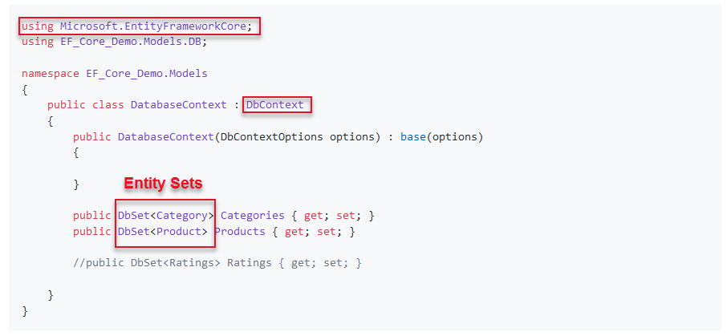
DbContext «short Intro»

Slide 5
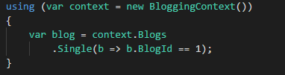
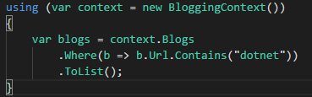
Query Data
Single Entities
Filtering

Slide 6
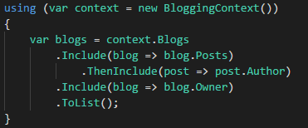
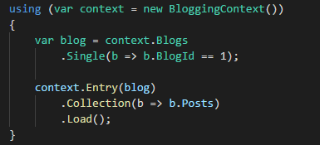
Query Data «Navigation Properties»
Eager loading (part of the query)
Explizit loading (loaded later)
→ «Lazy Loading» will be introduced with EF Core 2.1

Slide 7
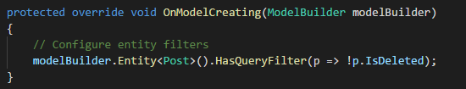

Global Query Filters
Example Ignore «IsDelete»
Ignore Query Filters

Slide 8
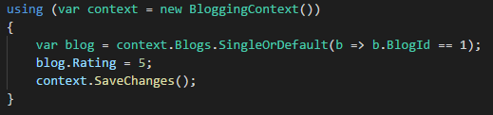
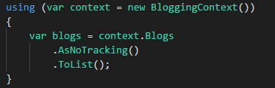
Change Tracker
EF Core keeps information about entities.
Performance boost when «readonly mode»

Slide 9
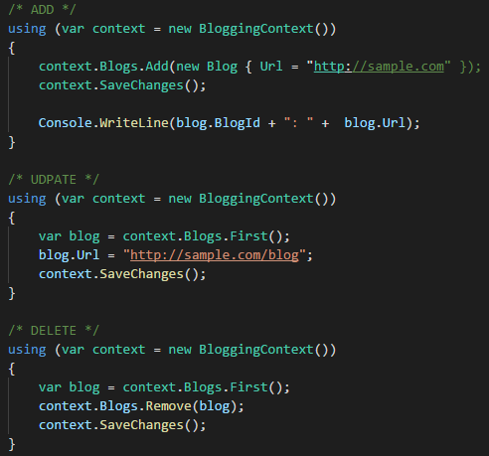
Insert, Update and Delete
There can be more than just one operation…
→ SaveChanges is transactional for most providers

Slide 10
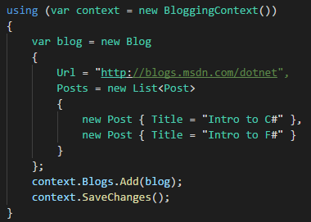
Related data
Adding children as well

Slide 11
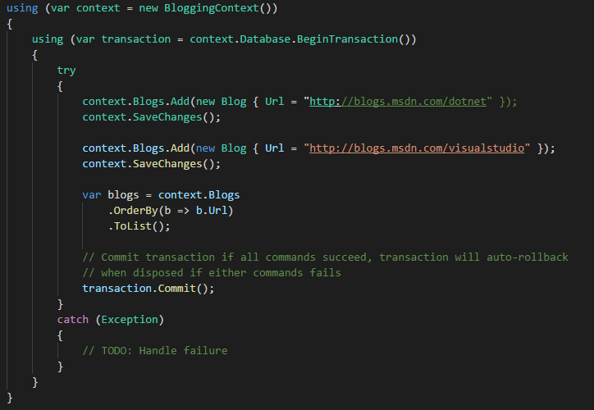
Transactions
Transactions can be handled

Slide 12
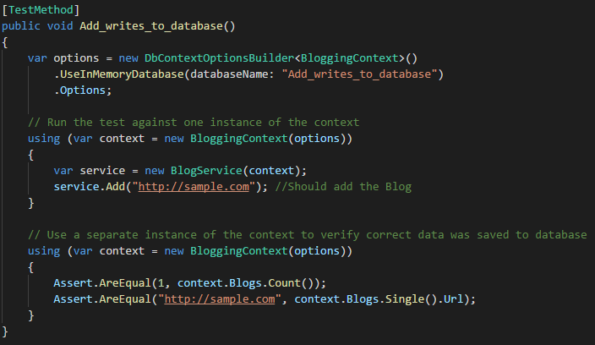
Testing with EF Core
EF Core introduced an «InMemory» provider → Details: https://docs.microsoft.com/en-us/ef/core/miscellaneous/testing/in-memory

Slide 13
Interresting links
Official MSDN docs? https://docs.microsoft.com/en-us/ef/core/
EF Tutorial http://www.entityframeworktutorial.net/efcore/entity-framework-core.aspx
Learn EF Core? https://www.learnentityframeworkcore.com/

Slide 14
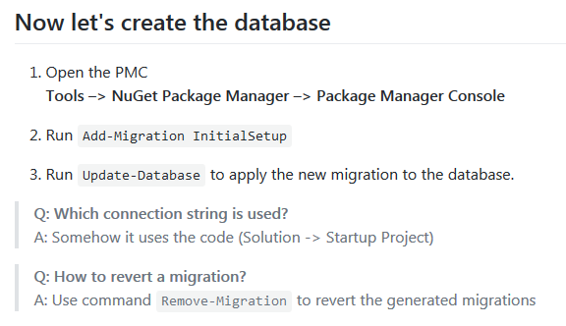
Migrations
«Add-Migration InitialCreate»

Slide 15
EF Core Demo

Slide 16
Comments? Questions?
Thank you!

