Slide 1


Introduction to git and GitHub
Download/ Setup instructions
(For Canepi! ☺)
By Sean Burnard

Slide 2
Welcome! Here is what will cover in the training session:
What is Git and GitHub
General Git workflow
Benefits of using GitHub
How to use your own Git/GitHub accounts
Downloading/ cloning repositories (‘repos’)
Website vs locally
Uploading our own repo
Locally vs website
Create and edit your own live website via GitHub!

Slide 3
Welcome! Here is what will cover in the training session:
What will you need?
Prior to the training session, you will need to have setup 4 different programmes/ accounts + saved/ bring 3 different photos (preferably in .png format).
What is Git and GitHub
General Git workflow
Benefits of using GitHub
How to use your own Git/GitHub accounts
Downloading/ cloning repositories (‘repos’)
Website vs locally
Uploading our own repo
Locally vs website
Create and edit your own live website via GitHub!
1) Text editor (programme)
2) Git (programme)
3) GitHub (account)
4) GitHub desktop (programme)
5) 3 ‘personal’ photos that you are happy to share and describe!
6) Think of 1 cartoon or animal.
The next slide will provide more details on how to install these programmes, please follow the order in which they are given!

Slide 4
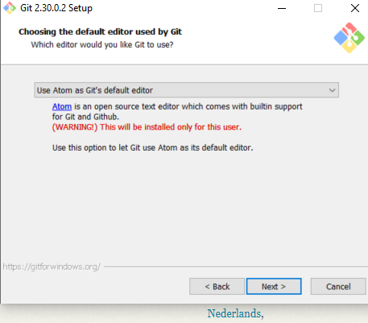
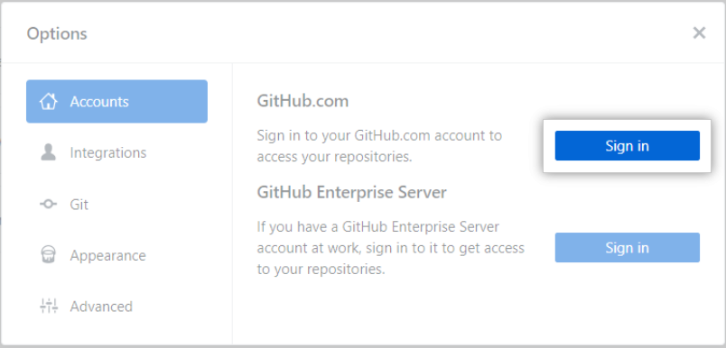
1) Text editor
2) Git
Go to the following and download for your comp:
https://git-scm.com/downloads
Keep all default settings apart from: ‘editor used by git’
Choose Atom or notepad++
Additional info:
Download either Atom or Notepad++:
Atom - https://atom.io/ (preferable over Notepad ++)
Notepad ++ https://notepad-plus-plus.org/downloads/
Follow all default settings during installation.
https://git-scm.com/book/en/v2/Getting-Started-First-Time-Git-Setup
https://docs.github.com/en/desktop/installing-and-configuring-github-desktop/getting-started-with-github-desktop
3) GitHub
4) GitHub Desktop
‘Signup’ for an account: https://github.com/ (top right corner)
FYI, your username will be used as your account link i.e https://github.com/SBurnard
Authenticate your account
Sign in to check you’ve set it up correctly
Download from: https://desktop.github.com/
Follow default installation options.
Authenticate/ link to your GitHub account:
Open the application
Click File→ Options → Accounts
Follow sign in instructions for GitHub.com
Done!

Slide 5

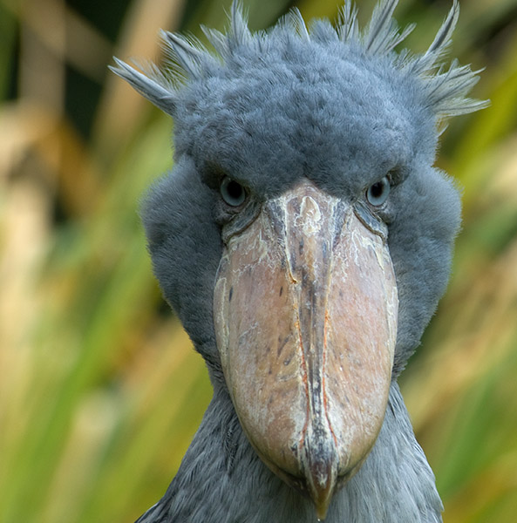
5) Please find and bring 3 ‘personal’ photos that you are happy to share and describe! (preferably in .png format). These could be photos of landscapes from around the world (holidays snaps), your family, or even your pet rock!
6) Think of 1 cartoon or animal.
https://www.wwf.org.au/news/blogs/in-photos-10-weird-and-wonderful-animals

Slide 6
And now… RELAX! ☺

