Slide 1
Meet the team
HAQA
Notes:
© Copyright Showeet.com – Creative & Free PowerPoint Templates

Slide 2
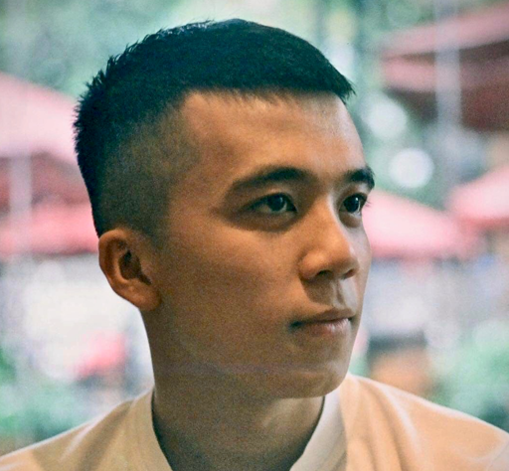
Meet the Team
HAQA
VŨ Hải Anh
LEAD TEAM
1st place in Vietnam Young Logistics Talent 2019, 2020( HUST qualifying round )
Prospect Award in Vietnam Young Logistics Talent 2020 ( Northern semifinal)
Co-author in some papers about optimization, optimizing parcel locker location
.Top 1 Sience Research Compettion hosted by School of Management and Economics - Ha Noi University Of Sience And Technology
Problem Solving
Phone: 0961213500
Email: vuhaianh240300@gmail.com
Communication
Microsoft office
Notes:
© Copyright Showeet.com – Creative & Free PowerPoint Templates

Slide 3
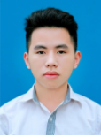
Meet the Team
HAQA
Nguyễn Quang ANh
PROGRAMMER
Java core, understanding of OOP, Servlet, Spring Boot
Used at a fairly stable level, knowledge about PyQt5, Flask, Pandas, Openpyxl,...
Good at solving optimization problem by using some heuristic, metaheuristic alogrithm like geneitc alogrithm, ant colony algorithm, ...
Top 1 Sience Research Compettion hosted by School of Management and Economics - Ha Noi University Of Sience And Technology
Phone: 0924566672
Email: anh.nq183476@sis.hust.edu.vn
Python
Optimization
Microsoft office
Notes:
© Copyright Showeet.com – Creative & Free PowerPoint Templates

Slide 4
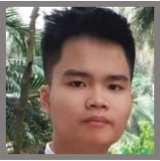
Meet the Team
HAQA
NGUYỄN ĐẮC VIỆT HÀ
TESTER, DATA COLLECTOR and analyst
IELTS 7.0 and Microsoft Office Specialist (Excel, Word)
Hard working , meticulous and wholeheartedly in work
1st place in Vietnam Young Logistics Talent 2019, 2020( HUST qualifying round )
Prospect Award in Vietnam Young Logistics Talent 2020 ( Northern semifinal)
Co-author in some papers about optimization, optimizing parcel locker location
.Top 1 Sience Research Compettion hosted by School of Management and Economics - Ha Noi University Of Sience And Technology
Phone: 0812289996
Email: vietha733@gmail.com
Data analyze
Microsoft skills
English
Communication
Notes:
© Copyright Showeet.com – Creative & Free PowerPoint Templates

