Slide 1
Lending Club Case Study
Sonipriya Singh
Anuja Kudumula

Slide 2
Problem Statement
Our objective is to assist a finance company in making smarter lending decisions by predicting loan defaults from past data.

Slide 3
Business Objective
Identify key factors driving loan defaults to minimize credit losses and improve risk assessment for the finance company.

Slide 4
Approach
Data cleaning and manipulation
Handling missing values & outliers
Univariate analysis
Segmented univariate analysis
Bivariate analysis
Multivariate analysis

Slide 5
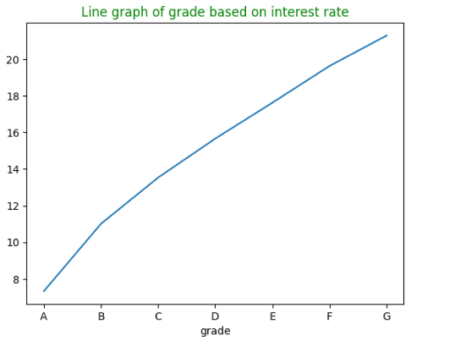
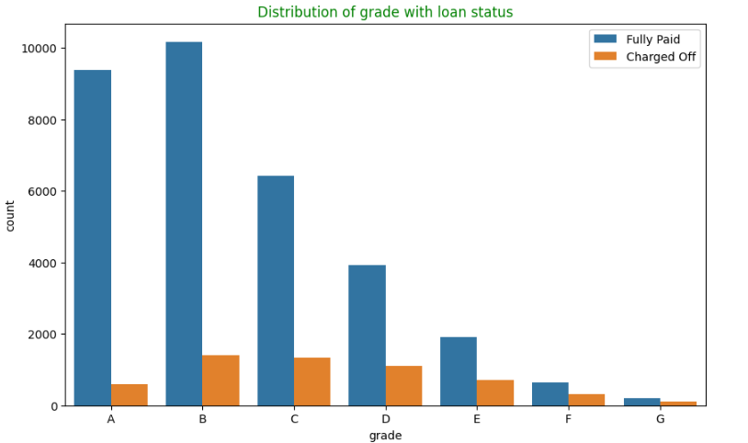
Analysis
Grade and loan status
Grade and Interest rate
As grade increases(meaning from A to G), interest rate has also increased
Borrowers with higher Grade E,F,G have higher chance of defaulting the loan.

Slide 6
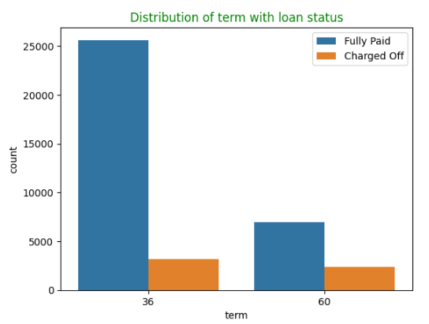
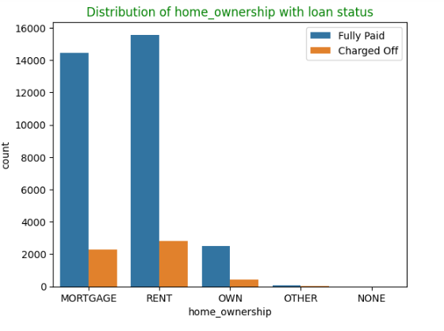
Analysis
Home Ownership
Term
Applicants who don’t own a property and on are rent/mortgage are more likely to default the loan.
Majority of loan given to 36 months tenure and are less likely to default

Slide 7
Analysis
Home Ownership
Term
Applicants who don’t own a property and on are rent/mortgage are more likely to default the loan.
Majority of loan given to 36 months tenure and are less likely to default

Slide 8
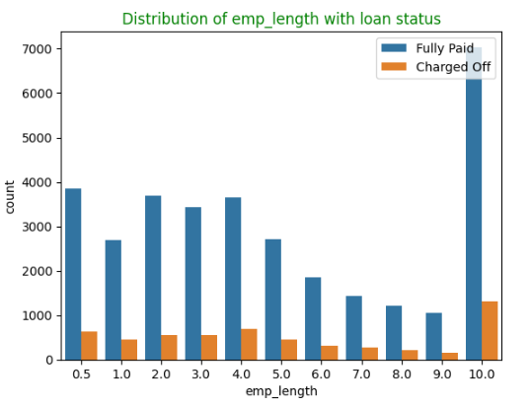
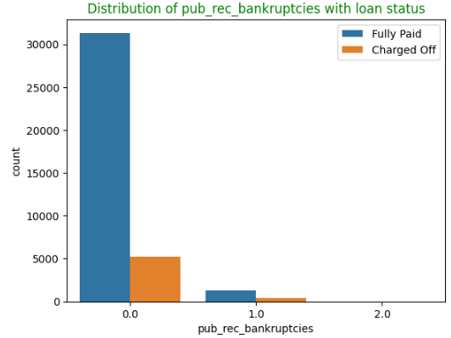
Analysis
Employment Length
Public record bankruptcies
Majority of the borrowers have 10+ years of experience and have highest number of defaulters.
Majority of the borrowers have no history of bankruptcy. Borrowers with large number of public records bankruptcies are more likely to default.

Slide 9
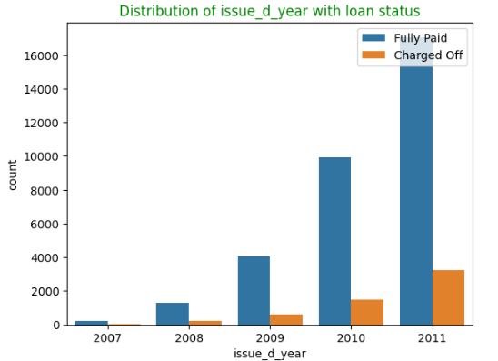
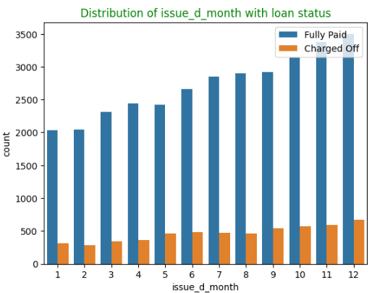
Analysis
Loan trend over years
Loan trend over months
Number of loans issued have increased from 2007 to 2011.
Number of the loans issued have increased in the last quarter.

Slide 10
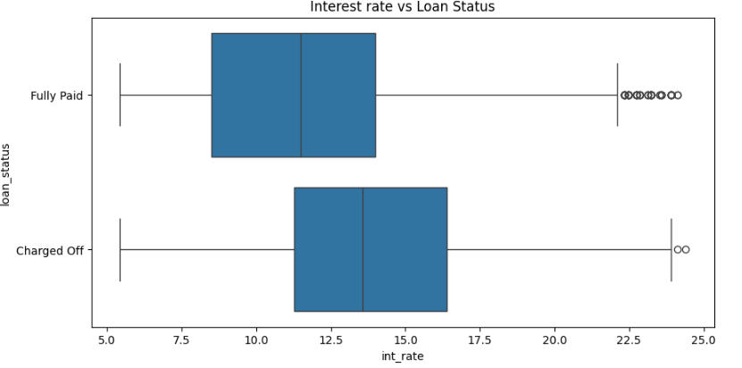
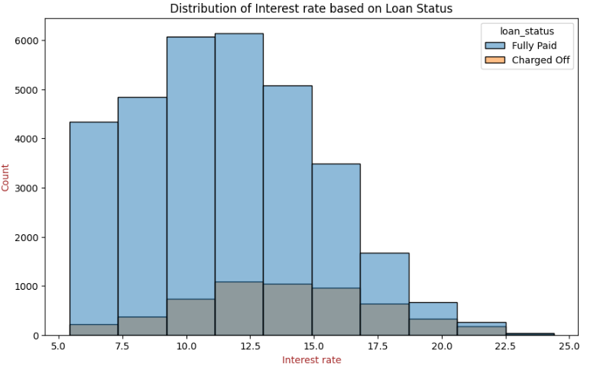
Analysis
Interest rate over loan status
Interest rate over loan status
High interest rate borrowers are more likely to default.
Majority of borrowers are in the interest range 10-15.

Slide 11
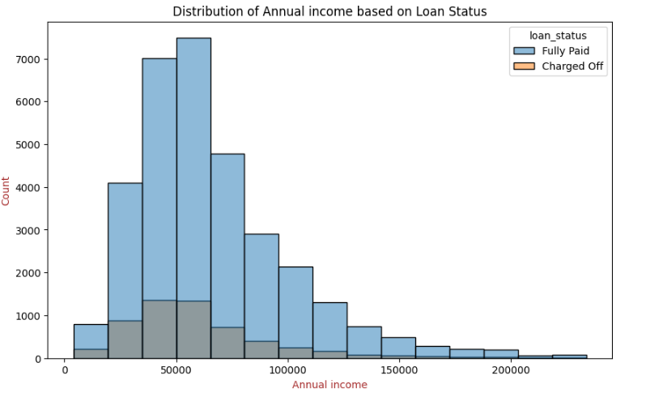
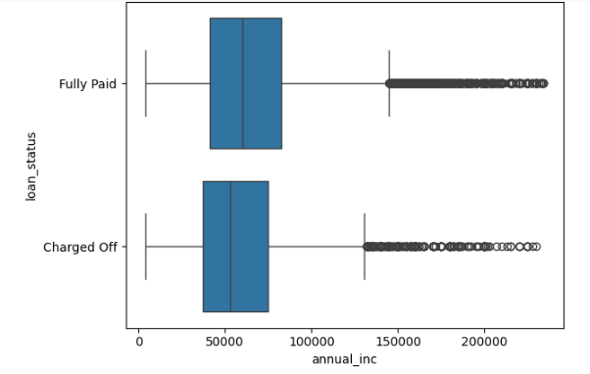
Analysis
Annual income
Annual income based on loan status
Majority of Borrowers are with annual income around 50000.
People with low annual income are more likely to default.

Slide 12
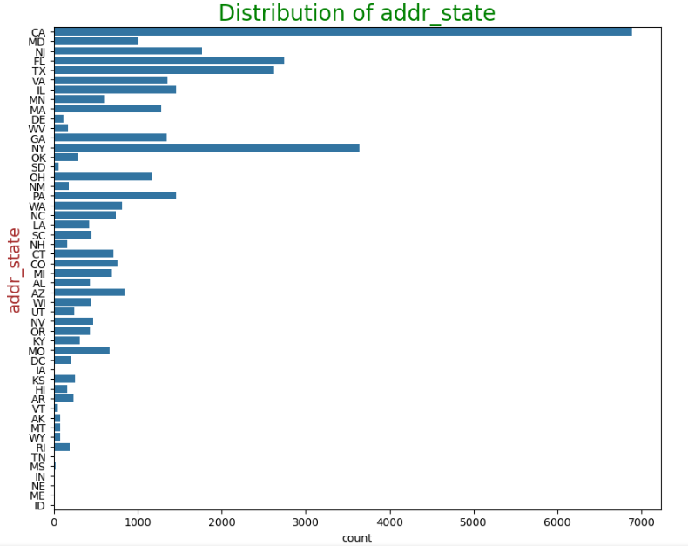
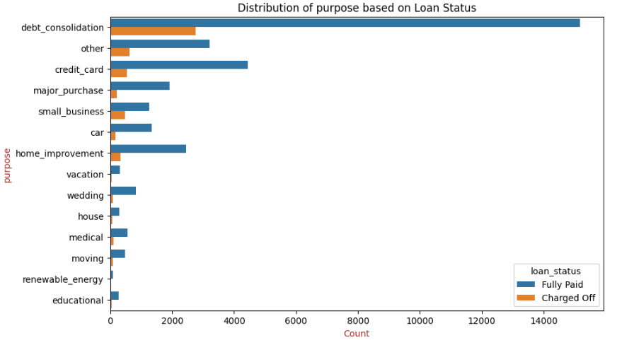
Analysis
Loan Purpose
State of the borrower
Majority of loans were taken for the purpose of debt_consolidation followed by credit_card.
Majority of borrowers are from CA followed by NY, FL, TX.

Slide 13
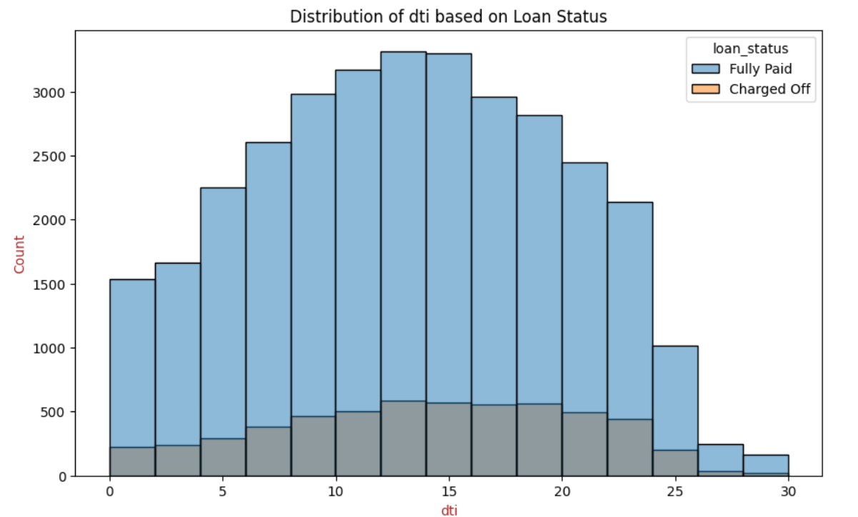
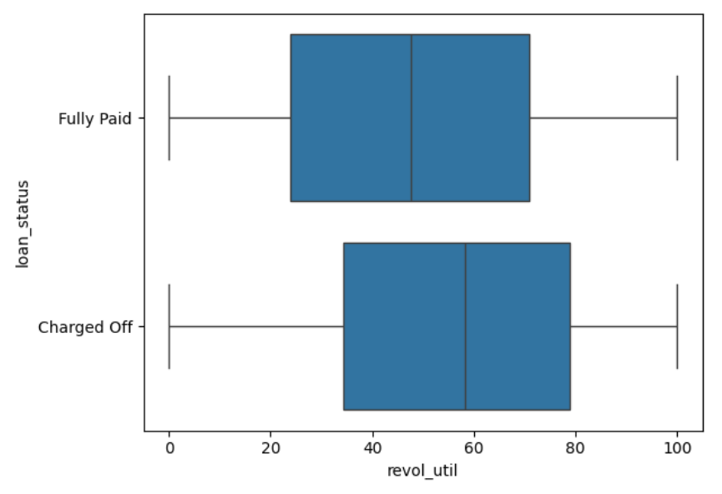
Analysis
dti
Revolving line utilization
Majority of the borrowers are with dti range 10 -15, the defaulters are also more.
Borrowers having high revolving utilization are more likely to default.

Slide 14
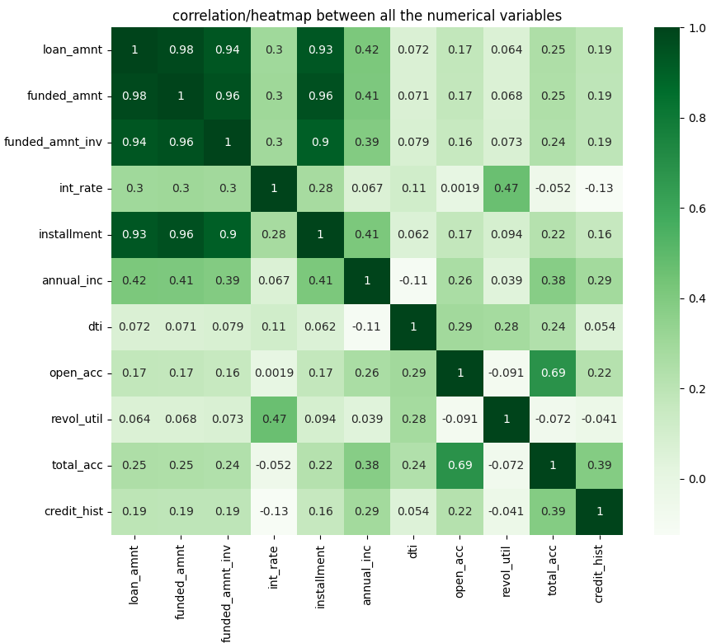
Analysis
Correlation matrix
There is strong correlation between installment and loan_amnt, funded_amnt and funded_amnt_inv. These parameters are directly proportional to one another.

Slide 15
Conclusion
Below are the Major Driving factors which can be used to predict the loan deafulters.
home_ownership
Grade
revolving_util
int_rate
Pub_rec
annual_income

