Slide 1
RISC-V · TENSOR ACCELERATOR · AXI4 · SKY130B · RTL → GDSII
Aurora v1 — AI SoC
A complete System-on-Chip taken from RTL to a signed-off GDSII layout —
open-source tools only, on a single 23 GB laptop.
Yashwanth Kudum · github.com/kudumyashwanth/aurora-v1

Slide 2
What is Aurora v1?
Multi-clock AI SoC: a 64-bit RISC-V core + a hardware matrix-multiply
accelerator over a coherent-terminated AXI4 fabric.
• Rocket RV64IMAC CPU tile — hardened macro, 33 MHz
• 4×4 systolic tensor engine (int16) — hardened macro, 50 MHz
• 8×8 AXI4 crossbar + dual async clock-domain bridges
• UART · GPIO · timer · interrupt ctrl · boot ROM · SRAM
Carried through the ENTIRE flow: RTL → lint → sim → formal →
synthesis → floorplan → place → CTS → route → DRC → LVS → GDSII.
complete
RTL→GDSII
137,562
Devices
41.25 mm²
Die
33 / 50 MHz
Clocks

Slide 3
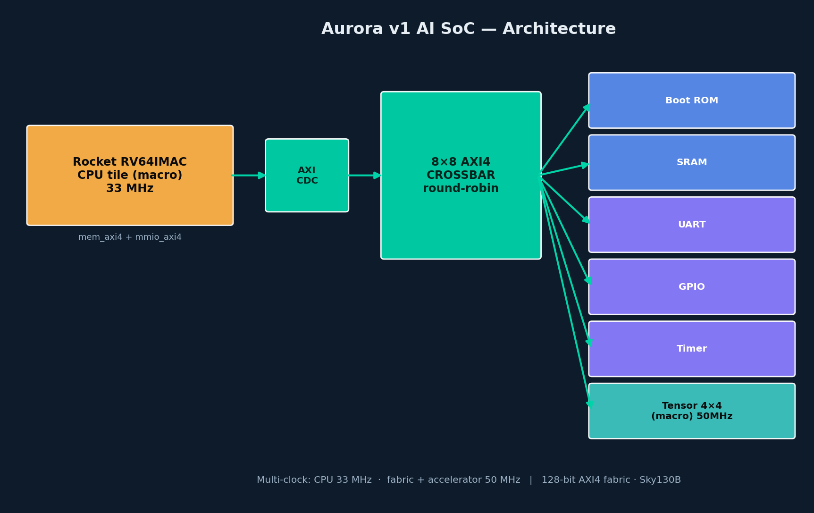
Architecture

Slide 4
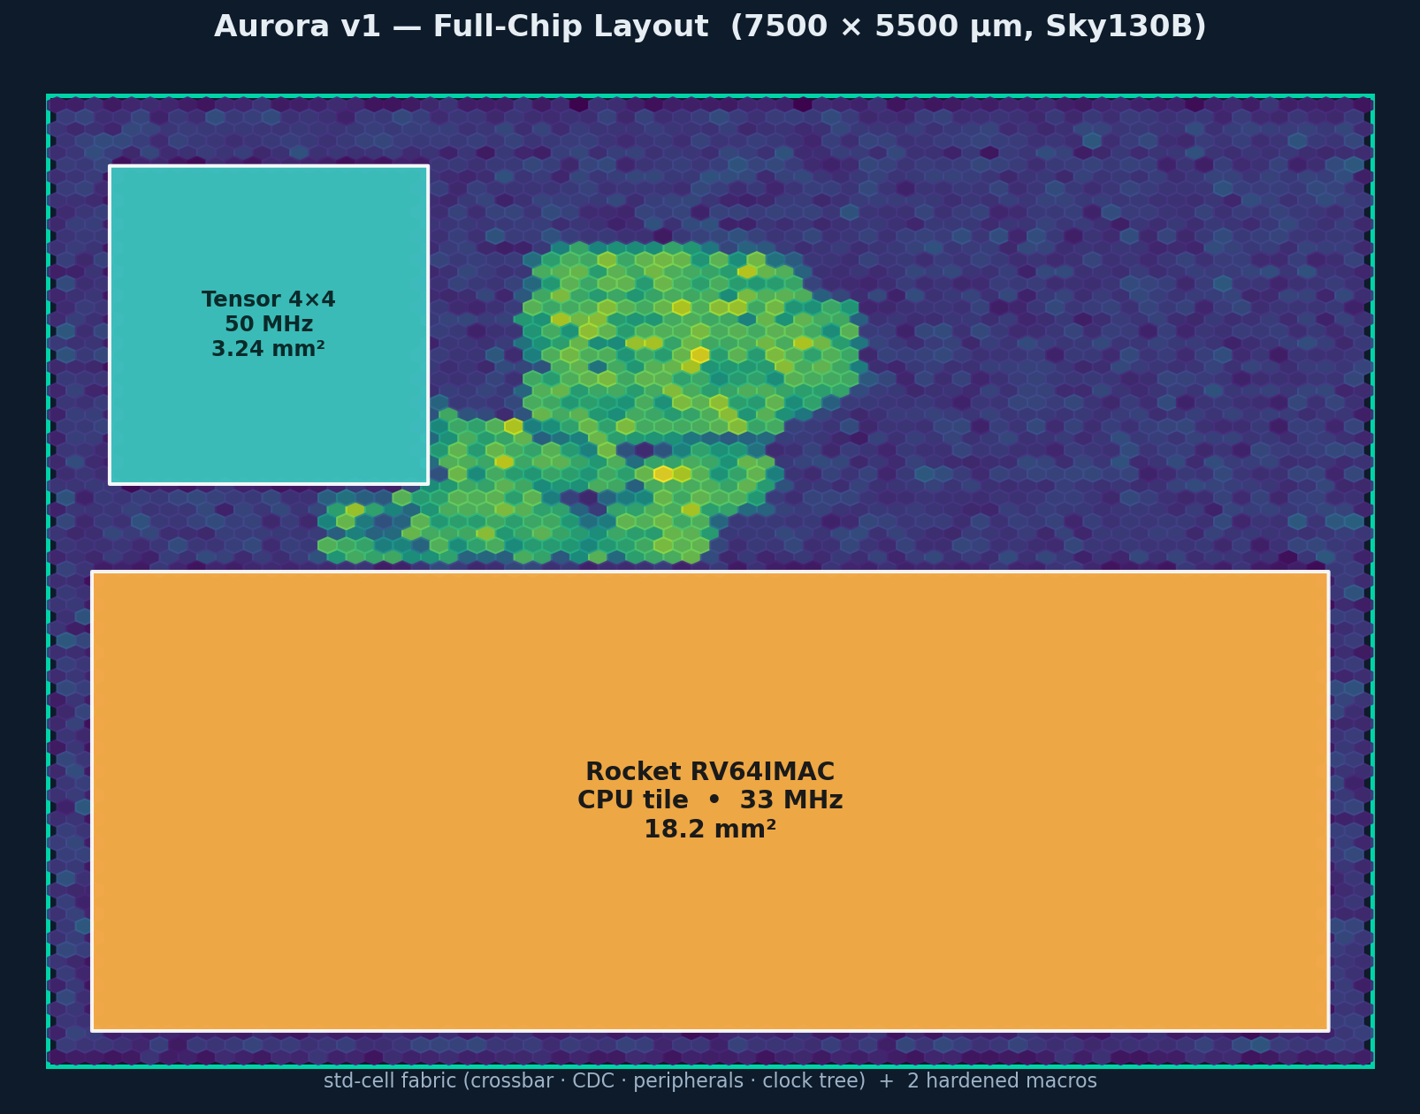
Full-Chip Layout
Rendered from
the actual
placement
database —
130.5k glue
cells + 2
hard macros.

Slide 5
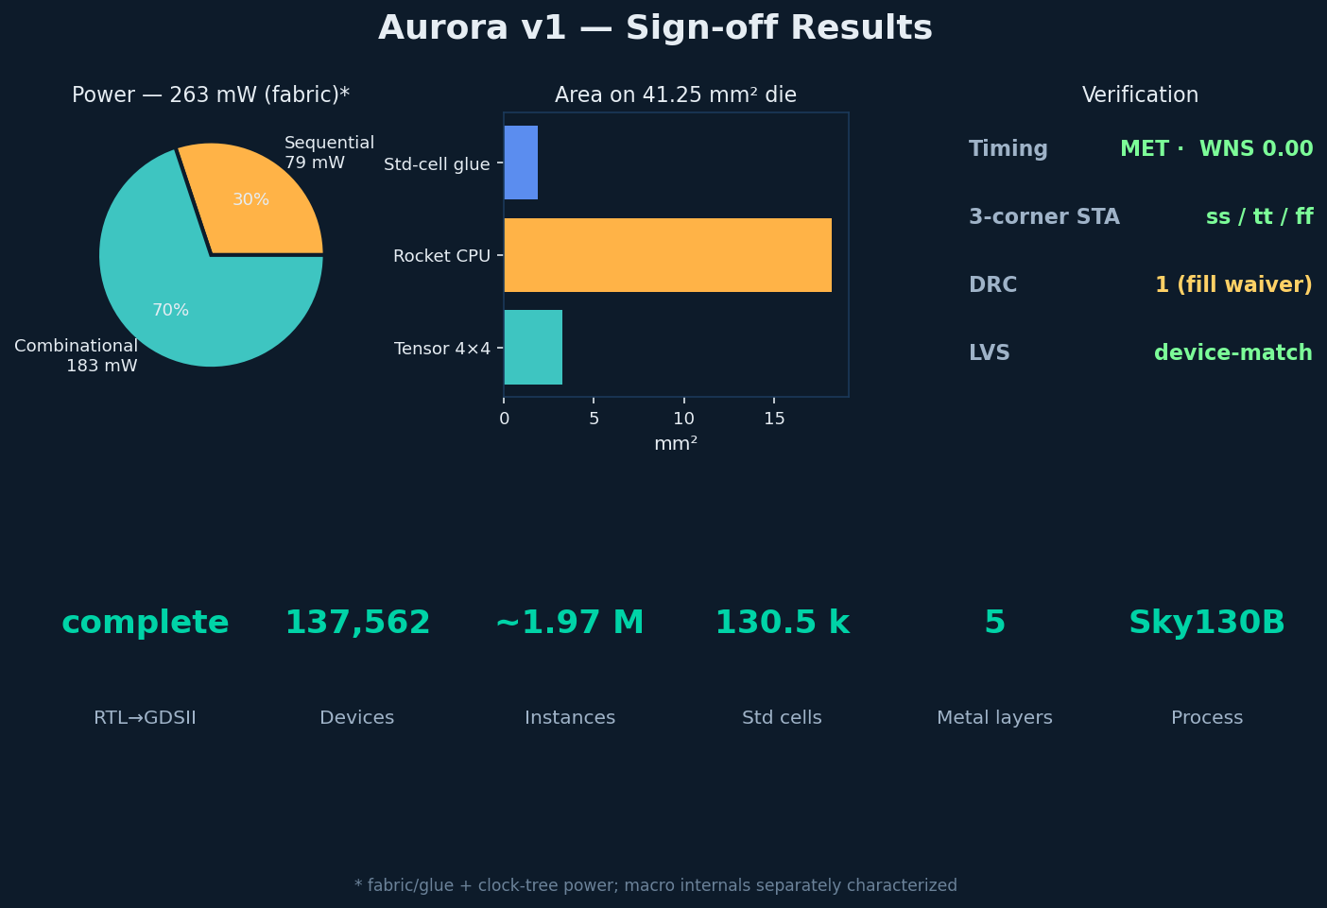
Sign-off Results

Slide 6
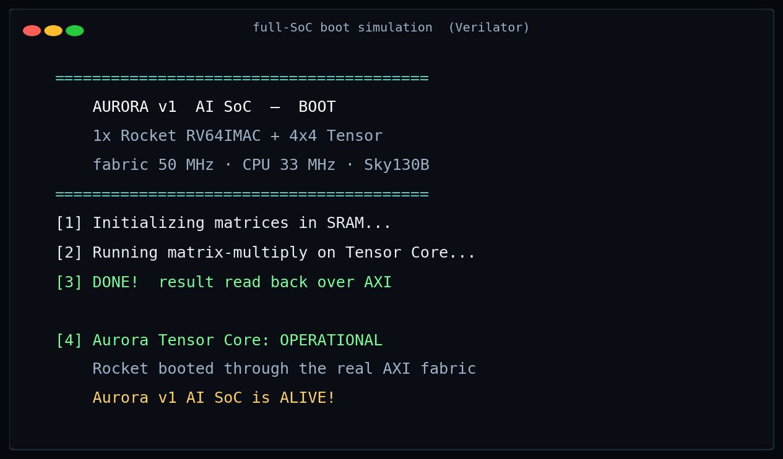
It Boots — Functional Verification
Full-SoC sim:
Rocket boots
through the
real fabric,
drives the
tensor core,
reads result
over AXI.
Zero traps.

Slide 7
Engineering Highlights
■ Cracked a routing-congestion wall on the dense systolic datapath —
diagnosed a metal-1 short-storm, beat it with a soft layer-derate.
■ Hardened a RISC-V tile as an AXI macro — re-wrapped Rocket's
TileLink-C port through a cache cork + TL-to-AXI4 bridge (Chisel).
■ Closed multi-clock timing — moved the FPU/divider-bound CPU path
to RV64IMAC @ 33 MHz; accelerator + fabric @ 50 MHz, async-bridged.
■ Full-chip PDN + LVS integration — root-caused power-grid fragmentation
to a dual-layer-power macro; fixed with a PDN keep-out → clean device-match.
■ Memory-bounded P&R — entire flow capped at 18 GB to survive a 23 GB host.

Slide 8
RTL to silicon — done.
A full RISC-V + tensor AI SoC, signed off to GDSII on commodity
hardware with open tools. Timing MET · DRC 1 · LVS device-match.
github.com/kudumyashwanth/aurora-v1 · IP available for licensing

