Slide 1
the koala project
by colin kuebler

Slide 2
what is koala?
“web-based sandbox programming environment for new and learning programmers”

Slide 3
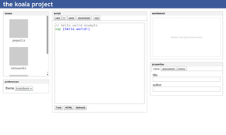
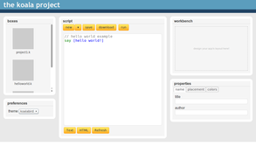
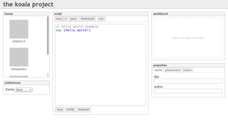
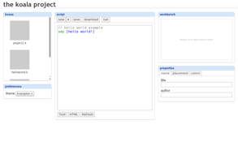
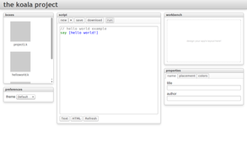
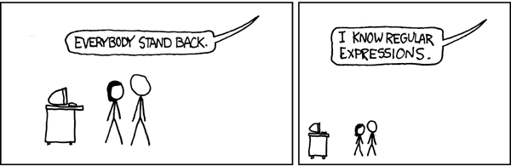
progress...
demo time?
syntax
highlighting!
themes!
lexical analyzer!
*(cc) xkcd

Slide 4







challenges...
browser differences!
contenteditable tag
selection and range
dynamic css
dom manipulation

Slide 5
next time
server side project management!
  work out issues with contenteditable
  compile to javascript
  add control structures
  arithmetic parsing
  user accounts (?)

Slide 6
thanks!
thanks to sean o'sullivan
for making rcos possible!
thanks to moorthy and rcos
for making koala possible!
questions? comments?

