Slide 1
the koala project
by colin kuebler

Slide 2
little bro/pops/miss texas/pet rock...
wants to learn computer programming

Slide 3
okay, lets start simple.
setup your environment.
which OS
do you use?
you sure?
do you want to use
visual studio?
install dev-c++
????
xcode!
(no idea...)
so wait, you're
not a programmer?
finally,
STEP 2!
ಠ_ಠ
sudo apt-get install build-essentials gcc g++

Slide 4
can we start coding yet?
short and simple “hello world”
#include <iostream>
using namespace std;
int main(){
cout << “hello world!” << endl;
return 0;
}

Slide 5
problem? solution.
platforms, languages, and IDEs
= confusing setup
web based
= no setup
verbose code
= scared noobs
plain english + intelligent interpreter
= quick learner
the koala project.

Slide 6
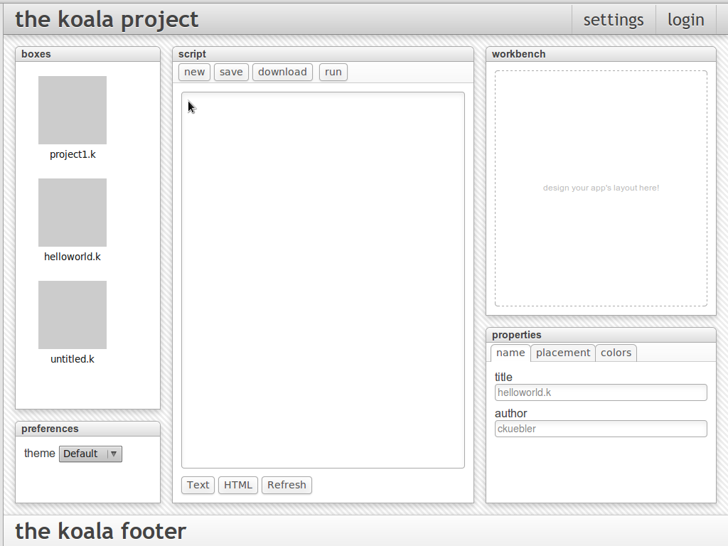

Slide 7
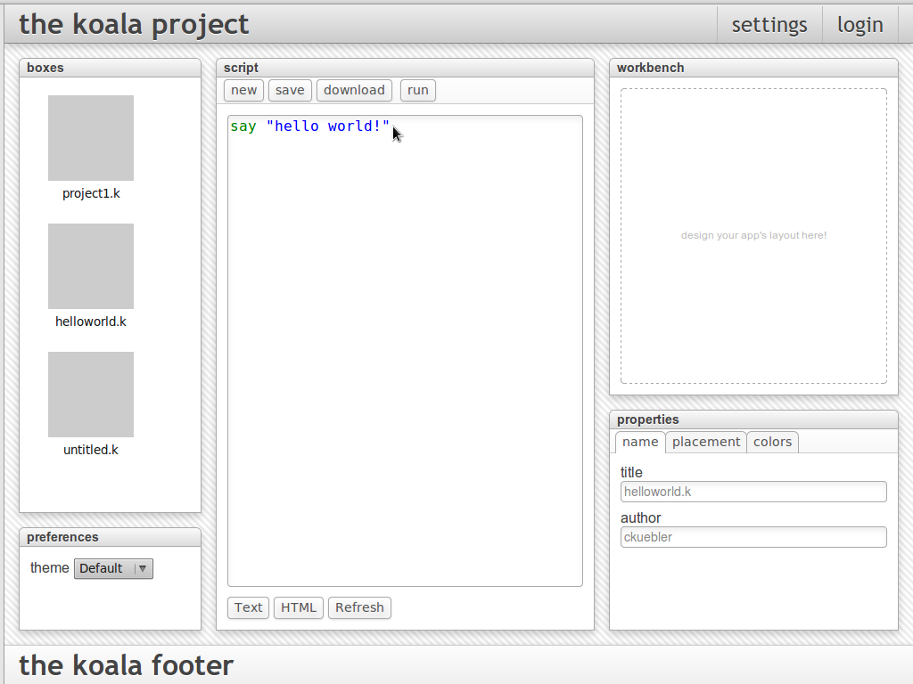

Slide 8
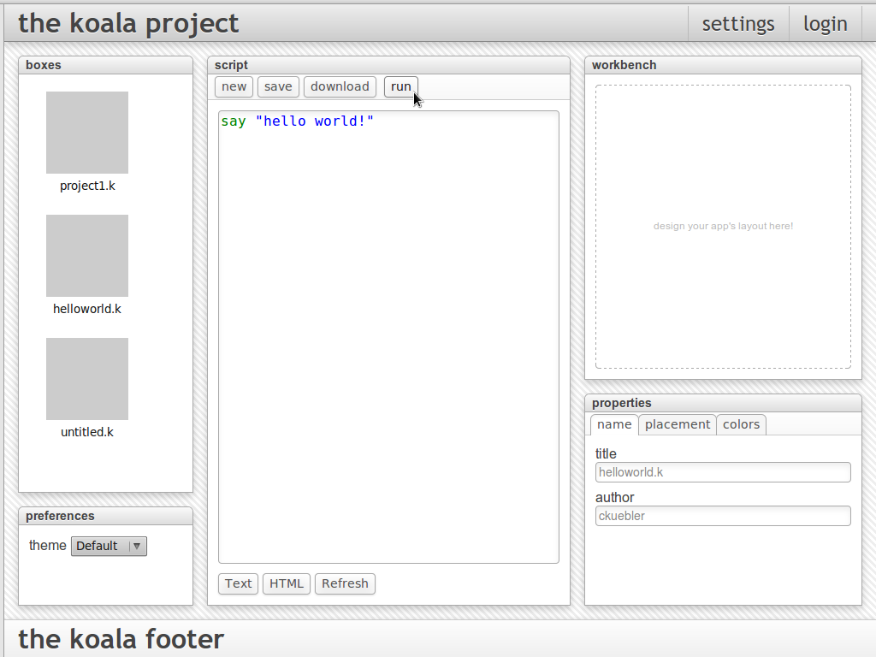

Slide 9
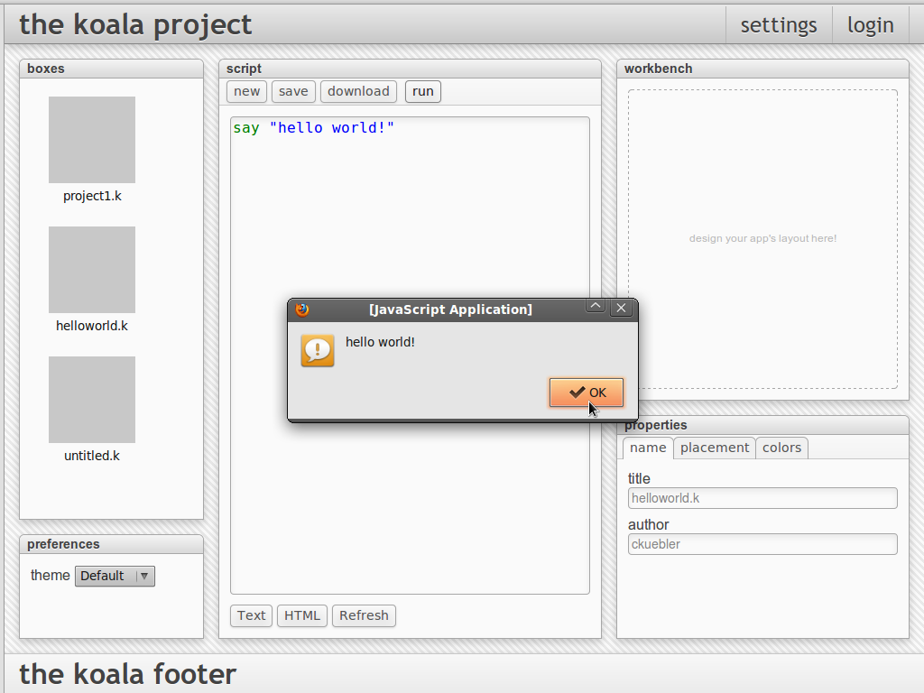

Slide 10

what's new?
nick's back end
design enhancements
fluid layout
panel management

Slide 11
thanks!
special thanks to nick pachulski
for taking a chance with ruby!
thanks to #rcos
for help with git!
thanks to moorthy, o'sully and rcos
for making this project possible!
questions? comments?

