Slide 1
the koala project
by colin kuebler

Slide 2
little sister/grandpa/friend/pet fish...
wants to learn computer programming

Slide 3







the problem
illogical IDEs
platform problems
#!/bin/python
import sys
scary syntax
#include <stdio.h>
printf("Hello, world!\n");
public static void main(String[] args)

Slide 4
the solution
koala!
“a web-based introductory scripting language with an accompanying IDE to provide a stepping stone for inexperienced programmers”

Slide 5
why koala?
nicer than snakes
no # edges
decaffeinated
cuter than qt
syntax--;

Slide 6
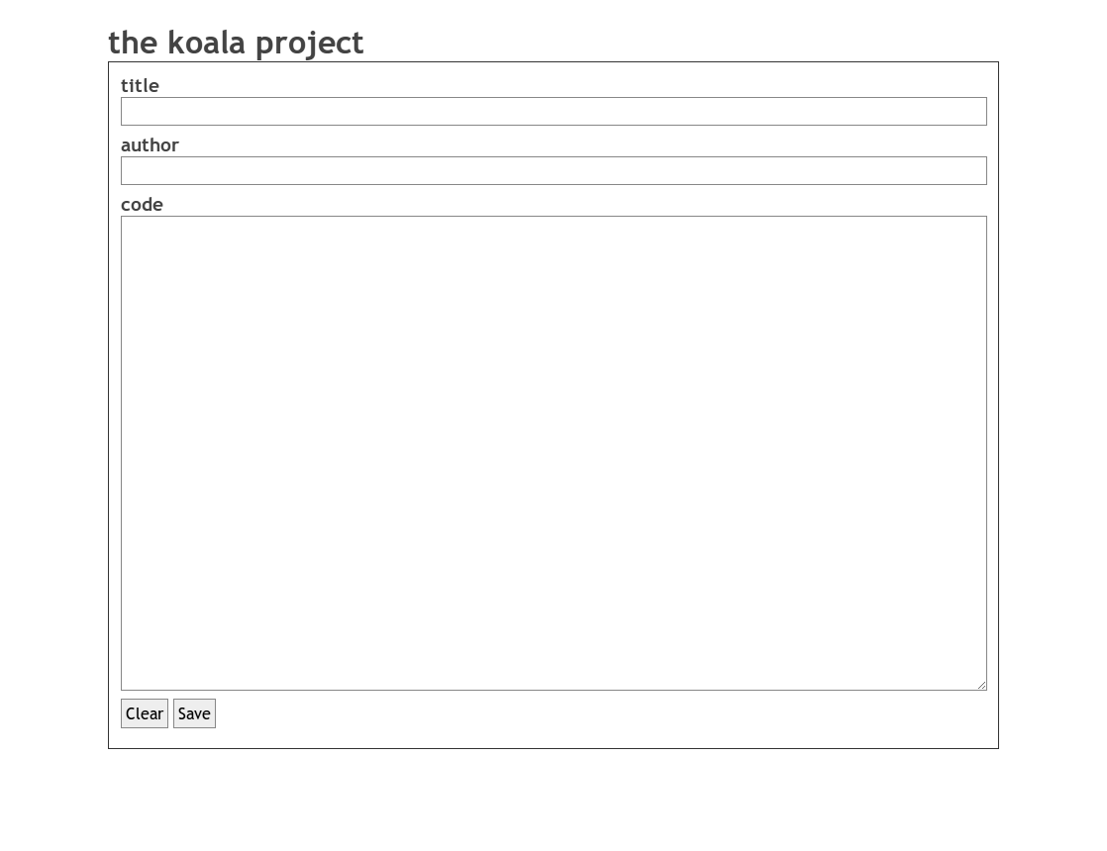
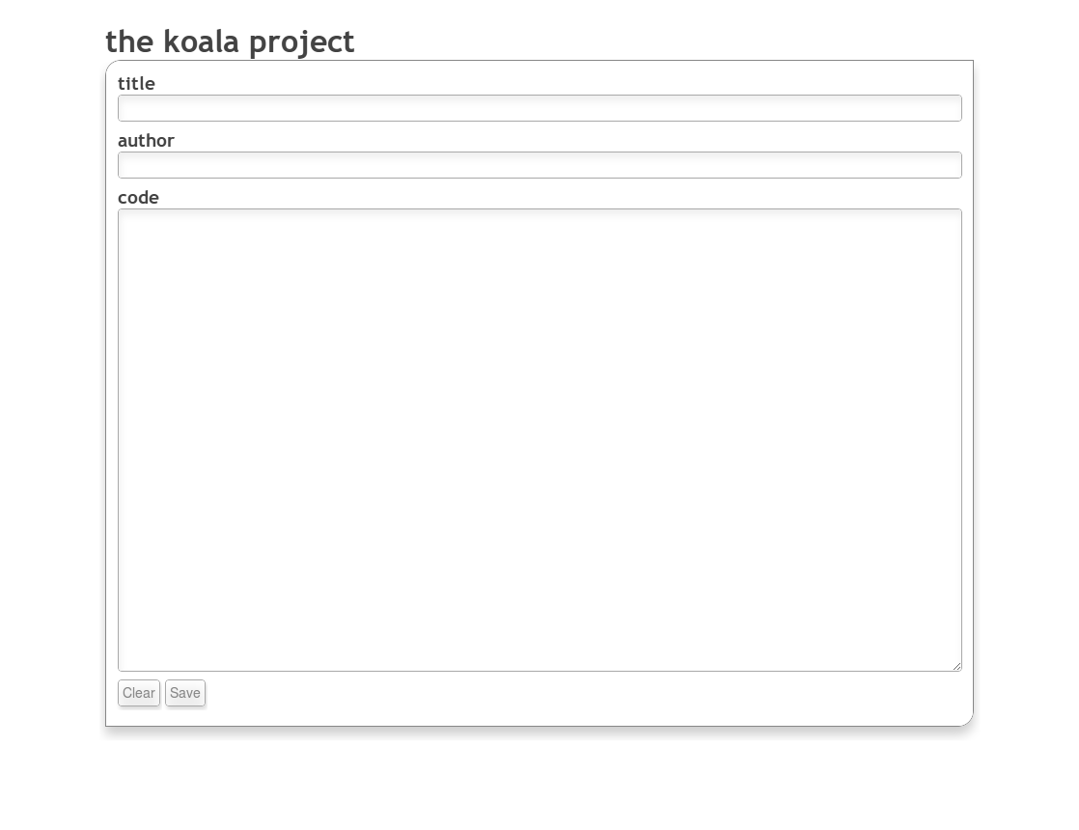
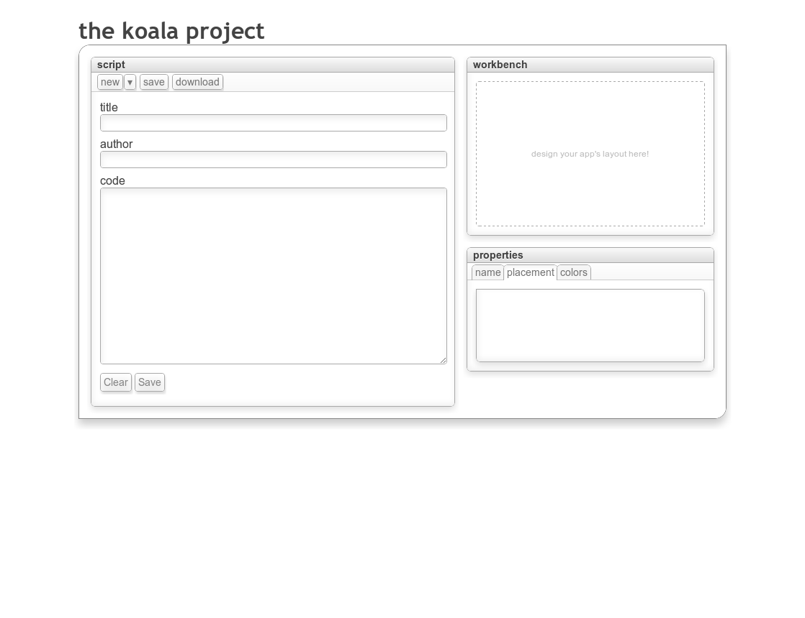
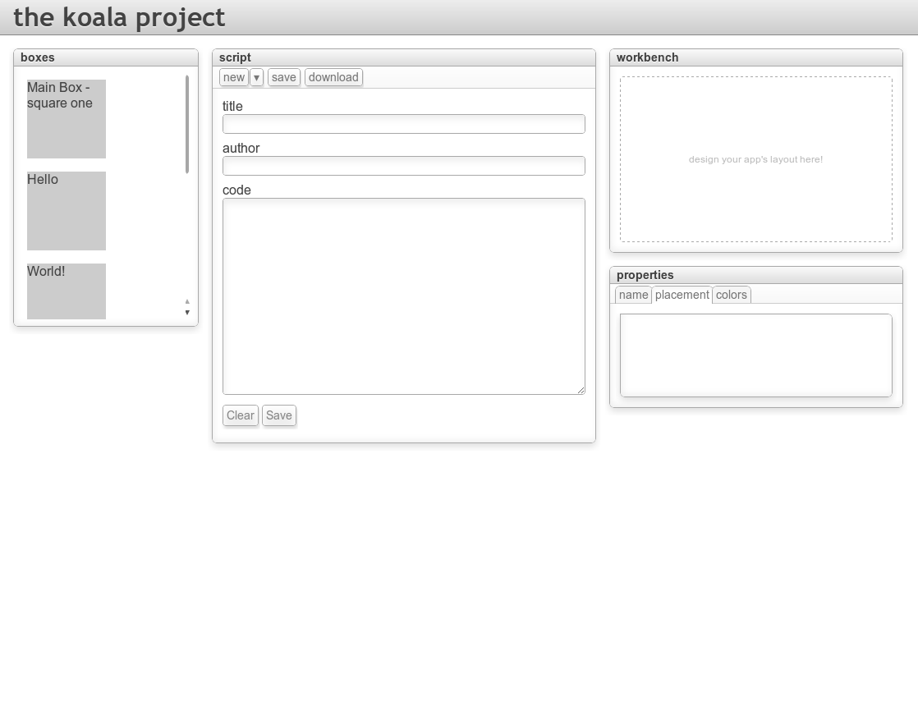
progress so far...

Slide 7









challenges so far...
git n00b
koalas are
really hard to draw
textareas are plaintext
can't figure out syntax highlighting
browser overload!

Slide 8
next time
have a working demo!
  finish interpreter core
  polish off language specifications
  fix browser inconsistencies
  get the back end in place
  have a more welcoming welcome page
  start on the workbench GUI designer

Slide 9
thanks!
special thanks to peter hajas and
nate stedman for help with git!
thanks to moorthy and rcos
for making this project possible!
questions? comments?

