Slide 1
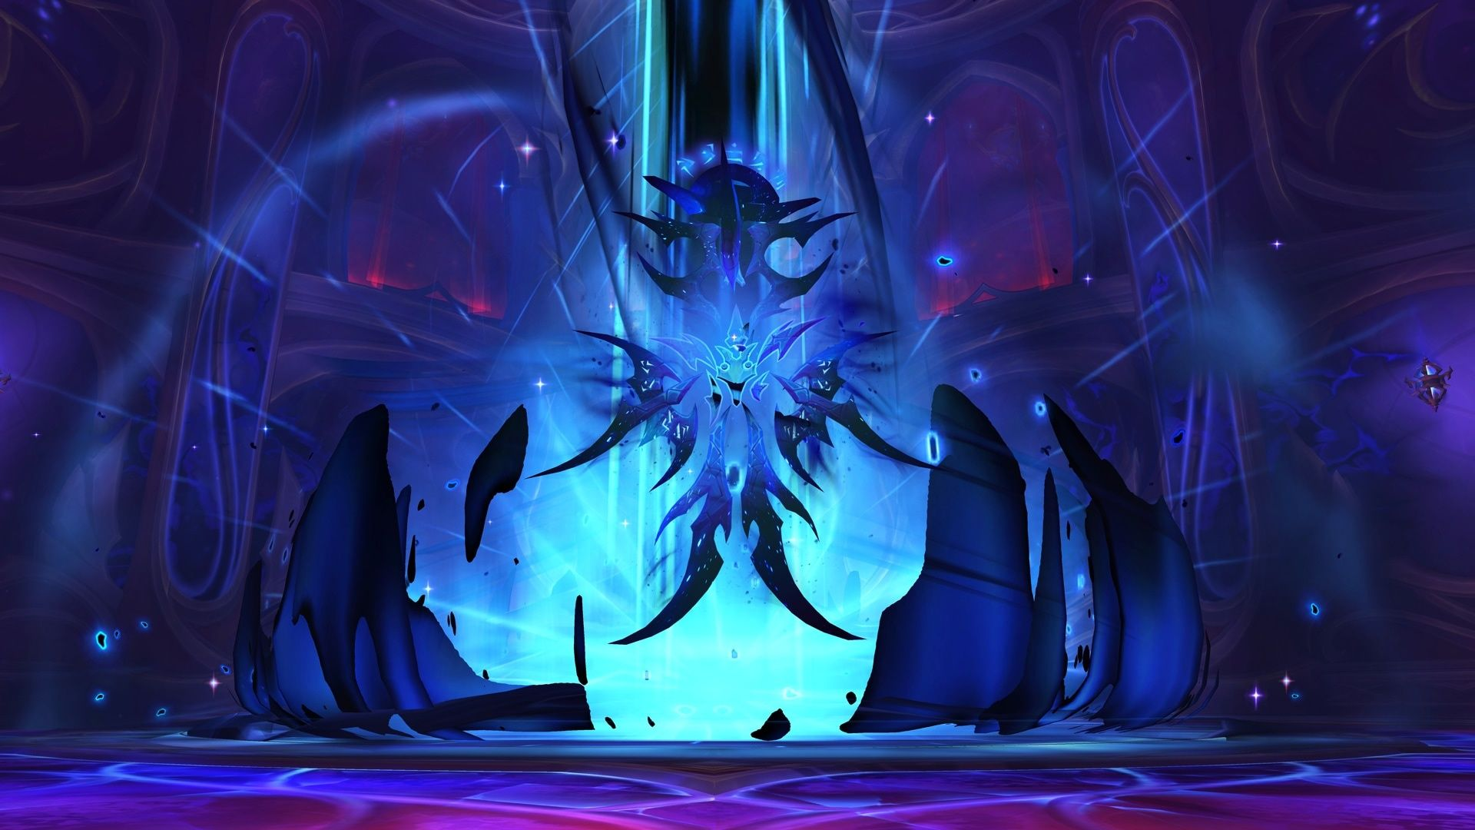

Explaining World of Warcraft Boss Mechanics to People Who Don’t Play World of Warcraft So They Can Look At Me Like I’m Crazy
A deep dive into the mechanics of the end boss of WoW Midnight Season 1 animated in MS pptx

Slide 2
AGENDA
General Context
Fight Summary and Timeline
Explaining the Fight In Detail
Phase 1
Intermission
Phase 2
Phase 3
Some Fun Fight Statistics?
Request for Thoughts and Prayers

Slide 3
WHAT IS…
…WORLD OF WARCRAFT?
Massively Multiplayer Online Role-Playing Game (MMORPG)
Massive waste of time
…A SEASON?
Release cycle for new content
New content: Raids, Dungeons, Story Quests
Every ~6 months
…A RAID?
Series of challenging encounters more difficult than regular solo content
Requires more people/time and communication/coordination
…MIDNIGHT FALLS?
Last encounter of this season’s raid
“Encounter” = Story
Actual boss character name is L’ura

Slide 4
TIMELINE AND OVERVIEW

Slide 5
PHASE 1 (00:00 – 03:06)
Phase Summary:
3x cycles
New cycle every 1min 2s
Important Mechanics
Matrices
Crystals
Glaives
Memory Game

Slide 6

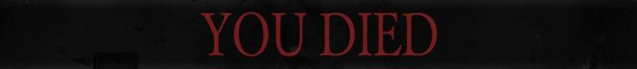
Phase 1 (Matrices)
3x Matrices
4x interrupts PER Matrix
2s window
12 total required (16 available)
Order is assigned beforehand
If missed interrupt:
1-shot frontal cone = WIPE
If interrupted all successfully:
3x Dusk Crystals
6x Midnight Crystals
2 seconds

Slide 7
Phase 1 (Crystals)
Midnight Crystals (6x)
Kill within 12s
Fail = WIPE
Dusk Crystals (3x)
Heal within 12s
Turns into Dawn Crystals at 100% HP
Dawn Crystals (3x)
3x players assigned to pick up
12 seconds

Slide 8
Phase 1 (Glaives)
5x Glaives
They ricochet!
Fly around the room for 1 min
Player gets hit = Player DEAD
Player with crystal gets hit = Player AND crystal DEAD = WIPE

Slide 9

Phase 1 (Memory Game)
Upstairs
A!
3x Groups
Groups: Upstairs, Red, Blue
Groups cannot see each other
5x Symbols shown
Upstairs > Red > Blue > Upstairs > Red
Each symbol shown for 2s
Communicated outside the game
5x players get symbols in each group
7s to line up in the correct order
Wrong order = WIPE
A
C
D!
D
E
B
Red
B!
A
E
C
D
B
E!
Blue
C!
E
B
A
C
D

Slide 10
Transition (03:06 – 03:10)
Boss is un-targetable
Go to assigned positions
Slight pull towards boss
Pulled into center = DEAD
DO NOT TOUCH

Slide 11
Intermission (03:10 – 03:40)
Important Mechanics
Starsplinters

Slide 12
Intermission (Starsplinters)
Starplinters every 5s
Total 6x
First 5: Random players
Last 1: Everybody

Slide 13
Phase 2 (03:45 – 05:30)
Phase Summary
3x Cycles
New cycle every 30s
Important Mechanics
Beam
Spread Circles
Core Harvest

Slide 14
Phase 2 (Beam)
12x Orbs
4x Beams on players
Beam aimed at orbs
6s to find position
Positions assigned beforehand
Damage split between people in the beam
Min 5 ppl in 1 beam
Beam activates orbs

Slide 15
Phase 2 (Spread Circles)
Activated orbs exert a PULL force
Players are pulled towards orbs
Force cancels out!
Boss also exerts a PULL force
Only effective force
Players are pulled towards boss
10s to run and spread out
Positions assigned beforehand
1x Circle = pain
Standing in another player’s circle = 2x Circle = DEAD

Slide 16
Phase 2 (Core Harvest)
Boss eats activated orbs
Zoom
Stand in orb path = dead

Slide 17
Phase 3 (05:30 - end)
I gave up here and got distracted

Slide 18
Fun Stats!
276 guilds have killed this boss
On average, 350 tries
Lower bound: 280
Upper bound: 410
Equivalent to 25-35 hrs of progression
That’s ~12 raid days

Slide 19
Formal Request For Thoughts And Prayers (Less Fun Stats)
We have 255 tries
Best try: 43%
First reached phase 3 at try #222
Linear Regression (n=60)
y = (1.2)x + 121
y is the total tries
x is the tries it takes to see phase 3 for the first time
Coefficients are statistically significant
Model can explain 70.1% of data
Prediction:
When x=222, y=393 [311,475]
~138 more tries before we kill

