Slide 1
Boundaryless EAM with Semantic Web Tools The Open Group London Event and Member Meeting
Thomas Kaleske, Senior Integration Architect, Kuehne + Nagel, Hamburg
April 25-28, 2016 – London (UK)

Slide 2
Agenda
Business Overview
Semantic Web Project
Outlook and Questions

Slide 3
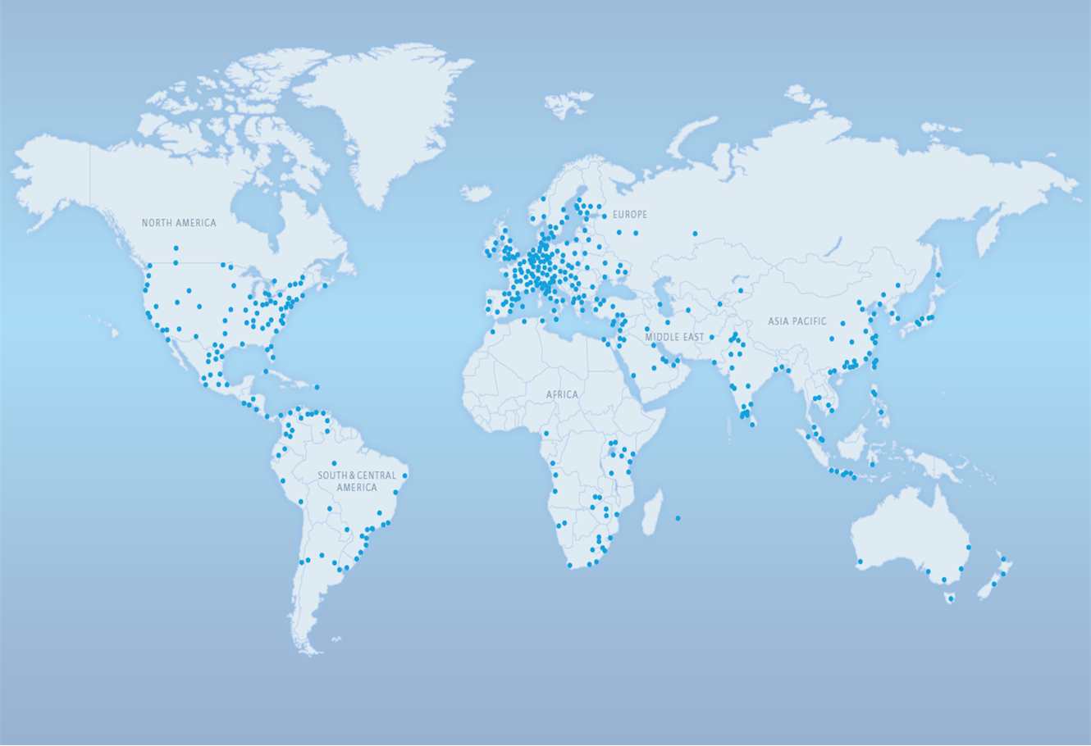
The Global Logistics Network
Worldwide network – more than 1,200 locations in over 100 countries
Integrated service portfolio – approximately 67,000 employees
Net Turnover of CHF 16,731 million in 2015

Slide 4

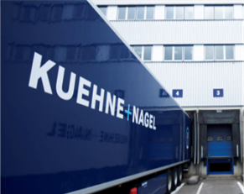
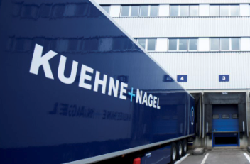



Comprehensive Global Logistics Solutions World Class Capabilities and Positioning
Airfreight
Top 2 globally
Contract Logistics
Top 2 globally
Seafreight
No.1 globally
Overland
Top 3 in Europe
Integrated Logistics
No.1 globally
3.8 million
TEUs shipped
1.25 million tons handled
22.5 million
road orders
9.5 million m²
Logistics Centre
footprint
683 locations
58 countries
750 experts in 7 global Logistics Control Centres
Note: All figures relate to 2015
Notes:
4

Slide 5







Dedicated Solutions for the World’s Major Industries
Aerospace
Automotive
Consumer
High-Tech
Industrial
Oil & Gas
Pharma & Healthcare
Notes:
5

Slide 6










Contract Logistics Focus Verticals & Services
Automotive
High-Tech
Consumer
Aerospace
Pharma & Healthcare
Industrials
Production Logistics
Spare Parts Logistics
E-commerce
Co-Packing
Distribution
Advanced Warehousing

Slide 7
Agenda
Business Overview
Semantic Web Project
Outlook and Questions

Slide 8
Evaluation of Semantic Web Tools for EAM Project from September 2015 to January 2016
Capabilities of EAM Tools (Kuehne + Nagel)
Meta Modelling (flexible data structures)
Sophisticated Reporting (own query language)
Integration of Enterprise Information Sources
Visualization
Simple User Interface
Support of Different Stakeholders
Assumption:
Through semantic web and modern web technologies all required capabilities can be addressed

Slide 9


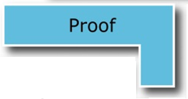


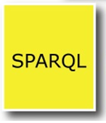



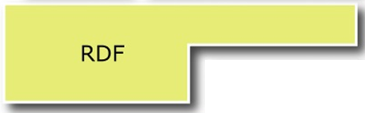


Semantic Web and the Technology Stack Tim Berners Lee et.al. “The Semantic Web”, Scientific American, May 2001
Sparql Protocol And Rdf Query Language (SPARQL)
Query language for RDF graph databases
Uses similar syntax as SQL (SELECT WHERE …)
Web Ontology Language (OWL)
Family of knowledge representation languages (OWL Lite, OWL DL, OWL Full, OWL2 EL, OWL2 QL, OWL2 RL) based on description logic – provides simple inferencing
kn:HAM kn:locatedIn kn:WEU
kn:Warehouse-HH1 kn:locatedIn kn:HAM
-----------------------------------------------------------
=> kn:Warehouse-HH1 kn:locatedIn kn:WEU
RDF Schema (RDFS)
Extension of RDF with classes, datatypes, domains, ranges…
Resource Description Framework (RDF)
Triples (subject predicate object) based on URI’s and primitives, e.g. (turtle syntax)
@prefix kn: http://kuehne-nagel.com
kn:HAM kn:locatedIn kn:WEU

Slide 10
Tool Selection for Evaluation Prototype two key components
OWL Editor
Triple Store (RDF)
Protégé was selected
large set of plugins
collaboration support (web version)
Note: the collaboration feature wasn’t used, because of the limitations of the web version
Note: Commercial products were not investigated
GraphDB from Ontotext was selected
free version
simple setup
widely used RDF database
supports all required features
Note: no commercial product selection
Features that we looked into
SPARQL 1.1
OWL2
User roles
API’s
Runtime Environment
Inference/Reasoning Engine
Stackoverflow Count
Free Version

Slide 11
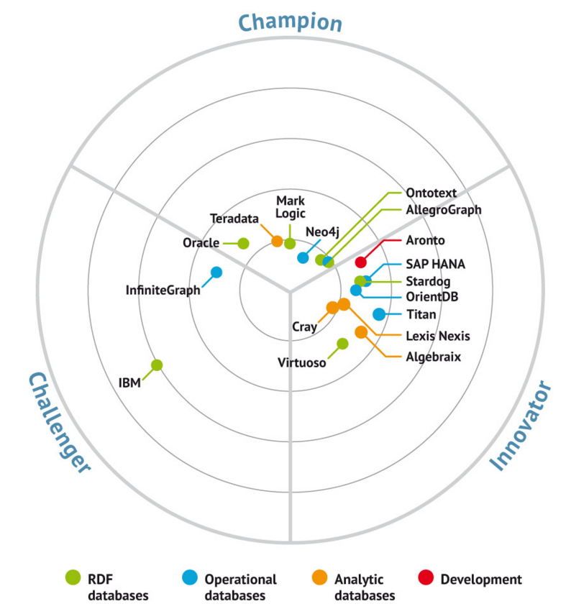
Market Overview for Graph Databases Bloor Research

Slide 12



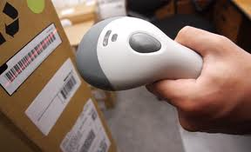



Evaluation based on a Concrete Business Demand Business impact analysis for the Parcel Carrier Integration Platform
Delivery Status Visibility
Label generation & IOD Update
User
WMS
TMS
PCIP
Carrier
Process steps
Package confirmed in WMS
Parcel info sent to PCIP
PCIP generates labels in Carrier format
User confirms “Tour Start” in TMS
Tour info sent to PCIP
PCIP generates Delivery Manifest
Parcel Manifest sent to carrier
Parcel Shipment Collected/Delivered
IOD/POD updates sent to TMS
Acronyms
PCIP - Parcel Carrier Integration Platform
WMS - Warehouse Management System
TMS - Transport Management System
IOD - Information of Delivery
POD - Proof of Delivery
1
2
7
9
9
3
6
4
5
8
Analysis of business and IT structures to support the incident manager
Elements
Customers and carriers
Organizational structures
Servers and applications
Covered IT incidents
server failure
carrier connection failure

Slide 13
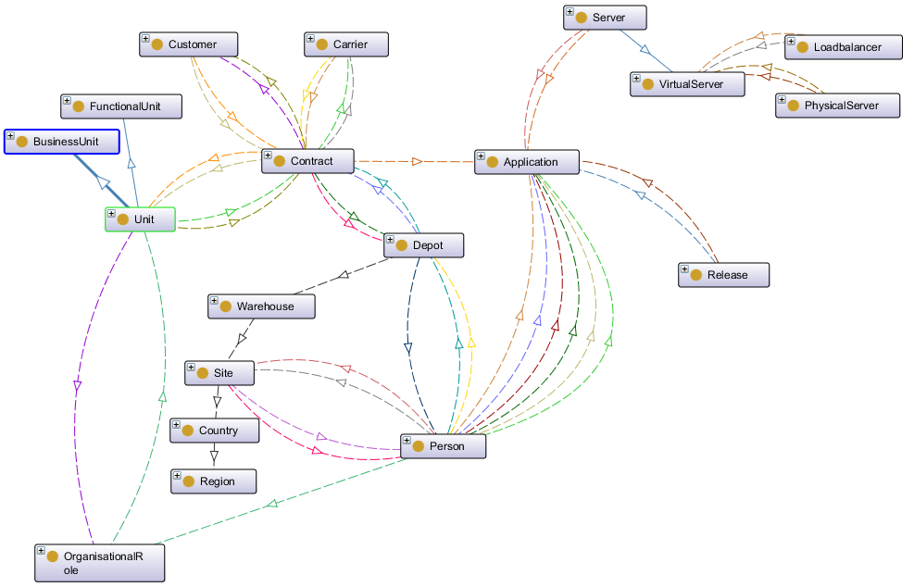
Ontology Following ontology was defined during the prototype project
subclass
has Carrier
runsOn
subclass
belongsToCustomer
has Carrier
runsOn
subclass
uses
belongsToUnit
belongsToDepot
isLocatedIn
isLocatedIn
develops
isSuperUser
develops
isLocatedIn
develops
isResponsibleFor
isSiteContact
isResponsibleFor
isLocatedIn
isAccountableFor
isMemberOf
High-Level OWL Ontology with OntoGraf (Protégé Plugin)
(the ontology is evolving and redefined iteratively)

Slide 14
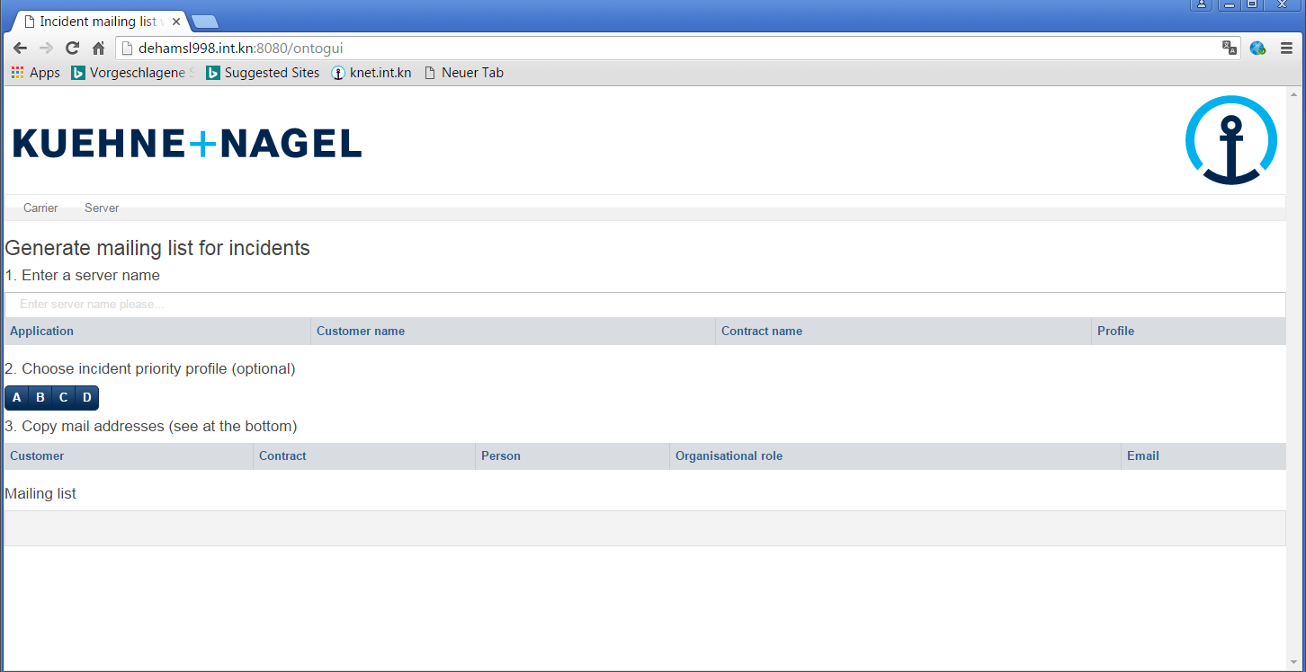
Web UI-Prototype with AngularJS and Bootstrap - Demo (mainly selected, because of existing knowledge and layout reuse)
Application flow
Server or carrier is selected
Impacted customers are shown
Responsible persons are shown

Slide 15
Agenda
Business Overview
Semantic Web Project
Outlook and Questions

Slide 16
Outlook Three projects started to address different aspects on the next level
Incident Collaboration
Semantic Web Platform
(university project)
ITIL Ontology Evaluation
(master thesis)
Implementation of a Business Impact Knowledge Base based on semantic web
(semantic web sub project)
Agile approach
For all corporate core applications
Focus on organizational aspects
Evaluation of viable ontologies for EAM use cases (e.g. Archimate)
Interface Catalog selected as use case
Comparison with EAM tool implementation
Identification of platform components
Evaluation of ITIL ontology for infrastructure use cases
ITSMO selected as ontology
Identification of platform components

Slide 17
Vision for KN Semantic Web Platform Collaborative initiative of all corporate IT departments
KN Semantic Web Applications
Bus Impact Knowledge Base
Application Catalog
Interface Catalog
Blueprint & Roadmap Planning
Private Cloud Provisioning
IT Service Catalog
Infrastructure Catalog (CI’s)
…
+ APM
+ SOA Governance
EA Repository
(IT Landscape)
Configuration Mgmt. System
Business/Application Architecture
Infrastructure/IT Service Mgmt.
KN Semantic Web Platform - Basic Services
(data storage, query language, meta model, inferencing)
Schema.org
BPMN Ontology
EA Ontology
(e.g. Archimate)
ITIL
Ontology
KN specific Ontologies
cross referencing
SPARQL
(REST API)
…
Person Data
KN Semantic Web Platform - Cross Service Components
Task
Scheduler
CSV
Importer
CSV
Exporter
Table
Editor
Authentication
(SAML/SSO)
Authorization
(OAuth)
…
Master Data
DNS
CMDB
CMDB
CMDB
… Enterprise Information Systems

Slide 18
Thank you !
Any further questions?

