Slide 1

Presentation title in one or two lines
Subtitle or event name · 6 Nov 2026

Slide 2

Presentation title in one or two lines
Subtitle or event name · 6 Nov 2026

Slide 3

01
SECTION
Section title
3

Slide 4
Slide title
• One idea per line, five lines at most.
• Numbers with unit and period: 212,480 readings yesterday.
• Data source and freshness below the chart.
4

Slide 5
Comparing two options
Option A
Option B
A short note on strengths and limits.
A short note on strengths and limits.
5

Slide 6
Consumption by zone, MWh
Source: sample data (synthetic), October 2026
6

Slide 7
212,480
readings yesterday
92% of expected · Komunala Vzorec d.o.o. (sample)
7

Slide 8
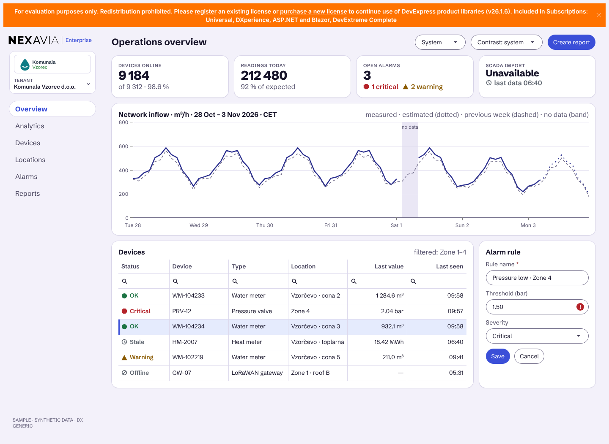
Operations overview
Nexavia Enterprise screen with sample data
8

Slide 9
Devices with alerts
Device | Location | State | Last value
WM-104233 | Vzorčevo · cona 2 | OK | 1,284.6 m³
PRV-12 | Cona 4 | Critical | 2.04 bar
WM-102219 | Vzorčevo · cona 5 | Warning | 211.0 m³
9

Slide 10
Thank you
first.last@example.com

