Slide 1
Control
2023 / 9 / 20

Slide 2
Print and None
Demo

Slide 3
None Indicates that Nothing is Returned
The special value None represents nothing in Python
A function that does not explicitly return a value will return None
Careful: None is not displayed by the interpreter as the value of an expression
>>> def does_not_return_square(x):
... x * x
...
No return
>>> does_not_return_square(4)
None value is not displayed
The name sixteen is now bound to the value None
>>> sixteen = does_not_return_square(4)
>>> sixteen + 4
Traceback (most recent call last):
File "<stdin>", line 1, in <module>
TypeError: unsupported operand type(s) for +: 'NoneType' and 'int'

Slide 4
Pure Functions & Non-Pure Functions
Pure Functions
just return values
Return value
-2
abs
2
Argument
2, 100
pow
1267650600228229401496703205376
2 Arguments
Non-Pure Functions
have side effects
Return None!
-2
print
None
A side effect isn't a value; it's anything that happens as a consequence of calling a function
Python displays the output “-2”

Slide 5
Nested Expressions with Print
>>> print(print(1), print(2))
1
2
None None
None, None
print
Does not get displayed
None
display “None None”
None
print(print(1), print(2))
func print(...)
None
None
print(1)
print(2)
func print(...)
1
func print(...)
2
print
2
print
1
None
None
display “1”
display “2”

Slide 6
print vs return
Demo

Slide 7
Control

Slide 8
Control
Expressions in programs evaluate to values
Statements are executed to perform actions
Ex: assignment and def statements
With what we have seen so far, a lot of useful programs have been left out
For example: returning ‘hot’, ‘warm’, or ‘cold’ depending on an argument temp
To do this we introduce the concept of control
Special expressions and statements can control how the program is executed by the interpreter

Slide 9
Conditional statements (if statements)
Clause
Syntax:
Always start with if clause
Zero or more elif clauses
Zero or one else clause, always at the end
if <conditional expression>:
<suite of statements>
elif <conditional expression>:
<suite of statements>
else:
<suite of statements>
Execution Rule for Conditional Statements:
Each header is considered in order
Evaluate the header’s conditional expression if the header is not an else
If the expression evaluates to true or the header is an else, execute the suite and skip the remaining headers

Slide 10
if examples
Demo

Slide 11
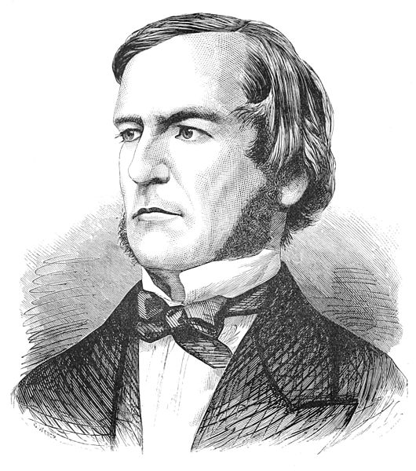
Boolean Contexts
def absolute_value(x):
“““Return the absolute value of x.”””
if x < 0:
return -x
elif x == 0:
return 0
else:
return x
Two boolean contexts
George Boole
Boolean context is any place where an expression is evaluated to check if it’s a True value or a False value
False values in Python: False, None, 0, ‘’ (more to come)
True values: everything else

Slide 12
Boolean Expressions
Boolean expressions contain special operators and, or, not
<exp1> and <exp2> and <exp3> and ...
Evaluate to the first false value.
If none are false, evaluates to the last expression
<exp1> or <exp2> or <exp3> or ...
Evaluate to first true value.
If none are true, evaluates to the last expression
not <exp>
Evaluates to True if <exp> if a false value and False if <exp> is a true value

Slide 13
Short-Circuiting
Demo

Slide 14
Iteration
Demo

Slide 15
While statements
Demo
i, total = 0, 0
while i < 3:
i = i + 1
total = total + i
Execution Rule for While Statements:
Evaluate the header’s expression
If it is a true value, execute the (whole) suite, then return to step 1
Python Tutor

Slide 16
The Fibonacci Sequence
0, 1, 1, 2, 3, 5, 8, 13, 21, 34, 55, 89, 144, 233, 377, 610, 987, ...
def fib(n):
"""Compute the nth Fibonacci number, for N >= 1"""
pred, curr = 0, 1 # 0th and 1st Fibonacci numbers
k = 1 # curr is the kth Fibonacci number
while k < n:
pred, curr = curr, pred + curr
k = k + 1
return curr
The next Fibonacci number is the sum of the current one and its predecessor
Python Tutor

Slide 17
Summary
print vs None
None represents when an expressions doesn’t evaluate to a value
print displays values in the interpreter
Control
Allow for the interpreter to selectively or repetitively execute parts of a program
Iteration
A particular variant of control which is based in the idea of repeating operations to compute a value

