Slide 1
LOCAL LLMs
My 8GB VRAM
vs the World
8
GB
From centralized AI to models you can own
Presenter · Organization · Date
A PRACTICAL STORY OF
OWNERSHIP, CONSTRAINTS,
AND CONTROL
Notes:
Welcome the audience. The claim is not that an 8 GB GPU defeats every cloud system. The claim is that useful language-model capability has become personal, programmable, and ownable. Preview the historical comparison and the live chess demonstration.

Slide 2
A MODEL IS ALREADY PLAYING ON THIS LAPTOP
Your machine. Your model. Your move.
♜
♚
♜
LOCAL DECISION
♟
Candidate moves
Stockfish proposes credible moves. Qwen3-4B chooses one through llama.cpp—and explains it without sending the game away.
1 e4
♟
2 Nf3
♙
3 d4
♙
“I’ll take space in the center while keeping options open.”
Qwen3-4B
Q4_K_M
♖
♔
♖
RTX 4060
Local only
LOCALHOST
Notes:
Give only a 30-second teaser. Point out that the model is local and the full decision pipeline will be demonstrated later. Do not begin the live demo yet.

Slide 3
THE CURRENT STATE
Two useful tiers—not one winner
CLOUD
LOCAL
Hosted frontier
Local / open-weight
Maximum general capability
Private and offline workflows
Large-scale tools and context
Control over model and runtime
Someone else runs the infrastructure
Fast, bounded, repeatable tasks
Local complements cloud. The job decides the tool.
Notes:
Stanford's 2026 AI Index reported a 3.3% gap between the top closed and top open model in March 2026. Benchmarks are incomplete and local models are usually smaller than the best open models. Use the number only to establish that open models are credible, not identical. Define open-weight: downloadable weights under a model-specific license. It is not automatically the same as open-source software.
Sources:
• https://hai.stanford.edu/ai-index/2026-ai-index-report/technical-performance

Slide 4
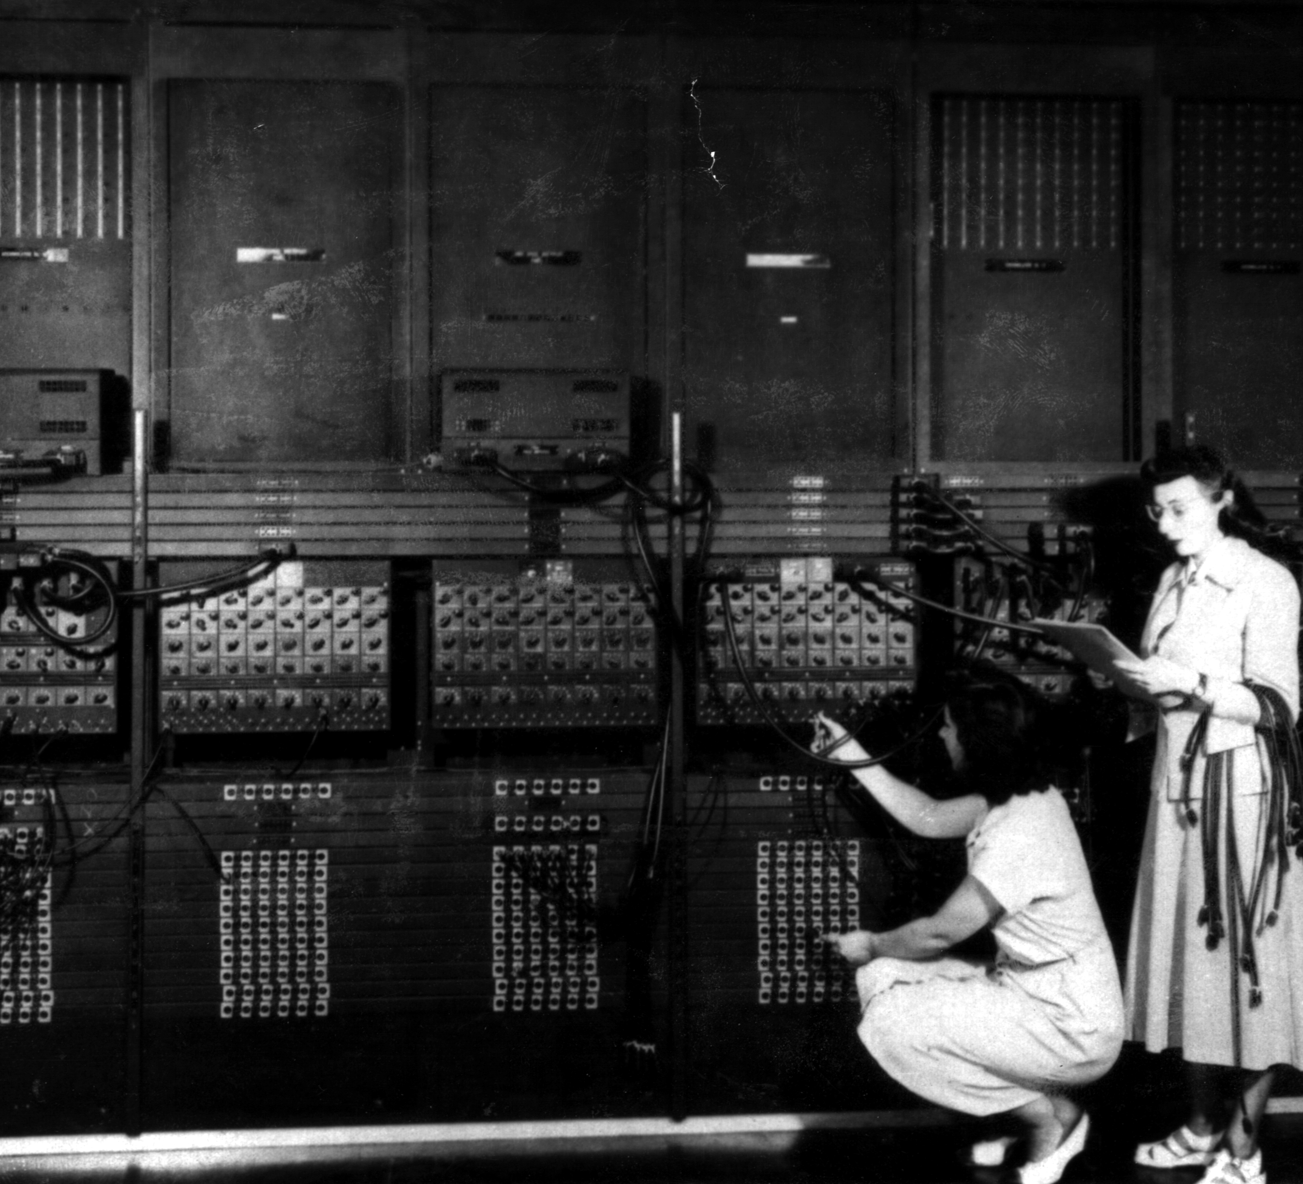
BEFORE COMPUTING BECAME PERSONAL
Capability arrived before accessibility
ENIAC filled a room. Programming it meant physically reconfiguring the machine.
ROOM-SCALE
Centralized capability came first.
U.S. Army, 1946 · Public domain
Notes:
ENIAC predates the mainframe category, so call it a room-scale centralized-computing precursor. Name the women shown: Ester Gerston and Gloria Gordon Bolotsky. The useful parallel is centralized access—not a claim that ENIAC and an LLM are the same technology.

Slide 5
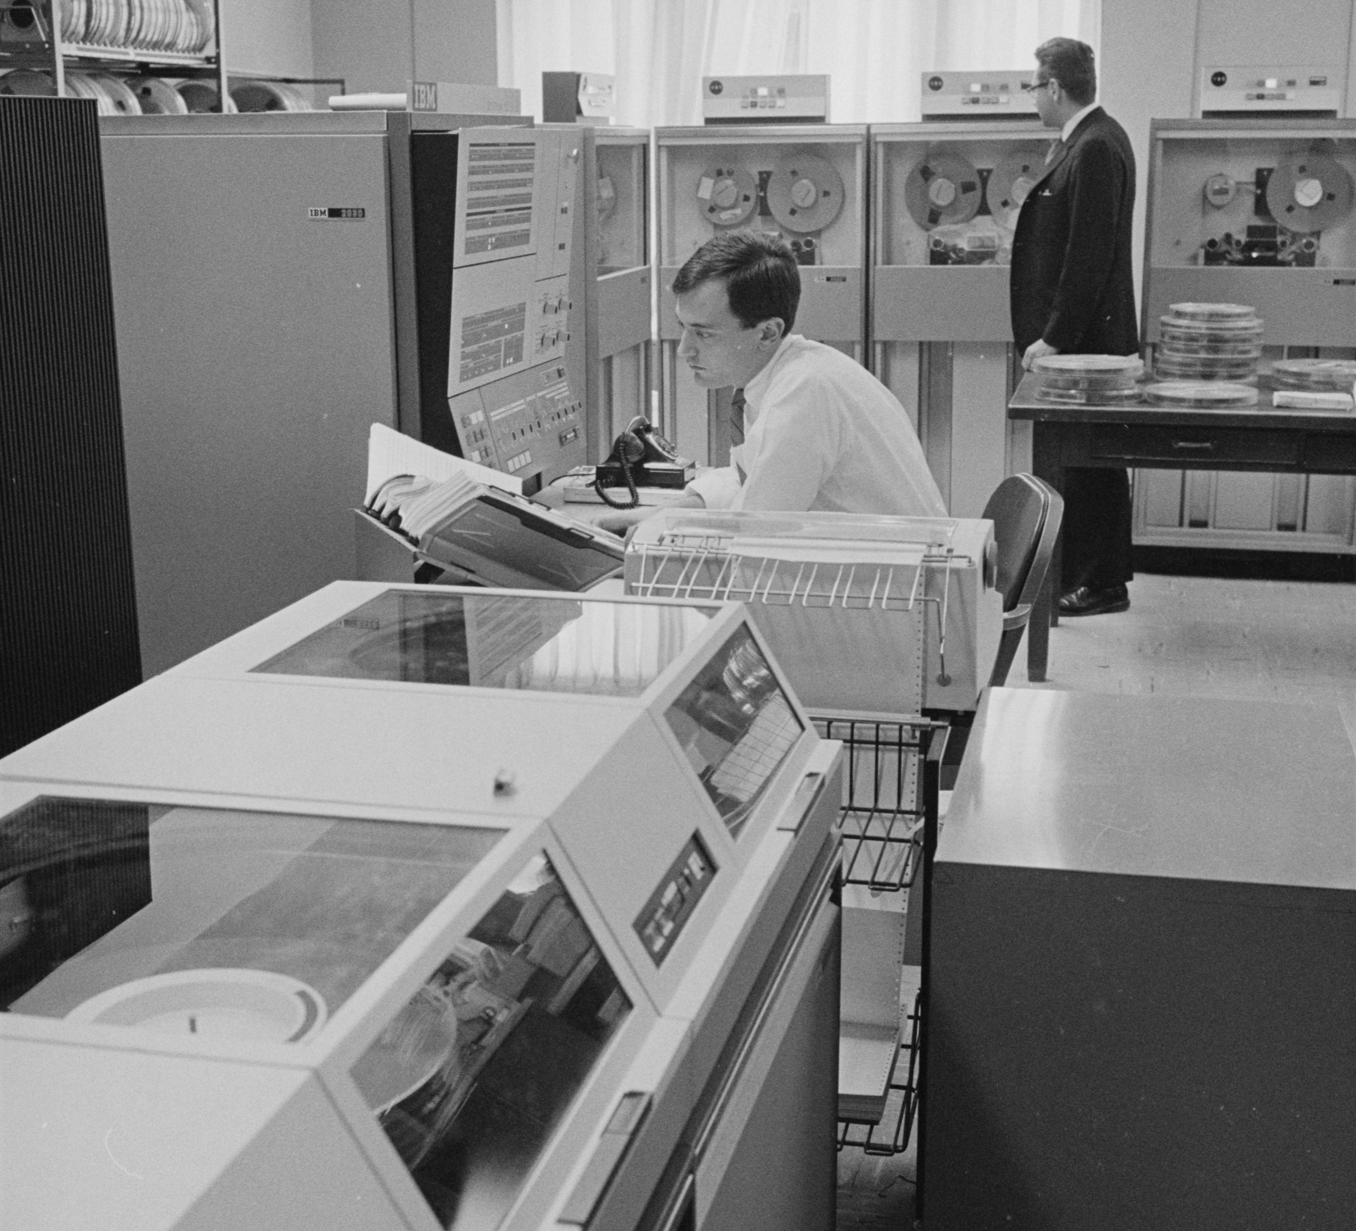
THE MAINFRAME ERA
One powerful machine. Many users.
Access was shared, scheduled, and mediated by an institution.
SYSTEM / 360
CENTRAL COMPUTER
USER 1
USER 2
USER 3
Warren K. Leffler / Library of Congress, 1967 · Public domain
Many access points · one shared center
Notes:
The photograph shows several people around an IBM System/360 Model 30 in New Haven. The terminal diagram illustrates time-sharing: many users interact with one centralized computer. Hosted AI has a similar access pattern, although modern infrastructure is distributed.

Slide 6
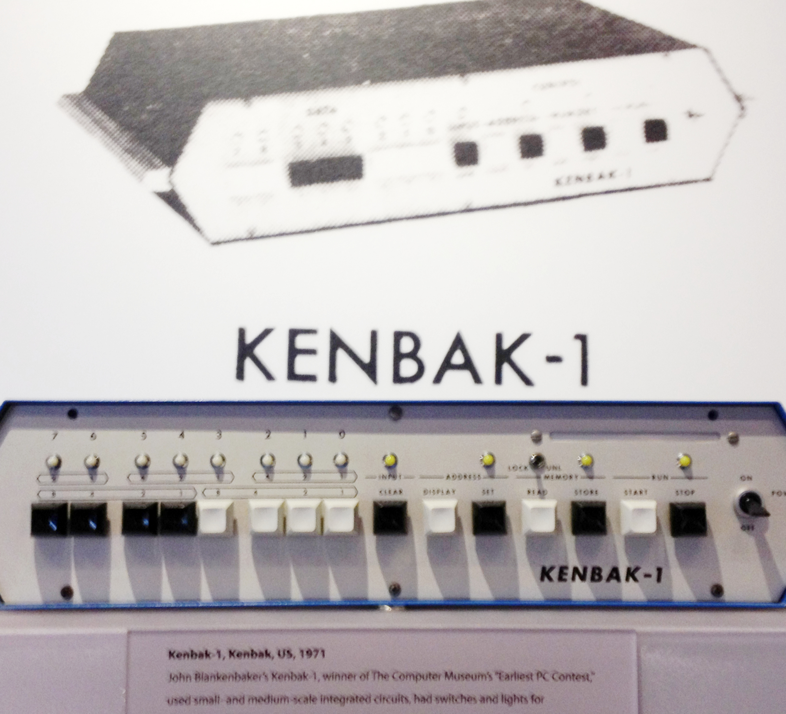
THE PERSONAL-COMPUTER SHIFT
Ownership changed who could experiment
The Kenbak-1 was one of the earliest commercial personal computers. The revolution was not only smaller hardware—it was direct access.
DIRECT ACCESS
Personal access changed the pace of learning.
Kathryn Greenhill · CC BY-SA 2.0
Notes:
The Computer History Museum dates the first Kenbak-1 sale to 1971 and calls it one of the earliest personal computers. Avoid declaring an undisputed single first PC. The PC did not eliminate centralized computing; it created a complementary personal layer.
Sources:
• https://www.computerhistory.org/timeline/computers/

Slide 7
THE TIMELINES RHYME
Decades in computing. Years in language models.
COMPUTING
1946
1960s
1971
1981
ENIAC
Mainframes + time-sharing
Kenbak-1
IBM PC
LANGUAGE MODELS
2017
2022
2023
Today
Transformer
Hosted chat goes mainstream
Open weights + local runtimes
A model on your laptop
A lens, not a prediction: personal and centralized computing coexist.
Notes:
The Transformer was introduced in 2017. ChatGPT launched publicly in November 2022. Open-weight releases and local runtimes expanded rapidly in 2023. The time scales differ dramatically, and history does not guarantee the same market outcome.
Sources:
• https://research.google/pubs/attention-is-all-you-need/
• https://openai.com/index/chatgpt/

Slide 8
WHAT MOVES ONTO YOUR MACHINE
A new layer of personal computing
01
02
03
Privacy
Inputs can stay on-device
Control
Choose the model, version, and rules
Offline
Work after the model is downloaded
04
05
06
Latency
No network round trip
Cost
No per-request API bill
Learning
Inspect the whole application stack
Local is not automatically private: the surrounding app must avoid cloud calls too.
Notes:
Balance each benefit with constraints: smaller models, finite memory, energy use, setup, maintenance, and model-specific licenses. Hugging Face describes privacy, speed, control, and cost as advantages of local apps.

Slide 9
QUANTIZATION
Pack the model into a smaller suitcase
Store each learned number with fewer bits. The model gets smaller and often faster—with some quality trade-off.
FP16
Largest
16 bits
fewer bits → smaller model
Q8
Half-ish
≈ 8 bits
Q4
Quarter-ish
Raw weight math is simple. Real memory also includes metadata, context, and runtime buffers.
≈ 4 bits
Notes:
Quantization is lossy numerical representation, not magical compression. Four-bit weights require roughly one quarter of the raw weight storage of 16-bit weights, but quantization metadata and runtime allocations mean total memory is not exactly one quarter. Q4_K_M uses mixed block quantization intended to preserve important weights better than a naive uniform four-bit scheme.

Slide 10


THE LOCAL ECOSYSTEM
Library → package → engine → easy launcher
GGUF
Hugging Face
GGUF
llama.cpp
Ollama
Find and distribute models
Portable model file + metadata
Run efficiently on CPU or GPU
Friendly install, pull, and serve
1
2
3
4
An open ecosystem—not one interchangeable license.
Notes:
Hugging Face is a collaboration and distribution platform. GGUF is a model container format. llama.cpp is an MIT-licensed inference runtime. Ollama is an MIT-licensed application built around a simple local workflow. Model weights retain their own licenses; avoid calling every model open source.
Sources:
• https://huggingface.co/docs/hub/local-apps
• https://huggingface.co/docs/hub/gguf

Slide 11
LLAMA.CPP
A model file becomes a local service
$
llama-server -m model.gguf -ngl 99
01
02
03
04
GGUF model
llama.cpp
Local HTTP API
Your application
CLI for people. API for programs. The same model stays on your machine.
Notes:
llama.cpp is a runtime rather than a single graphical interface. It provides command-line tools and an OpenAI-compatible local server, and supports several CPU and GPU backends. In Chess Llama the server is bound to localhost and runs in a CUDA container.

Slide 12
CONTROLLED DELEGATION
Constrain creativity. Keep authority in code.
1
2
3
4
Stockfish
Qwen3-4B
Gateway
SQLite
Proposes up to 5 credible legal moves
Makes the stochastic choice + commentary
Validates schema, candidate, and game state
Saves the move and visible evidence
The model chooses every AI move. It cannot invent an illegal one.
Notes:
Stockfish searches briefly on the CPU. The best move is always retained; alternatives are included only when close enough. Qwen is sampled at temperature 0.2 and must select from a JSON Schema enum. The gateway validates the answer independently. There is one retry, but no random or silent engine fallback. This showcases useful stochastic judgment inside a deterministic safety envelope.

Slide 13
LIVE ON AN RTX 4060
Watch one local decision travel through the stack
RUNNING LOCALLY
♜
♚
♜
DECISION TRACE
Model: Qwen3-4B
♟
Stockfish → e4, Nf3, d4
Quantization: Q4_K_M
Qwen3-4B → e4
Backend: CUDA
♟
Gateway → valid
GPU memory: 8 GB
♙
Saved → move + evidence
Network: not required after setup
♙
WATCH
♖
♔
♖
1.8 s · 34 tok/s
Candidate moves
Chosen move
Commentary
Latency
Tokens / second
Notes:
Before presenting, run ./chess-llama doctor, load the model, and start the application. If all artifacts are cached and venue projection is independent of Wi-Fi, disconnect Wi-Fi before the move. Make one normal opening move. Narrate Request → Gateway → Stockfish → Llama → Saved. Point to model identity, Q4_K_M, CUDA, candidates, choice, commentary, latency, and tokens per second. If inference fails, use the embedded completed-decision visual and explain the resumable awaiting_ai state.
Sources:
• https://www.nvidia.com/en-us/geforce/news/ultimate-guide-to-4060/

Slide 14
THE OPPORTUNITY IS OWNERSHIP
Start with one bounded task
8
Use cloud models when maximum capability matters.
01
GB
Use local models when privacy, control, latency, or learning matters.
02
Build systems that decide what the model may decide.
03
The future is hybrid—and part of it fits in 8 GB.
Notes:
Return to the thesis: local models are not a universal replacement. Their potential is that developers and students can own an increasingly useful layer of computation. End on the concrete invitation to choose one bounded task and try it locally.

Slide 15
APPENDIX · SOURCES
Sources
STATE OF AI
HISTORY
Stanford HAI · 2026 AI Index, Technical Performance
Computer History Museum · Timeline of Computer History
MILESTONES
LOCAL STACK
Google Research · Attention Is All You Need; OpenAI · Introducing ChatGPT
Hugging Face GGUF + Local Apps; llama.cpp server docs
HARDWARE
DEMO
NVIDIA · GeForce RTX 4060 specifications
Chess Llama repository architecture and runtime manifest
Full URLs live in slide notes and presentation/README.md.
Notes:
Appendix slide. All links are embedded in the corresponding slide notes and in the presentation README. Facts and current-state figures were checked on 18 September 2026.

Slide 16
APPENDIX · MEDIA
Image and logo credits
01
Reprogramming ENIAC · U.S. Army / ARL Technical Library · Public domain
02
IBM 2030 in New Haven · Warren K. Leffler / Library of Congress · Public domain
03
Kenbak-1 · Kathryn Greenhill · CC BY-SA 2.0 · cropped
04
Hugging Face logo · official Hugging Face brand asset
05
llama.cpp logo · ggml-org llama.brand · CC BY-NC 4.0 + nominative-use permission
06
Ollama logo · Ollama repository · MIT license
07
Chess Llama interface preview · original vector composition for this deck
Full URLs, licenses, hashes, and modification notes: assets/ATTRIBUTION.md
Notes:
Appendix slide. Full URLs, license links, file hashes, and alteration notes are in presentation/assets/ATTRIBUTION.md. Logos are used only to identify their projects and do not imply sponsorship or endorsement.

Slide 17


EXPLORE THE PROJECTS
Take the models home
Two practical starting points for building with local models.
REPOSITORY 01
REPOSITORY 02
Chess Llama
Dockerized llama.cpp
The local-LLM chess decision demo
A containerized local inference stack
github.com/kugtong33/labs-chess-llama
github.com/kugtong33/labs-local-llm
SCAN · CLONE · RUN LOCALLY
Notes:
Leave this slide visible during questions. The left QR code opens the Chess Llama repository. The right QR code opens the Dockerized llama.cpp repository. Both repository names and URLs are also readable and clickable for anyone viewing the deck digitally.

