Slide 1
Lifetime and Smart Pointers
Course: Rust Basics
Author: Aleksandr Kugushev

Slide 2
Null in Rust aka Option
let mut var: Option<i32> = Option::None;
assert_eq!(true, var.is_none());
var = Option::Some(42);
assert_eq!(true, var.is_some());
print!("{}", var.unwrap());

Slide 3









Stack vs Heap

Slide 4
How to move data to heap?
unsafe {
let layout = Layout::new::<u16>();
let ptr = alloc(layout);
if ptr.is_null() { handle_alloc_error(layout); }
*(ptr as *mut u16) = 42;
assert_eq!(*(ptr as *mut u16), 42);
dealloc(ptr, layout);
}
Problems?

Slide 5









Ownership Based Resource Management (OBRM)

Slide 6



Linked List
struct Node { value: i32, next: Node, }
error[E0072]: recursive type `Node` has infinite size
struct Node<'a> { value: i32, next: &'a Node<'a> }

Slide 7




Linked List
let mut node1 = Node { value: 1, next: None }; {
let mut node2 = Node { value: 2, next: None };
{
let mut node3 = Node { value: 3, next: None }; node2.next = Some(&node3);
node1.next = Some(&node2);
println!("{}", node1.next.unwrap().next.unwrap().value);
node1.next = None; }
println!("{}", node1.value) }
struct Node<'a> { value: i32, next: &'a Node<'a> }
Borrowing ^
error[E0597]: `node3` does not live long enough

Slide 8
Box
Former ~T syntax
Now it is just a Rust structure Box<>
let smart_ptr: Box<i32> = Box::new(42);
struct Box<T>{ pointer: *const T }

Slide 9











Linked List
struct Node { value: i32, next: Option<Box<Node>>, }
Ownership ^
struct Node<'a> { value: i32, next: &'a Node<'a> }
Borrowing ^

Slide 10
Linked List
struct Node { value: i32, next: Option<Box<Node>>, }
Ownership ^
let mut root = Box::new(Node { value: 1, next: Some( Box::new( Node { value: 2, next: Some(Box::new(Node { value: 3, next: None, })), })), });
println!("{}", root.next.unwrap().next.unwrap().value);
root.next = None;
println!("{}", root.value);

Slide 11






Java-Style

Slide 12
Java-style
struct JavaStyleStruct { reference: Option<Box<MyStruct>>, }
let boxed_struct = Box::new(MyStruct { value1: 42, value2: true });
let java_style = JavaStyleStruct { reference: Some(boxed_struct) };
println!("{}", java_style.reference.unwrap().value1)

Slide 13








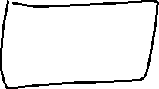
Rust-Style

Slide 14
Reference to Boxed value
let mut boxed = Box::new(MyStruct { value1: 42, value2: true });
let reference: &MyStruct = boxed.borrow();
println!("{}", reference.value1);
let mut_reference: &mut MyStruct = boxed.borrow_mut();
mut_reference.value1 = 123;
let reference: &MyStruct = boxed.borrow();
println!("{}", reference.value1);

Slide 15
Box is special
let b = Box::new(MyStruct { value1: 42, value2: true });
let mut x: MyStruct = *b;
x.value1 = 123;
println!("{}", x.value1);
let reference = &x;
println!("{}", b.value1)
error[E0382]: borrow of moved value: `*b`

Slide 16









Previous in linked list

Slide 17
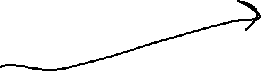


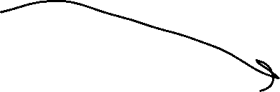

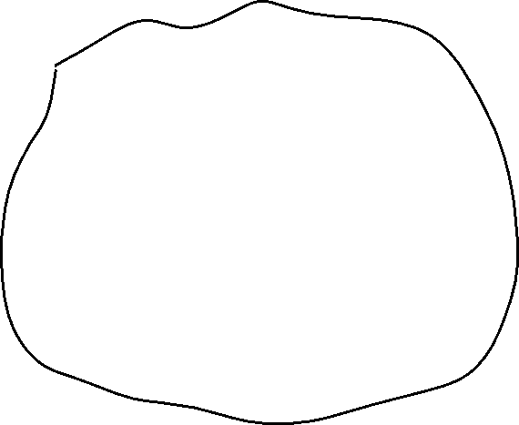


RC – shared ownership

Slide 18
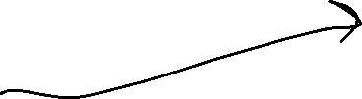


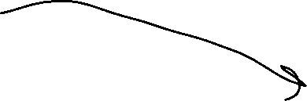

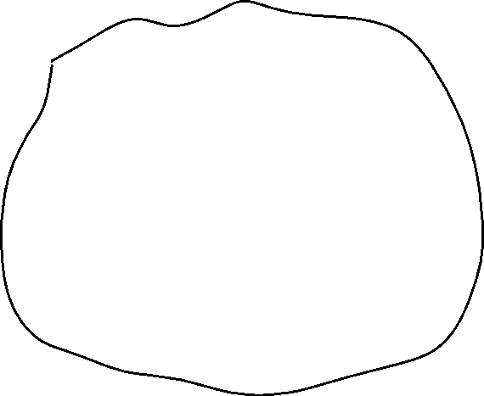


RC – shared ownership

Slide 19







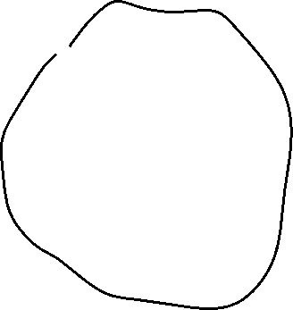


RC vs Box
RC
Box.borrow()

Slide 20
Rc
let owner1 = Rc::new(MyStruct { value1: 42, value2: true });
let owner2: Rc<MyStruct> = owner1.clone();
let owner3: Rc<MyStruct> = owner2.clone();
println!("{}", owner3.value1);
println!("{}", owner1.value1);
println!("{}", owner2.value1);
let reference: &MyStruct = owner1.borrow();
println!("{}", reference.value1);

Slide 21
Clone
fn clone(&self) -> Rc<T> { unsafe { self.inner().inc_strong(); Self::from_inner(self.ptr) } }

Slide 22
Edit Rc value
let owner1 = Rc::new(MyStruct { value1: 42, value2: true });
owner1.value1 = 123;
error[E0594]: cannot assign to data in an `Rc`

Slide 23
Interior Mutability
let cell = Cell::new(42);
let reference1: &Cell<i32> = cell.borrow();
let reference2: &Cell<i32> = cell.borrow();
println!("{}", reference1.get()); // > 42
reference1.replace(123);
println!("{}", reference2.get()); // > 123

Slide 24
Cell – Alias Safe
pub fn replace(&self, val: T) -> T { mem::replace(unsafe { &mut *self.value.get() }, val) // wrapped assignment }
pub const fn replace<T>(dest: &mut T, src: T) -> T { // SAFETY: We read from `dest` but directly write `src` into it afterwards, // such that the old value is not duplicated. Nothing is dropped and // nothing here can panic. unsafe { let result = ptr::read(dest); ptr::write(dest, src); result } }

Slide 25
How to get data from Cell
get() – returns copy
take() – return value and replace with Default
replace() – return value and replace

Slide 26
RefCell
let cell = RefCell::new(MyStruct { value1: 42, value2: true });
{ let reference1: Ref<MyStruct> = cell.borrow(); println!("{}", reference1.borrow().value1); // > 42 }
{ let mut borrowed: RefMut<MyStruct> = cell.borrow_mut(); borrowed.value1 = 123; }
let reference2: Ref<MyStruct> = cell.borrow();
println!("{}", reference2.borrow().value1); // > 123

Slide 27
RefCell
let cell = RefCell::new(MyStruct { value1: 42, value2: true });
let reference1: Ref<MyStruct> = cell.borrow(); println!("{}", reference1.borrow().value1); // > 42 { let mut borrowed: RefMut<MyStruct> = cell.borrow_mut(); borrowed.value1 = 123; }
let reference2: Ref<MyStruct> = cell.borrow();
println!("{}", reference2.borrow().value1); // > 123
PANIC: already borrowed: BorrowMutError
Ref != &

Slide 28






Circular references
struct NodeLeft { right: Cell<Option<Rc<NodeRight>>>, } struct NodeRight { left: Cell<Option<Rc<NodeLeft>>>, }
let node_left = Rc::new(NodeLeft { right: Cell::new(None) });
let node_right = Rc::new(NodeRight { left: Cell::new(Some(node_left.clone())) });
let e = node_left.right.replace(Some(node_right.clone()));

Slide 29


Rc::downgrade()
struct NodeLeft { right: Cell<Option<Rc<NodeRight>>>, }
struct NodeRight { left: Cell<Option<Weak<NodeLeft>>>, }
let node_left = Rc::new(NodeLeft { right: Cell::new(None) });
let node_right = Rc::new(NodeRight { left: Cell::new(Some(Rc::downgrade(&node_left))) });
let e = node_left.right.replace(Some(node_right.clone()));

Slide 30
Custom Smart Pointer
struct MySmartPtr { value: i32, }
let ptr = MySmartPtr { value: 42 };
let integer: i32 = *ptr;
error[E0614]: type `MySmartPtr` cannot be dereferenced

Slide 31
Deref Trait
impl Deref for MySmartPtr{ type Target = i32; fn deref(&self) -> &Self::Target { &self.value } }
let integer: i32 = *ptr;
let integer: i32 = *(ptr.deref());

Slide 32
Vec
pub struct Vec<T> { pointer: *const T, len: usize, }
let mut vec: Vec<i32> = Vec::new();
vec.push(42);
let last: Option<i32> = vec.pop();

Slide 33
Vec
let mut vec = vec![1, 2, 3];
let count = vec.len();
let first:i32 = vec[0];
let mut vec = vec![String::from("Hi")]; let first: String = vec[0];
error[E0507]: cannot move out of index of `Vec<String>`

Slide 34
Get by reference
let mut vec = vec![String::from("Hi")];
let first: &String = &vec[0];
let first: Option<&String> = vec.get(0);

Slide 35
Borrow element, borrow whole vector
let mut vec = vec![String::from("Hi")];
let first: &String = &vec[0];
vec.push(String::from("World"));
println!("{}", first);
error[E0502]: cannot borrow `vec` as mutable because it is also borrowed as immutable

Slide 36
Set vec element
let first_mut: &mut String = &mut vec[0]; *first_mut = String::from("Hello");
vec[0] = String::from("World");

Slide 37
Drain
let mut vec = vec![1, 2, 3, 4, 5, 6, 7];
let drained: Drain<i32> = vec.drain(2..5);
drop(drained);
println!("{}", vec.len()) // 4

Slide 38
Range
let arr = [0, 1, 2, 3, 4];
assert_eq!(arr[ .. ], [0, 1, 2, 3, 4]); assert_eq!(arr[ .. 3], [0, 1, 2 ]); assert_eq!(arr[ ..=3], [0, 1, 2, 3 ]); assert_eq!(arr[1.. ], [ 1, 2, 3, 4]); assert_eq!(arr[1.. 3], [ 1, 2 ]); // This is a `Range` assert_eq!(arr[1..=3], [ 1, 2, 3 ]);
for i in 0..42 { println!("{}", i) }

Slide 39
Slice
let mut vec = vec![1, 2, 3, 4, 5, 6, 7];
let slice: &[i32] = &vec[2..5];
let count = slice.len(); // 3
println!("{}",count);
let item: &i32 = &slice[1]; // 4
let item: Option<&i32> = slice.get(1);

Slide 40
Slice mut
let mut vec = vec![1, 2, 3, 4, 5, 6, 7];
let mut slice_mut: &mut [i32] = &mut vec[2..5];
slice_mut[0] = 42;
println!("{}", vec[2]) // 42

Slide 41
For
let vector = vec![1, 2, 3, 4, 5, 6, 7, 8, 9];
for x in vector { println!("{}", x); }
for x in vector { println!("{}", x); }
error[E0382]: use of moved value: `vector`
consider iterating over a slice of the `Vec<i32>`'s content to avoid moving into the `for` loop

Slide 42


For
let vector = vec![1, 2, 3, 4, 5, 6, 7, 8, 9]; for x in &vector { println!("{}", x); } for x in &vector { println!("{}", x); }

Slide 43
String
pub struct String { vec: Vec<u8>, }
let string_eng = String::from("Hello!!");
let string_china = String::from("读写汉字学中文");
println!("{}", string_eng.len()); // 7
println!("{}", string_china.len()); // 21

Slide 44
String slice aka &str
let string = String::from("Hello World");
let slice: &str = &string[..];
let other_slice = "Hello World";

Slide 45
Slice UTF-8
let string_china = String::from("读写汉字学中文");
let slice_china = &string_china[1..2]; println!("{}", slice_china);
panic: byte index 1 is not a char boundary; it is inside '读' (bytes 0..3) of `读写汉字学中文`
let slice_chars: Vec<char> = string_china.chars().collect();
let chars_china: &[char] = &slice_chars[1..2];
println!("{}", chars_china[0]); // 写

Slide 46
Replace char at index
let mut string = String::from("Hello World");
let slice_mut: &mut str = &mut string[1..2]; *slice_mut[0..1] = "00";
error[E0614]: type `str` cannot be dereferenced
string.replace_range(1..2, "00");
println!("{}", string); // H00llo World

Slide 47
Homework
TBD
Rustlings
smart_pointers

