Slide 1
Intro
Course: Rust Basics
Author: Aleksandr Kugushev

Slide 2
Course Structure
1 lecture: 75 min
Questions
Core Part
Fun Part
Homework
Main: Github Classroom
Optional: Rustlings
Use telegram for questions

Slide 3
Tools: rustup
https://rust-lang.github.io/rustup/installation
> rustc --version
rustc 1.65.0 (897e37553 2022-11-02)
> rustup update
….
stable-x86_64-pc-windows-msvc updated - rustc 1.67.0 (fc594f156 2023-01-24) (from rustc 1.65.0 (897e37553 2022-11-02))
> rustc --version
rustc 1.67.0 (fc594f156 2023-01-24)

Slide 4
Tools: rustc
https://doc.rust-lang.org/stable/rustc/
> rustc main.rs

Slide 5

Tools: cargo
Package manager
Templates
CLI: Run, Test, etc.
…

Slide 6
Crate
A Rust crate is either a library or an executable program, referred to as either a library crate or a binary crate, respectively.
Every target defined for a Cargo package is a crate.
Library
Executable program
Cargo Package

Slide 7
Hello World
main.rs
fn main() { println!("Hello, world!"); }
> rustc main.rs
Hello, world!

Slide 8
Hello World, Cargo edition
> cargo new hello-world
.gitignore
Cargo.lock
Cargo.toml
src
main.rs
target

Slide 9
Hello World, Cargo edition
> cargo new hello-world
.gitignore
Cargo.lock
Cargo.toml
src
main.rs
target
/target

Slide 10
Hello World, Cargo edition
> cargo new hello-world
.gitignore
Cargo.lock
Cargo.toml
src
main.rs
target
[package] name = "hello-world" version = "0.1.0" edition = "2021" [dependencies]

Slide 11
Hello World, Cargo edition
> cargo new hello-world
.gitignore
Cargo.lock
Cargo.toml
src
main.rs
target
[package] name = "hello-world" version = "0.1.0" edition = "2021" [dependencies] time = "0.1.12" regex = "0.1.41"

Slide 12
Hello World, Cargo edition
> cargo new hello-world
.gitignore
Cargo.lock
Cargo.toml
src
main.rs
target
# This file is automatically @generated by Cargo. # It is not intended for manual editing. version = 3 [[package]] name = "time" version = "0.1.45" source = "registry+https://github.com/rust-lang/crates.io-index" checksum = "1b797afad3f312d1c66a56d11d0316f916356d11bd158fbc6ca6389ff6bf805a" dependencies = [ "libc", "wasi", "winapi 0.3.9", ] …..

Slide 13
Tools: cargo
build
run
check
test
doc
fix
…

Slide 14
Functions
fn my_function(parameter1: String, parameter2: String) -> String { return format!("{} {}", parameter1, parameter2); }
fn my_function_no_return(parameter1: String, parameter2: String) { println!("{} {}", parameter1, parameter2); }

Slide 15
Variables
let variable: String = parameter1;
let variable2 = parameter1;
let mut variable_mut = parameter1;
fn my_function(parameter1: String, mut parameter2: String)

Slide 16
Return
fn my_function(parameter1: String, parameter2: String) -> String { return format!("{} {}", parameter1, parameter2); }
fn my_function(parameter1: String, parameter2: String) -> String { format!("{} {}", parameter1, parameter2) }

Slide 17
Macro
format!("{}", variable);
macro_rules! format { ($($arg:tt)*) => {{ let res = $crate::fmt::format($crate::__export::format_args!($($arg)*)); res }} }

Slide 18
panic!
panic!(“It’s over");

Slide 19
Data Types
Numeric: +-*/%
i8, u8, i16, u16 …. u128, isize, usize: 42, 98_222, 0xff, etc.
Overflow Rules: panic on debug, overflow on release
f32, f64: 2.1, 0.1
bool: true, false
char 32bit: 'a’
array
tuple
…

Slide 20
If
if a > 0 { // do something positive } else { // do something negative }
let b = if a > 0 { 1 } else { 2 };

Slide 21
Loop
loop { println!("Oh no, it's dizzy") }
let mut counter = 1; loop { println!("Oh no, it's dizzy"); counter += 1; if counter > 42 { break } }

Slide 22
Loop as expression
let mut counter = 1; let b= loop { println!("Oh no, it's dizzy"); counter += 1; if counter > 42 { break counter * 2 } };

Slide 23
Break to label
let b = 'main_loop: loop { loop { loop { counter += 1; if counter > 42 { break 'main_loop counter * 2; } } } };

Slide 24
While/For
let mut counter = 0; while counter < 42 { println!("Oh no, it's dizzy"); counter += 1; }
for _ in 0..42 { println!("Oh no, it's dizzy"); }

Slide 25
Rust is not…
Competitor to Go
Substitution of C#/Java/Python
C/C++ killer

Slide 26
Rust usage (rustjobs.dev)
Cryptocurrency
Big-tech
High-Load Backend
GameDev
C++ legacy
Cross Platform Libraries (Android/IOS)
…

Slide 27
Rust characteristics
No Undefined Behaviors, except unsafe
Zero Cost Abstractions
Memory Safety
LLVM
Functional Programming Language
Performance (why is it the last one?)

Slide 28
No Undefined Behaviors
fn main() { fn compute(input: &u32, output: &mut u32) { if *input > 10 { *output = 1; } if *input > 5 { *output *= 2; } // remember that `output` will be `2` if `input > 10` } }
fn main() { fn compute(input: &u32, output: &mut u32) { let cached_input = *input; // keep `*input` in a register if cached_input > 10 { *output = 2; } else if cached_input > 5 { *output *= 2; } } }

Slide 29
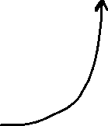


No Undefined Behaviors
fn main() { fn compute(input: &u32, output: &mut u32) { if *input > 10 { *output = 1; } if *input > 5 { *output *= 2; } // remember that `output` will be `2` if `input > 10` } }
fn compute(input: &u32, output: &mut u32)

Slide 30

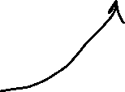
No Undefined Behaviors
fn main() { fn compute(input: &u32, output: &mut u32) { if *input > 10 { *output = 1; } if *input > 5 { *output *= 2; } // remember that `output` will be `2` if `input > 10` } }
fn compute(input: &u32, output: &mut u32)

Slide 31
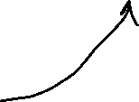
No Undefined Behaviors
fn main() { fn compute(input: &u32, output: &mut u32) { if *input > 10 { *output = 1; } if *input > 5 { *output *= 2; } // remember that `output` will be `2` if `input > 10` } }
fn compute(input: &u32, output: &mut u32)

Slide 32
No Undefined Behaviors
fn main() { fn compute(input: &u32, output: &mut u32) { let cached_input = *input; // keep `*input` in a register if cached_input > 10 { *output = 2; } else if cached_input > 5 { *output *= 2; } } }
fn compute(input: &u32, output: &mut u32)

Slide 33
No Undefined Behaviors?
fn compute(input: &u32, output: &mut u32)
fn compute(input: &u32, output: &mut u32)

Slide 34
No Undefined Behaviors!!!
fn compute(input: &u32, output: &mut u32)
fn compute(input: &u32, output: &mut u32)

Slide 35
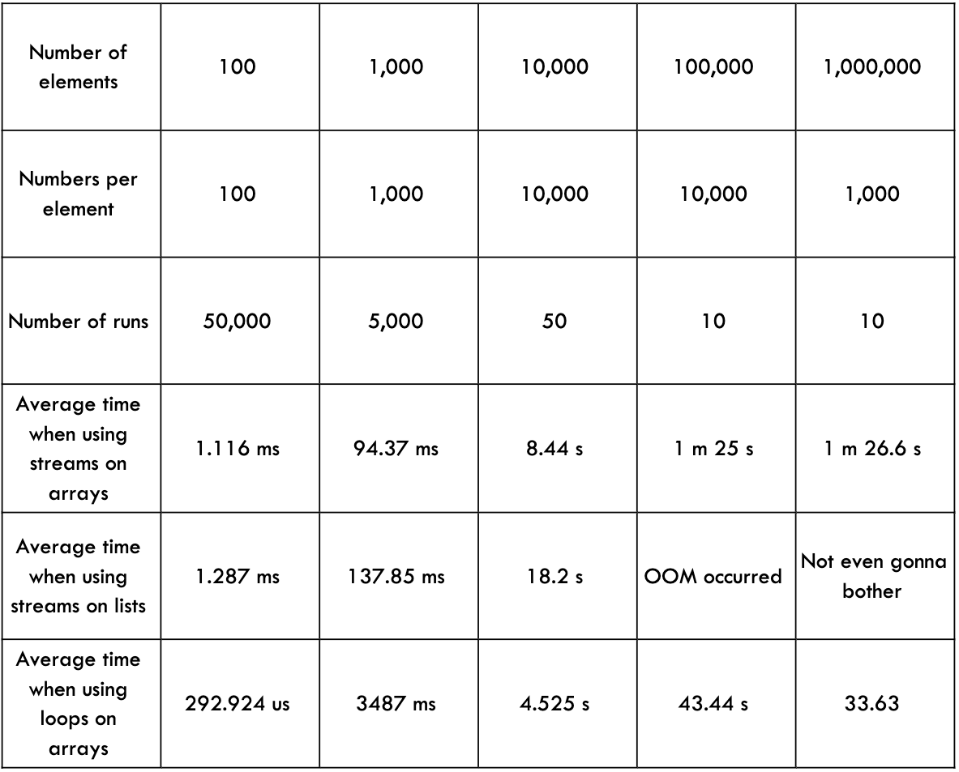

Zero Cost Abstractions: Iterator
Java
Rust
test bench_search_for ... bench: 19,620,300 ns/iter (+/- 915,700)
test bench_search_iter ... bench: 19,234,900 ns/iter (+/- 657,200)
https://doc.rust-lang.org/book/ch13-04-performance.html

Slide 36





Zero Cost Abstractions: Tuple(1, 2)
C#/Java/Python/etc.
Rust

Slide 37


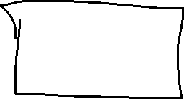





Zero Cost Abstractions: Monomorphization
C#/Java/Python/etc.
Rust
myClass.MyIterfaceMethod()
myClass.MyTraitMethod()

Slide 38






Memory Safety
let raw_ptr: *const MyStruct = …
let reference: &MyStruct = unsafe { &*raw_ptr };

Slide 39











Memory Safety
Contract
Prerequisites
Parameters Validation
Etc.

Slide 40








Memory Safety
pub const unsafe fn split_at_mut_unchecked(&mut self, mid: usize) -> (&mut [T], &mut [T])
pub const fn split_at_mut(&mut self, mid: usize) -> (&mut [T], &mut [T]) { assert!(mid <= self.len()); // SAFETY: `[ptr; mid]` and `[mid; len]` are inside `self`, which // fulfills the requirements of `from_raw_parts_mut`. unsafe { self.split_at_mut_unchecked(mid) } }
Contract

Slide 41
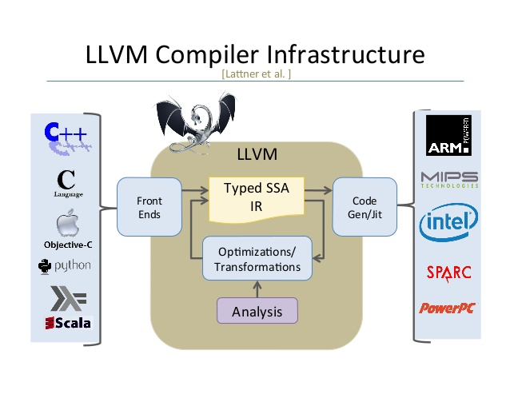
LLVM

Slide 42
LLVM
HIR
Desugaring
THIR
MIR
Borrow Checking
Parsing
Etc.
Optimization
LLVM IR
Machine Code
Optimization
Platform Specific
Exhaustiveness Checking

Slide 43
Functional Programming Language
High level functions
Tuples
Algebraic data type
Iterators
Pattern Matching
Immutability
Pure Functions
Etc.

Slide 44
Functional Programming Language
C++
Rust
C with classes
OOP
Backward Compatibility
OCaml with performance
FP
Breaking Changes

Slide 45
Performance (why is it the last one?)
No Undefined Behaviors, except unsafe
Zero Cost Abstractions
Memory Safety
LLVM
Functional Programming Language

Slide 46
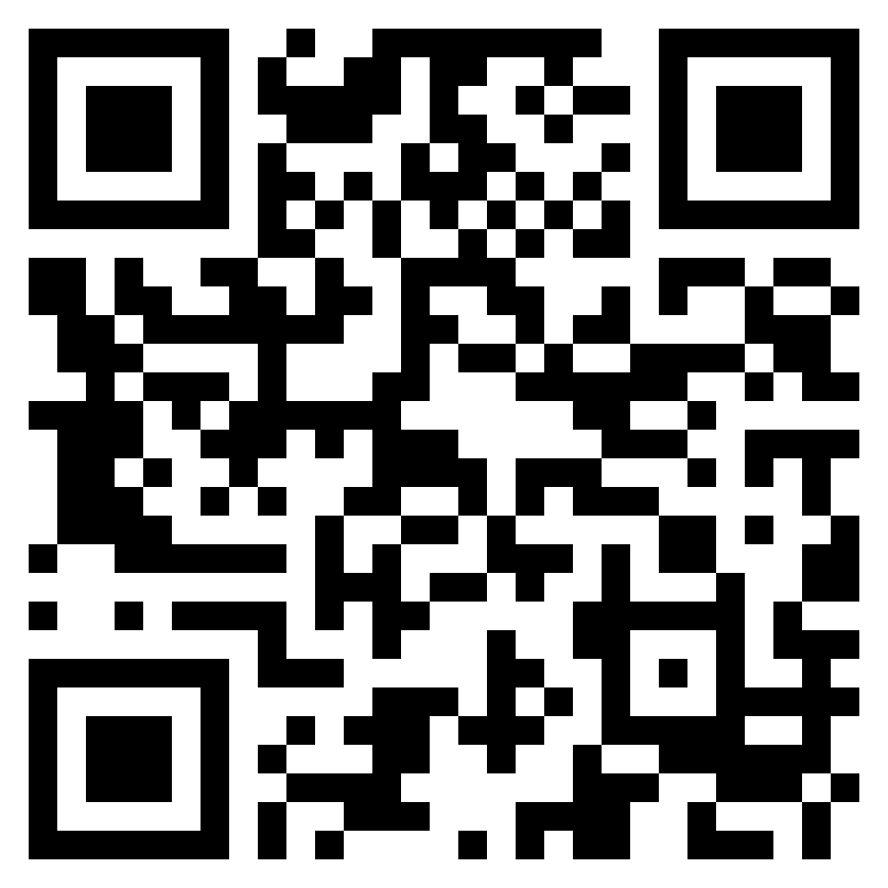
References
https://doc.rust-lang.org/book/title-page.html

Slide 47
Homework
Setup Rust environment
Setup your Text Editor/IDE for Rust
Hello World in the repo root
Upload to Github Classroom!
Rustlings
https://github.com/rust-lang/rustlings
rustlings run <name_of_file>
exercises/variables
exercises/functions
exercises/if
exercises/primitive_types

